Slide 1

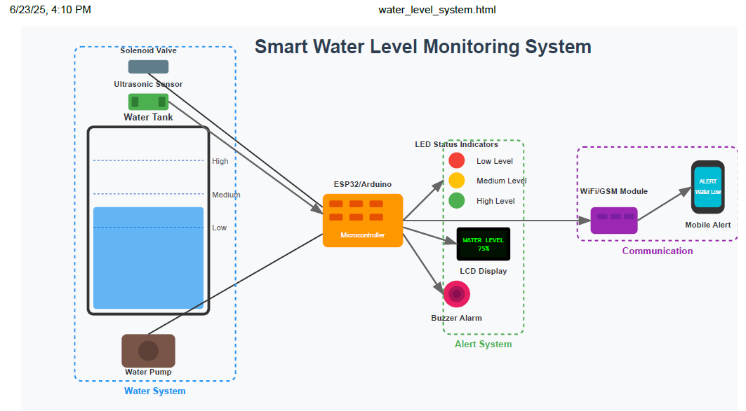
SMART WATER-LEVEL MONITORING SYSTEM FOR TANKS & DRUMS
Your name | Your Name| Your name
Problem
Project Design
Results
In Kampala & Its surrounding urban communities such as Kira, Mukono, and Wakiso, Water storage is commonly done using rooftop or ground-level tanks due to intermittent water supply from NWSC. However, many households lack efficient means of monitoring water levels in these tanks. As a result, tank overflows frequently go unnoticed, leading to water wastage and structural damage, or run dry, leaving residents without water during peak usage times.
Project Objectives
Develop a real-time water-level monitoring system for storage tanks
Alert users of critical water level to prevent overflows or dry tanks.
Improve water management in areas with irregular supply (e.g. Kira)
Reduce manual checks in apartments, schools, and clinics.
Provide simple, accessible user alerts (SMS/display).
Results
Include key screenshots of your system and visualisations
Result 2
Result 3
Step 1
Show key components of your system
Step 2
Describe this step in your experiment
Step 3
Describe this step in your experiment
Step 4
Describe this step in your experiment
Project Requirements
ESP-32, YF-S201 Water Flow Sensor Detector, 9V Battery,
Ultrasonic Sensor, USB-A to B cable
Breadboard, 5V water Pump, DC Female
5mm LED: (Green, Orange, Red)
Buzzer
Male to Female, Male to Male Jumper Wires.
LCD 1602 Yellow (12C)
Conclusion
Brief summary of what you discovered based on results
Indicate and explain whether or not the data supports your hypothesis
Target Users
Future Work
1. Residential Home Owners
To automate water-level tracking and reduce manual checks or guesswork
2. School & Clinic Administrators
To ensure reliable water access for sanitation, & support H/Safety
3. Landlords & Apartment Managers
To prevent tank overflows, schedule timely refills, reduce water bills and handle tenant complaints efficiently
To avoid dry tanks, and save water by preventing unnoticed overflows
Observation 1
Observation 2
Observation 3
References
Include print and electronic sources in alphabetical order
Notes:
To change this poster, replace our sample content with your own. Or, if you'd rather start from a clean slate, press the New Slide button on the Home tab to insert a new page. Now enter your text and pictures in the empty placeholders. If you need more placeholders for titles, subtitles or body text, copy any of the existing placeholders, then drag the new one into place.

