Slide 1
Project design
Title. Development of mobile application for community based water leakage reporting system

Slide 2
Specific Objectives.
To develop a user interface for community members to submit leak reports.
To create a database for storing and managing reported water leak data.
To integrate a database with the user interface.
To integrate automatic geolocation features with the leakage reporting system.

Slide 3
Design methodology
This project adopted a modular design approach to structure the system into manageable components. Each module developed independently to enhance clarity and maintainability.
The tools used for designing is figma.

Slide 4
System architecture design
The system follows a client-server architecture, where the mobile application act as the client and communicates with a central server for data processing and storage. The mobile front end is developed using Kotlin for android.
The admin portal is built using JavaScript allowing administrator to review and manage submitted reports.

Slide 5
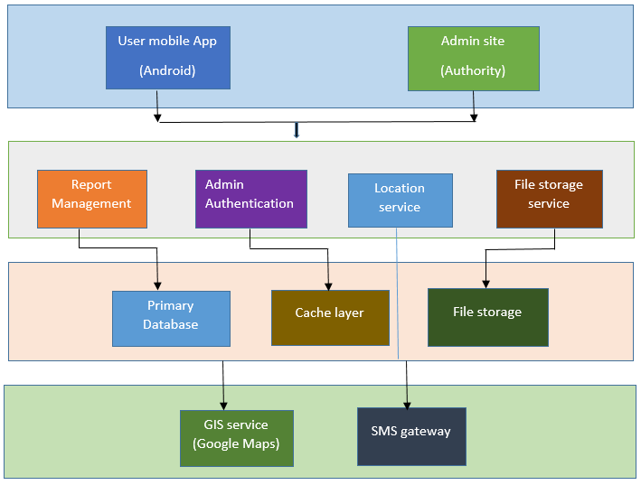
Block diagram of system architecture

Slide 6
Database design
Database is designed to efficiently store and manage data related to water leakage reports submitted by community members. The system allows the public user to submit reports without logging in. however the admin portal includes authentication to ensure the authorized personal from an authority can review and manage report.

Slide 7
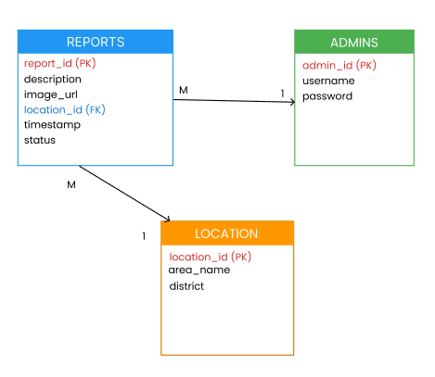
ER diagram

Slide 8
Ui/ux design
The user interface of the mobile application is designed with a focus on simplicity, clarity, and ease of use. Key screens include the home page, where users will require to register then can quickly access the report form; the report submission page.
For administrators, a login interface is provided to secure access to the web portal.

Slide 9
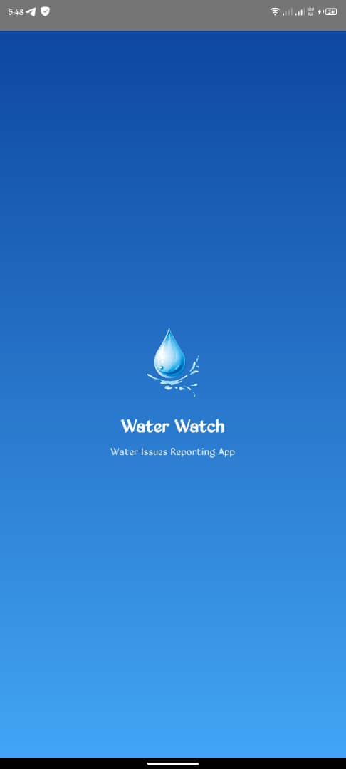
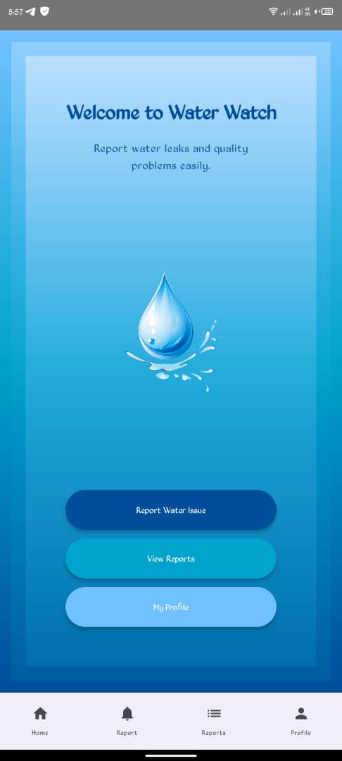
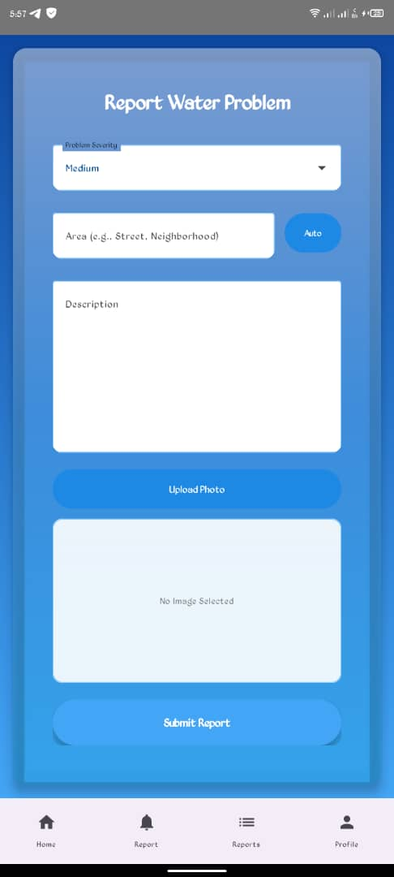
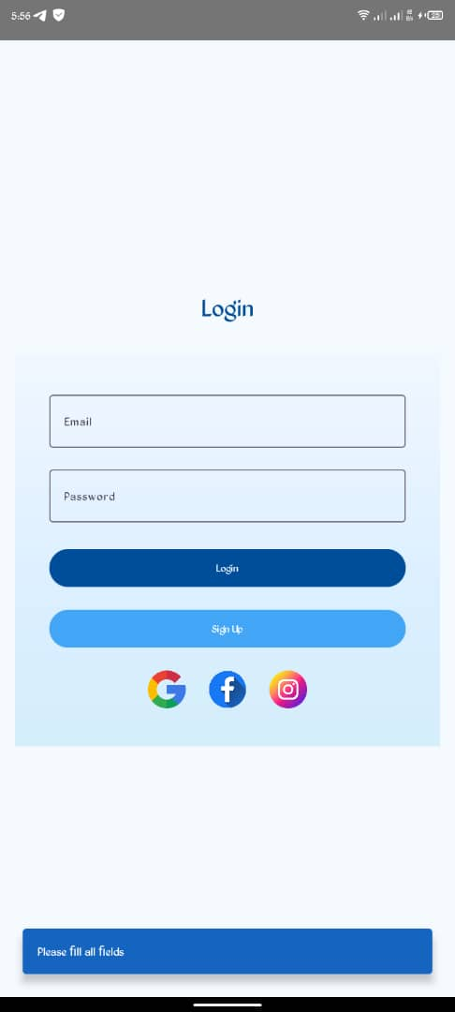
Ui/ux design

Slide 10
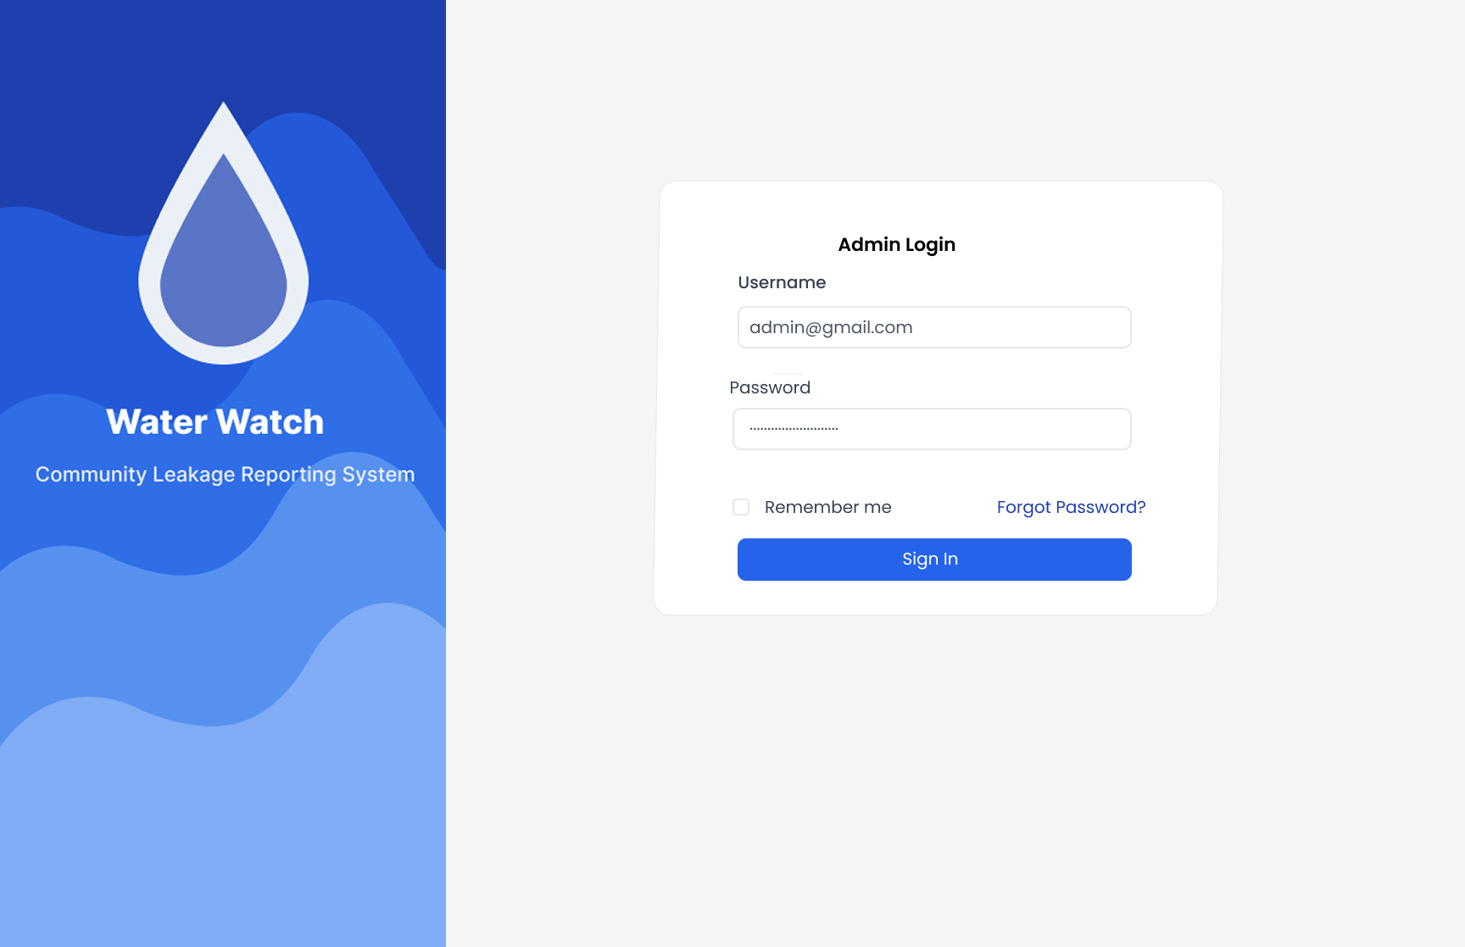
Ui/ux design(admin site)

Slide 11
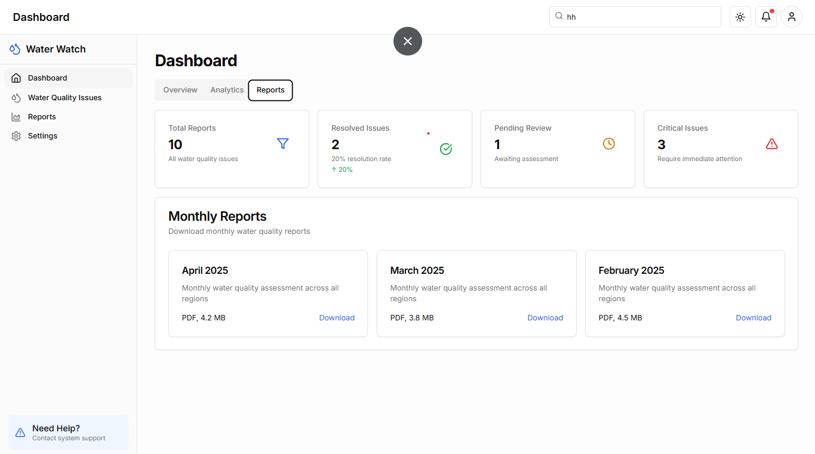
Ui/ux design(admin site)

Slide 12
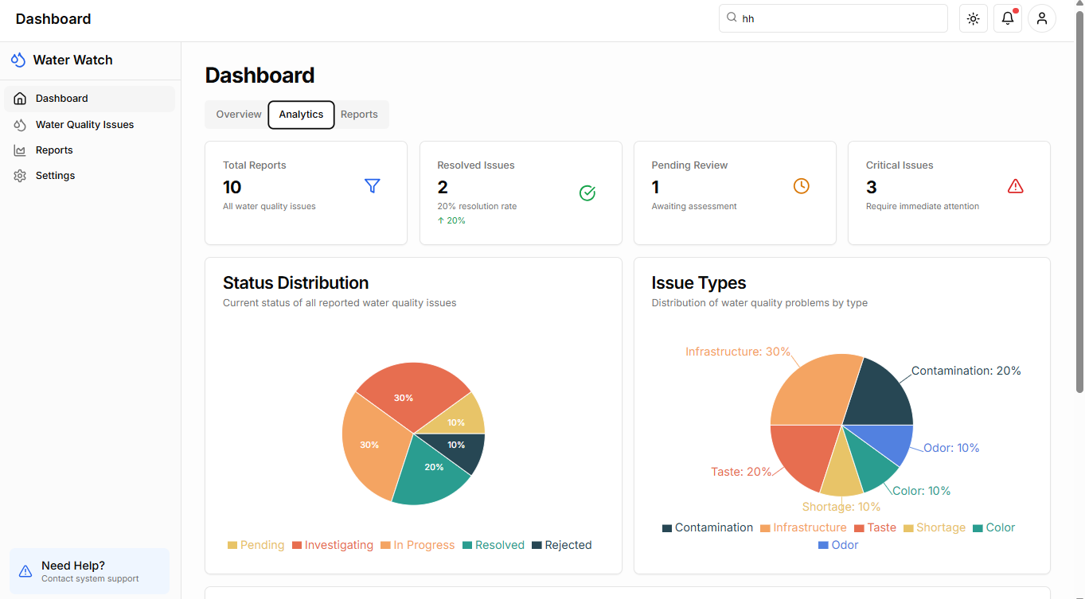
Ui/ux design(admin site)

Slide 13
Ui/ux design(admin site)

Slide 14
Functional design
The functional design outlines the core modules and features that drive the mobile application and admin portal. The key functionality includes a report submission module, allowing users to send details and images of water leakages. The admin review dashboard enables authorized personnel to manage and respond to these reports.

Slide 15
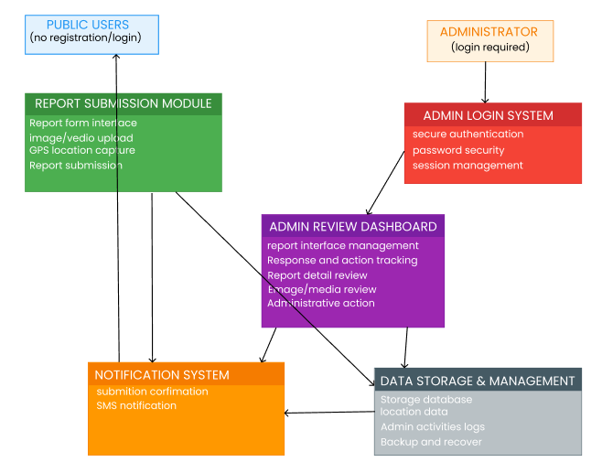
Functional diagram
User Login

Slide 16
Use case diagram
Use case diagram illustrate the interaction between user and the system of the water leakage reporting application. There a two main actor, the community member and the admin or authority who logs into the web-based dashboard to review and manage the report.

Slide 17
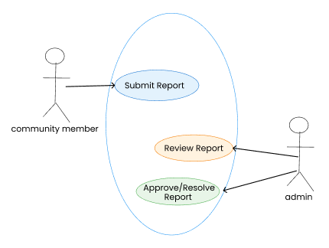
Use case diagram

Slide 18
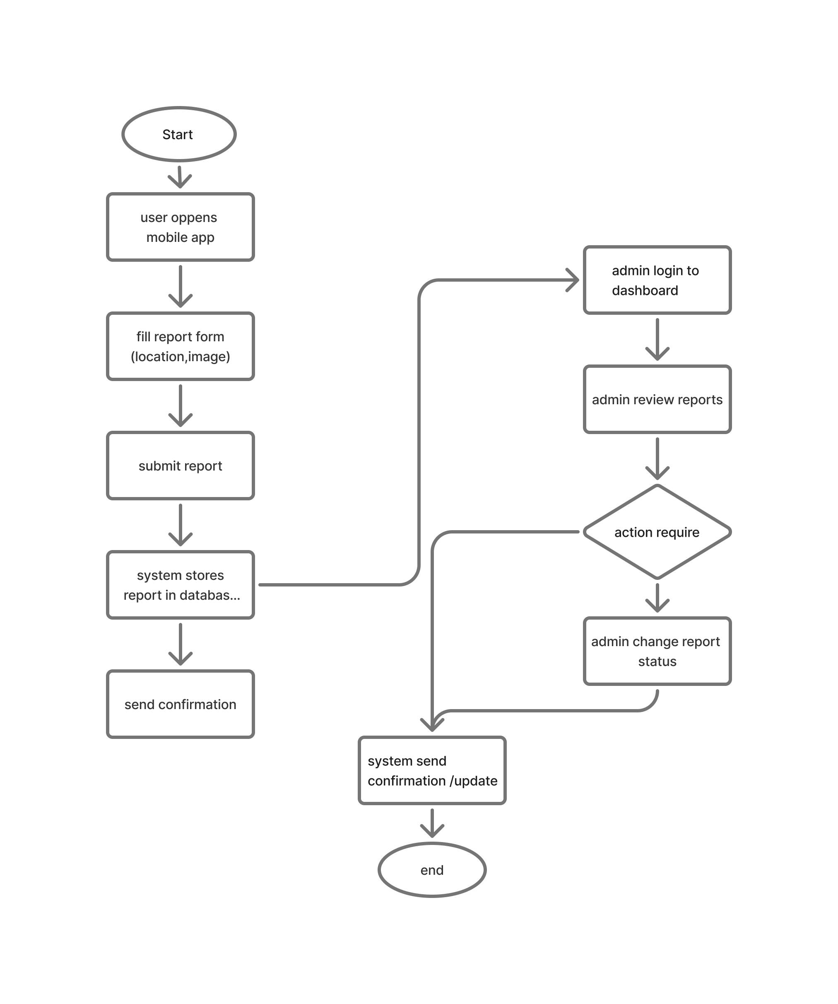
Flowchart diagram

Slide 19
Thank you

