Slide 1
AdvancedOO Final Project HitBrick Game
打磚塊遊戲
四資管三 吳芷昀
B10630327

Slide 2
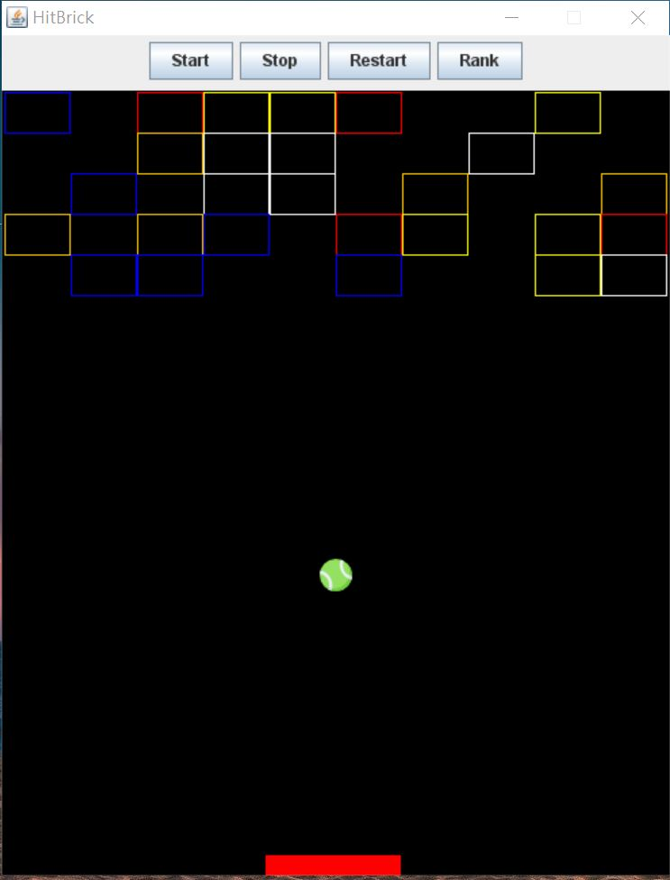
HitBrick Interface
Start
Stop
GameOver / Win ->Save Score
Rank
Restart

Slide 3
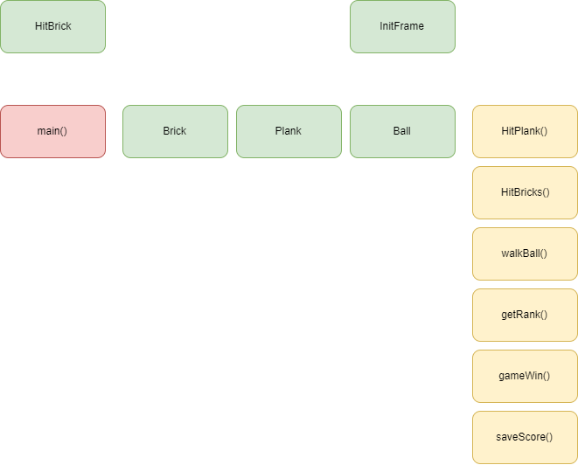
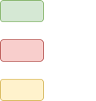
Structure Diagram - Client

Slide 4
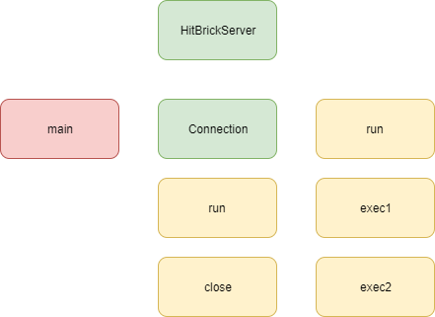
Structure Diagram - Server

Slide 5
Used
JFrame, Jpanel, keyListener
Enum -> BallState
Walk, HitBricks, HitPlank
Timer -> Ball
Thread -> HitBrickServer, Connection
Socket
MongoDB + Robo3t

Slide 6
DEMO

