Slide 1
AdvancedOO Final Project HitBrick Game
打磚塊遊戲
四資管三 吳芷昀
B10630327

Slide 2
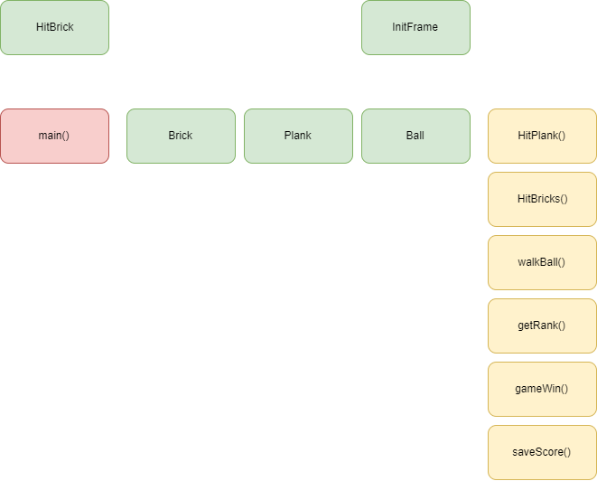
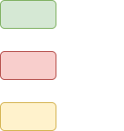
Structure Diagram

Slide 3
Used
JFrame, Jpanel, keyListener
Enum -> BallState
Walk, HitBricks, HitPlank
Timer -> Ball
Socket
MongoDB + Robo3t

Slide 4
DEMO

