Slide 1
Dataset

Slide 2
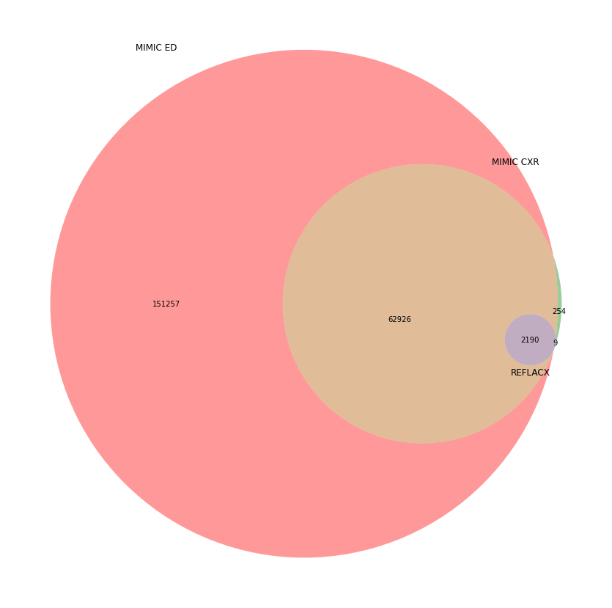

Slide 3
Stay_id

Slide 4
Can’t identify stay Id
This caused a tremendous amount of data loss during training REFLACX dataset.
We use the intime and outtime from stay table to identify stay_id. Where the time CXR taken is in the range of the intime and outtime of a stay, then we say CXR is taken in that stay and use the clinical data from that stay.
It’s mainly caused by the following three problems:
Has multiple matches
Doesn’t have any matches, but still can find this patient.
Doesn’t have this patient at the ED table.

Slide 5
The proportion of each problem.
 | MIMIC-CXR | In REFLACX
Total number of images | 377,110 | 2616
Has multiple matches | 2 | 0
Can find the patient at the table but can’t find a match stay. | 205,768 (55.99%) | 1,600 (61.16%)
Within 1 days can be considered matched | 182.513(48.39%) | 1,383(52.86%)
Within 3 days can be considered matched | 154,448(40.95%) | 1145(43.76%)
Within 7 days can be considered matched | 123,453(32.73%) | 876(33.48%)
Doesn’t have this patient at ED table. | 1275 (0.33%) | 10 (0.38%)

Slide 6
Case of having multiple matches.
2157-07-25 20:57:07
It’s only one case, and this is also not sampled for REFLACX.

Slide 7
Doesn’t have any matches, but still can find this patient.
2132-10-15 08:40:47
The CXR was taken after the patients moved to another department (left ED).
We can also include this kind of instance. We can assign stay_id for them with some restrictions. For example, the time shouldn’t be

