Slide 1
Clinical-BERT: Vision-Language Pre-Training for Radiograph Diagnosis and Reports Generation

Slide 2
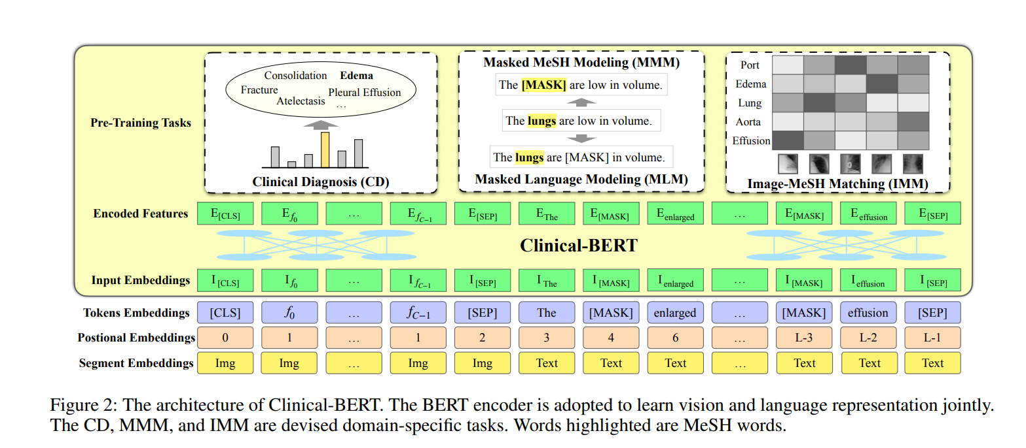
Architecture

Slide 3
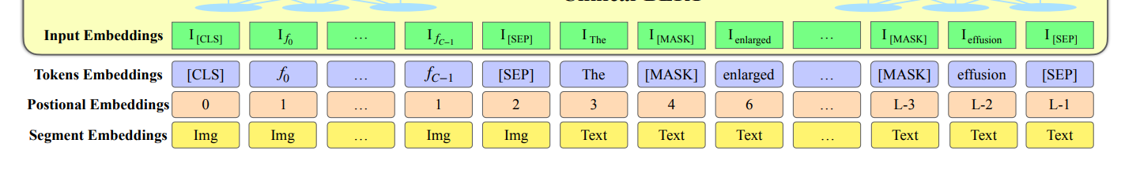
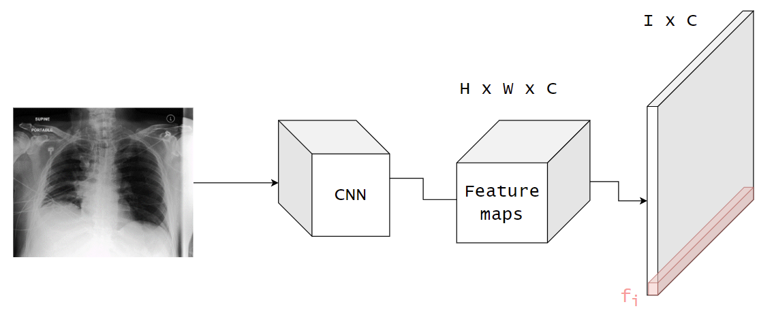
Input

Slide 4
Tasks to perform
Clinical Diagnosis (CD)
Masked MeSH Modeling (MMM)
Masked Language Modeling (MLM)
Image-MeSH Matching (IMM)

Slide 5
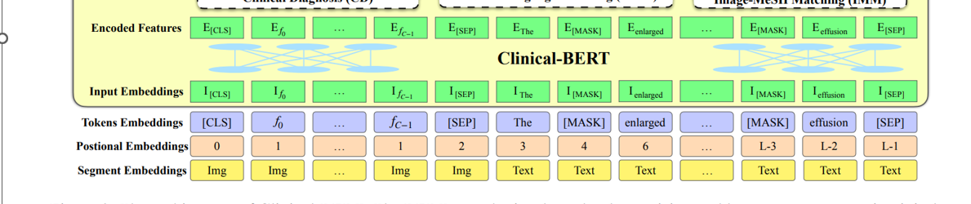









Clinical Diagnosis (CD)
Neural Network
14 binary outputs (diseases)
CheXpert

Slide 6
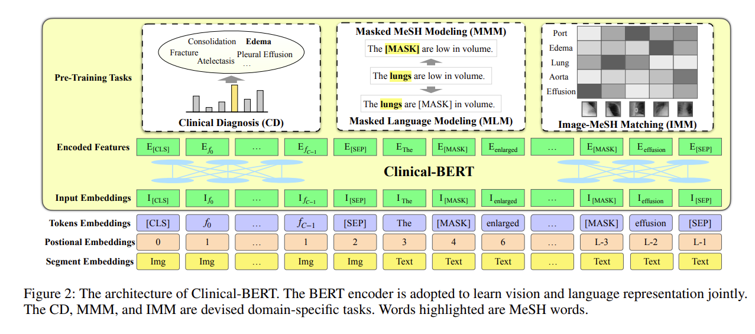
Masked MeSH Modeling (MMM) – 80% Masked Language Modeling (MLM) – 15%
MeSH stands for Medical Subject Headings

Slide 7
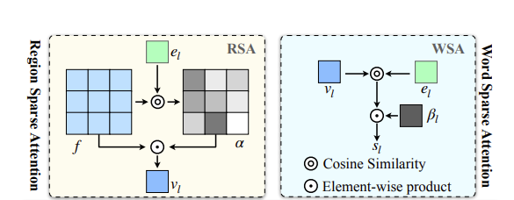
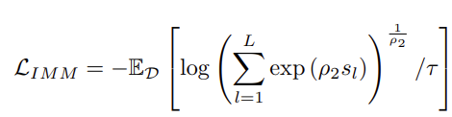
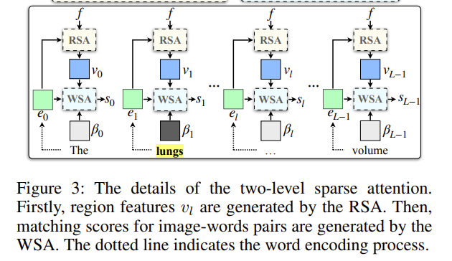






Image-MeSH Matching (IMM) - like the contrastive learning

Slide 8
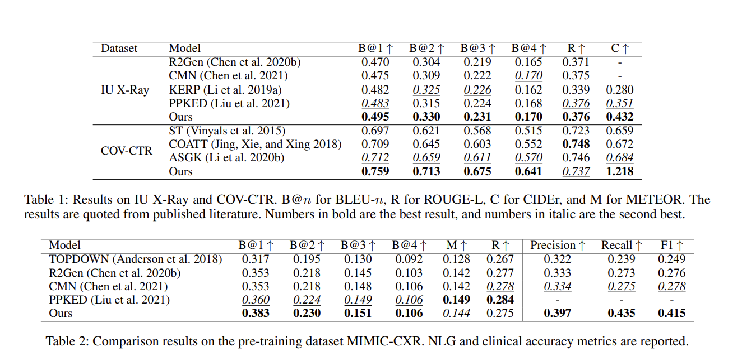
Results

Slide 9
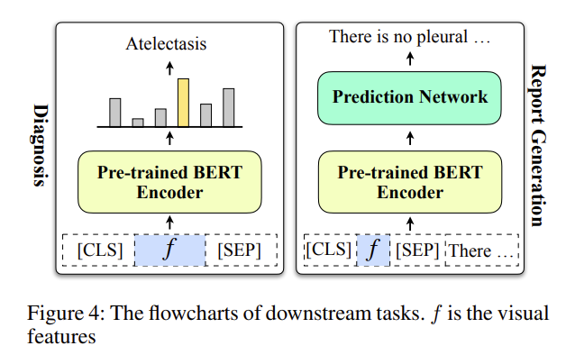
Downstream tasks

Slide 10
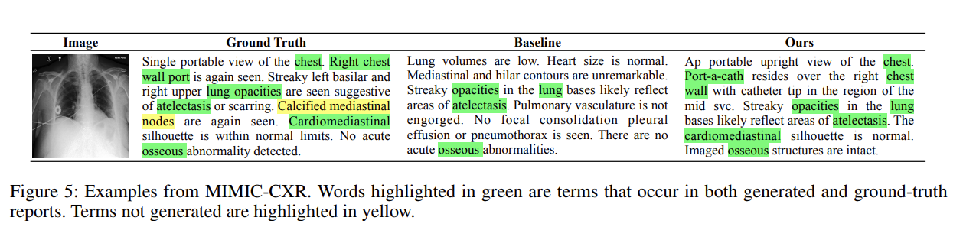
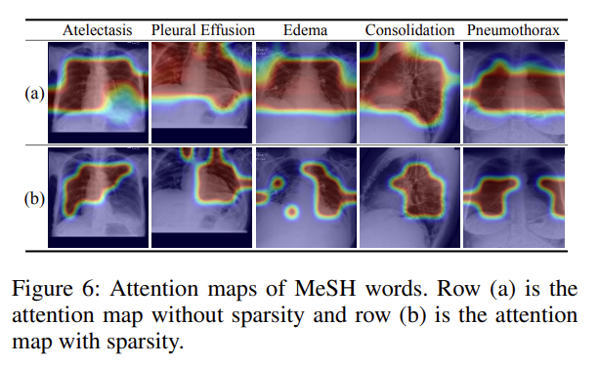
Examples and Attention heatmaps

Slide 11
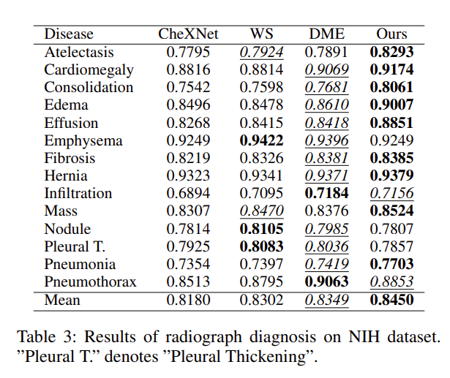
Radiograph Diagnosis

Slide 12
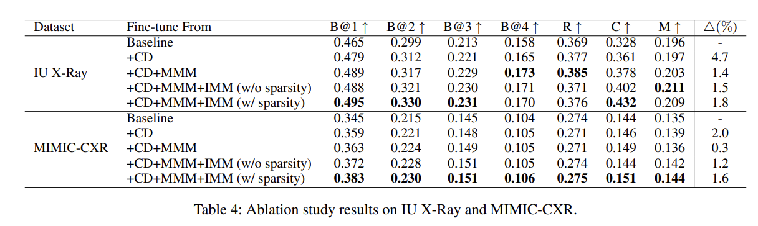
Ablation Study

Slide 13
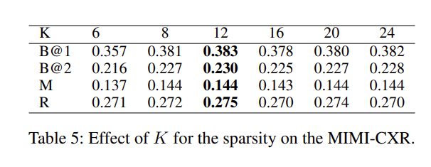
Effect of K on sparse attention

