Slide 1

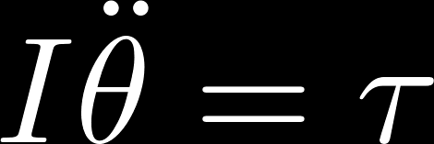
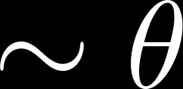

2nd Midterm
(4 pts)
(4 pts)
Equation of motion
In the limit of small oscillations,
Torque (7 pts)

Slide 2


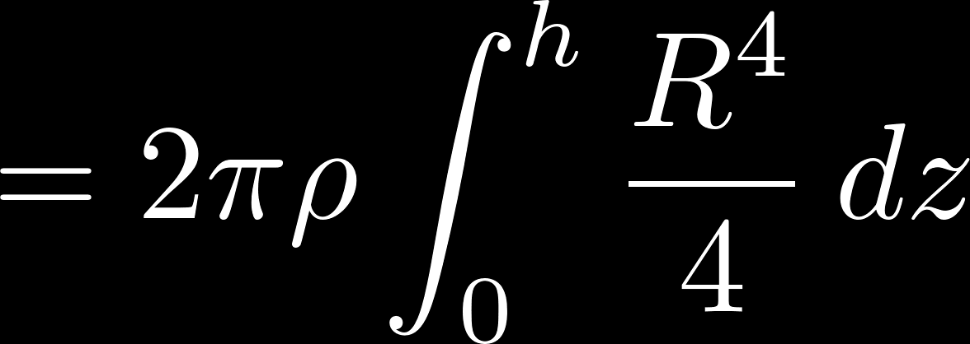




2nd Midterm
(15 pts)

Slide 3

2nd Midterm
Yes, the Kepler’s 2nd law still holds since the angular momentum is conserved (no net torque since it’s a central force).
(10 pts)
The force (acceleration) would give rise to a torque that make the gyroscope rotate around the direction of the force (acceleration).
(10 pts)

Slide 4
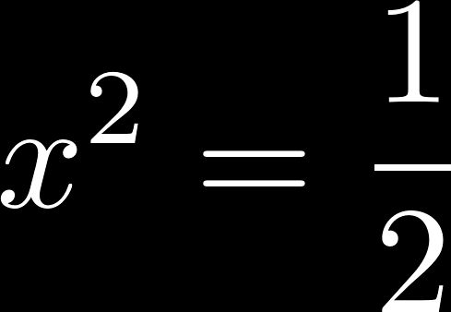
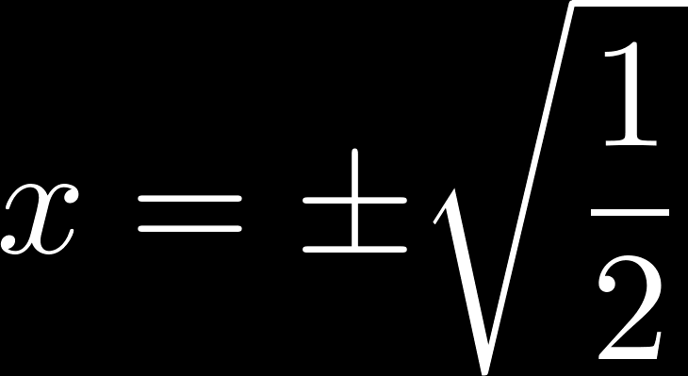
2nd Midterm
The largest energy density occurs at the maximum slope (largest stretching) or maximum vertical velocity (largest kinetic energy).
(10 pts)

Slide 5



2nd Midterm
(i)
(7 pts)

Slide 6



2nd Midterm
(ii)
(8 pts)

Slide 7




2nd Midterm
(i)
Resonance occurs when the denominator is minimized
(7 pts)

Slide 8


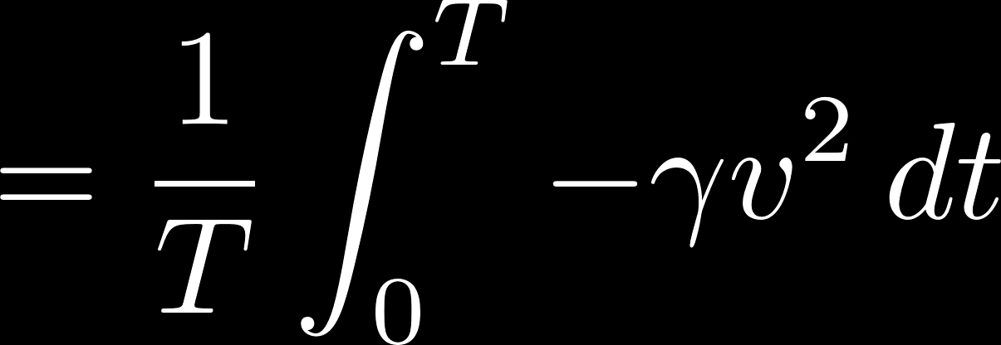



2nd Midterm
(ii) Average power dissipation in a cycle
(8 pts)

Slide 9


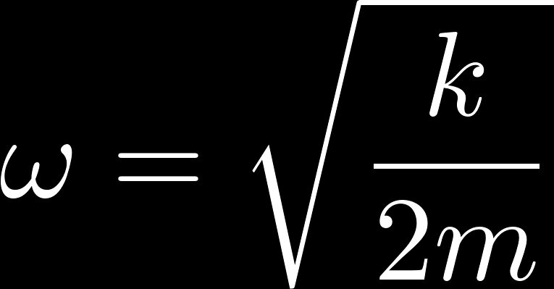
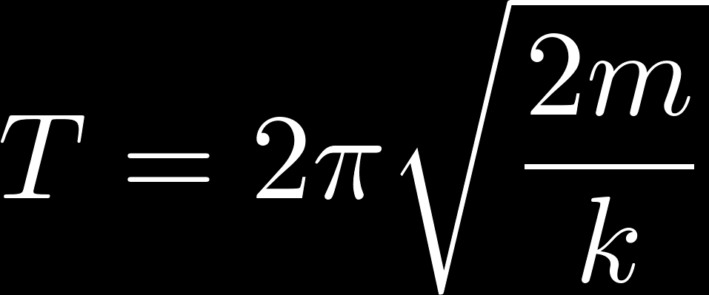
2nd Midterm
(i) Let x be the displacement of the hoop along the inclined
I = mR² (5 pts out of 10 pts)
(5 pts)

Slide 10



2nd Midterm
(ii)
(10 pts)

