Slide 1
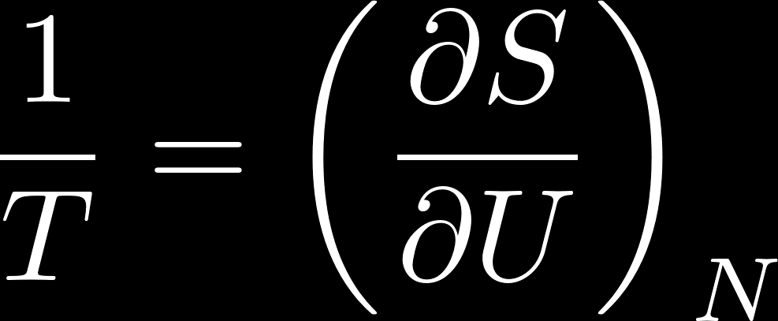
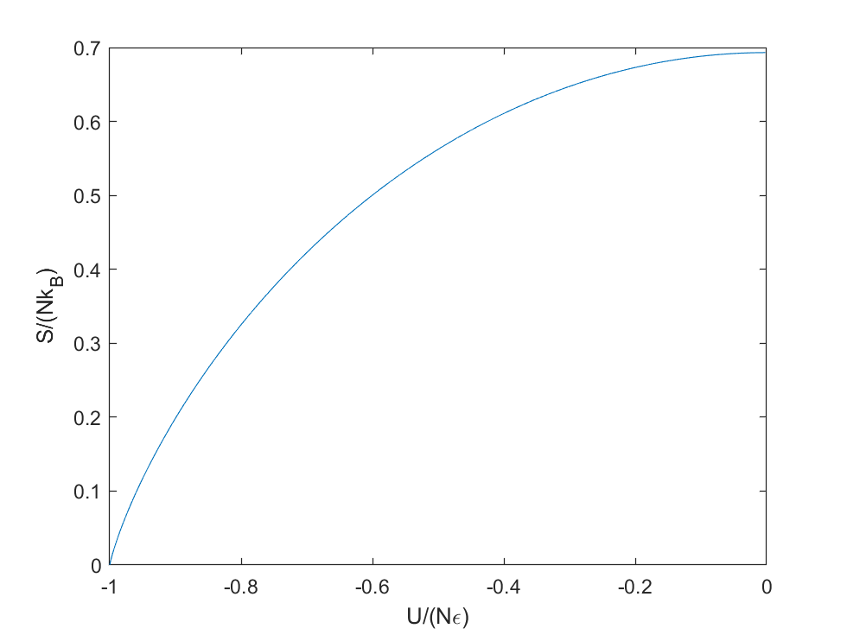
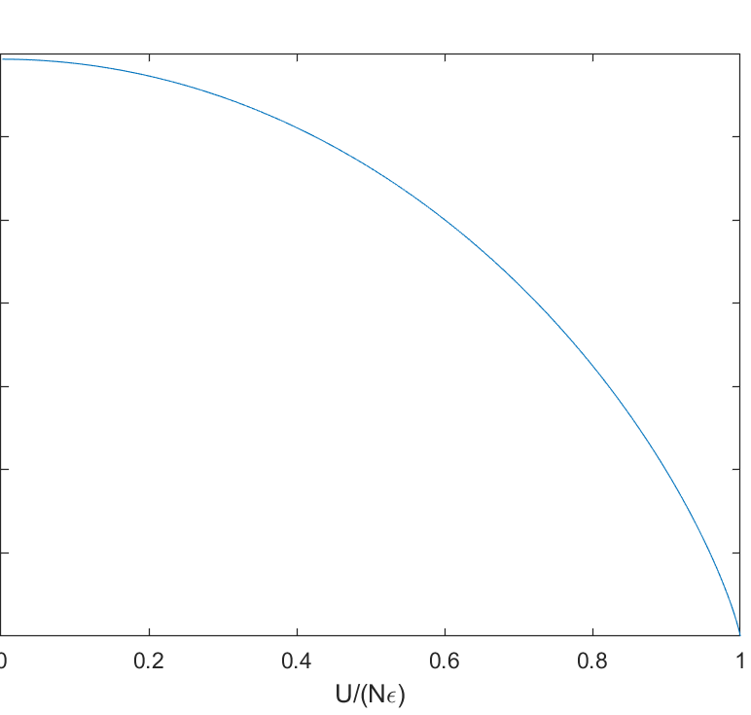







Midterm
Put two paramagnets of different temperature in contact, the total system is going to maximize its entropy.

Slide 2

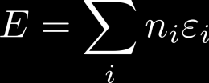




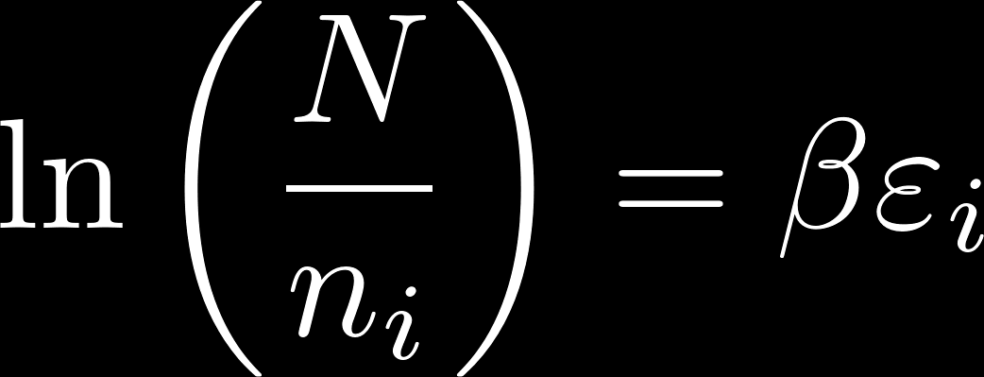
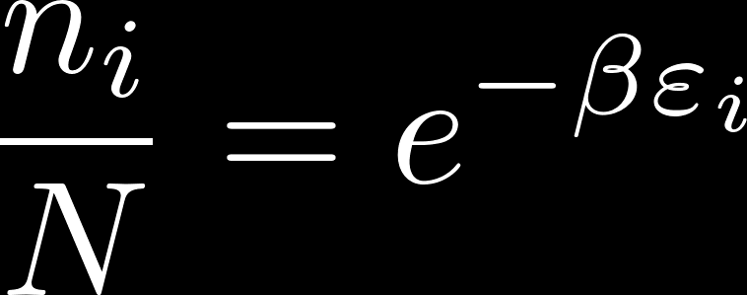

Midterm
Number of ways to distribute N particles
Constraint:
Or you can add an additional Lagrange multiplier for N to maximize Ω, but note that

Slide 3




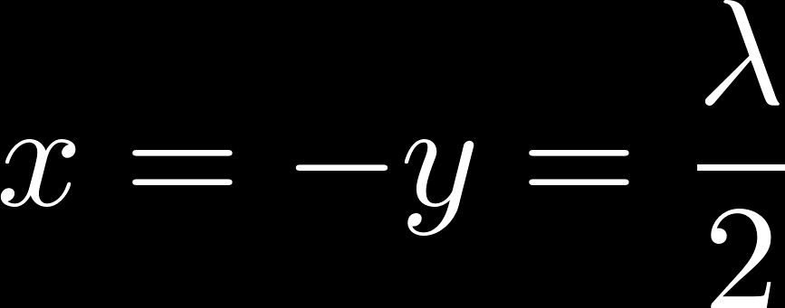
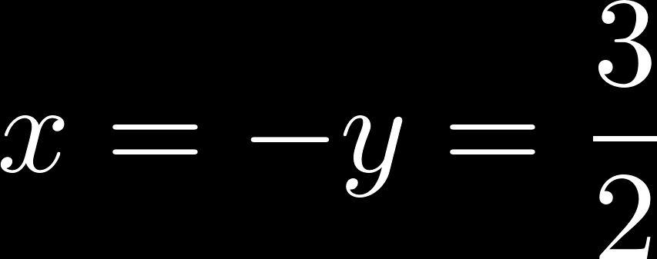



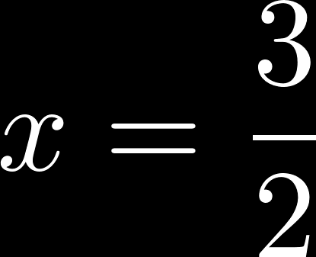
For example, to maximize the following function
Midterm
subject to the following constraints
Number of ways to distribute N particles
Constraint:
This way of solving problems could be easier than substituting the constraint back to the function which we desire to maximize.
Or you can add an additional Lagrange multiplier for N to maximize Ω, but note that
It may seem simpler because only 2 variables are involved. Imagine what if you have many variables. Lagrange multipliers make things simpler.

Slide 4





Midterm
Consider a system with a permeable wall in between that allows particle flows.
If
then
With the “negative” sign, particles flow from the high chemical potential region to the low chemical potential region as expected.

Slide 5



Midterm
The multiplicity function contains number of ways of distributing particles in the position space and in the momentum space. And it is subject to the uncertainty principle and the indistinguishability of particles.

Slide 6







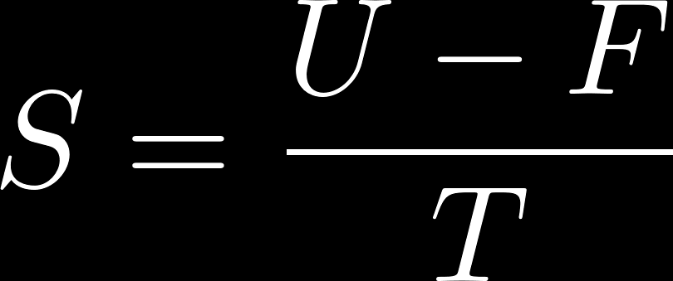

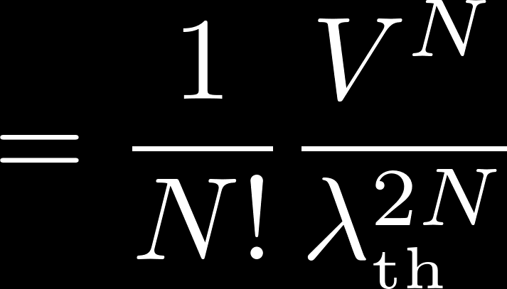

Midterm

Slide 7

Midterm
Before mixing,
After mixing,

Slide 8




Midterm

Slide 9




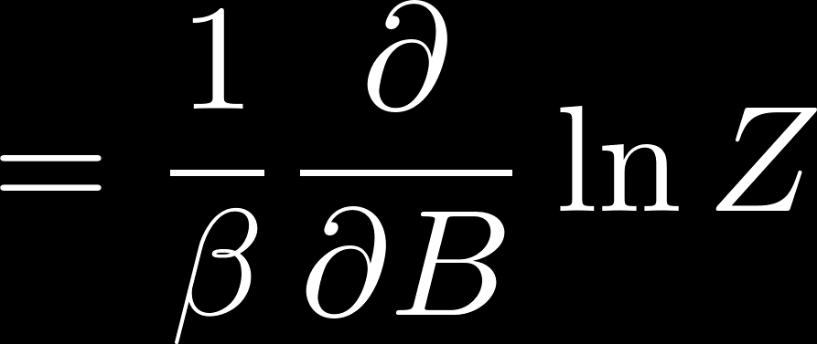
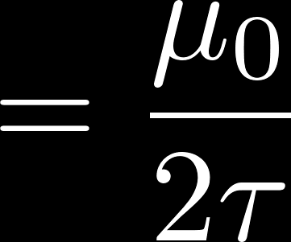
Midterm
Or you can work out the following,
In the classical case, there is no energy gap between allowed energies, so C_{B} is expected to be finite at low temperature limit.

