Slide 1
Chapter 15
Textbook questions

Slide 2
Question 15-2
Define the following terms
(a) Fluorescence is the process in which a molecule, excited by the absorption of radiation, emits a photon while undergoing a transition from an excited singlet electronic state to a lower state of the same spin multiplicity (e.g., a singlet → singlet transition).
(b) Phosphorescence is the process in which an excited molecule emits a photon while undergoing a transition from an excited triplet state to a lower state of a different spin multiplicity (e.g., a triplet → singlet transition).
(c) Resonance fluorescence is observed when an excited species emits radiation of the same frequency as that used to cause the excitation.
(d) A singlet state is one in which the spins of the electrons of an atom or molecule are all paired so there is no net spin angular momentum

Slide 3
(e) A triplet state is one in which the spins of the electrons of an atom or molecule are unpaired so that their spin angular moments add to give a net non-zero moment.
(f) Vibrational relaxation is the process by which a molecule loses its excess vibrational energy without emitting radiation.
(g) Internal conversion is the intermolecular process in which a molecule crosses to a lower electronic state without emitting radiation.
(h) External conversion is a radiationless process in which a molecule loses electronic energy while transferring that energy to the solvent or another solute.

Slide 4
(i) Intersystem crossing is the process in which a molecule in one spin state changes to another spin state with nearly the same total energy (e.g., singlet → triplet).
(j) Predissociation occurs when a molecule changes from a higher electronic state to an upper vibrational level of a lower electronic state in which the vibrational energy is great enough to rupture the bond.
(k) Dissociation occurs when radiation promotes a molecule directly to a state with sufficient vibrational energy for a bond to break.
(l) Quantum yield is the fraction of excited molecules undergoing the process of interest. For example, the quantum yield of fluorescence is the fraction of molecules absorbing radiation that fluoresce.
(m) Chemiluminescence is a process by which luminescent radiation is produced as a result of a chemical reaction

Slide 5
Question 15-3
Why is spectrofluorometry potentially more sensitive than spectrophotometry?
For spectrofluorometry, the analytical signal F is proportional to the source intensity P₀ and the transducer sensitivity.
In spectrophotometry, the absorbance A is proportional to the ratio of P₀ to P. Increasing P₀ or the transducer sensitivity to P₀ produces a corresponding increase in P or the sensitivity to P. Thus the ratio does not change.
As a result, the sensitivity of fluorescence can be increased by increasing P₀ or transducer sensitivity, but that of absorbance does not change.
螢光訊號與光源強度成正比，同時也與傳感器(transducer)的靈敏度成正比
分光光度法中，吸收度A指的是光源強度與通過sample的光強度的比例，增加光強度或增加傳感器靈敏度的同時只會增加通過sample的光，無助增強吸收度訊號
因此在我們可簡單的藉由增加光源強度與傳感器靈敏度增加螢光光譜法的靈敏度，但分光光度法無法藉由此方法增加

Slide 6
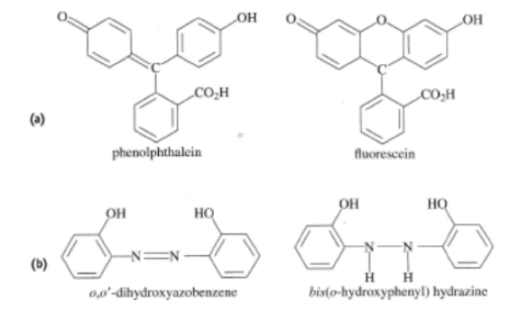
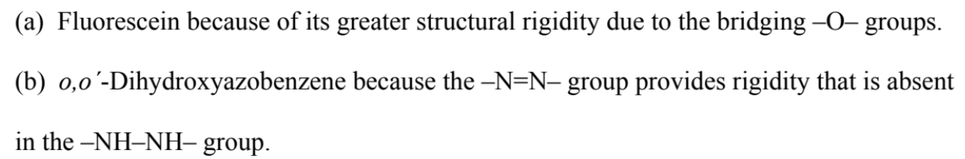
Question 15-4
Which compound in each of the following pairs would you expect to have a greater fluorescence quantum yield? Explain.
Keyword 關鍵字: rigidity
Fluorescein
o,oˊ-Dihydroxyazobenzene

Slide 7
Question 15-5
Why do some absorbing compounds fluoresce but others do not?

