Slide 1
Chapter 13
Textbook questions

Slide 2
13-13
描述以下選項之間的不同以及寫出其優點(是另一項所沒有的)
Hydrogen and deuterium discharge lamps as sources for UV radiation.
Filters and monochromators as wavelength selectors.
Photovoltaic cells and phototubes as detectors for electromagnetic radiation.
Photodiodes and photomultiplier tubes.
Double beam in space and double bean in time spectrophotometers.
Spectrophotometers and photometers.
Single beam and double beam instruments for absorbance measurements.
Conventional and multichannel spectrophotometers.

Slide 3
13-13
Answer:
Hydrogen and deuterium discharge lamps as sources for UV radiation.
Hydrogen discharge lamps 氫氣放電燈
Deuterium discharge lamps 氘氣放電燈
不同：一個是用氫氣去放電，另一個用氘氣。
優點: Deuterium discharge lamps 可產生較高強度的放射。
(b) Filters and monochromators as wavelength selectors.
Filters 可選擇較低解析度之波長，較適合定量，不適合定性分析或結構解析。
Monochromators 選擇高解析度之波長且適合定性及定量。

Slide 4
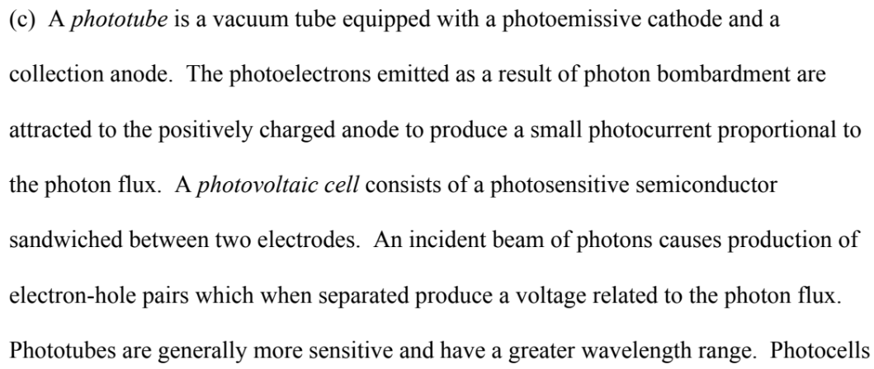
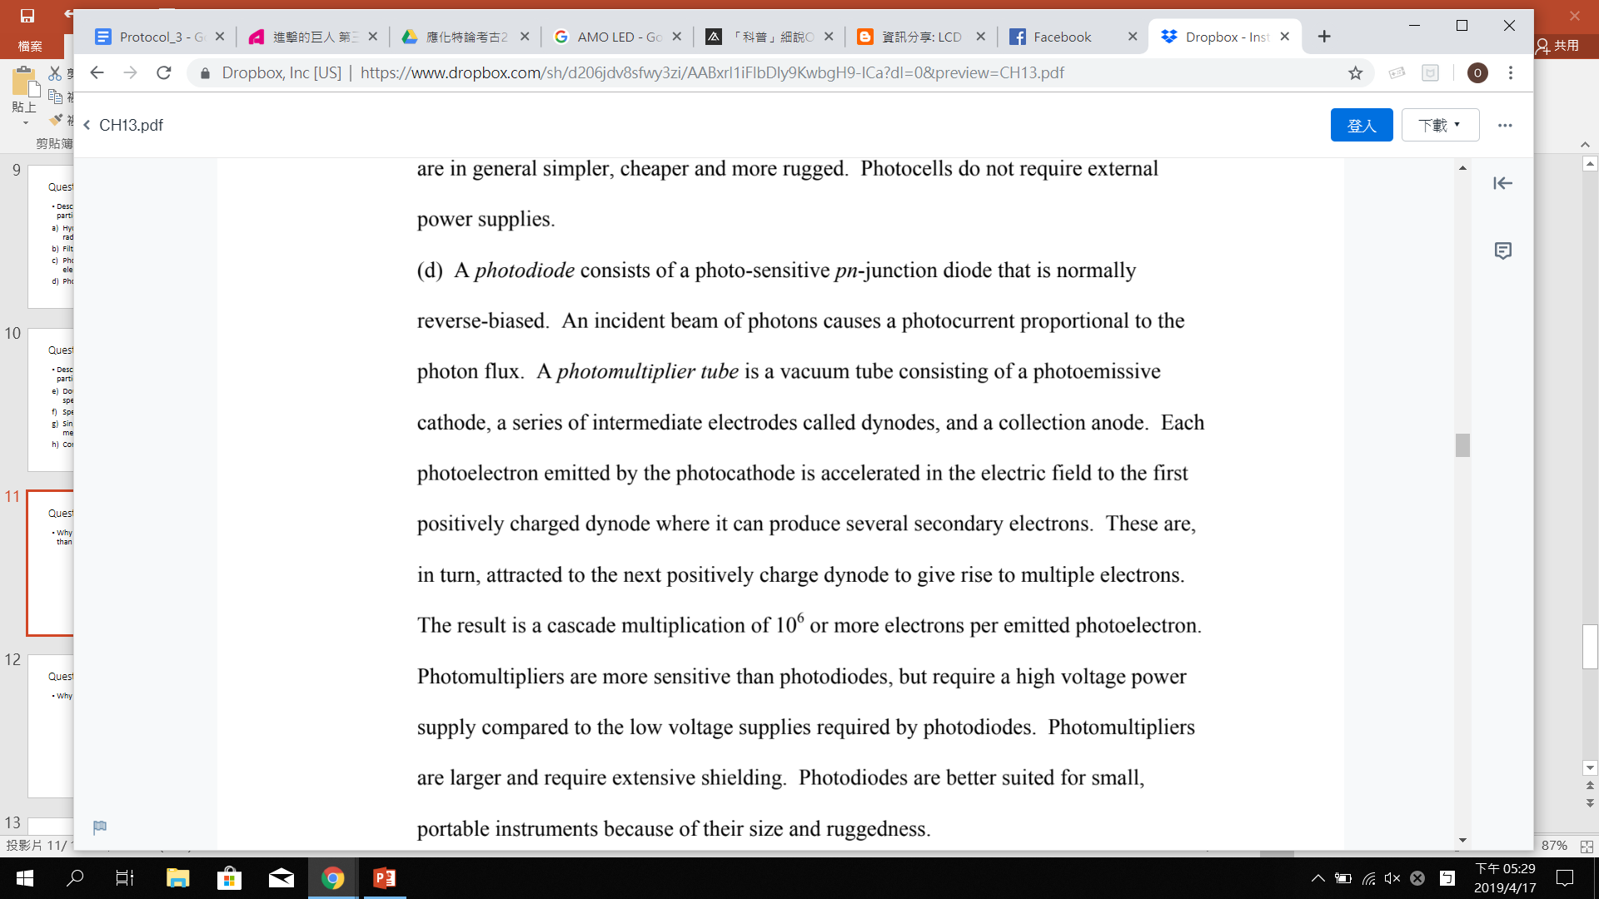
13-13
Answer:
(c) Photovoltaic cells and phototubes as detectors for electromagnetic radiation.

Slide 5
13-13
Answer:
(d) Photodiodes and photomultiplier tubes.

Slide 6
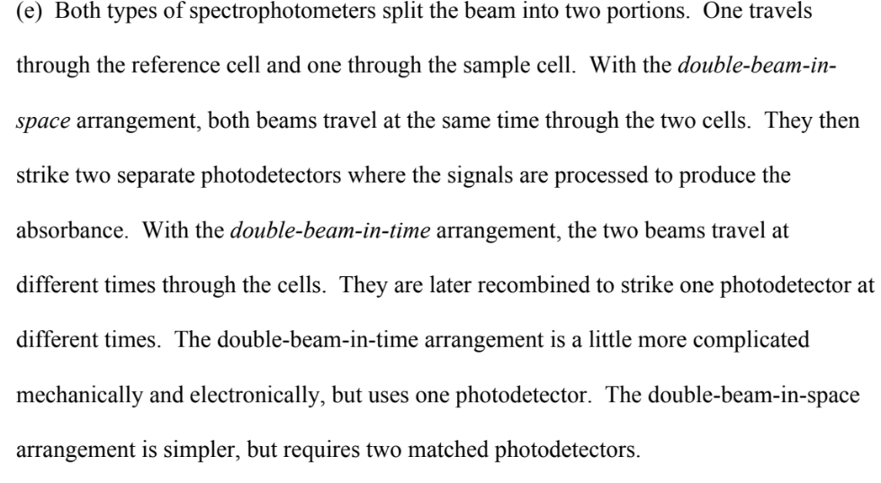
13-13
Answer:
(e) Double beam in space and double bean in time spectrophotometers.

Slide 7
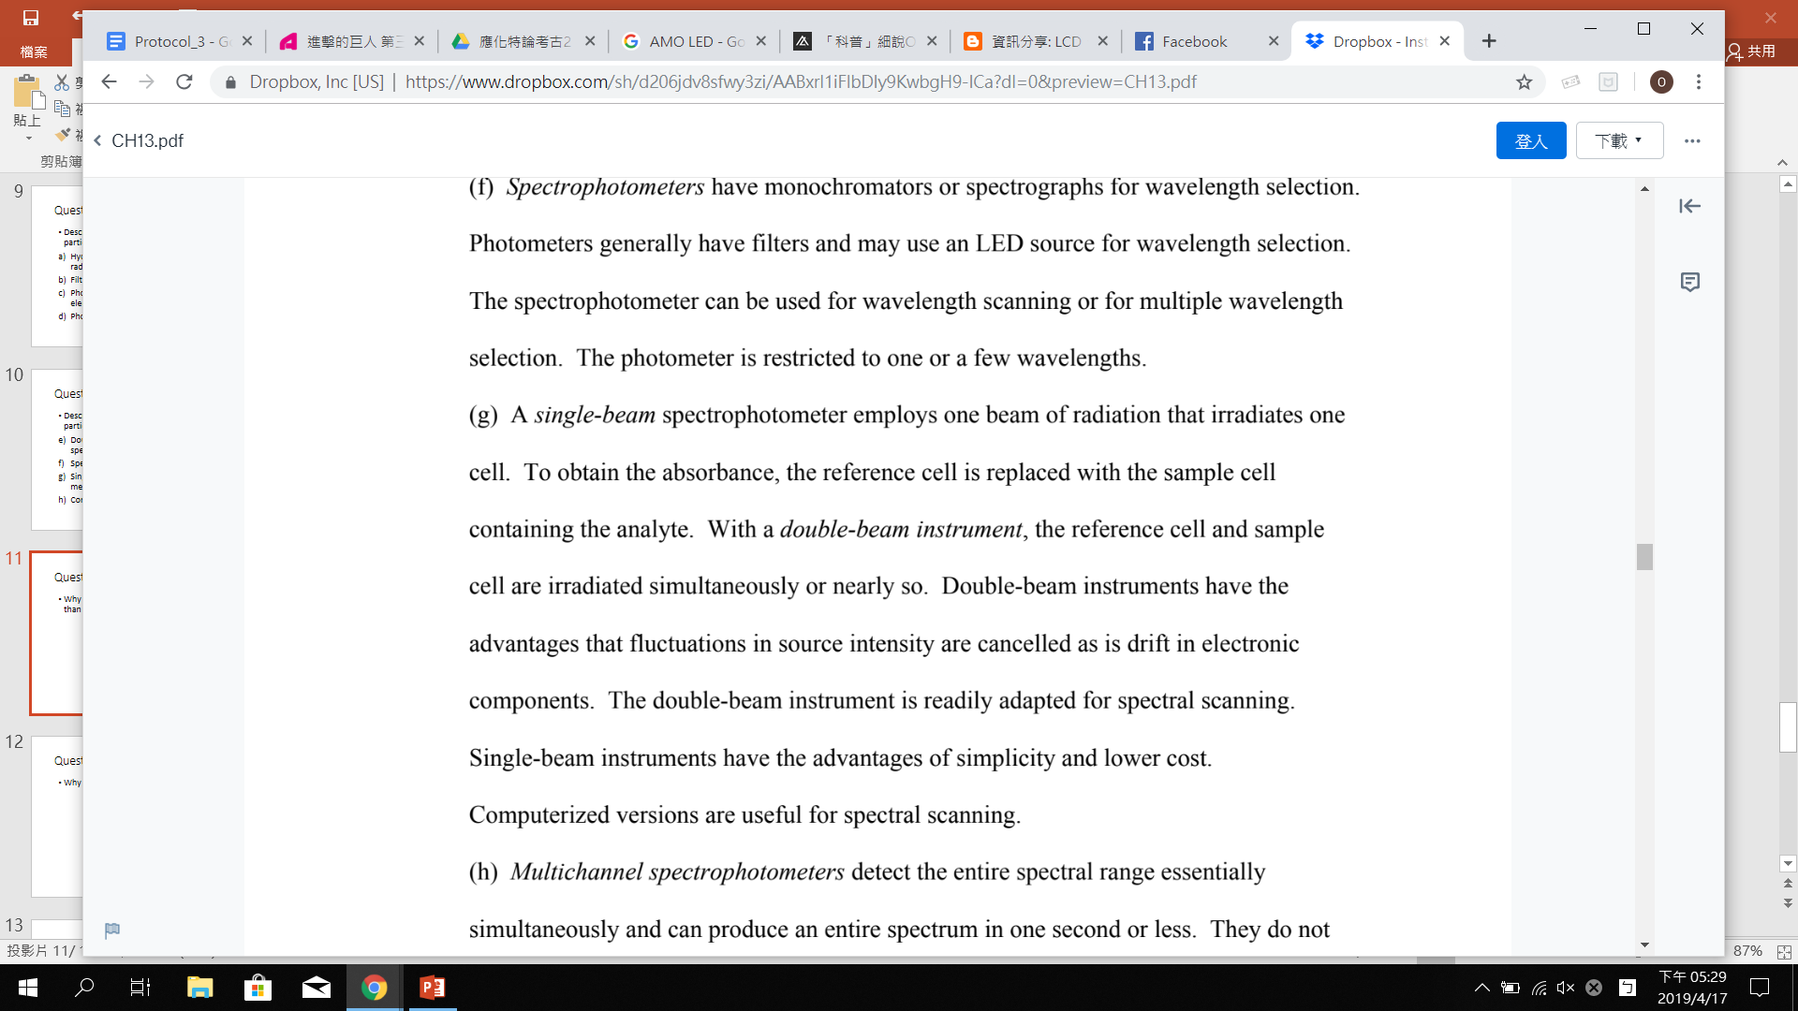
13-13
Answer:
(f) Spectrophotometers and photometers
(g) Single beam and double beam instruments for absorbance measurements.

Slide 8
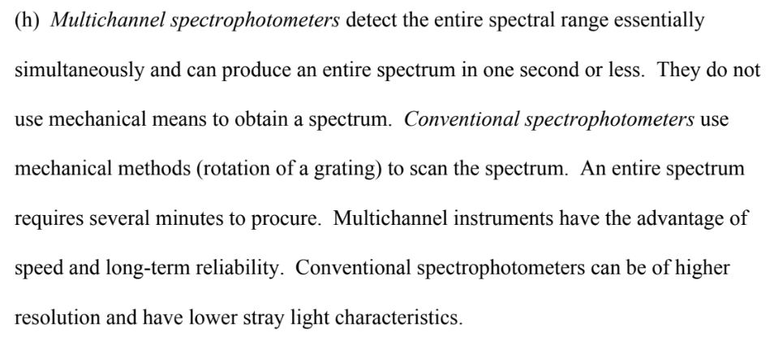
13-13
Answer:
(h) Conventional and multichannel spectrophotometers.

Slide 9


13-16
為什麼氚燈(deuterium lamp)在 UV 中是產生連續光譜而不是線譜？
Answer:
在氘燈中，電源的燈能量產生激發態的氘分子，氘分子會解離為基態的兩個原子和輻射的光子。 隨著激發態的氘分子弛豫(relaxation)，其量化的能量分佈在光子和兩個原子的能量之間。後者可以幾乎從零到激發分子的能量變化。因此輻射的能量，即激發態分子的量子化能量與原子的動能之差，也可以在同一範圍內連續變化。因此，放射出的光譜是連續光譜。
可參考課本 p.315

Slide 10
13-16
為什麼光電倍增管不能用於紅外光輻射？
光電倍增管
一種具有高靈敏度與超快響應時間的光探測元件，在一般典型的光電倍增管中 ，在其響應範圍最佳的近紅外光區到紫外光區，可以將只有數百個光子的光訊號轉換為有用的脈衝電流，進而利用此脈衝電流來做訊號的分析。
Answer:
因為紅外光輻射所產生的光子沒有足夠的能量可以讓光電倍增管產生光電發射(photoemission)
http://www.phys.ncku.edu.tw/~optlab/modernoptics/lock-in%20amplifier/2.1.htm

Slide 11
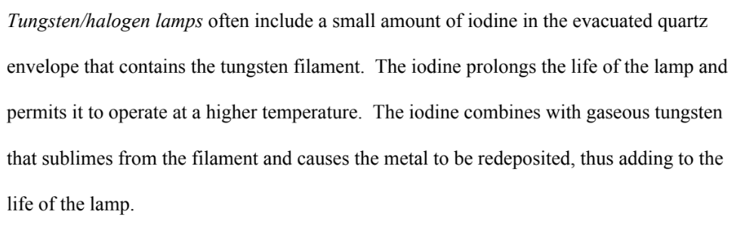
Question 13-18
Why is iodine sometimes introduced into tungsten lamp?
有時鎢絲燈(白熾燈)的玻璃中會填入碘氣體，稱為鹵素燈，可增加發光效率及使用壽命。鎢原子(tungsten)被蒸發後和碘結合形成碘化鎢。碘化鎢在燈泡中循環並回到被氧化的燈絲上，遇熱後又重新分解成碘和鎢，鎢又可在燈絲上沉積下來，延長燈泡壽命。

Slide 12
Chapter 15
Textbook questions

Slide 13
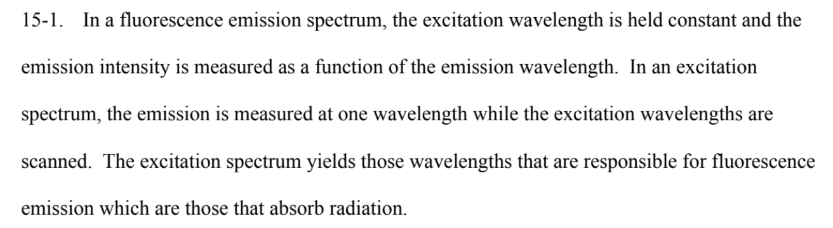
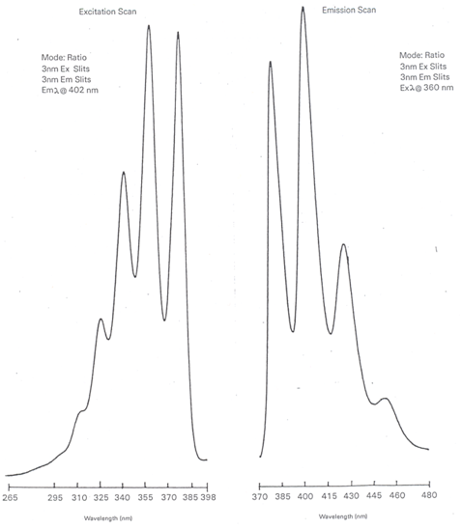
Question 15-1
Explain the difference between a fluorescence emission spectrum and a fluorescence excitation spectrum.
Which is more closely resembles an absorption spectrum?
Emission spectrum: 固定 excitation wavelength 掃描不同波長 emission light的強度
Excitation spectrum: 固定 emission wavelength掃描不同波長 excitation light的強度
Excitation spectrum 較接近吸收光譜，因為分子吸收了excitation light 後放出emission light
https://chem.libretexts.org/Bookshelves/Analytical_Chemistry/Supplemental_Modules_(Analytical_Chemistry)/Analytical_Sciences_Digital_Library/Active_Learning/In_Class_Activities/Molecular_and_Atomic_Spectroscopy/03_Text%3A_Molecular_and_Atomic_Spectroscopy/3%3A_Molecular_Luminescence/3.4%3A_Excitation_and_Emission_Spectra

Slide 14
Question 15-2
Define the following terms
Fluorescence
(b) Phosphorescence
(c) Resonance fluorescence
(d) A singlet state
The process in which a molecule, excited by the absorption of radiation, emits a photon while undergoing a transition from an excited singlet electronic state to a lower state of the same spin multiplicity (e.g., a singlet → singlet transition).
The process in which an excited molecule emits a photon while undergoing a transition from an excited triplet state to a lower state of a different spin multiplicity (e.g., a triplet → singlet transition).
Can be observed when an excited species emits radiation of the same frequency as that used to cause the excitation.
One in which the spins of the electrons of an atom or molecule are all paired so there is no net spin angular momentum

Slide 15
(e) A triplet state
(f) Vibrational relaxation
(g) Internal conversion.
(h) External conversion
One in which the spins of the electrons of an atom or molecule are unpaired so that their spin angular moments add to give a net non-zero moment.
The process by which a molecule loses its excess vibrational energy without emitting radiation.
The intermolecular process in which a molecule crosses to a lower electronic state with emitting radiation.
A radiationless process in which a molecule loses electronic energy while transferring that energy to the solvent or another solute.

Slide 16
Intersystem crossing
(j) Predissociation
(k) Dissociation
(l) Quantum yield
(m) Chemiluminescence
The process in which a molecule in one spin state changes to another spin state with nearly the same total energy (e.g., singlet → triplet).
Occurs when a molecule changes from a higher electronic state to an upper vibrational level of a lower electronic state in which the vibrational energy is great enough to rupture the bond.
Occurs when radiation promotes a molecule directly to a state with sufficient vibrational energy for a bond to break.
The fraction of excited molecules undergoing the process of interest. For example, the quantum yield of fluorescence is the fraction of molecules absorbing radiation that fluoresce.
A process by which luminescent radiation is produced as a result of a chemical reaction

Slide 17
Question 15-3
Why is spectrofluorometry potentially more sensitive than spectrophotometry?
For spectrofluorometry, the analytical signal F is proportional to the source intensity P₀ and the transducer sensitivity.
In spectrophotometry, the absorbance A is proportional to the ratio of P₀ to P. Increasing P₀ or the transducer sensitivity to P₀ produces a corresponding increase in P or the sensitivity to P. Thus the ratio does not change.
As a result, the sensitivity of fluorescence can be increased by increasing P₀ or transducer sensitivity, but that of absorbance does not change.
螢光訊號與光源強度成正比，同時也與傳感器(transducer)的靈敏度成正比
分光光度法中，吸收度A指的是光源強度與通過sample的光強度的比例，增加光強度或增加傳感器靈敏度的同時只會增加通過sample的光，無助增強吸收度訊號
因此在我們可簡單的藉由增加光源強度與傳感器靈敏度增加螢光光譜法的靈敏度，但分光光度法無法藉由此方法增加

Slide 18
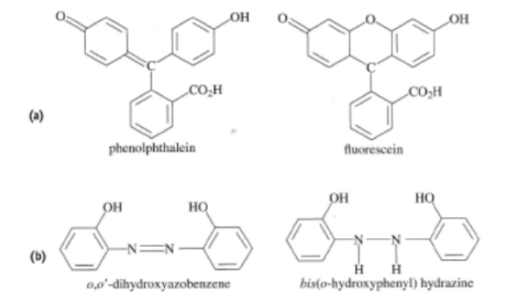
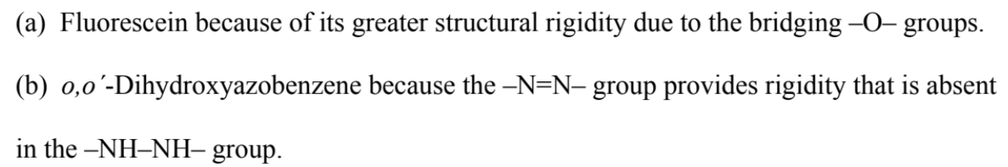
Question 15-4
Which compound in each of the following pairs would you expect to have a greater fluorescence quantum yield? Explain.
Keyword 關鍵字: rigidity
Fluorescein
o,oˊ-Dihydroxyazobenzene

Slide 19
Question 15-5
Why do some absorbing compound fluoresce but others do not?
Compounds that fluoresce have structures that slow the rate of nonradiative relaxation to the point where there is time for fluorescence to occur.
Compounds that do not fluoresce have structures that permit rapid relaxation by nonradiative processes.

Slide 20
Question 15-6
Discuss the major reasons why molecular phosphorescence spectrometry has not been as widely use as molecular fluorescence spectrometry?
The triplet state has a long lifetime which makes it susceptible to collisional deactivation.
Thus, most phosphorescence measurements are made at low temperature in a rigid matrix or in solutions containing micelles.
Also, electronic methods must be used to discriminate phosphorescence from fluorescence. Not as many molecules give good phosphorescence signals as fluorescence signals.
As a result, the experimental requirements to measure phosphorescence are more difficult than those to measure fluorescence and the applications are not as large.
訊號弱、反應時間慢、易將能量傳給solvent，所以不好測

Slide 21
15-7
The reduced form of NADH is an important and highly fluorescent coenzyme. It has an absorption maximum of 340 nm and an emission maximum at 465 nm. Standard solutions of NADH gave the following fluorescence intensities
 | Intensity / a.u.
0.100 | 2.24
0.200 | 4.52
0.300 | 6.63
0.400 | 9.01
0.500 | 10.94
0.600 | 13.71
0.700 | 15.49
0.800 | 17.91
Construct a spreadsheet and use it to draw a calibration curve for NADH
Find the least squares slope and intercept for the plot
Calculate the standard deviation of the slope and the standard deviation about regression for the curve
An unknown exhibit a relative fluorescence intensity of 12.16. Use the spreadsheet to calculate the concentration of NADH
Calculate the relative standard deviation for the result in (D)
Calculate the relative standard deviation for the result in (D) if the result of 7.95 was the mean of three measurements

Slide 22
