Slide 1
Common error
1.
2. C-C-C vs CH₃CH₂CH₃
3.

Slide 2
(a)
(b)

Slide 3
(c)
S-trans → No reaction
(fused)
(d)

Slide 4
(e)
(f)

Slide 5
(g)
(h)

Slide 6
2.
Rate
2
3
1

Slide 7
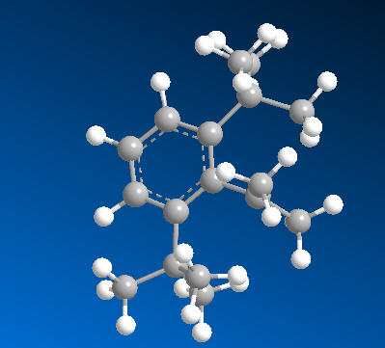
(3a)
Bulky groups decrease pi-pi
interaction between benzene
ring and carbocation
>

Slide 8
(3b)
E.N. ： O > N
Stability : N⁺ > O⁺

Slide 9
4.
2
1
Conjugated acid more acidic
Conjugated base more stable
3
Resonance effects

Slide 10
5.
1. Rearrangement ?
2. Carbon skeleton change? Yes. How to make C-C bond ?
3. Functional group transformation ?

Slide 11
(a)
(b)
Tautomerize

Slide 12
(c)
(d)

Slide 13
6
E.N. ： O > N
Stability : N⁺ > O⁺

Slide 14
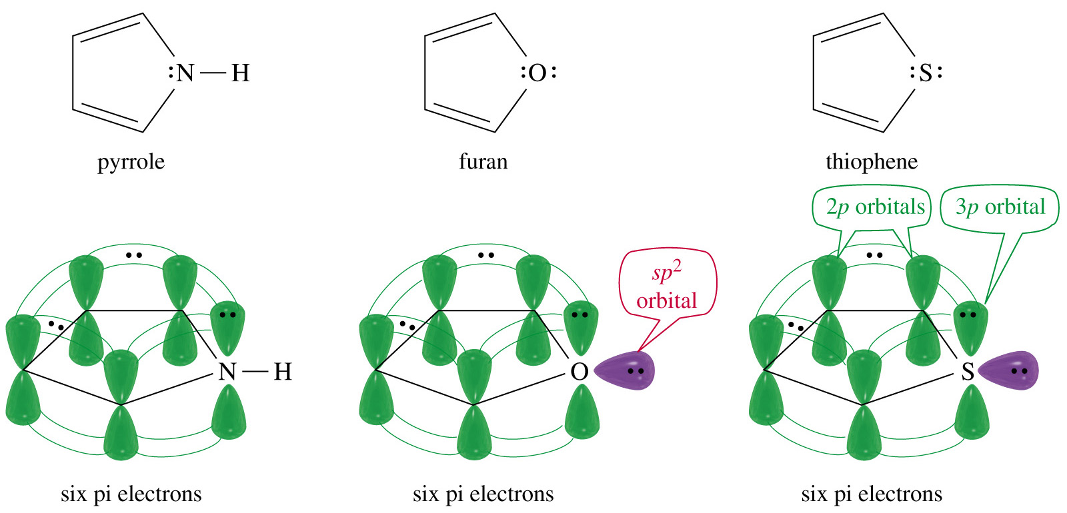

Slide 15
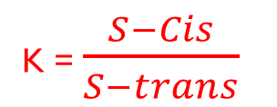
7
S-trans
S-cis
K = $\frac{S−Cis}{S−trans}$
Only S-cis is reactive → K larger → more reactive
Fused ring
S-cis
Fused ring
S-trans
Unstable in S-cis (steric dffect)
K
1st
4th
3rd
2nd

Slide 16
8
Resonance + 2º +3º cation

Slide 17
Less bulky site
Thermodynamic
kinetic
bulky site

Slide 18
9
5e⁻
3e⁻
6e⁻
2e⁻
Non aromatic
aromatic
4n+2 rule (huckel rule)

Slide 19
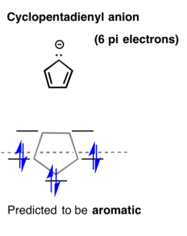
4n+2 rule (huckel rule)

Slide 20
10
1. Solvent : protic polar solvent
2. ROH : weak base/ weak Nu:
3. Substract : 2º + benzylic + allylic
→E1 or S_{N}1 →High temp. ?
No → S_{N}1 major

Slide 21
Major
(Conjugated System)

Slide 22
11
Hyperconjugation
Inductive effect
Inductive effect Resonance effect
(Re > In)
e⁻ donating
e⁻ withdrawing
e⁻ donating
least reactive
(most unstable)
Most reactive
(most stable)

