Slide 1

Behind the 95%:
Who Is the Dempsey Center Really Reaching?
Dempsey Center Annual Client Survey · 2022–2025 · n = 1,179
CS5100 Foundation of AI · Northeastern University -Yuchen Kuang, Lingyun Chen
1,179
4
11
Respondents
Survey Years
Cell Analyses

Slide 2
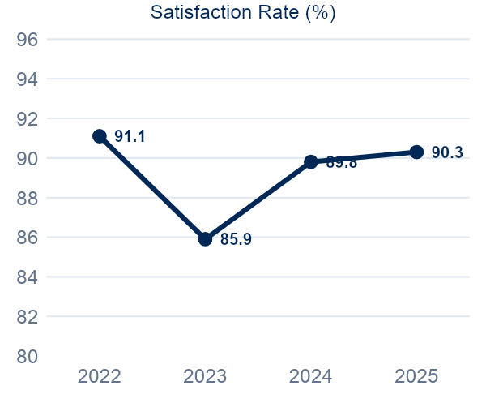
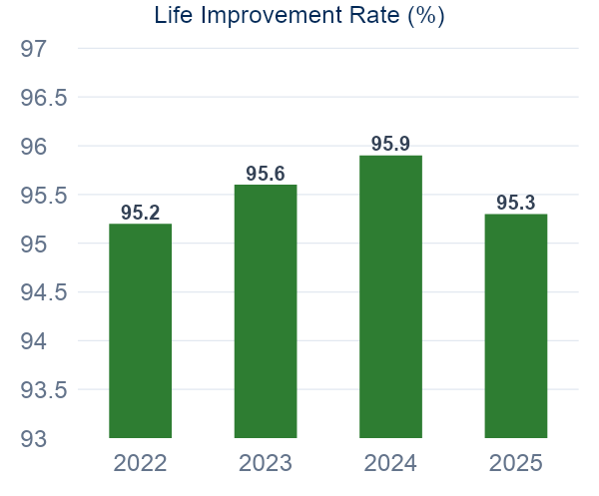
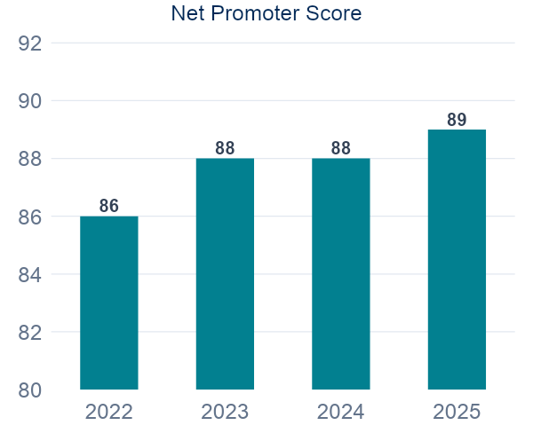
THE CENTER IS PERFORMING — BUT IS IT PERFORMING FOR EVERYONE?
90.3%
95.3%
89
Satisfaction Rate
Life Better
Net Promoter Score
Satisfied or Very Satisfied
Say their life improved
Above 80 = world-class threshold

Slide 3
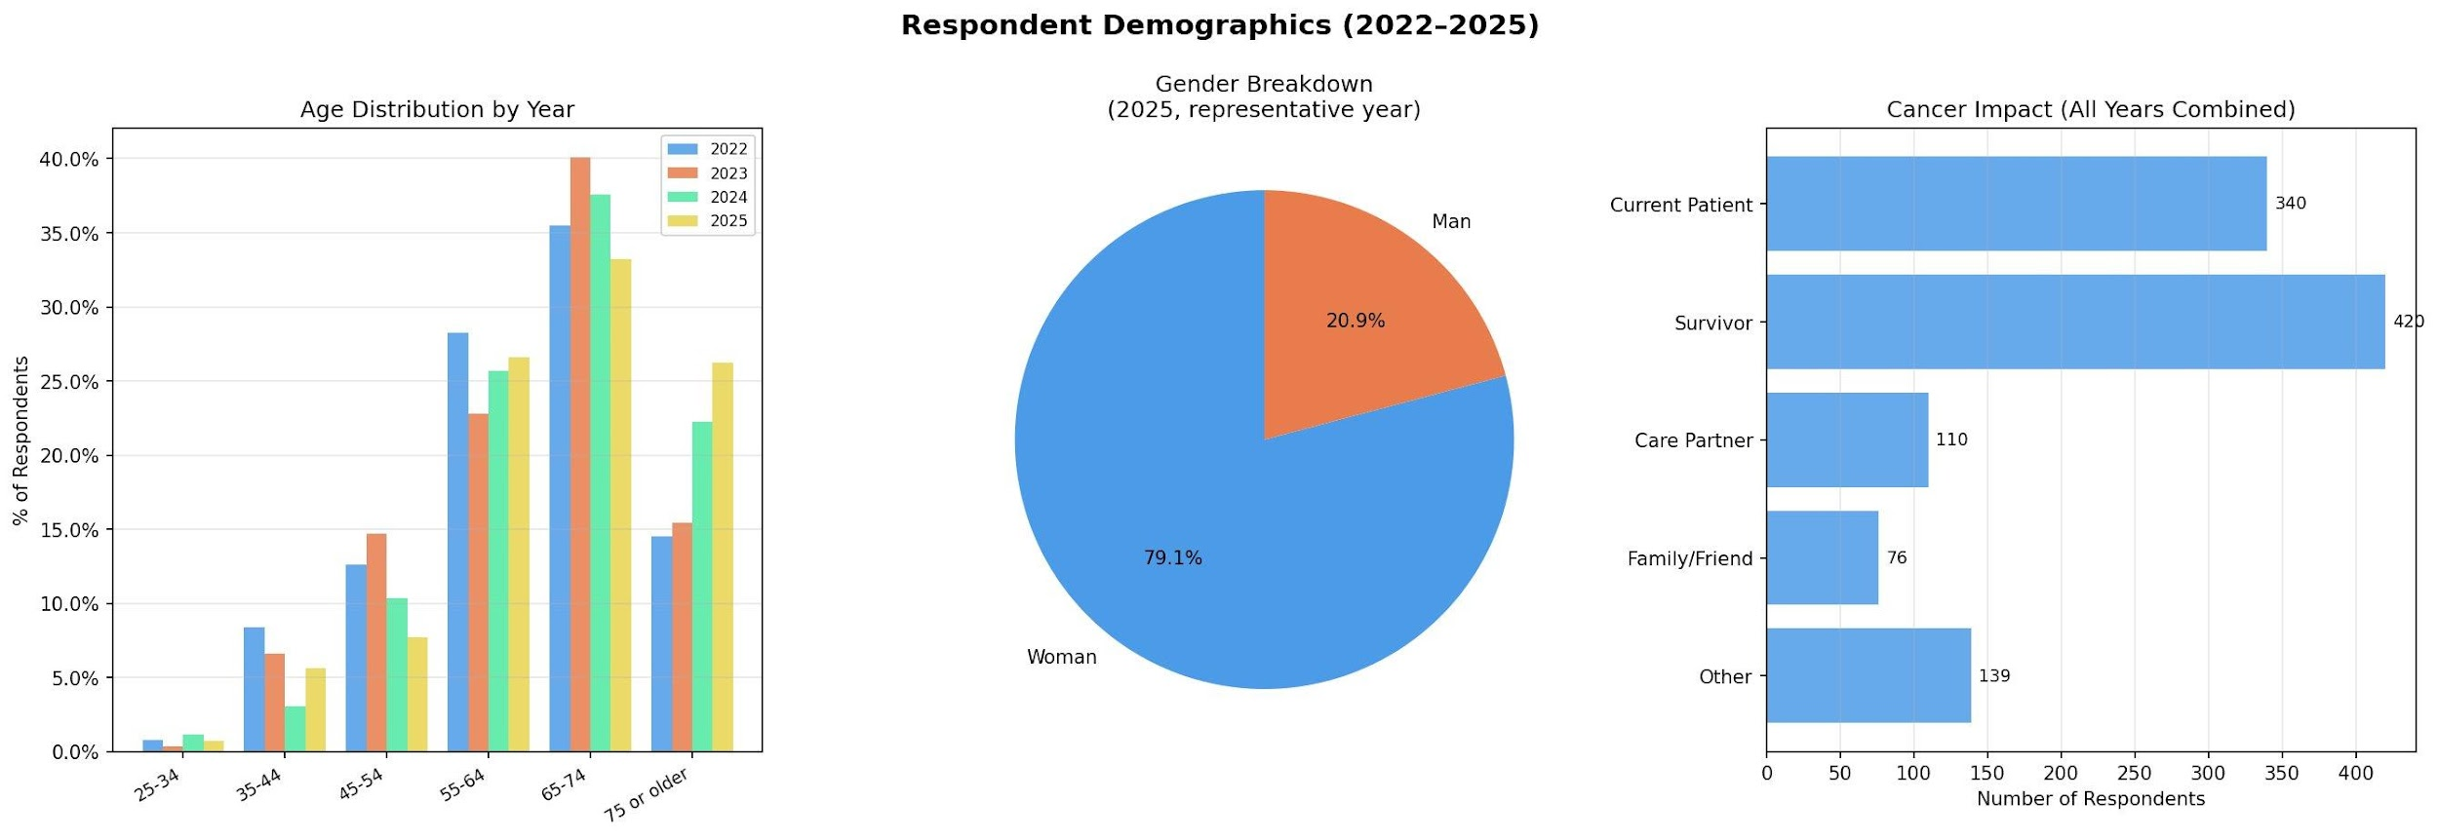
WHO ARE THE CLIENTS? · n = 1,179 across 4 years
Key Trend: 75+ age group nearly doubled — 14% in 2022 to 26% in 2025. Transportation barriers grew 3% → 11.6% in the same period. These are the same problem.

Slide 4
ANALYTICAL APPROACH · All methods trained on all 4 years (n = 1,179)
Correlation Analysis
Decision Tree
①
②
Which variables move together? Reveals relationships between frequency, satisfaction, service use, and life outcomes.
Which factors best predict high satisfaction? Trained on all 4 years. Provides ranked feature importance scores.
K-Means Clustering
Chi-Square Tests
③
④
Segment clients by behavior and outcomes — reveals groups hidden by overall averages. Used k=3 based on elbow curve.
Statistically verify Decision Tree findings. Confirms whether associations are real or noise. Threshold: p < 0.05.

Slide 5
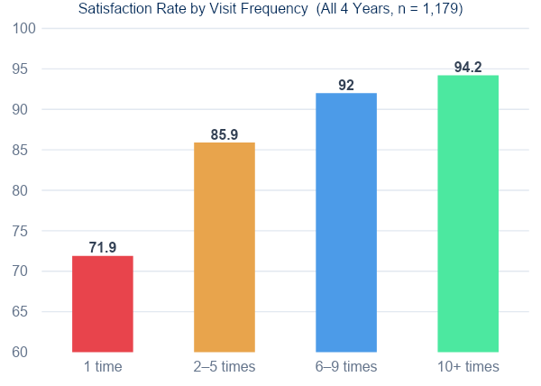
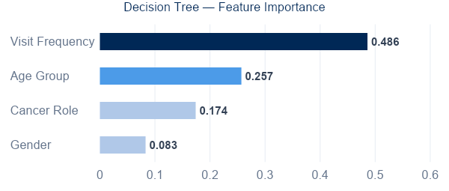
FINDING 1 · VISIT FREQUENCY IS THE STRONGEST PREDICTOR OF SATISFACTION
Chi-Square
22-point gap
p < 0.001
71.9% → 94.2%
Statistically significant — all 4 years
1-time visitors vs. 10+ visits
Visit Frequency is the ONLY factor validated by both machine learning (#1 feature importance, 0.486) AND statistical testing (p < 0.001). No other variable survives both tests.

Slide 6
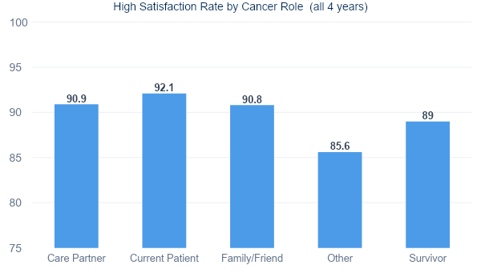
FINDING 2 · DEMOGRAPHICS DO NOT PREDICT SATISFACTION
Cancer Role × Satisfaction
p = 0.28
Not significant — even with n = 1,179
Visit Frequency × Satisfaction
p < 0.001
Statistically significant
Implication:
The Center serves current patients, survivors, and caregivers at comparable quality. Improving satisfaction does not require demographic targeting — it requires strategies to increase repeat visits across all groups.

Slide 7
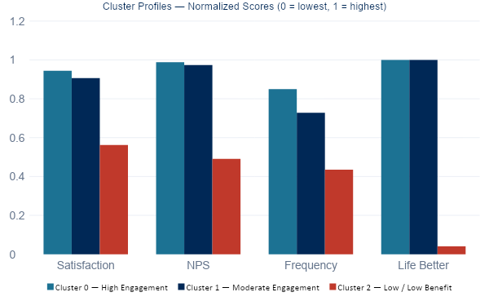
FINDING 3 · THREE DISTINCT CLIENT SEGMENTS (K-Means, k=3, all 4 years)
Cluster 0
Cluster 1
Cluster 2
High Engagement
Moderate Engagement
Low Benefit
n = 365 (31%)
n = 760 (64%)
n = 54 (5%)
Sat
Sat
Sat
4.72/5
4.53/5
2.81/5
Life
Life
Life
100%
100%
4%
Loyal therapy users
Counseling + fitness focus
⚠ Priority intervention group
Cluster 2 is the priority: 54 clients (4.6% of respondents) with only 4% Life Better rate. Averages cannot reveal this group — clustering can. These clients need direct outreach.

Slide 8
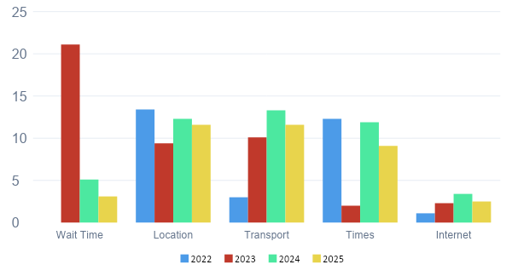
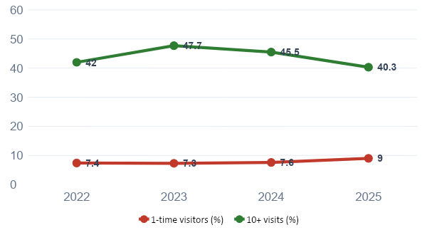
FINDING 4 · TWO TRENDS THAT NEED ATTENTION NOW
Why did satisfaction dip in 2023?
Engagement is declining
2023 wait time: 5.9% → 21.1% → directly explains the satisfaction drop
Resolved by 2024 — not a systemic problem
1-time visitors: 7.4% → 9.0% · 10+ visits: 47.7% → 40.3%
New clients are not converting — first-visit retention is the leverage point

Slide 9
DISCUSSION
Three findings that matter most
01
The average hides the real story
95% Life Better sounds excellent. But Cluster 2 (n=54) shows only 4% say their life improved. A single average conceals that one in twenty clients is getting almost nothing from their visits.
02
Aging and access barriers are the same problem
The 75+ cohort doubled in 3 years. Transportation barriers grew 3% → 11.6% in the same period. These are not independent trends — they are two sides of the same operational challenge.
03
Frequency is the only lever with statistical proof
Visit Frequency is validated by Decision Tree (importance 0.486) AND Chi-Square (p < 0.001). No other variable survives both tests. Converting first-time visitors into repeat clients is the single highest-ROI action available.

Slide 10
RECOMMENDATIONS
1
Design a first-visit follow-up program
HIGH
Targeted outreach after a client's first visit — asking how it went, suggesting a return — directly addresses the rising 1-time visitor rate (7.4% → 9.0%).
2
Investigate Cluster 2 specifically
HIGH
54 clients with 4% Life Better rate are the Center's highest-priority target. A short survey asking why they didn't return is more valuable than another general survey.
3
Plan ahead for the 75+ population
MEDIUM
Transportation barriers grew 3% → 11.6%. Daytime scheduling and transportation partnerships should be addressed now, before the cohort is even larger.
4
Lock the survey schema from 2026
MEDIUM
Column positions changed every year, making analysis significantly harder. A stable schema allows this entire pipeline to run automatically on future data.
5
Add a unique client ID across years
LOW
Currently impossible to track whether the same person improved over time. A longitudinal view would fundamentally change what questions can be answered.

Slide 11
LIMITATIONS
Self-selection bias
Binary service encoding
Survey completed only by clients who visited. Clients who came once and never returned are absent. Satisfaction and NPS figures likely overestimate the full population.
Service usage is coded used / not used. Session count was unavailable. A client with 1 session and one with 12 sessions are coded identically — dose-response cannot be analyzed.
Class imbalance in classification
No unique client ID across years
89.2% of respondents are high satisfaction. The Decision Tree struggles to identify low-satisfaction clients (recall = 0.43). Frequency findings are robust, but individual predictions are not.
Respondents cannot be tracked across years. All cross-year comparisons are population-level, not individual trajectories. Whether the same person improved over time is unknown.

Slide 12
Future Work
Move from descriptive analysis to predictive and actionable decision-making.
01
Predict Client Retention
Identify first-time visitors unlikely to return and improve engagement
02
Enable Longitudinal Tracking
Track individual client progress across years with unique IDs
03
Test Targeted Interventions
Use A/B testing to evaluate follow-up programs and outreach strategies

Slide 13
Thank You
Behind the 95%: Who Is the Dempsey Center Really Reaching?
Visit Frequency
p < 0.001
54 clients
#1 predictor — importance 0.486
Chi-Square significance confirmed
Priority group — only 4% Life Better
GitHub: github.com/Chihiro1998/CS5800_FinalProject
CS5800 Foundation of AI · Northeastern University · 2026

