Slide 1

Cross-Document Event-Keyed Summarization
William Gantt Walden (JHU), Pavlo Kuchmiichuk (Rochester), Alexander Martin (JHU), Chihsheng Jin (Rochester), Angela Cao (Rochester), Claire Sun (Rochester), Curisia Allen (Rochester), Aaron Steven White (Rochester)
PEER 2025 @ University of Rochester

Slide 2
Table of Content
Task Introduction
The building of SEAMuS
Experiments & analysis
Conclusion

Slide 3
Background
Blogger Lashing: Saudi Rejects Criticism of Badawi Case (BBC Article)
...Saudi Arabia has expressed "surprise and dismay" at international media reports criticizing the flogging of a Saudi blogger for insulting Islam...
Raif Badawi was sentenced to 1,000 lashes and 10 years in jail last year.... Mr. Badawi's case has prompted international protests and was raised by several governments. Germany's economic affairs minister and vice-chancellor, Sigmar Gabriel, currently on a visit to Saudi Arabia, was urged by MPs and human rights organizations to take up Mr. Badawi's case while in Riyadh. Before going into a meeting with King Salman, Mr. Gabriel said "the harshness of this sentence, especially the corporal punishment, is something unimaginable for us and of course it weighs on our relations"....
Mr. Badawi established the Liberal Saudi Network, a now-closed online forum that sought to encourage debate on religious and political matters in 2008. In 2012, he was arrested and charged with "insulting Islam through electronic channels"
Synthesized summary
During a 2015 visit, Sigmar Gabriel tried to persuade Saudi authorities, including King Salman, to grant Raif Badawi clemency for insulting Islam through electronic channels.
Sigmar Gabriel (Wikipedia Excerpt)
...During a 2015 visit to King Salman of Saudi Arabia, Gabriel launched an unusual public effort to persuade Saudi authorities to free imprisoned writer Raif Badawi and grant him clemency, amplifying Germany's political voice in a region in which its influence had largely been limited to economic issues in years past. He had been urged by MPs and human rights organizations to take up Badawi's case before his trip...

Slide 4
Background
Key Motivations
How are long descriptions of complex events distributed over multiple sentences?
What kinds of complex events can be compressed into a single sentence?
Our Aims
Develop a dataset that relates long descriptions of complex events with short descriptions of complex events.
Develop models that can map long descriptions of events to short descriptions of events.

Slide 5
Background
Multi-document Summarization
DiverseSumm (Huang et al., 2024)
AutoMDS (Zopf, 2018)
WCEP (Gholipour Ghalandari et al., 2020)
Our Work (SEAMuS)
Single event & multiple sources
Event-centric Summarization
Event-centric summaries
Event-keyed Summarization (Gantt et al., 2024)
Timeline Summarization (Allan et al., 2001; Chieu and Lee, 2004, Li et al., 2021a; Rajaby Faghihi et al., 2022, i.a.)
POQue (Vallurupalli et al., 2022)
Structured event representations

Slide 6
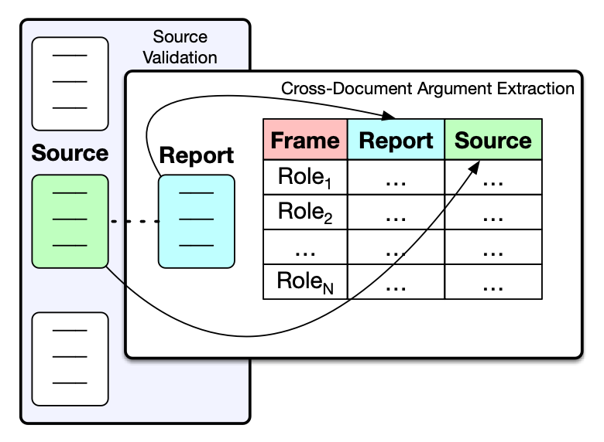
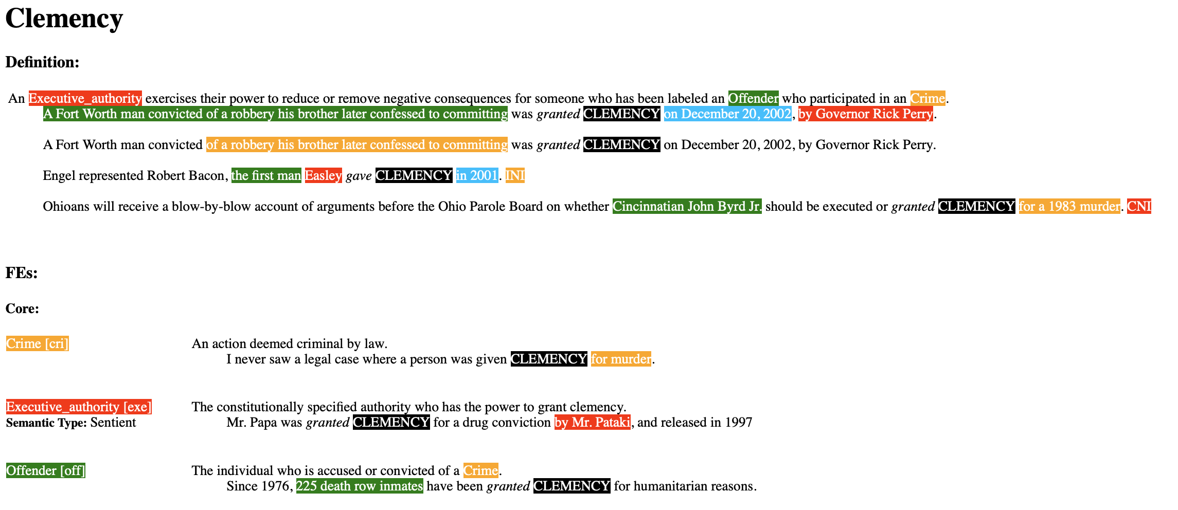
Background
FAMuS (Vashishtha et al., 2024)
FrameNet (Baker et al., 1998)
Illustration of a cross-document argument extraction task (CDAE)
FrameNet is a collection of more than 200,000 manually annotated sentences linked to more than 1,200 semantic frames provide a unique training dataset for semantic role labeling, used in applications such as information extraction, machine translation, event recognition, sentiment analysis, etc.
Source: FAMuS: Frames Across Multiple Sources (Vashishtha et al., NAACL 2024)
A dataset of Wikipedia passages that report on some event, paired with underlying, genre-diverse source articles for the same event
253 event types
1,265 report-source pairs

Slide 7
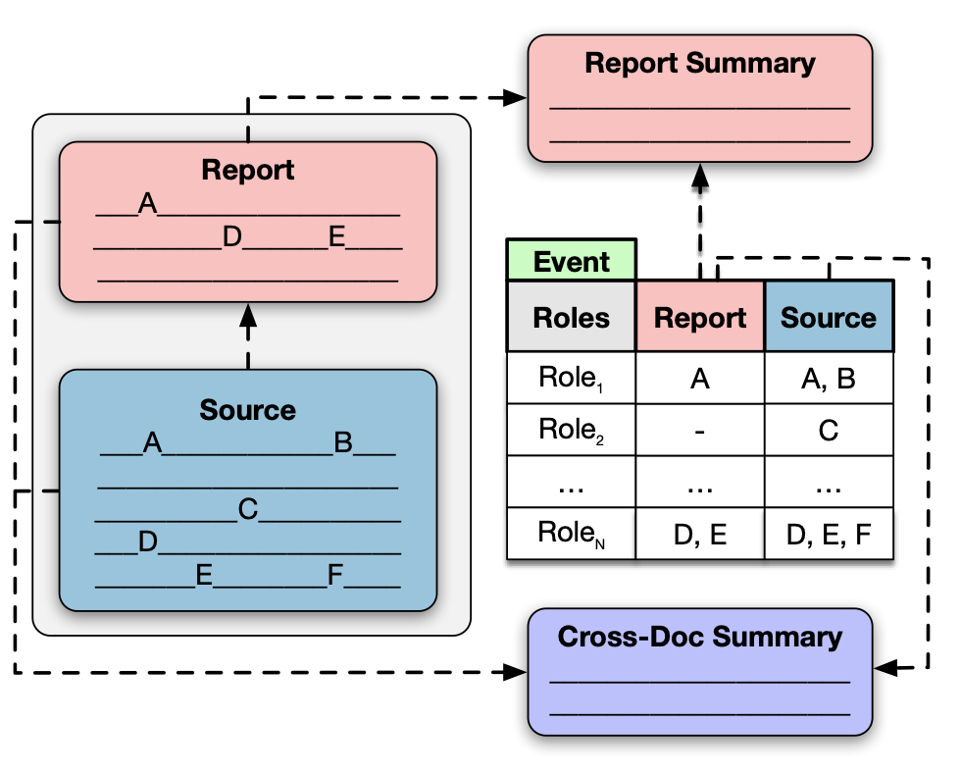
Background
FAMuS (Vashishtha et al., 2024)
Illustration of a cross-document argument extraction task (CDAE)
Source: FAMuS: Frames Across Multiple Sources (Vashishtha et al., NAACL 2024)
Source: Walden, William, et al. "Cross-Document Event-Keyed Summarization." arXiv preprint arXiv:2410.14795 (2024).
A dataset of Wikipedia passages that report on some event, paired with underlying, genre-diverse source articles for the same event
253 event types
1,265 report-source pairs

Slide 8
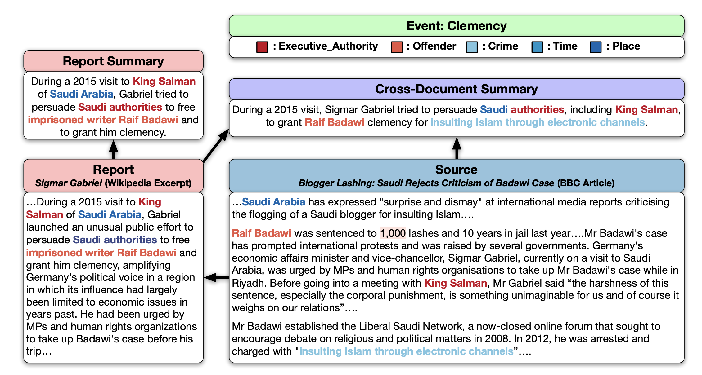
Background
Source: Walden, William, et al. "Cross-Document Event-Keyed Summarization." arXiv preprint arXiv:2410.14795 (2024).

Slide 9
SEAMuS (Summaries of Events Across Multiple Sources)
Features
Comprehensive ontology
Events and arguments annotated using a subset of FrameNet, covering many (253) event types
Expert annotations
Event arguments and summaries all (re-)annotated by the authors
Detailed summaries
1. Report summaries cover all event arguments described in the report texts
2. Cross-Document summaries cover all event arguments described in the report and source texts

Slide 10
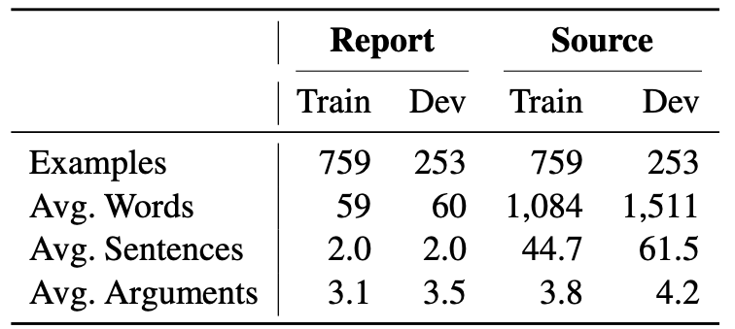
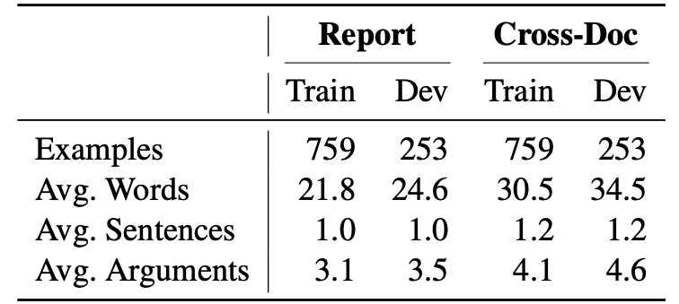
SEAMuS (Summaries of Events Across Multiple Sources)
Statistics
FAMuS documents
SEAMuS summaries

Slide 11
Annotation
Phase 1
Phase 2
report + event arguments
corrected report arguments
+ report summary
+ report summary arguments
report + source
+ event arguments
corrected source arguments +
cross-document summary +
cross-document summary arguments

Slide 12
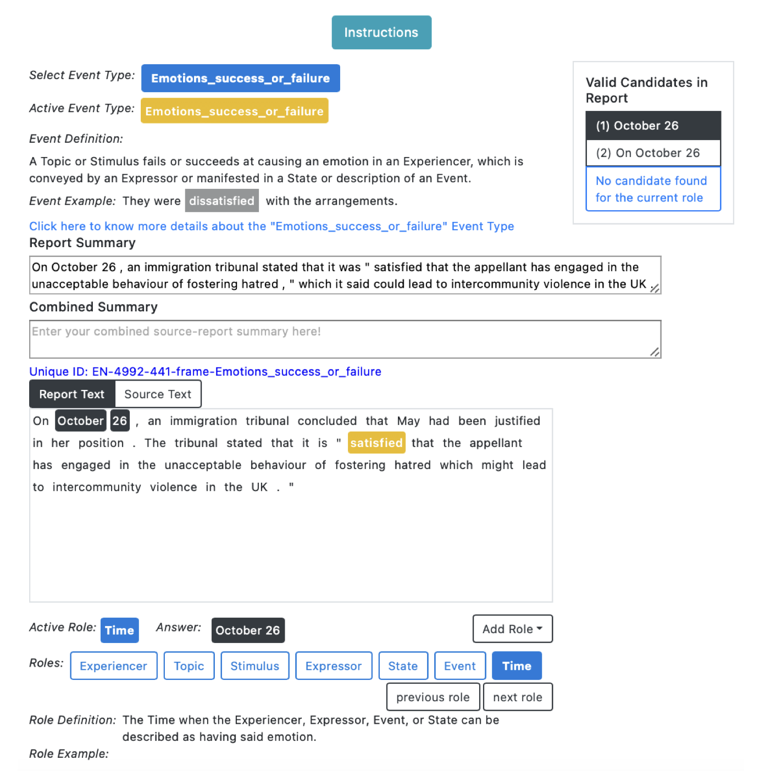
Annotation
Details of the workflow
Instructions for annotators
Ideal summaries are:
Focus only on the annotated event;
Convey the same information as is conveyed by the event argument annotations
Who the participants are + their roles
Be natural
A snapshot of our interface

Slide 13
Experiments
Tasks:
Baseline:
Report text
Method:
Using the report text as the summary
Encoder-decoder models:
BART (large)
PEGASUS (large)
T5 (large)
Method:
Fine-tuned on SEAMuS train split
Proprietary LLMs:
GPT4o
GPT4o Mini
Claude 3 Haiku
Claude 3.5 Sonnet
Method:
Zero-shot
Few-shot (3 examples)
Single Document Summarization (Report)
Cross Document Summarization (Cross-Document)

Slide 14
Experiments
Metrics:
BERTScore (Zhang et al., 2019)
Evaluation:
text generation quality
How it works:
Calculating the similarity between the predicted summary embedding and the gold summary embedding
CEAF-REE
(Du et al., 2021)
Evaluation:
argument extraction quality
How it works:
Extract arguments from predicted and gold summaries using LOME and evaluate how many entities in the predicted summary match the gold
AlignScore
(Zha et al., 2023)
Evaluation:
factual consistency
How it works:
Using a fine-tuned model to evaluate the factual consistency between a context and a predicted summary, the context being the report and the report and the source texts concatenated for two types of summaries
FActScore
(Min et al., 2023)
Evaluation:
factual consistency
How it works:
Calculating the factual precision of atomic facts in a predicted summary generated by an LM with the context being the report and the report and the source texts concatenated for two types of summaries

Slide 15
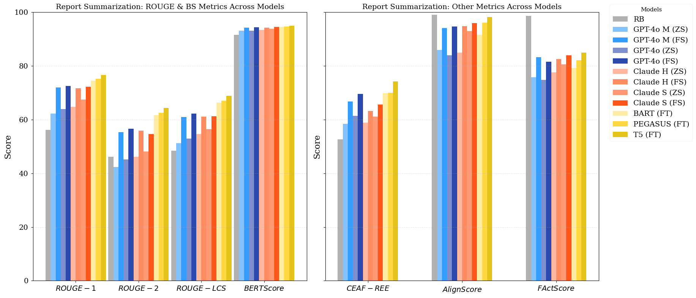
Experiments
Single-document Summarization
(Model comparison)

Slide 16
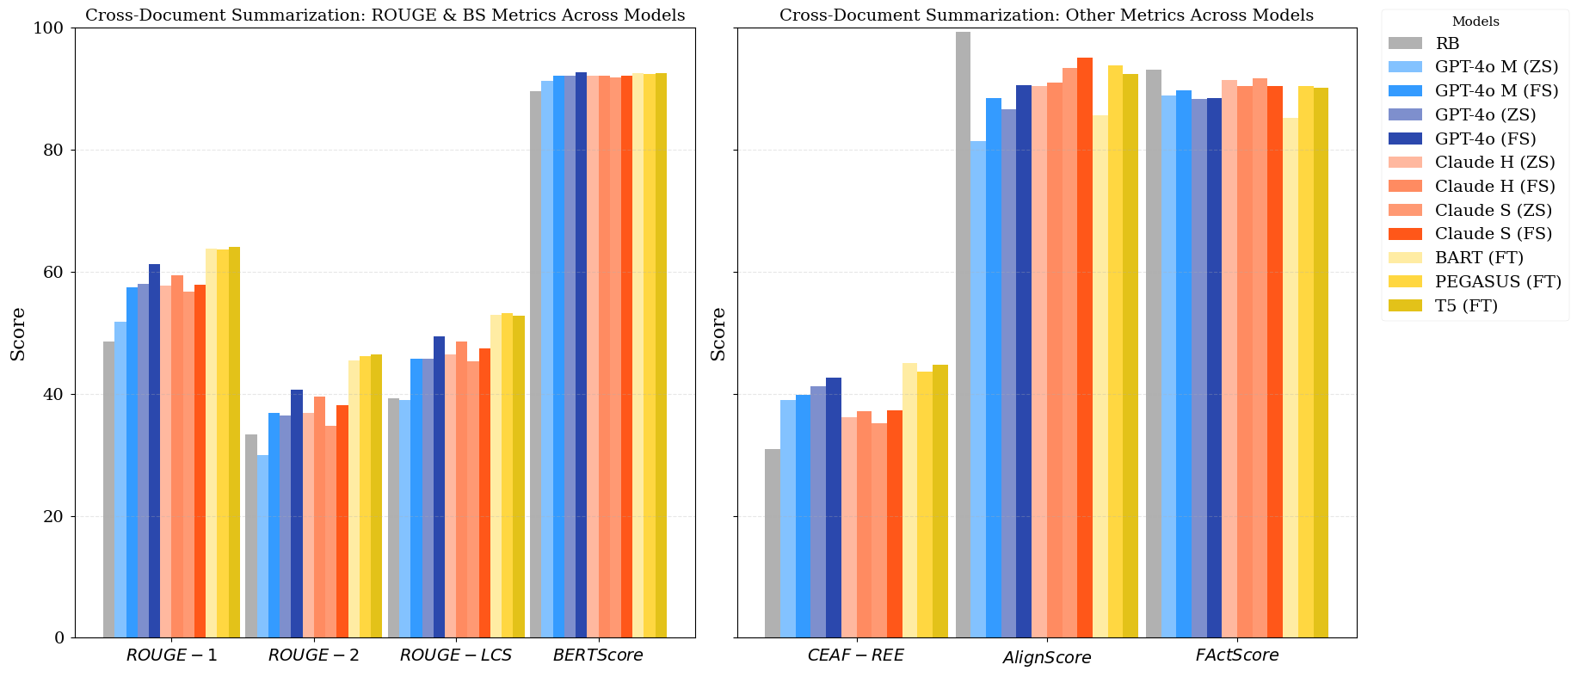
Experiments
Cross-document Summarization
(Model comparison)

Slide 17
Experiments
Ablation 1:
Ablated Inputs
Text only: only texts
Event only: only event argument annotations
Text + Schema: only texts, name of the event per text, and corresponding roles
Text + Event: unablated setting

Slide 18
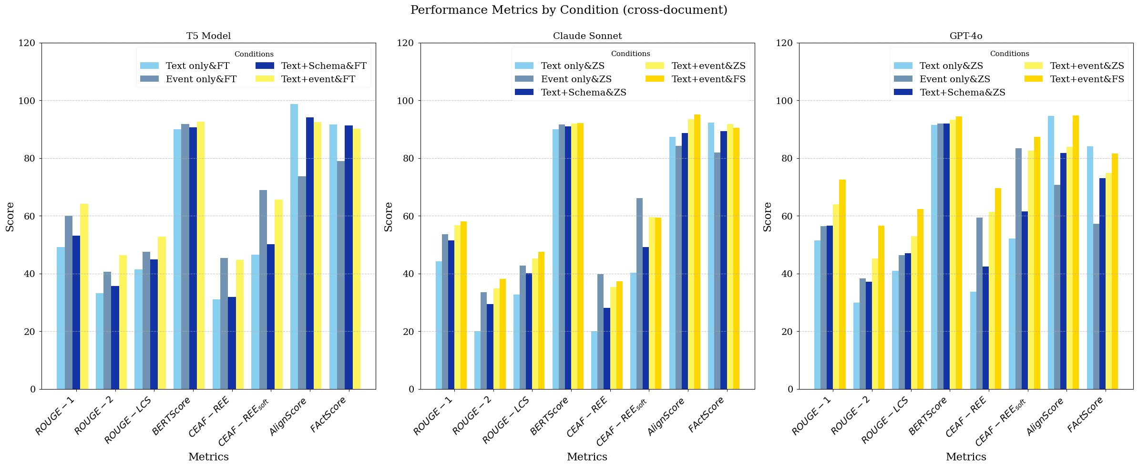
Experiments

Slide 19
Experiments
Unablated inputs produce the best results, which means that EKS cannot be reduced to standard summarization tasks and structure-to-text tasks.

Slide 20
Experiment
Ablation 2:
Add: add a spurious argument
Edit: alter an existing argument span
Delete: remove a correct argument
Parameter p controls probability of making an edit to a given role
→ Vary p from 0 to 0.5

Slide 21
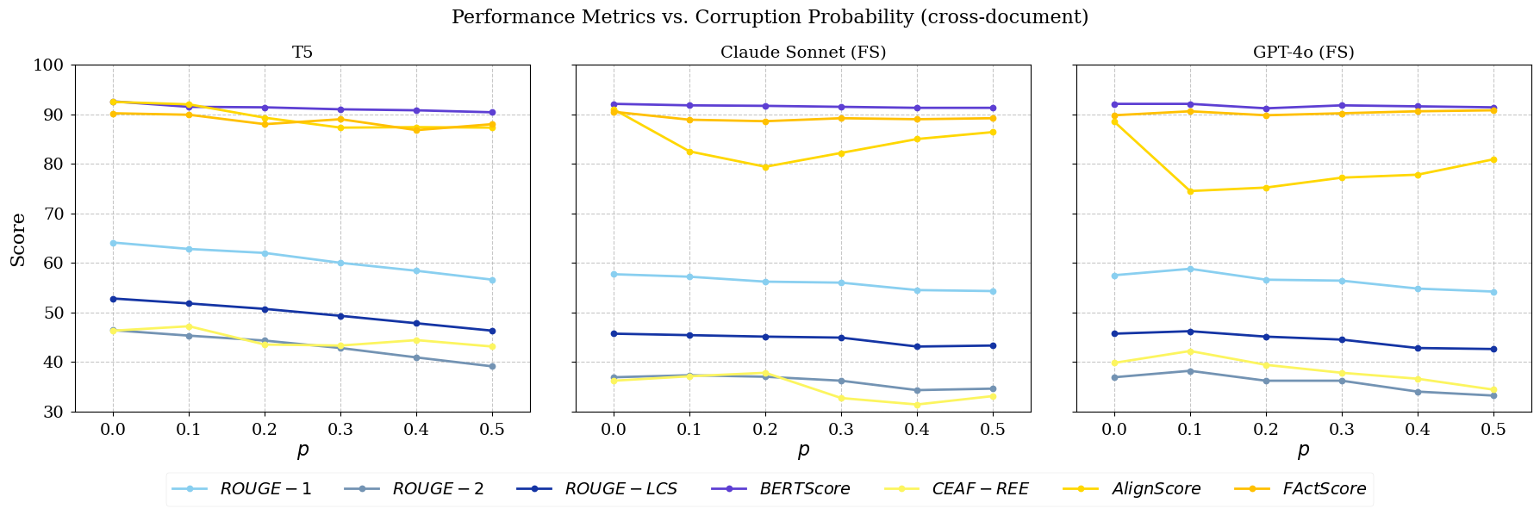
Experiment
Ablation 2:

Slide 22
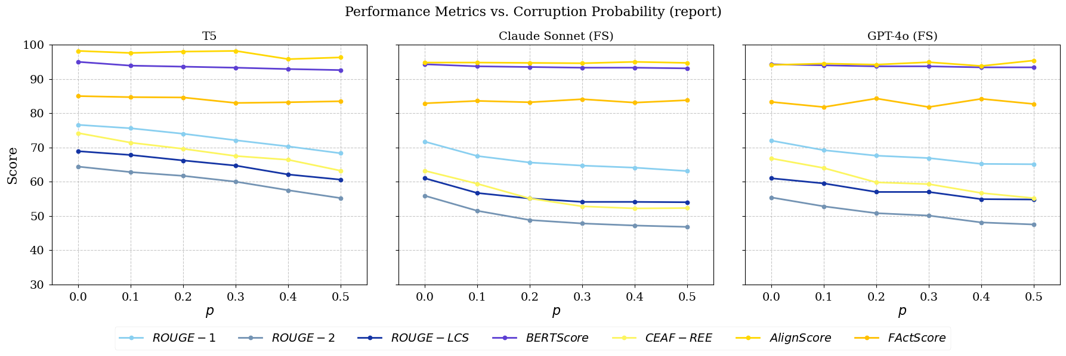
Experiment
Ablation 2:
Corrupted role annotations do not significantly affect the summarization quality, which means the model is robust to role extraction noise.

Slide 23
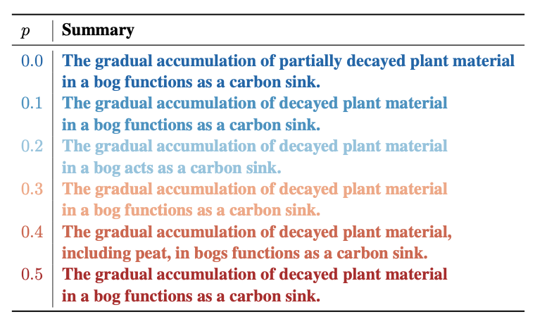
Experiment
Generally minimal degradation in summary quality as p increases.

Slide 24
Experiment
Human evaluation:
Three assessors*
30 randomly sampled test examples
Single quality judgment (1-5) based on actuality, adequacy, coherence, relevancy, and fluency
*Intra-rater preference:
Wilcoxon rank-sum test with Bonferroni correction for multiple comparisons shows no significant differences.

Slide 25
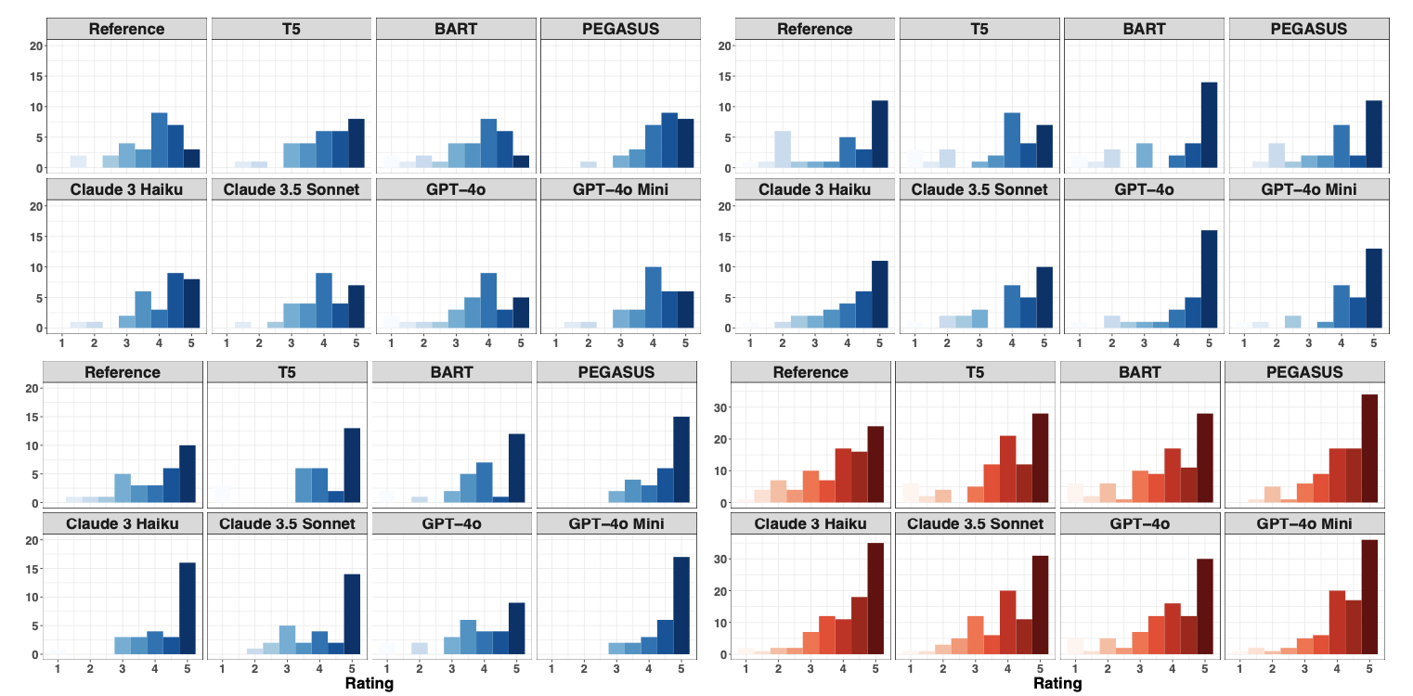
Experiment
Blue: Single assessor judgments
Red: Aggregate judgments
Wilcoxon rank-sum test with Bonferroni correction for multiple comparisons shows no significant differences

Slide 26
Conclusion
SEAMuS is a high-quality dataset for single- and cross-document event-keyed summarization
Benchmark results with fine-tuned smaller models and prompted LLMs show extracted event representations can help produce accurate, targeted summaries
Ablation studies show that cross-document event-keyed summarization is a distinctive summarization task and is robust to errors in event extraction

Slide 27
Limitations
Dataset size likely insufficient for effective fine-tuning of large models
Annotations cover pairs of documents; future work should explore > 2 sources

Slide 28
Thank you!
And have a nice day!
PEER 2025 @ University of Rochester

Slide 29
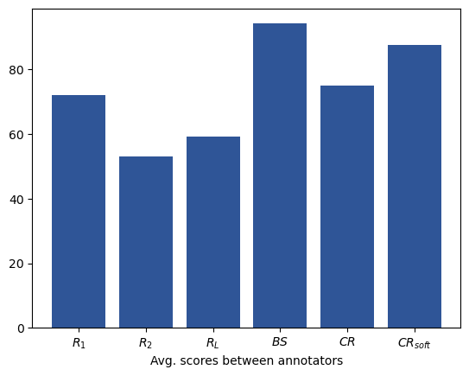
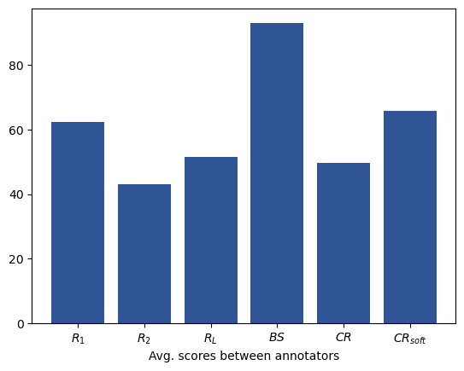
SEAMuS (Summaries of Events Across Multiple Sources)
Statistics
Annotator agreement: report summaries
Annotator agreement: cross-document summaries

Slide 30
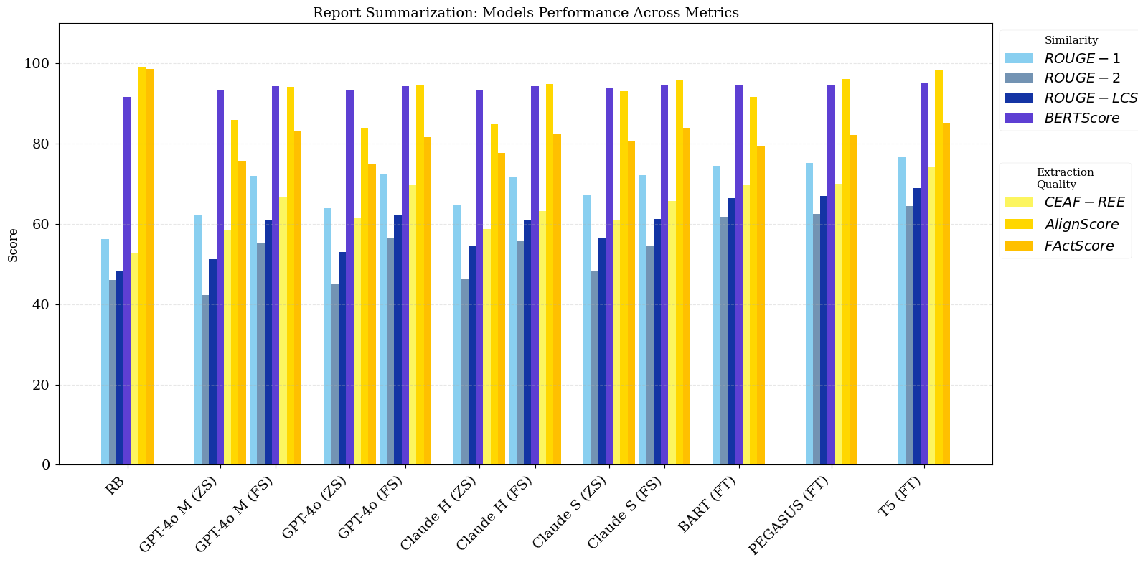
Experiment
Single-document Summarization (report only)

Slide 31
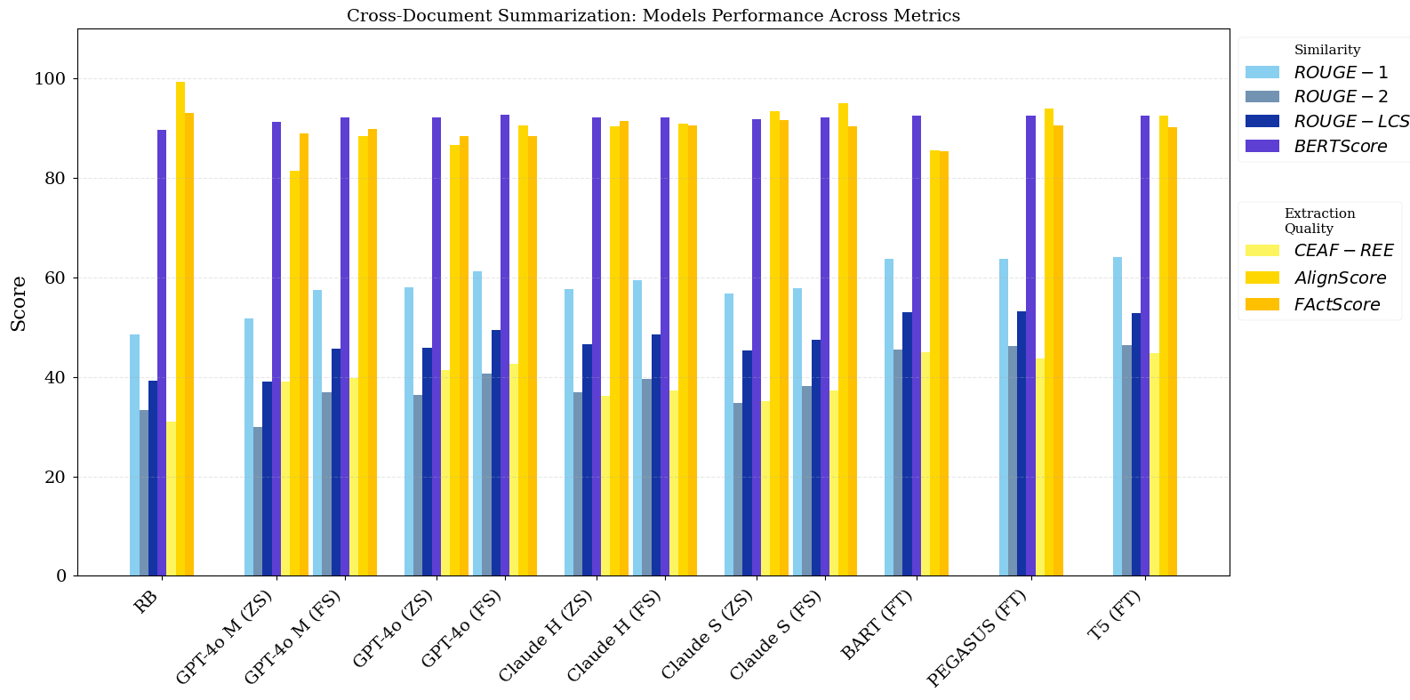
Experiment
Cross-document Summarization (report + source)

Slide 32
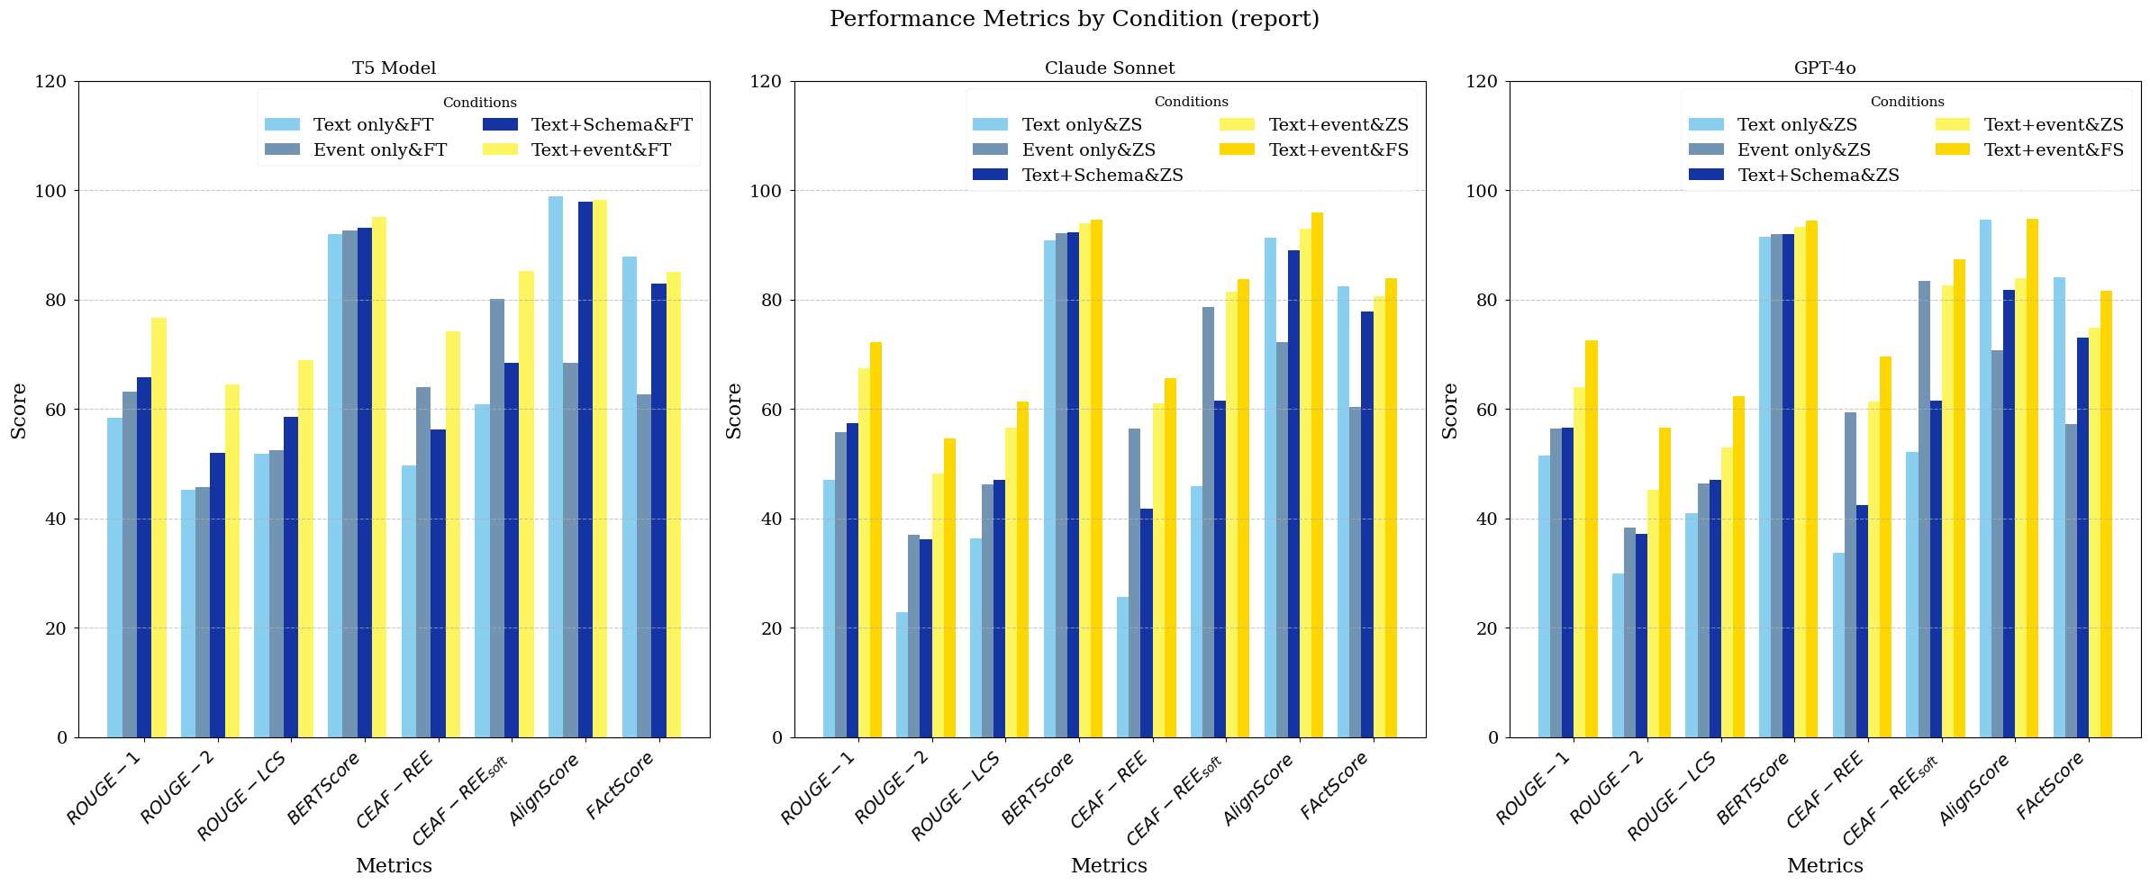
Experiment
Ablation 1:
Text only: only texts
(standard summarization)
Event only: only event argument annotations
(structure-to-text)
Text + Schema: only texts, name of the event per text, and corresponding roles
Text + Event: unablated setting
Unablated inputs produce the best results, which means that EKS cannot be reduced to standard summarization tasks and structure-to-text tasks.

