Slide 1
Dynamic Time Warping Algorithm for measuring similarity in time series
Ali Javed
Department of Computer Science
University of Vermont

Slide 2
Outline of the talk
Why use DTW
Intuitive explanation
Algorithm
For multivariate time series
Code for DTW

Slide 3
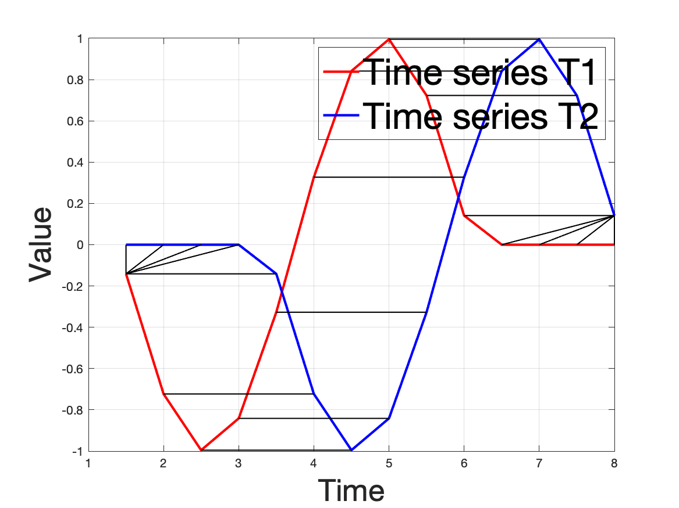
What is dynamic time warping? Why use it?
Time series T2 is lagged 3 time steps.
Can happen easily if the same routine takes place but the person wakes up 3 minutes later.
Similar examples include:
A dog walker going through the same path every day, but at different speeds. We will have a squeezed version of the same time series.
The same dog walker walks at different paces each day.

Slide 4
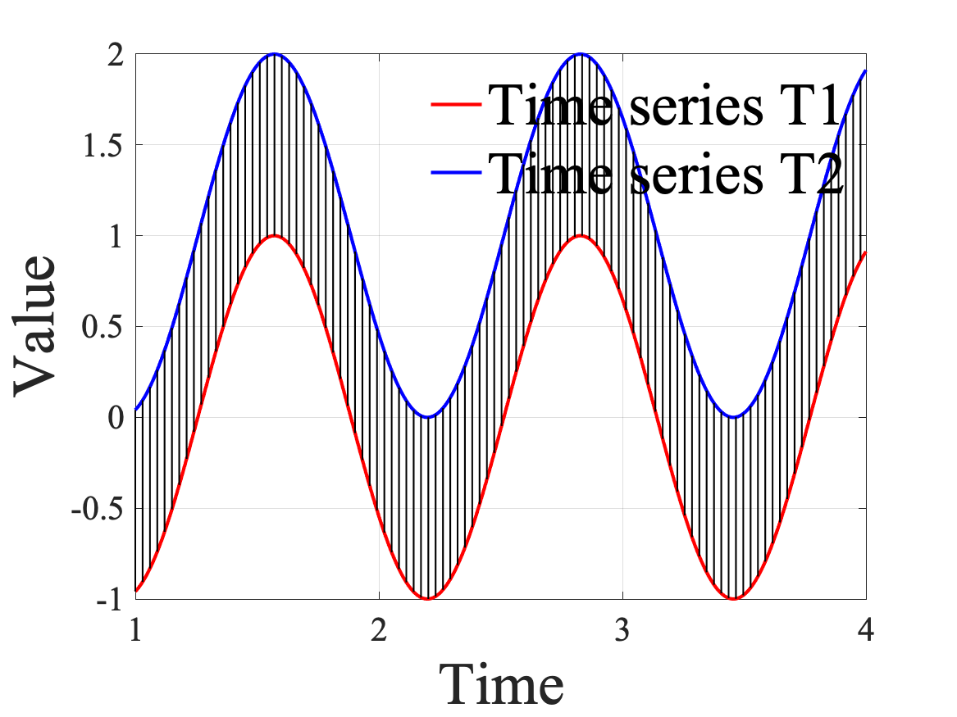
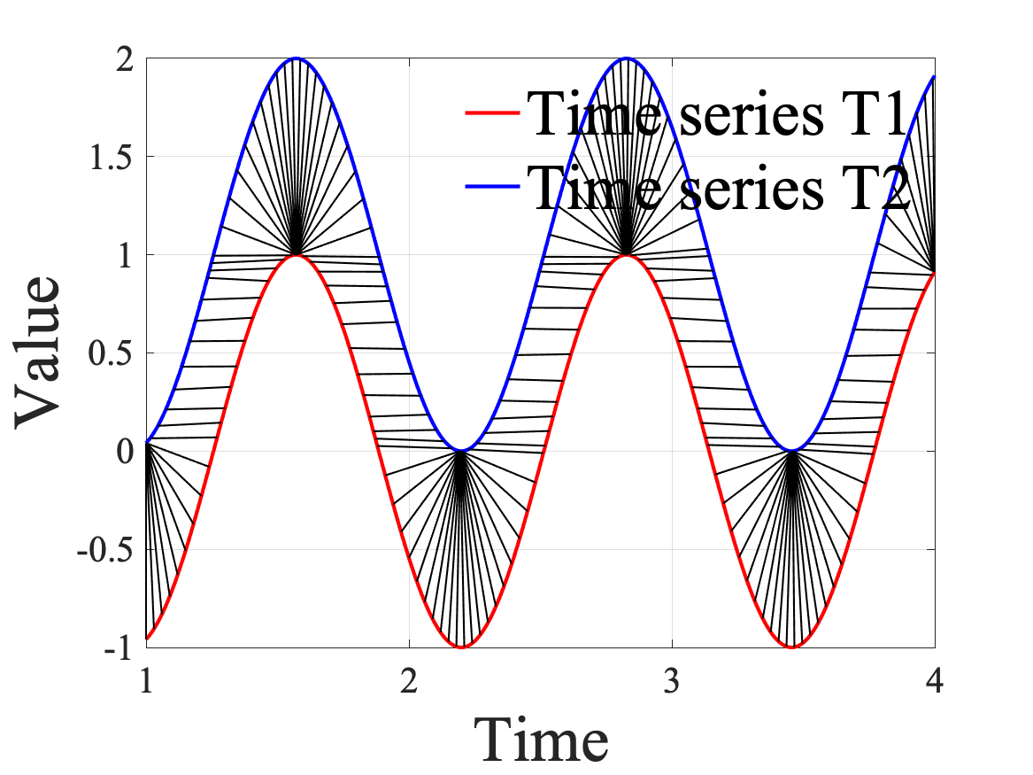
Dynamic time warping vs Euclidean distance
(a) Euclidean
(a) DTW - Euclidean
Illustration depicting the two types of alignment (one-to-many and one-to-one) for calculating distance between two times-series for: (a) Euclidean and (b) Dynamic time warped Euclidean.

Slide 5
Dynamic time warping vs Euclidean distance
Three conditions are followed:
Every point from T1 must be aligned with one or more points from T2, and vice versa.
The first points must align between T1 and T2, and so do the last points between them.
The mapping between points from T1 to T2 must increase monotonically, and vice versa. In other words, no cross-alignment is allowed. (do not go back in time).
Simply put:
While the Euclidean distance metric employs a one-to-one alignment; DTW employs a one-to-many alignment. This one-to-many alignment allows warping the time dimension so as to minimize the distance between the two time series. DTW can optimize alignment, both global alignment (by shifting the entire time series left or right) and local alignment (by stretching or squeezing sections of time series).

Slide 6
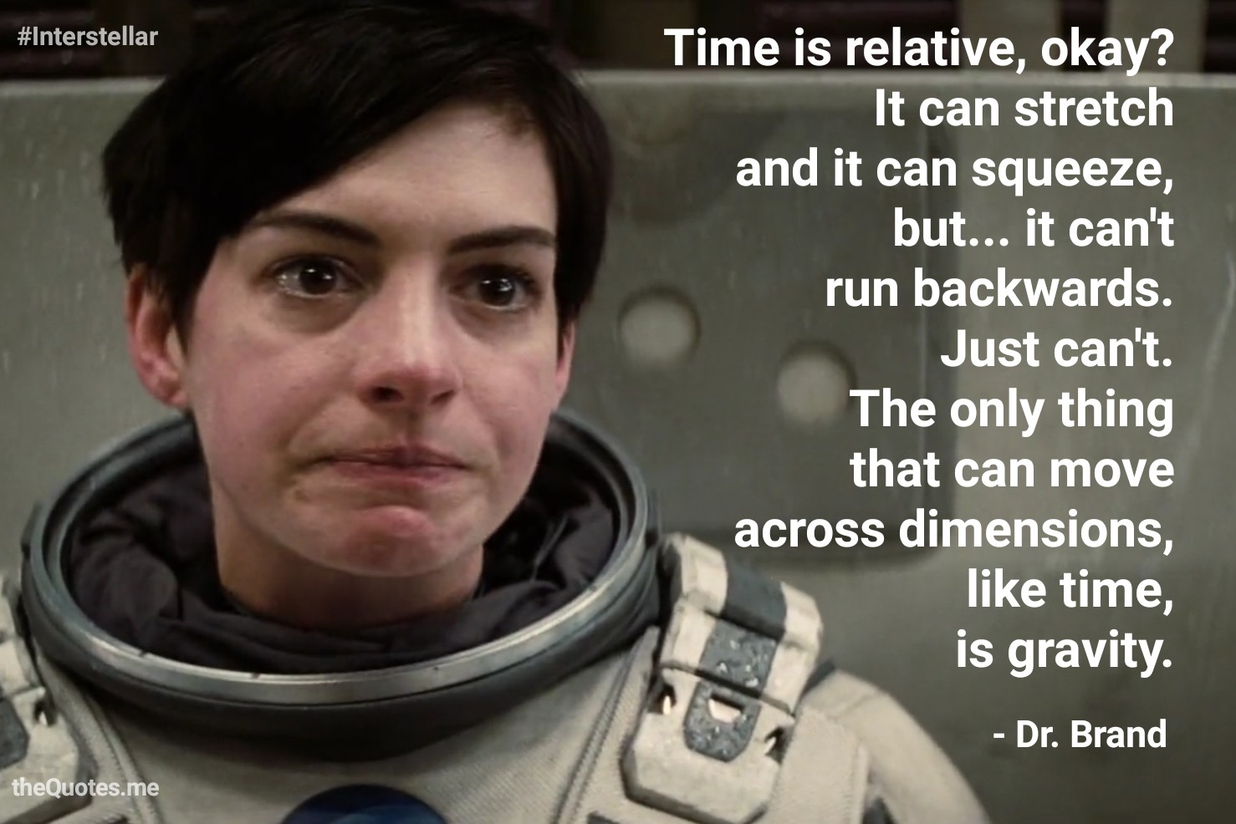
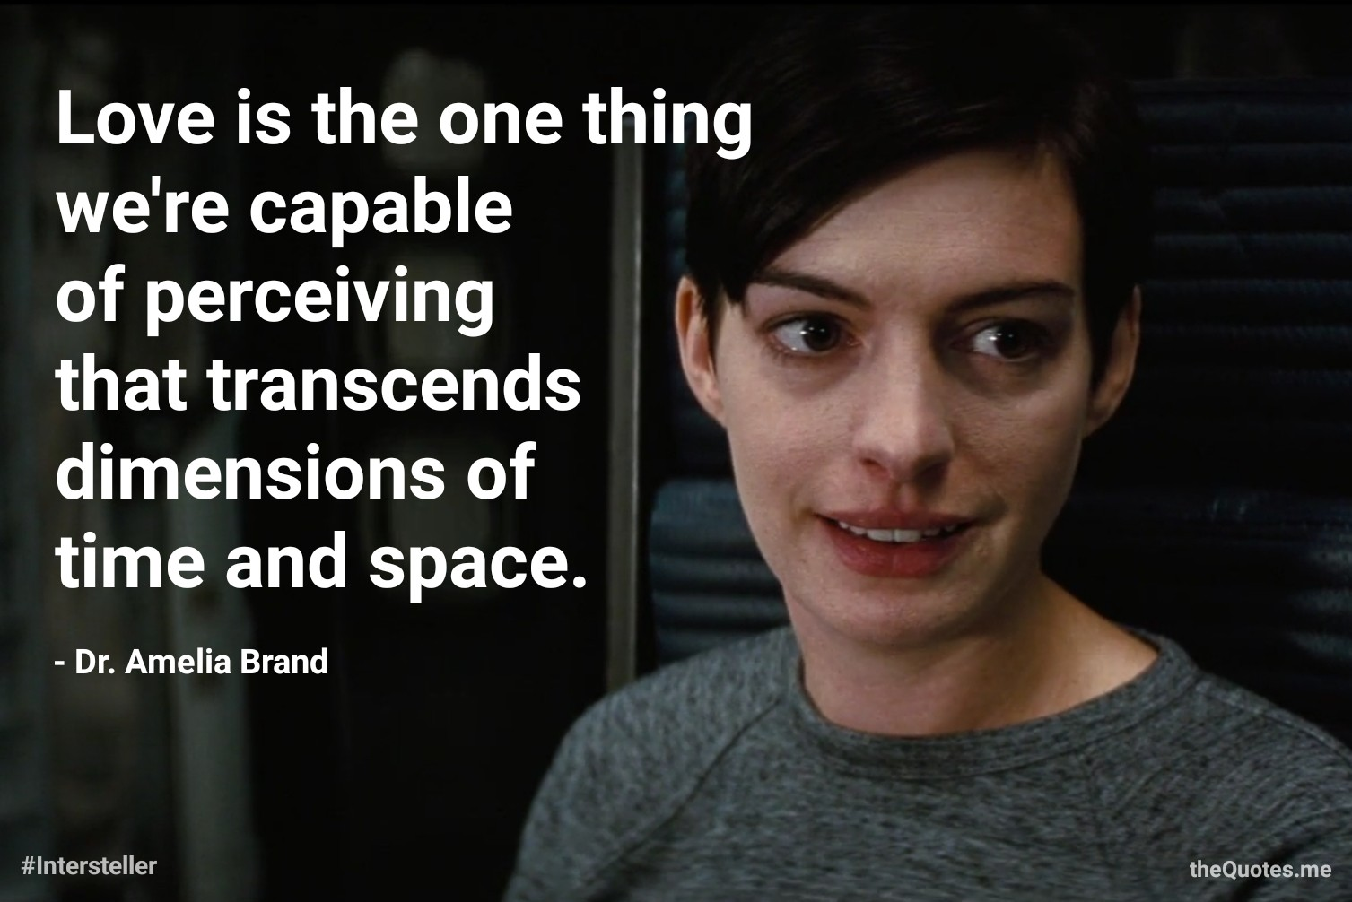
Nobody said it better than Dr. Amelia Brand – Interstellar (2014)
**So, unless your really love your data, do not go backwards in time.
Notes:
https://www.youtube.com/embed/-Y-QLhwSiPs?start=135

Slide 7
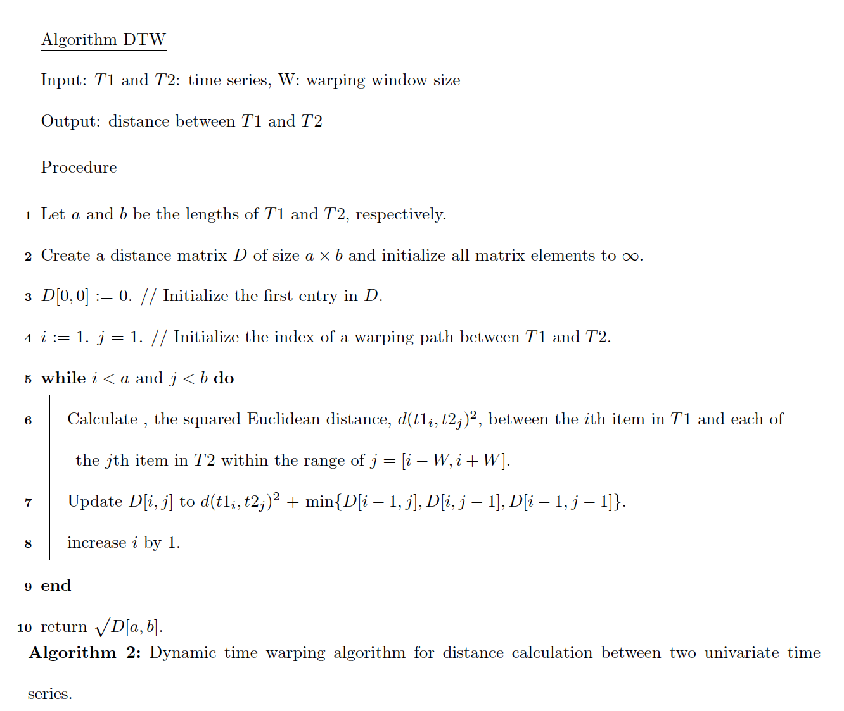
Algorithm

Slide 8
Algorithm
T1 = [1,3,4,4,4,3,6,1]
T2 = [1,1,3,4,4,4,3,6]
a = 8
b = 8

Slide 9
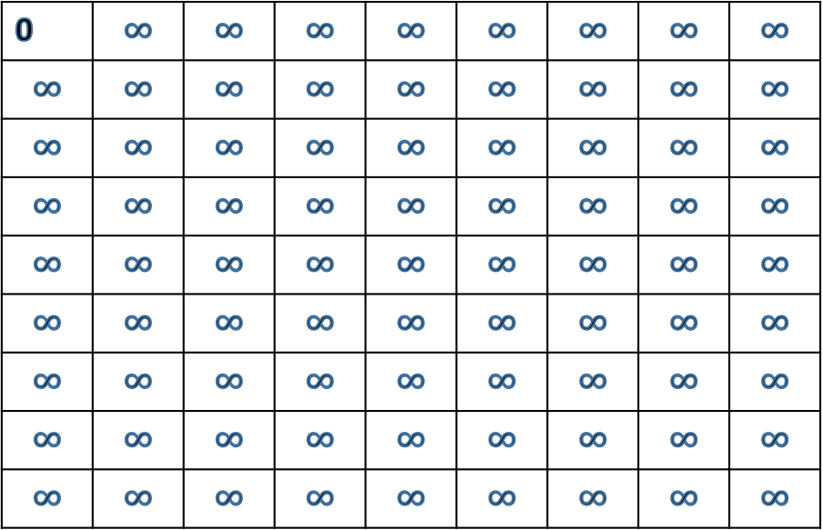
Algorithm
T1 = [1,3,4,4,4,3,6,1]
T2 = [1,1,3,4,4,4,3,6]
a = 8
b = 8
0 | $$∞$$ | $$∞$$ | $$∞$$ | $$∞$$ | $$∞$$ | $$∞$$ | $$∞$$ | $$∞$$
$$∞$$ | $$∞$$ | $$∞$$ | $$∞$$ | $$∞$$ | $$∞$$ | $$∞$$ | $$∞$$ | $$∞$$
$$∞$$ | $$∞$$ | $$∞$$ | $$∞$$ | $$∞$$ | $$∞$$ | $$∞$$ | $$∞$$ | $$∞$$
$$∞$$ | $$∞$$ | $$∞$$ | $$∞$$ | $$∞$$ | $$∞$$ | $$∞$$ | $$∞$$ | $$∞$$
$$∞$$ | $$∞$$ | $$∞$$ | $$∞$$ | $$∞$$ | $$∞$$ | $$∞$$ | $$∞$$ | $$∞$$
$$∞$$ | $$∞$$ | $$∞$$ | $$∞$$ | $$∞$$ | $$∞$$ | $$∞$$ | $$∞$$ | $$∞$$
$$∞$$ | $$∞$$ | $$∞$$ | $$∞$$ | $$∞$$ | $$∞$$ | $$∞$$ | $$∞$$ | $$∞$$
$$∞$$ | $$∞$$ | $$∞$$ | $$∞$$ | $$∞$$ | $$∞$$ | $$∞$$ | $$∞$$ | $$∞$$
$$∞$$ | $$∞$$ | $$∞$$ | $$∞$$ | $$∞$$ | $$∞$$ | $$∞$$ | $$∞$$ | $$∞$$

Slide 10
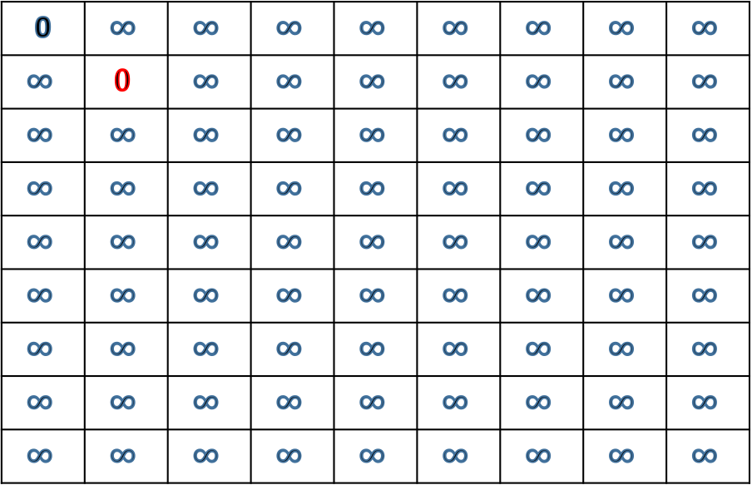
Algorithm
T1 = [1,3,4,4,4,3,6,1]
T2 = [1,1,3,4,4,4,3,6]
a = 8 T1_i = 1
b = 8 T2_j = 1
i = 1
j = 1
Squared Euclidean distance(T2_i, T2_j) = 1
0 | $$∞$$ | $$∞$$ | $$∞$$ | $$∞$$ | $$∞$$ | $$∞$$ | $$∞$$ | $$∞$$
$$∞$$ | $$0$$ | $$∞$$ | $$∞$$ | $$∞$$ | $$∞$$ | $$∞$$ | $$∞$$ | $$∞$$
$$∞$$ | $$∞$$ | $$∞$$ | $$∞$$ | $$∞$$ | $$∞$$ | $$∞$$ | $$∞$$ | $$∞$$
$$∞$$ | $$∞$$ | $$∞$$ | $$∞$$ | $$∞$$ | $$∞$$ | $$∞$$ | $$∞$$ | $$∞$$
$$∞$$ | $$∞$$ | $$∞$$ | $$∞$$ | $$∞$$ | $$∞$$ | $$∞$$ | $$∞$$ | $$∞$$
$$∞$$ | $$∞$$ | $$∞$$ | $$∞$$ | $$∞$$ | $$∞$$ | $$∞$$ | $$∞$$ | $$∞$$
$$∞$$ | $$∞$$ | $$∞$$ | $$∞$$ | $$∞$$ | $$∞$$ | $$∞$$ | $$∞$$ | $$∞$$
$$∞$$ | $$∞$$ | $$∞$$ | $$∞$$ | $$∞$$ | $$∞$$ | $$∞$$ | $$∞$$ | $$∞$$
$$∞$$ | $$∞$$ | $$∞$$ | $$∞$$ | $$∞$$ | $$∞$$ | $$∞$$ | $$∞$$ | $$∞$$

Slide 11
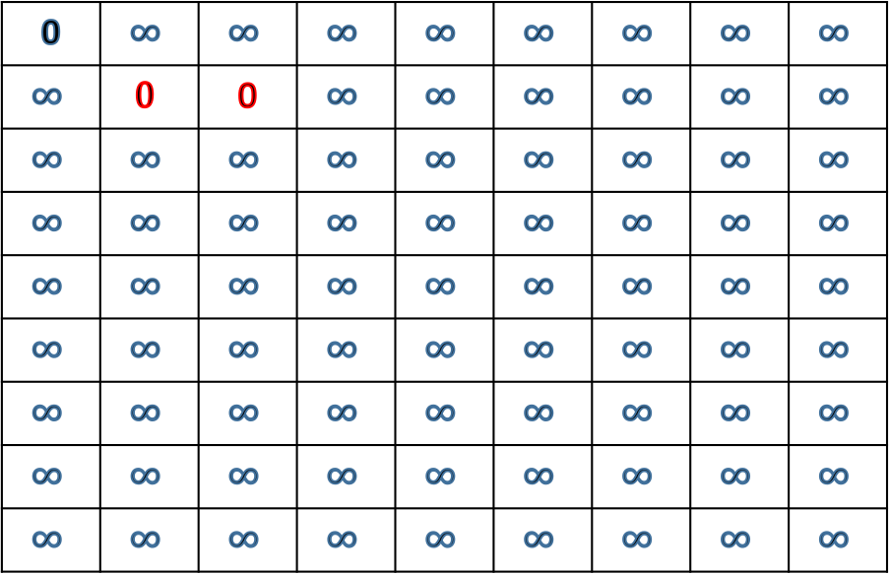
Algorithm
T1 = [1,3,4,4,4,3,6,1]
T2 = [1,1,3,4,4,4,3,6]
a = 8 T1_i = 1
b = 8 T2_j = 1
i = 1
j = 2
Squared Euclidean distance(T2_i, T2_j) = 1
0 | $$∞$$ | $$∞$$ | $$∞$$ | $$∞$$ | $$∞$$ | $$∞$$ | $$∞$$ | $$∞$$
$$∞$$ | $$0$$ | 0 | $$∞$$ | $$∞$$ | $$∞$$ | $$∞$$ | $$∞$$ | $$∞$$
$$∞$$ | $$∞$$ | $$∞$$ | $$∞$$ | $$∞$$ | $$∞$$ | $$∞$$ | $$∞$$ | $$∞$$
$$∞$$ | $$∞$$ | $$∞$$ | $$∞$$ | $$∞$$ | $$∞$$ | $$∞$$ | $$∞$$ | $$∞$$
$$∞$$ | $$∞$$ | $$∞$$ | $$∞$$ | $$∞$$ | $$∞$$ | $$∞$$ | $$∞$$ | $$∞$$
$$∞$$ | $$∞$$ | $$∞$$ | $$∞$$ | $$∞$$ | $$∞$$ | $$∞$$ | $$∞$$ | $$∞$$
$$∞$$ | $$∞$$ | $$∞$$ | $$∞$$ | $$∞$$ | $$∞$$ | $$∞$$ | $$∞$$ | $$∞$$
$$∞$$ | $$∞$$ | $$∞$$ | $$∞$$ | $$∞$$ | $$∞$$ | $$∞$$ | $$∞$$ | $$∞$$
$$∞$$ | $$∞$$ | $$∞$$ | $$∞$$ | $$∞$$ | $$∞$$ | $$∞$$ | $$∞$$ | $$∞$$

Slide 12
Algorithm
T1 = [1,3,4,4,4,3,6,1]
T2 = [1,1,3,4,4,4,3,6]
a = 8 T1_i = 1
b = 8 T2_j = 3
i = 1
j = 2
Squared Euclidean distance(T2_i, T2_j) = 4
0 | $$∞$$ | $$∞$$ | $$∞$$ | $$∞$$ | $$∞$$ | $$∞$$ | $$∞$$ | $$∞$$
$$∞$$ | $$0$$ | 0 | $$∞$$ | $$∞$$ | $$∞$$ | $$∞$$ | $$∞$$ | $$∞$$
$$∞$$ | $$∞$$ | $$∞$$ | $$∞$$ | $$∞$$ | $$∞$$ | $$∞$$ | $$∞$$ | $$∞$$
$$∞$$ | $$∞$$ | $$∞$$ | $$∞$$ | $$∞$$ | $$∞$$ | $$∞$$ | $$∞$$ | $$∞$$
$$∞$$ | $$∞$$ | $$∞$$ | $$∞$$ | $$∞$$ | $$∞$$ | $$∞$$ | $$∞$$ | $$∞$$
$$∞$$ | $$∞$$ | $$∞$$ | $$∞$$ | $$∞$$ | $$∞$$ | $$∞$$ | $$∞$$ | $$∞$$
$$∞$$ | $$∞$$ | $$∞$$ | $$∞$$ | $$∞$$ | $$∞$$ | $$∞$$ | $$∞$$ | $$∞$$
$$∞$$ | $$∞$$ | $$∞$$ | $$∞$$ | $$∞$$ | $$∞$$ | $$∞$$ | $$∞$$ | $$∞$$
$$∞$$ | $$∞$$ | $$∞$$ | $$∞$$ | $$∞$$ | $$∞$$ | $$∞$$ | $$∞$$ | $$∞$$

Slide 13
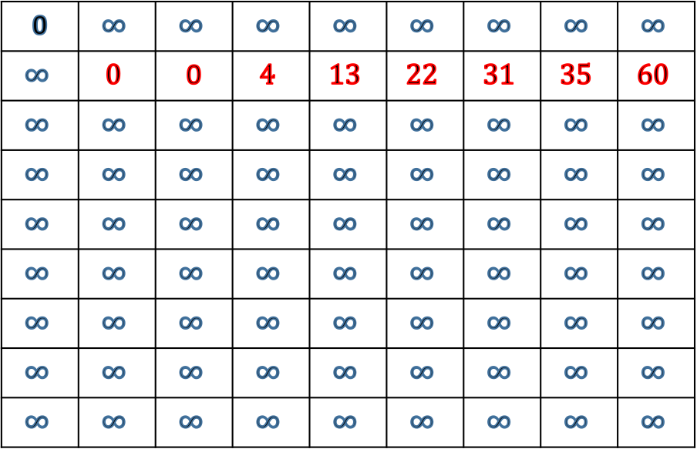
Algorithm
T1 = [1,3,4,4,4,3,6,1]
T2 = [1,1,3,4,4,4,3,6]
a = 8 T1_i = 1
b = 8 T2_j = 1
i = 1
j = 2
Squared Euclidean distance(T2_i, T2_j) = 1
0 | $$∞$$ | $$∞$$ | $$∞$$ | $$∞$$ | $$∞$$ | $$∞$$ | $$∞$$ | $$∞$$
$$∞$$ | $$0$$ | 0 | $$4$$ | $$13$$ | $$22$$ | $$31$$ | $$35$$ | $$60$$
$$∞$$ | $$∞$$ | $$∞$$ | $$∞$$ | $$∞$$ | $$∞$$ | $$∞$$ | $$∞$$ | $$∞$$
$$∞$$ | $$∞$$ | $$∞$$ | $$∞$$ | $$∞$$ | $$∞$$ | $$∞$$ | $$∞$$ | $$∞$$
$$∞$$ | $$∞$$ | $$∞$$ | $$∞$$ | $$∞$$ | $$∞$$ | $$∞$$ | $$∞$$ | $$∞$$
$$∞$$ | $$∞$$ | $$∞$$ | $$∞$$ | $$∞$$ | $$∞$$ | $$∞$$ | $$∞$$ | $$∞$$
$$∞$$ | $$∞$$ | $$∞$$ | $$∞$$ | $$∞$$ | $$∞$$ | $$∞$$ | $$∞$$ | $$∞$$
$$∞$$ | $$∞$$ | $$∞$$ | $$∞$$ | $$∞$$ | $$∞$$ | $$∞$$ | $$∞$$ | $$∞$$
$$∞$$ | $$∞$$ | $$∞$$ | $$∞$$ | $$∞$$ | $$∞$$ | $$∞$$ | $$∞$$ | $$∞$$

Slide 14
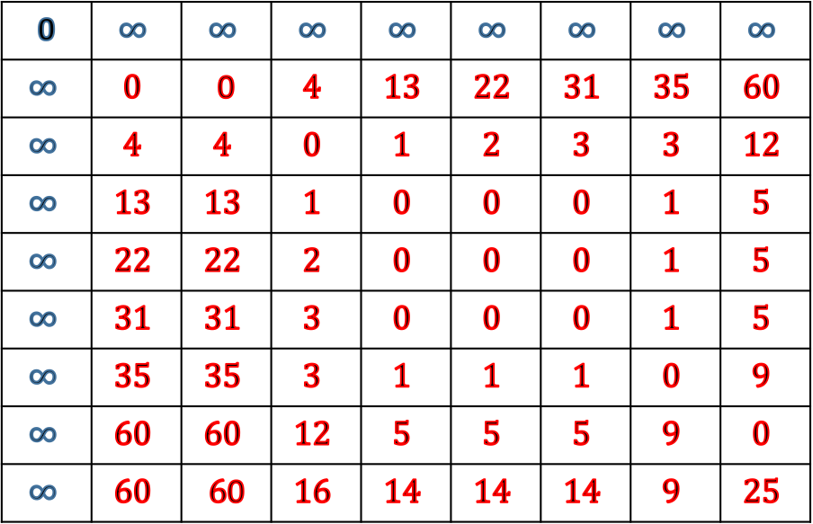
Algorithm
T1 = [1,3,4,4,4,3,6,1]
T2 = [1,1,3,4,4,4,3,6]
a = 8 T1_i = 1
b = 8 T2_j = 1
i = 1
j = 2
Squared Euclidean distance(T2_i, T2_j) = 1
0 | $$∞$$ | $$∞$$ | $$∞$$ | $$∞$$ | $$∞$$ | $$∞$$ | $$∞$$ | $$∞$$
$$∞$$ | $$0$$ | 0 | $$4$$ | $$13$$ | $$22$$ | $$31$$ | $$35$$ | $$60$$
$$∞$$ | $$4$$ | $$4$$ | $$0$$ | $$1$$ | $$2$$ | $$3$$ | $$3$$ | $$12$$
$$∞$$ | $$13$$ | $$13$$ | $$1$$ | $$0$$ | $$0$$ | $$0$$ | $$1$$ | $$5$$
$$∞$$ | $$22$$ | $$22$$ | $$2$$ | $$0$$ | $$0$$ | $$0$$ | $$1$$ | $$5$$
$$∞$$ | $$31$$ | $$31$$ | $$3$$ | $$0$$ | $$0$$ | $$0$$ | $$1$$ | $$5$$
$$∞$$ | $$35$$ | $$35$$ | $$3$$ | $$1$$ | $$1$$ | $$1$$ | $$0$$ | $$9$$
$$∞$$ | $$60$$ | $$60$$ | $$12$$ | $$5$$ | $$5$$ | $$5$$ | $$9$$ | $$0$$
$$∞$$ | $$60$$ | $6$0 | $$16$$ | $$14$$ | $$14$$ | $$14$$ | $$9$$ | $$25$$

Slide 15
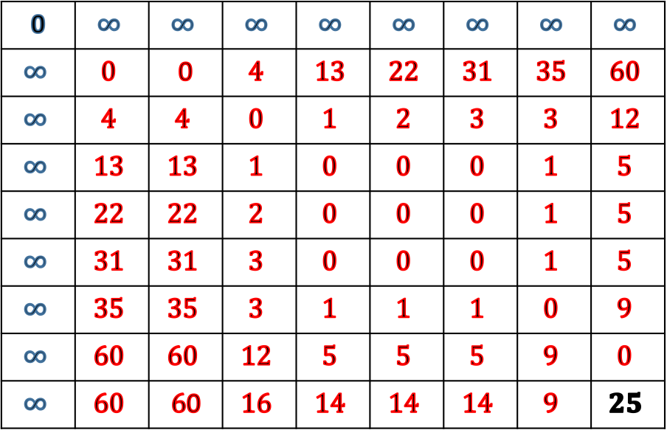
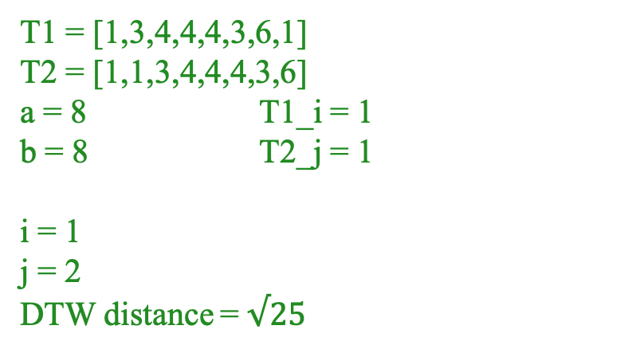
Algorithm
T1 = [1,3,4,4,4,3,6,1]
T2 = [1,1,3,4,4,4,3,6]
a = 8 T1_i = 1
b = 8 T2_j = 1
i = 1
j = 2
DTW distance = $√25$
0 | $$∞$$ | $$∞$$ | $$∞$$ | $$∞$$ | $$∞$$ | $$∞$$ | $$∞$$ | $$∞$$
$$∞$$ | $$0$$ | 0 | $$4$$ | $$13$$ | $$22$$ | $$31$$ | $$35$$ | $$60$$
$$∞$$ | $$4$$ | $$4$$ | $$0$$ | $$1$$ | $$2$$ | $$3$$ | $$3$$ | $$12$$
$$∞$$ | $$13$$ | $$13$$ | $$1$$ | $$0$$ | $$0$$ | $$0$$ | $$1$$ | $$5$$
$$∞$$ | $$22$$ | $$22$$ | $$2$$ | $$0$$ | $$0$$ | $$0$$ | $$1$$ | $$5$$
$$∞$$ | $$31$$ | $$31$$ | $$3$$ | $$0$$ | $$0$$ | $$0$$ | $$1$$ | $$5$$
$$∞$$ | $$35$$ | $$35$$ | $$3$$ | $$1$$ | $$1$$ | $$1$$ | $$0$$ | $$9$$
$$∞$$ | $$60$$ | $$60$$ | $$12$$ | $$5$$ | $$5$$ | $$5$$ | $$9$$ | $$0$$
$$∞$$ | $$60$$ | $6$0 | $$16$$ | $$14$$ | $$14$$ | $$14$$ | $$9$$ | $$25$$

Slide 16
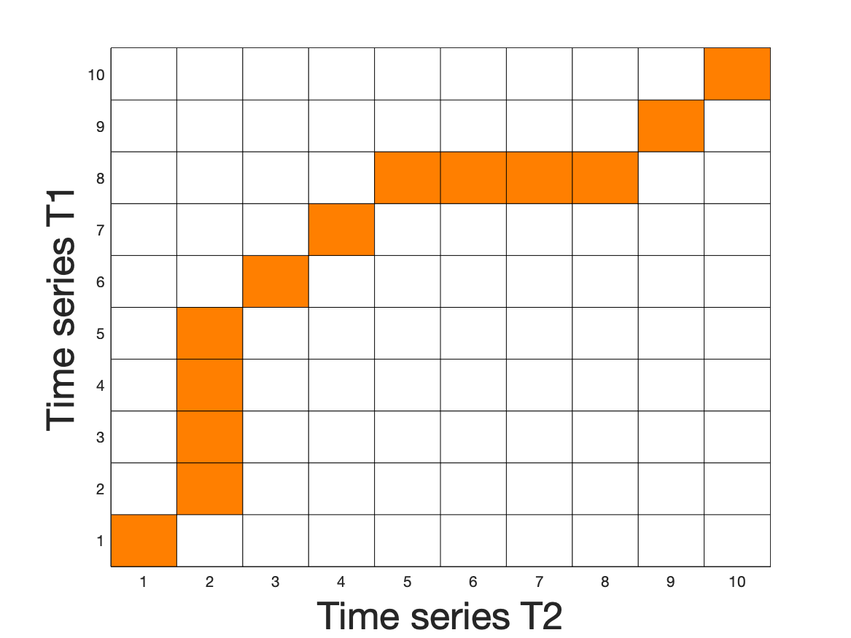
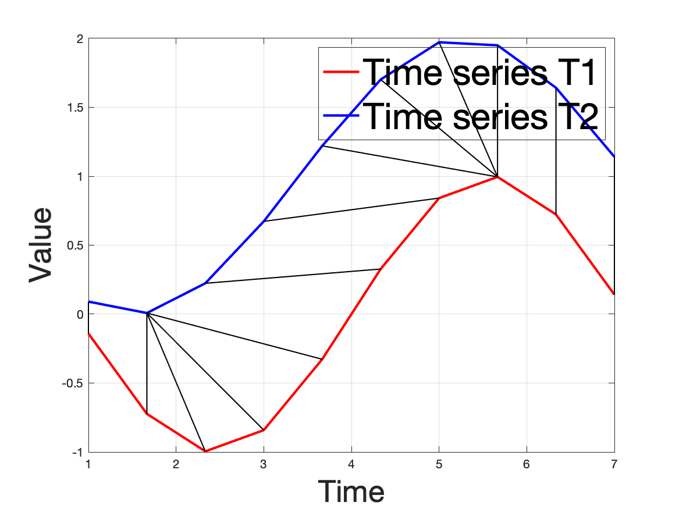
DTW matrix and alignment

Slide 17
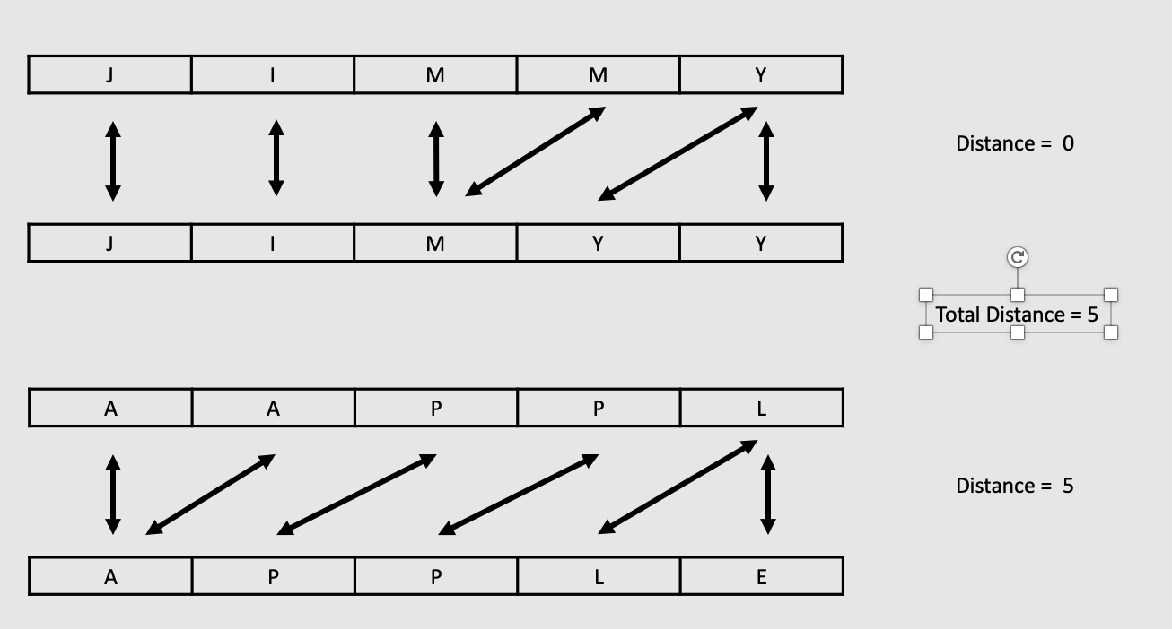
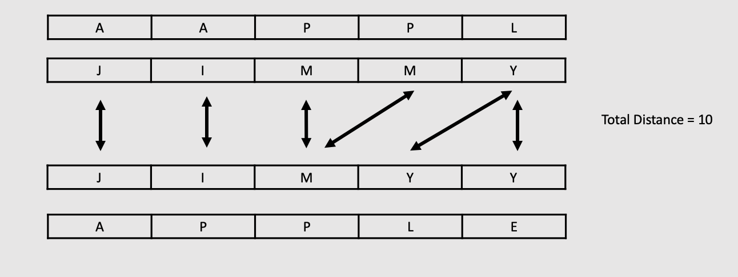
Dynamic time warping for multivariate time series
Functions for multivariate time series are not available as packages in Python Matlab or R.
Two popular options.
DTW – Independent.
Treat each variable independently.
DTW – Dependent.
Use the same alignment for all variable time series.

Slide 18
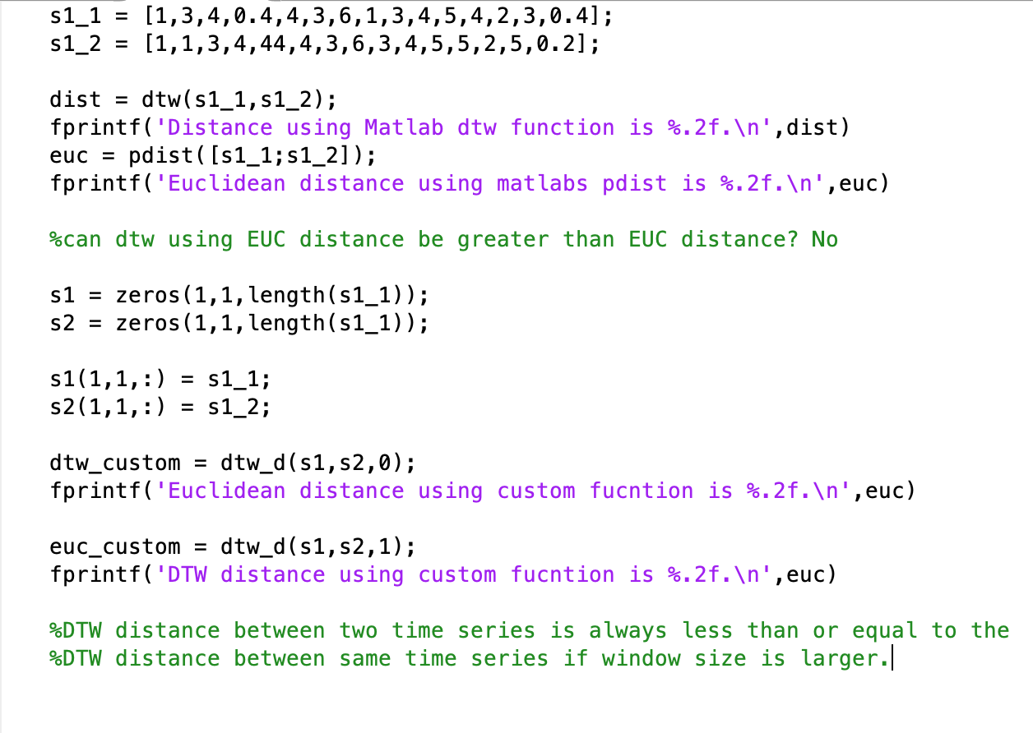
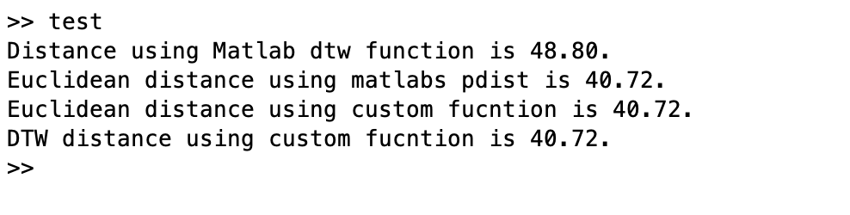
Code for multivariate time series DTW-D
Matlabs dtw does not agree with Euclidean distance

Slide 19
Code for multivariate time series DTW-D
Functions to calculate DTW distances are available on my git-hub. Please note that the default distance function in Matlab does not return same values, and other online codes also return different values. One of the reasons is when the square and square root are taken. As long as you use the same code it will not be a problem.
Basically DTW distance with window size > x is always less than or equal to EUC distance (window size x). This is not true for Matlab DTW function, the values returned by DTW are greater than DTW (0) i.e pdist euclidean function.
Link to git-hub
https://github.com/ali-javed/dynamic-time-warping

Slide 20
Questions?

