Slide 1


Steve Smyth
CityGML SWG Co-Chair
28 October 2025
Urban Digital Twins (UDT)
CityGML SWG - Joint Meeting
The 133rd OGC Member Meeting, Boulder, Colorado USA
Meeting Host
Meeting Sponsor

Slide 2
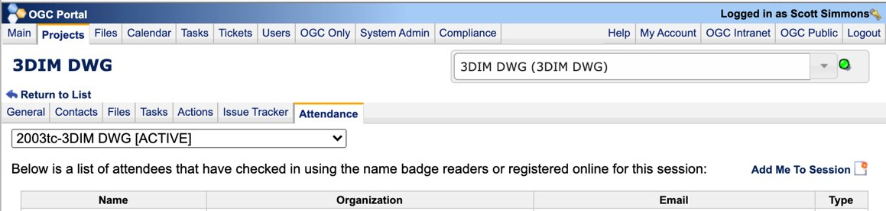
Online Members: please record your attendance
1
2
3
Find the Appropriate Project
Go to the Attendance Tab
Add Yourself to the Session

Slide 3
About these Working Groups
This is a joint meeting of the Urban Digital Twins(UDT) DWG and CityGML SWG. Both groups focus on urban models, UDT from a broad organizational and domain perspective, and CityGML from a narrower city model data format standard point of view.
There are hundreds of millions of real-world buildings and their environments modelled in CityGML.

Slide 4
Agenda
Session Agenda Items
Speaker:
Speaker:
Speaker:
]
Welcome
Tam Belayneh (ESRI): Gaussian Splats [15 minutes]
Steve Smyth: (CityGML SWG) New Combined Monthly CityGML Online Meetings: [5 minutes]
Mei-Ling (Milly) Yeh, (Associate Professor, GIS Research Center, Feng Chia University) Applications of Urban Digital Twins [15 minutes]
Diego Diaz, (Software Engineer, Bentley Systems)BION Material Schema [15 minutes]
Chikako Yasutaka, Yuka Sogawa (Asia Air Survey, MLIT): CityGML to glTF Conversion [15 minutes]
Steve Smyth (CityGML SWG): “Rendering” Hundreds of Millions of CityGML Building Models as GeoLocated and Posed glTF [10 minutes]
Wrapup – Time permitting

Slide 5
The Presentations

Slide 6
Presenters
Tam Belayneh (ESRI): Gaussian splats [15 minutes]
Steve Smyth: (CityGML SWG) New Combined Monthly CityGML Online Meetings: [5 minutes]
Mei-Ling (Milly) Yeh, (Associate Professor, GIS Research Center, Feng Chia University) Applications of Urban Digital Twins [15 minutes]
Diego Diaz, (Distinguished Software Engineer, Bentley Systems)
  BION Material Schema [15 minutes]
Chikako Yasutaka, Yuka Sogawa (Asia Air Survey, MLIT): CityGML to glTF Conversion [15 minutes]
Steve Smyth (CityGML SWG): Rendering Millions of CityGML Building Models as glTF [10 minutes]

Slide 7
New Combined Monthly CityGML Online Meetings
  A standard that is not actively maintained will (and should) not be used.
  Meeting topics
    CityGML 3 Maintenance and Support
    3DCityGB and CityGML4J
    CityRDF
    CityGML SWG participation in creating a standard profile
  Meeting schedule – Meetings duplicated in two recorded sessions
    First Thursday each month
    Meeting A at 15:00 UTC+9/06:00 UTC
    Meeting B at 15:00 UTC+1/14:00 UTC
    First meeting 6 November 2025

Slide 8
Wrapup
  Questions or comments for the presenters?
  Thank you for joining us!

Slide 9

THANK YOU
www.ogc.org

Slide 10
Backup slides
Chairs: please write a series of bullets to describe what your Working Group does – this should be presented at the beginning of each session
No need to be comprehensive or spend more than a few minutes, consider what you want new attendees to learn

Slide 11
Template for WG Action Motion
The <DWG or SWG name> approves <an action>.
  Motion: <Name of person making the motion>
  Second: <name of the person seconding the motion>
  Discussion:
If there is a hand vote, the results of the vote. Otherwise, the phrase <There was no objection to unanimous consent> should be used

Slide 12
Template for Chair Election
The <DWG or SWG name> approves the following individuals as Chairs of this Working Group.
<list of names and affiliations>
  Motion: <Name of person making the motion>
  Second: <name of the person seconding the motion>
  Discussion:
If there is a hand vote, the results of the vote. Otherwise, the phrase <There was no objection to unanimous consent> should be used

Slide 13
Template for TC Document Approval Motion
The <DWG or SWG name> recommends that the OGC Technical Committee approve release of [OGC Document Number] “<OGC Document Name>” as an OGC <White Paper/Discussion Paper/ Engineering Report>.
  Pending any final edits and review by OGC staff
  <Any Discussion Points that the TC needs to be aware of>
  Motion: <Name of person making the motion>
  Second: <name of the person seconding the motion>
  Discussion:
If there is a hand vote, the results of the vote. Otherwise, the phrase <There was no objection to unanimous consent> should be used
Short abstract of the document shall go here

Slide 14
Template to Request a TC Electronic Vote
The <DWG or SWG name> recommends that the OGC Technical Committee approve an electronic vote to approve release of <OGC Document Number> “<OGC Document Name>” as an OGC <Best Practice/Standard>.
  Pending any final edits and review by OGC staff
  <Any Discussion Points that the TC needs to be aware of>
  Motion: <Name of person making the motion>
  Second: <name of the person seconding the motion>
  Discussion:
If there is a hand vote, the results of the vote. Otherwise, the phrase <There was no objection to unanimous consent> should be used

