Slide 1

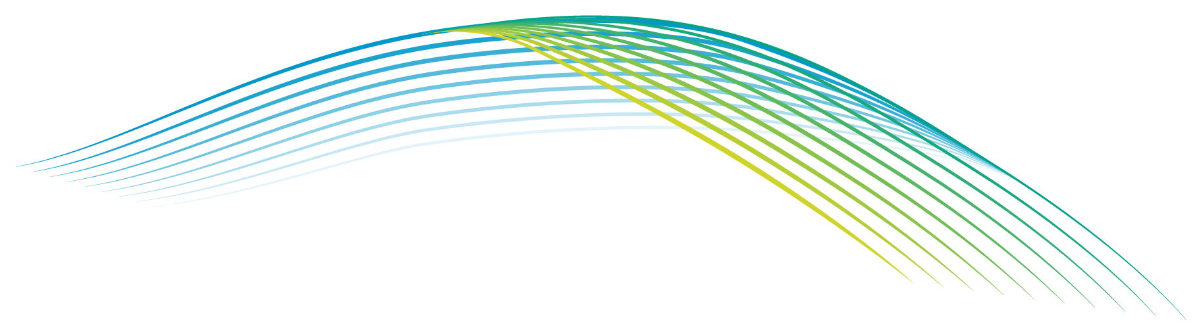
Steve Smyth
CityGML SWG
27 October 2025
A Khronos glTF 2 Extension:
(Geo)Locate, Orient, Bound

Slide 2
Extension to Locate, Orient, and Bound glTF
Khronos glTF lives in its own space.
GeoPose links the space to the planet.
That’s the extension.

Slide 3
Khronos glTF 2 Extension Proposal from OGC: EXT_geolocate_orient_bound
Description
    An Extension to Support GeoSpatial Content in a glTF Scene.
Contributors
  Christine Perey, PEREY Research & Consulting, cperey@perey.com
  Steve Smyth, co-Chair OGC GeoPose SWG, steve@opensiteplan.org
  Jeremy Morley, University College London, ucfsjmg@ucl.ac.uk
  Josh Lieberman, Tumbling Walls, jlieberman@tumblingwalls.com>
Status
Khonos “Idea” = Draft
Dependencies
    Written against the Khronos glTF 2.0 specification and the Open Geospatial Consortium (OGC) GeoPose 1.0 standard.

Slide 4
Overview
Summary
    The proposed extension geolocates, orients, and bounds a glTF Scene in space and time.
Geolocates
    The extension links the "floating" 3D origin of the glTF coordinate system to a position in geographically located three-dimensional space. The extension also identifies the proper time, measured by a clock at the origin, and well-defined even with very high velocities between unaccelerated reference frames.
Orients
    The extension provides the 3D rotational relationship between that 3D Cartesian coordinate system and coordinates in an East(X), North(Y), Up(Z) plane tangent to the earth at the origin, using a JSON-encoded Basic-YPR OGC GeoPose v1.0.
Bounds
    The extension specifies spatial bounds as a maximum distance in meters from the origin of the glTF coordinate system. This defines the valid extent of a model. It may represent a real-world property such as a cell-tower service radius or a collision volume.

Slide 5
Details
Use cases
    Publication of CityGML models in glTF 2.
    Preloading of visual perception systems.
    Exchange of visual perception fragments from vehicle mounted mobile platfforms.
    Archive of geolocated surveillance video, including video with WebVMT tracks.
glTF Schema Updates
    EXT_geolocate_orient_bound is implemented as a JSON object carrying the bounds, orientation, and geolocation parameters of a scenegraph. It becomes an additional property of a glTF Scene object. If a glTF model contains multiple Scenes, it may contain multiple OGC_geolocate_orient_bound properties. A Scene shall **not** have more than one OGC_geolocate_orient_bound property.
JSON Schema
JSON Schema
Known Implementations
GeoPoseIt service under development.
glTF example here.
<img src="2025-10-02-224001.png" alt="hfb" width="200">

Slide 6
A Cruss-SWG Application of the Extension
Convert (“render”) hundreds of million CityGML buildings to glTF.
  Immediately makes the individual buildings integrable into custom-made models.
  Automated annotation of ML training imagery.
Questions/comments?
Thank you.

Slide 7


THANK YOU
www.ogc.org
https://metaverse-standards.org/

