Slide 2

Classification
Classification is a type of supervised learning which specifies the class to which element belongs to and also tries to predict the output variable.

Slide 3
Use Cases: some areas where classification is frequently used are:
Spam Email Detection: classification can be applied in this area in order to determine which emails are spam or ham.
Identify Customer Segment
Loan Approval
Employees or Customers Churn
Identify if a kid will pass or fail an examination.
The list is in fact endless.
Now lets take a look at the types of classification.

Slide 4
Types of Classification
We have two main type of Classification Model, we have the linear classification model, and the non-linear classification model.
Each of these models contains different algorithms.
Linear Model: this model consists of Logistic regression and Support vector machine
Non-Linear Model: this contains algorithms like K-nearest neighbor, Random Forest, Decision Tree,..
So let’s get started to see how we can build our own classification models.
We are going to break our analysis into steps based on the data science workflow. So let’s get started.

Slide 5
Step 1: Start with a question/problem
CASE STUDY: YAKUB TRADING GROUP - ALGORITHMIC STAFF PROMOTION Abdullah’s Baba Yakub, 38, is the heir apparent to the highly revered Yakub business dynasty. The enterprise has spanned decades with vast investment interest in all the various sectors of the economy.
Abdullah has worked for 16 years in Europe and America after his first and second degrees at Harvard University where he studied Engineering and Business Management. He is a very experienced technocrat and a global business leader who rose through the rank to become a Senior Vice President at a leading US business conglomerate. His dad is now 70 and has invited him to take over the company with a mandate to take it to the next level of growth as a sustainable legacy. Abdullah is trusted by his father and his siblings to lead this mandate.
On resumption, he had an open house with the staff to share his vision and to listen to them on how to take the business to the next level.

Slide 6
Beyond the general operational issues and increasing need for regulatory compliance, one of the issues raised by the staff was a general concern on the process of staff promotion. Many of the staff allege that it is skewed and biased. Abdullah understood the concern and promised to address it in a most scientific way.
You have been called in by Abdullah to use your machine learning skills to study the pattern of promotion. With this insight, he can understand the important features among available features that can be used to predict promotion eligibility.

Slide 7
Step 2: Getting and Cleaning the data
The dataset contains these variables as explained below:
• EmployeeNo : System-generated unique staff ID
• Division: Operational department where each employee works
• Qualification: Highest qualification received by the staff
• Gender: Male or Female
• ChannelofRecruitment: How the staff was recruited – this is via internal process, use of an agent or special referral
• Trainings_Attended : Unique paid and unpaid trainings attended by each staff in the previous business cycle
Yearofbirth: Year that the employee was born
• LastPerformanceScore Previous year overall performance HR score and rated on a scale of 0-14

Slide 8
Yearofrecruitment : The year that each staff was recruited into the company
• Targets_met: A measure of employees who meet the annual set target. If met, the staff scores 1 but if not, it is a 0.
• Previous_Award : An indicator of previous award won. If yes, it is a 1 and if No it is a 0.
• Trainingscoreaverage: Feedback score on training attended based on evaluation
• StateOfOrigin: The state that the employee claims
• Foreign_schooled: An indicator of staff who had any of their post-secondary education outside the country. Responses are in Yes or No
• Marital_Status: Marriage status of employees and recorded as Yes or No
• PastDisciplinaryAction : An indicator if a staff has been summoned to a disciplinary panel in the past. This is indicated as Yes or No
• PreviousIntraDepartmentalMovement : This is an indicator to identify staff who have moved between departments in the past. Yes and No are the responses.
• Noofprevious_employers : A list of the number of companies that an employee worked with before joining the organization.

Slide 9
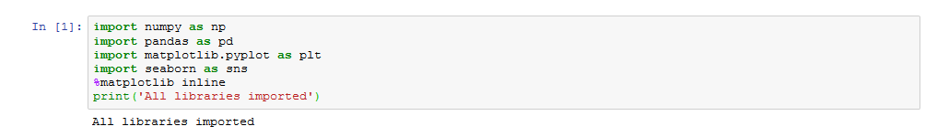
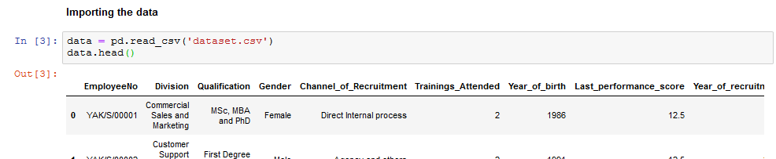
Having seen the problem we want to solve and the data we are going to use to solve the problem. Let’s proceed to our jupyter notebook and import our libraries and data.
We are going to add one more library to the one’s you already know, the new library is call ‘seaborn’ and it is an advanced visualization library which you will come to see.

Slide 10
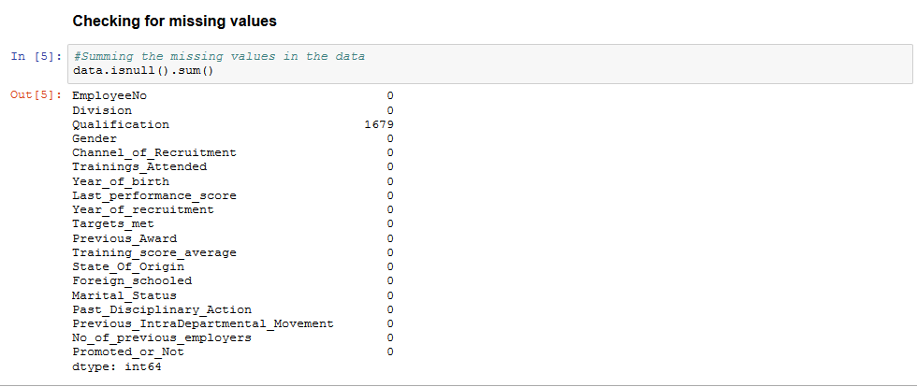
Step 3: Exploratory data analysis
Here, we are going to clean our data, visualize them and select important features from the data.
Checking for missing values

Slide 11
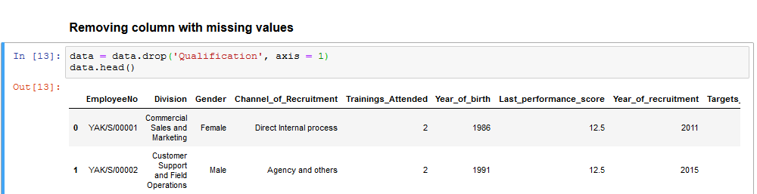
We see that only the qualification column contains some missing values, so it’ll be convenient for us to remove the column entirely. To achieve that, we make use of the ‘drop()’ method.
Next, we can make some basic plot. In order to get some nice looking plots, we can customize our default plotting parameter (Note: it is optional, you can decide not to and still have good plots). Simply copy and run the code on the next slide and don’t worry about the coding.

Slide 12
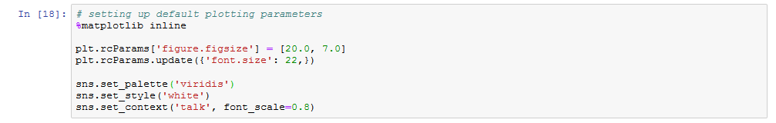
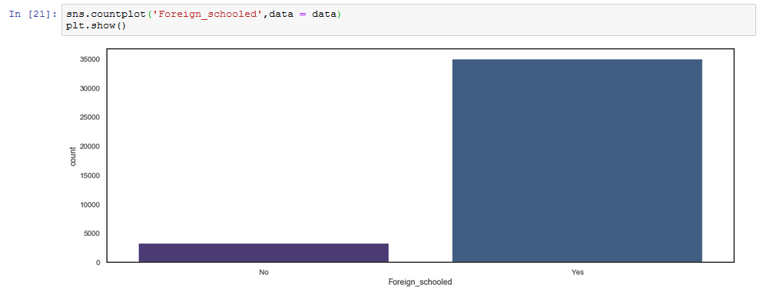
We can make a countplot to see how many staffs are foreign trained, and how many are not.

Slide 13
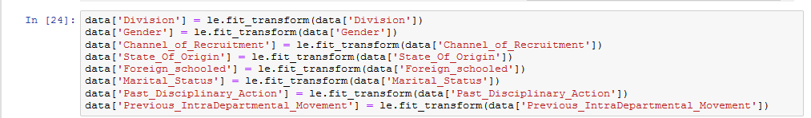
Data Preprocessing: looking at our data, we can see that some of the columns are not numbers, so we have to convert them to numbers so that our machine learning algorithms can work with them. The process of converting categorical variables into numeric is called encoding.
And to achieve that here, we have to import the ‘LabelEncoder’ function from ‘’preprocessing’ in ‘sklearn’ library.
After importing the function, we use the ‘fit_transform()’ to convert the columns.

Slide 14
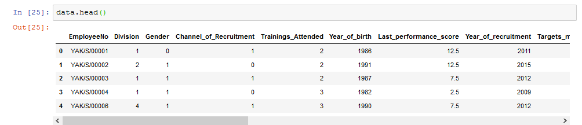
Great, we have successfully converted our columns into usable ones. Next, we see some of the columns that will be important for our model, so that we won’t have bias in our data.

Slide 15
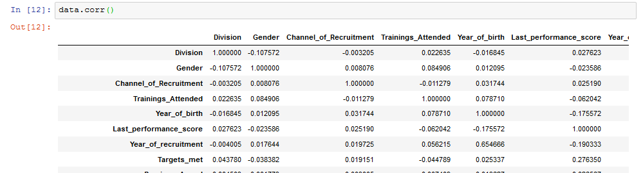
Feature Selections: there are many ways to do feature selections, but we are going to focus on the basics yet powerful method which is ‘correlation’.
To get correlations, we simply use the ‘corr()’ method.
From the table, we can see the relationships between each of the variable. We can do a plot for the correlation using ‘heatmap()’ function in seaborn.

Slide 16
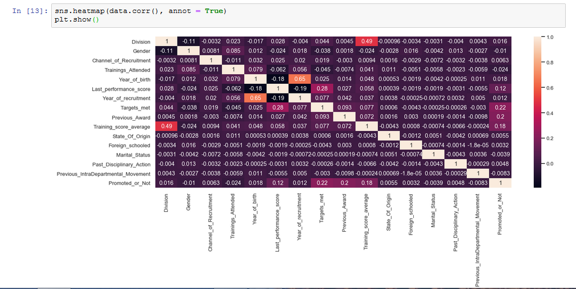
We can study the plot and table and see what variables correlates well with our target variable which is ‘Promoted_or_Not’ . Or better still write a code to list them for us.

Slide 17
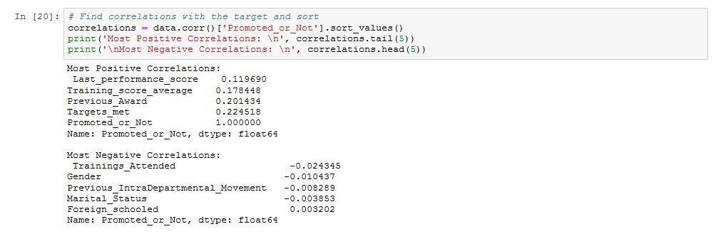
Now we have a list of variables that best affects our target variable, so we can simply start building our models with them. So next, we separate our data into dependent and independent variables.

Slide 18
Separating our data into dependent and independent variables.
After doing that, just like last week we split our data into training and testing sets. With 25% going to the test set.
After splitting our data into training and testing sets, we can now move on to the next step to start building our models.

Slide 19
Step 4: Building our models (Applying Techniques)
We are going to be building different models with different machine learning algorithms, and them comparing them to see which one works best. We are going to be building our models with the following algorithms.
Decision Trees Classifier
Logistic Regression
Random Forest Classifier
Support Vector Machine
Gradient Boosting Classifier

Slide 20
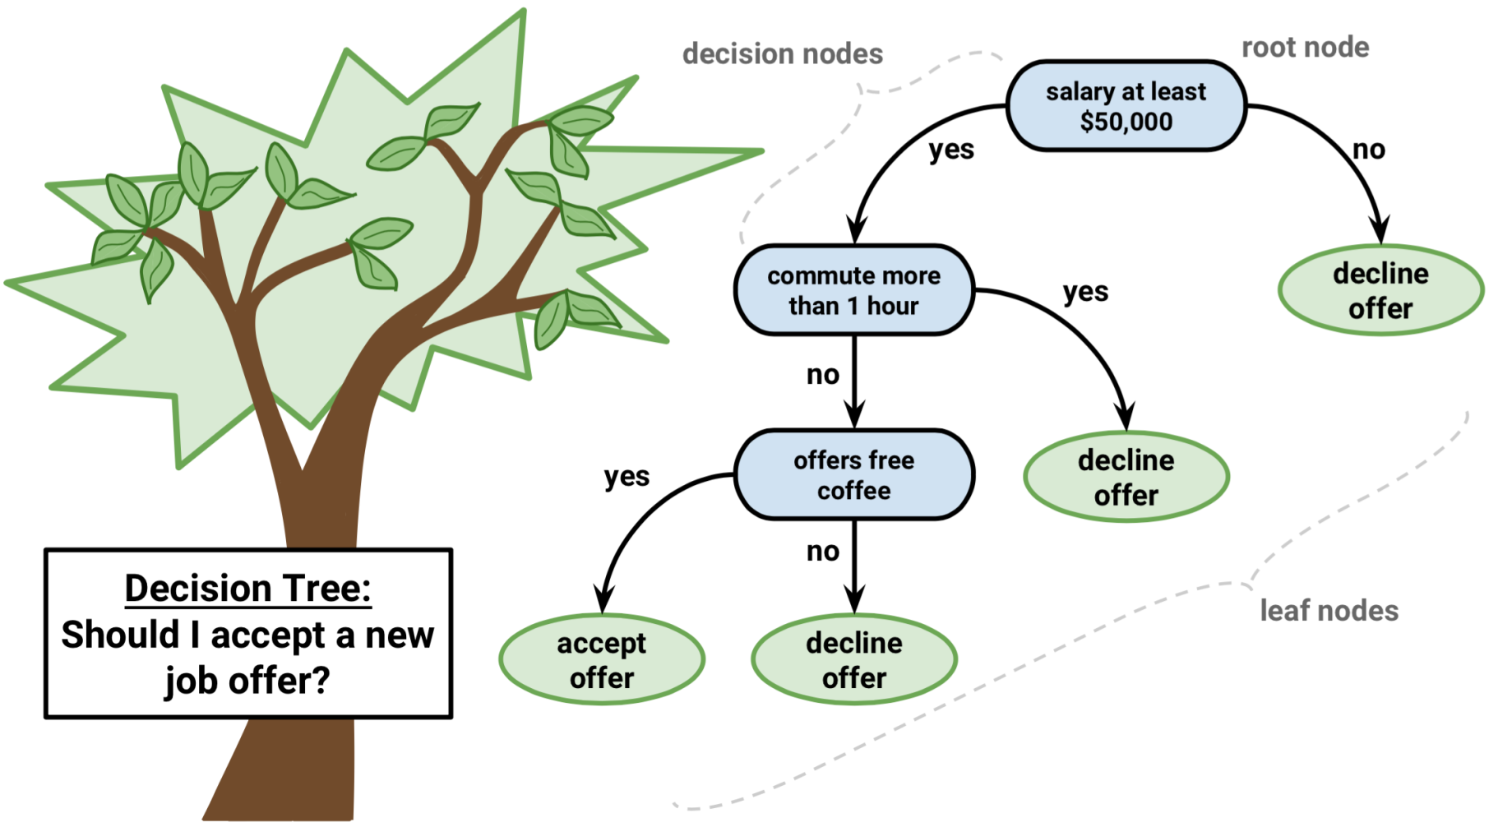
Decision Tree Algorithm
The decision tree algorithm is a type of non-linear classification model, where data points pass through a tree-like process in order to predict an output variable.

Slide 21
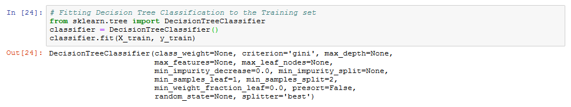
Now lets proceed to see how we can implement the decision tree classifier in python.
Just like we did last week when we looked at regression, make use of our powerful ‘sklearn’ library. After fitting our model, we can now make predictions.
Finally, we can see how well our model did by calculating the accuracy.

Slide 22
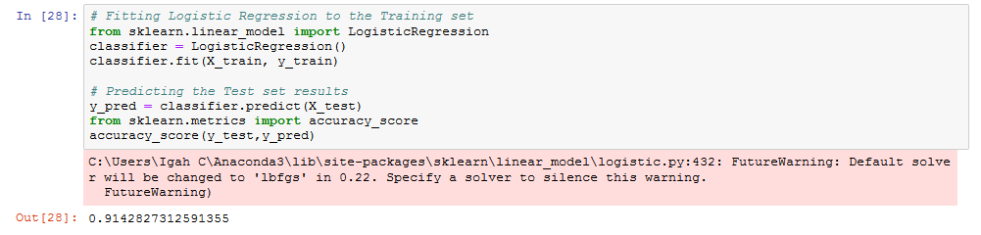
Awesome, so we can see that the model we build using decision tree classifier has 92% accuracy, which is good.
Logistic Regression model
We perform similar steps to build the model for logistics regression.
Our logistics regression model got 91% accuracy, which is less than that of decision trees.

Slide 23
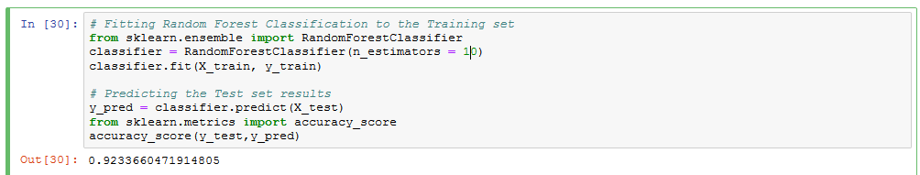
Random Forest Classifier Model
Same as the others, we only need to import the algorithm from our library and repeat the same process.
Our Random forest model performed slightly better than the decision trees library

Slide 24
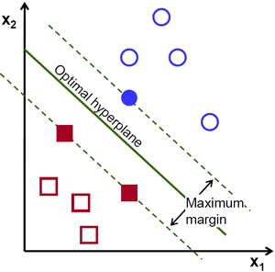
Support Vector Machine
The support vector machine is arguably one of the most popular and powerful classification algorithm today, the primary idea behind support vector machine is to find a hyperplane in an N-dimensional space(N — the number of features) that distinctly classifies the data points.

Slide 25
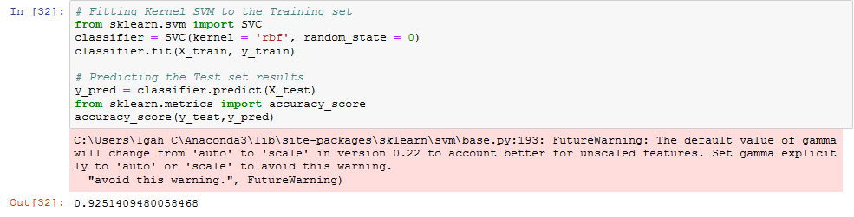
To implement these in code follows the same process as the other algorithms. So we leave everything the same, and focus on just building the model.
So we simply continue by importing the algorithmic function for the support vector machine.
Fit the model, and make predictions.
So far our SVM model has the best accuracy score, but this is not always the case.

Slide 26
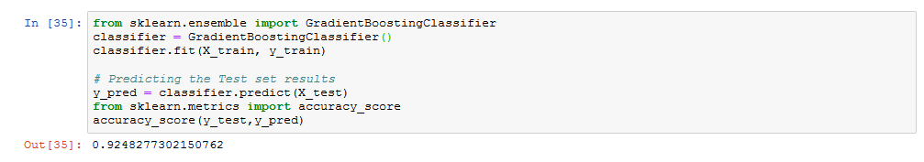
Gradient Boosting algorithm
Finally, we follow the same step to build our GB classifier
Step 5: Share Insight
Based on our analysis so far, we can present YAKUB TRADING GROUP our SVM model which is capable of predicting the employees in the company that is likely to be promoted with over 92% accuracy based on the following variables.
Training_score_average, Last_performance_score, Previous_Award, Targets_met .
Good Luck on your Hackathon.

