Slide 1

HAI Course Project Presentation
Your Project Name
Authors
Date
AI Thrust
HKUST (GZ)

Slide 2
Table of Contents
1
Section Name 1
2
Section Name 2
1/8

Slide 3
Section Name 1
Title
❒
item
❒
item
2/8

Slide 4
Section Name 2
Title
❒
item
❒
item
❒
item
❒
item
❒
item
3/8

Slide 5
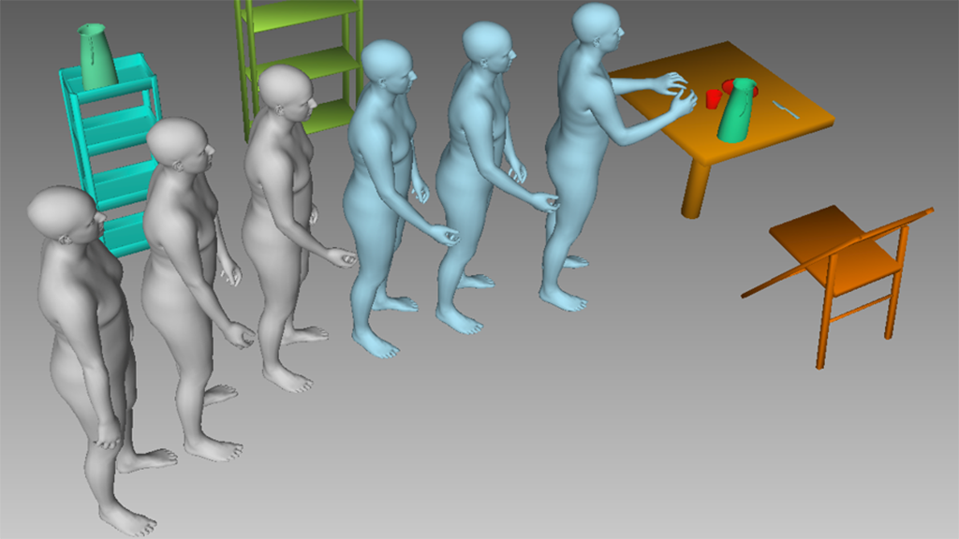
Section Name 2
Title
Test Image
[Hu TVCG(2024)]
4/8

Slide 6
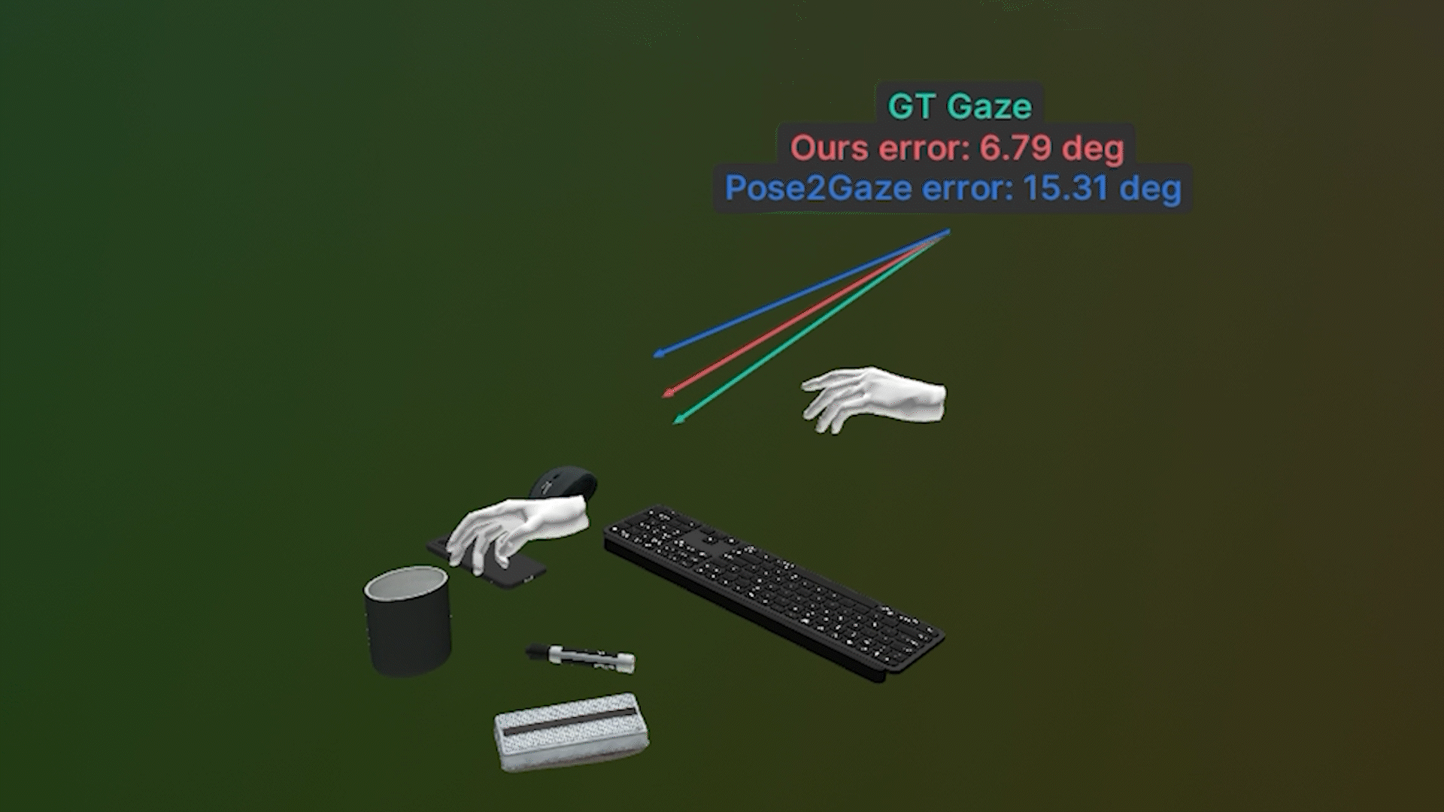
Section Name 2
Title
Test Image 1
Test Image 2
[Hu TVCG(2024)]
[Hu SIGGRAPH(2025)]
5/8

Slide 7
Conclusion
Conclusion 1
Conclusion 2
Conclusion 3
1
item
1
item
1
item
2
item
2
item
2
item
3
item
3
item
3
item
6/8

Slide 8
Thank you!
Any questions?
7/8

Slide 9
References I
Hu SIGGRAPH.
Hoigaze: Gaze estimation during hand-object interactions in extended reality exploiting eye-hand-head coordination.
In Proceedings of the 2025 ACM Special Interest Group on Computer Graphics and Interactive Techniques, 2025.
Hu TVCG.
Hoimotion: Forecasting human motion during human-object interactions using egocentric 3d object bounding boxes.
IEEE Transactions on Visualization and Computer Graphics, 2024.
8/8

