Slide 1

MINOR PROJECT ON FACE RECOGNITION SUBMITTED TO-
DEEPENDRA SINGH

Slide 2
Face Detection
MINOR Project
NAME | ROLL NO | EMAIL
AMIT RAJ | 21051457 | 21051457@KIIT.AC.IN
SWARNALI | 21051522 | 21051522@KIIT.AC.IN
AYUSH KASHYAP | 2105362 | 2105362@KIIT.AC.IN
U LIPIKA | 21051443 | 21051443@KIIT.AC.IN

Slide 3
CONTENT
Introduction
Motivation
Innovation of Project
Scope of the Project
Open-CV Python
Face Detection
Haar Features System
Conclusion
References

Slide 4
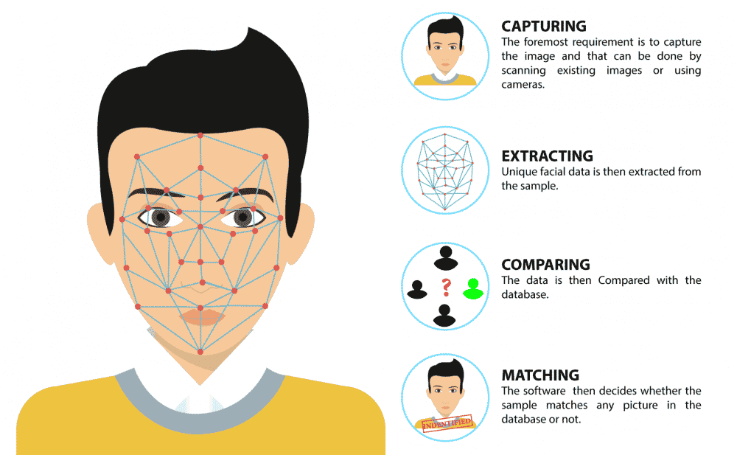
Introduction
Face detection, a subset of computer vision technology, plays a crucial role in identifying and visualizing human faces within digital images. This specialized form of object detection is adept at recognizing semantic objects—like humans, buildings, or vehicles—in both images and videos.
The evolution of this technology has propelled its importance, particularly in domains such as photography, security, and marketing. It offers enhanced

Slide 5
Motivation
Our Face Detection Project was conceived to bolster the capabilities of the Indian Army, enhance security surveillance systems, and provide a user-friendly solution for the general public. In an era where global security is paramount, our technology stands as a sentinel against potential threats, enabling swift identification of individuals in crowded spaces.
With an emphasis on efficiency, our project distinguishes faces in images, regardless of quality, with remarkable speed. This robust Face Detection Code is versatile, ready to be integrated into various platforms, from application cameras to security applications and websites, ensuring a safer environment for all.

Slide 6
Innovation Idea of Project
It can Detect faces easily with less time of execution.
It can Detect Face in any quality of Images even blur.
It can Detect single, double or even multiple faces in any Image.
It can tell the number of Peoples/faces in Image.
It is fully automatic face recognition system
It is one of the best in today world Innovation as per less number of code use in the system.
It use Haar feature based Algorithm to detect which it makes very accurate and fast processing of face detection

Slide 7
Scope of Project
Security Enhancement:
To provide a sophisticated layer of security for the Indian Army and police force.
To aid in the identification of persons of interest or suspects in public areas through CCTV surveillance.
Public Safety:
To assist in crowd management and monitoring by identifying faces in large gatherings.
To potentially identify lost or missing individuals in public spaces.

Slide 8
Technological Integration:
To offer a seamless integration with existing security applications and cameras.
To ensure compatibility with various platforms, including mobile and web applications.
User Accessibility:
To create a user-friendly interface that can be utilized by the general public for personal security.
To provide a tool that can enhance user interaction through face detection in social media and other online platforms.

Slide 9
Performance Efficiency:
To ensure the system can process images rapidly, including those that are old or of lower quality.
To minimize execution time while maintaining high accuracy in face detection.
Innovation and Research:
To contribute to the advancement of computer vision and facial recognition technology.
To encourage ongoing research and development for continuous improvement of the system.

Slide 10
OpenCV-Python
•
OpenCV-Python: This library combines the power of Open-CV with the simplicity of Python, enabling users to implement complex image processing tasks with minimal code.
Installation: It can be installed via pip, and there are different packages available depending on the user’s needs, such as opencv-python for the main modules and opencv-contrib-python for both main and extra modules1.
Usage: OpenCV-Python utilizes NumPy, a highly optimized library for numerical operations, which makes array manipulations and matrix operations
more efficient.
•
•

Slide 11
Capabilities: With OpenCV-Python, you can perform a wide range of operations like reading, writing, and displaying images and videos, real-time analysis, face detection, object detection, and much more.
•
•
Documentation and Tutorials: There are extensive tutorials and documentation available to help users get started and explore the vast functionalities of OpenCV-Python

Slide 12
Installation
OpenCV: This library is used for image processing and video capture. pip install opencv-python
Face Recognition: This is the library that provides the functionality for face detection and recognition. pip install face_recognition
NumPy: It is used for handling arrays and is a dependency for many other Python libraries, including OpenCV and Face Recognition.
pip install numpy

Slide 13
Face Detection
Face detection is a technique that identifies or locates human faces in digital images. A typical example of face detection occurs when we take photographs through our smartphones, and it instantly detects faces in the picture.
Face detection is different from Face recognition. Face detection detects merely the presence of faces in an image while facial recognition involves identifying whose face it is. In this article, we shall only be dealing with the former.
Face recognition is the task of identifying an already detected object as a known or unknown face. Often the problem of face recognition is confused with the problem of face detection Face Recognition on the other hand is to decide if the "face" is someone known, or unknown, using for this purpose a database of faces in order to validate this input face.

Slide 14
Face Detection Classifiers
Face detection is performed by using classifiers. A classifier is essentially an algorithm that decides whether a given image is positive(face) or negative(not a face). A classifier needs to be
trained on thousands of images with and without faces. Fortunately, Open-CV already has two pre-trained face detection classifiers, which can readily be used in a program. The two
classifiers are:
Haar Classifier and
Local Binary Pattern (LBP)

Slide 15
Haar Feature Selection: Features are selected using Haar-like features, which are simple digital image features used for object recognition. They are defined by the difference in intensity values between adjacent rectangular groups of pixels.
Creation of Integral Images: This step simplifies the calculation of Haar features by allowing the sum of pixel values within a rectangular area to be computed rapidly
AdaBoost Training: This machine learning algorithm selects the best features and trains classifiers that can then be combined to form a strong classifier.
Cascade Classifier: This is a method to combine multiple classifiers in a cascade to discard non-faces quickly and focus more computation on regions that are more likely to be faces.

Slide 16
Haar feature-based cascade classifiers
The AdaBoost, or Adaptive Boosting, algorithm plays a key role in this process. It selects a small set of important features from a larger set and trains classifiers on them. Once trained, these classifiers are arranged in a series of stages, where each stage is designed to filter out non-faces. This staged approach is efficient because it allows the system to quickly reject non-faces and spend more computational resources on regions that are more likely to be faces.
The stages in a cascade classifier work:
Initial Stage: The first stage uses a few features to quickly reject the majority of non-faces. If a region passes this stage, it moves on to the next one.
Subsequent Stages: Each subsequent stage uses more features and is more complex, allowing for more accurate detection. If a region fails at any stage, it is immediately rejected as a non-face.

Slide 17
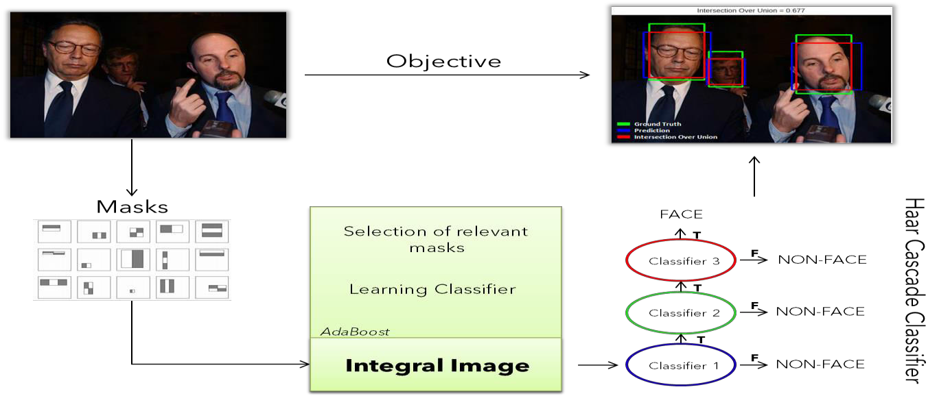
Final Stage: The last stage is the most complex and uses all the selected features to confirm whether the region contains a face.

Slide 18
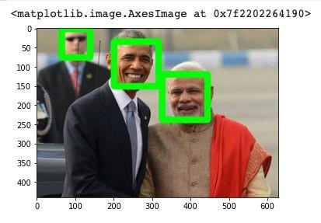
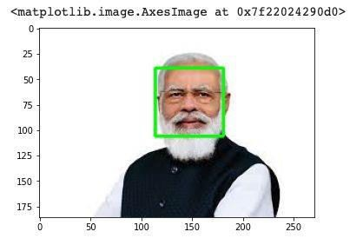
Sample Outputs
PM Modiji Face Detection
Modiji, Obama & Security Guy Face Detection
Image 1
Image 2

Slide 19
Code Preview-
import cv2import face_recognition as frimport osimport numpy as np
# Path to the main folder containing subfolders, each representing a different personmain_folder =
"images"
# Load known faces and their names dynamically from the subfoldersknown_face_encodings =
[]known_face_names = []
# Traverse through all subfolders in the main folderfor person_folder in os.listdir(main_folder): person_folder_path = os.path.join(main_folder, person_folder)
if os.path.isdir(person_folder_path):
# List all image files within the subfolder
image_files = [f for f in os.listdir(person_folder_path) if f.endswith(('.jpg', '.jpeg', '.png'))]
# Load images and extract face encodings for each image
for image_file in image_files:
image_path = os.path.join(person_folder_path, image_file)

Slide 20
image = fr.load_image_file(image_path)
# Attempt to find faces in the image
try:
face_locations = fr.face_locations(image)
if len(face_locations) > 0:
# Extract face encoding if a face is found
face_encoding = fr.face_encodings(image, face_locations)[0] known_face_encodings.append(face_encoding)
# Associate each face encoding with the name of the image file (without extension)
known_face_names.append(os.path.splitext(image_file)[0])
else:
print(f"No faces found in {image_file}")
except KeyboardInterrupt:
# If KeyboardInterrupt occurs, break out of the loop
break
# Start video capturevideo_capture = cv2.VideoCapture(0)
try:

Slide 21
while True:
ret, frame = video_capture.read()
if not ret:
print("Failed to capture frame from camera.")
break
rgb_frame = frame[:, :, ::-1]
fc_locations = fr.face_locations(rgb_frame)
fc_encodings = fr.face_encodings(rgb_frame, fc_locations)
for (top, right, bottom, left), face_encoding in zip(fc_locations, fc_encodings): matches = fr.compare_faces(known_face_encodings, face_encoding)
name = "Unknown"
# If a match is found, use the name of the corresponding image file (without extension)
if True in matches:
match_index = matches.index(True)

Slide 22
name = known_face_names[match_index]
cv2.rectangle(frame, (left, top), (right, bottom), (0, 0, 255), 2)
cv2.rectangle(frame, (left, bottom - 35), (right, bottom), (0, 0, 255), cv2.FILLED) font = cv2.FONT_HERSHEY_SIMPLEX
cv2.putText(frame, name, (left + 6, bottom - 6), font, 1.0, (255, 255, 255), 1)
cv2.imshow('Face Detection System', frame)
if cv2.waitKey(1) & 0xFF == ord('q'):
break
except KeyboardInterrupt:
pass
video_capture.release()cv2.destroyAllWindows()

Slide 23

AFTER IMPLEMENTATION-
AMIT

Slide 24
Conclusion
It’s now feasible for governments and non-governmental organizations (NGOs) in India to consider the deployment of facial recognition technology in diverse fields. By providing financial incentives and recognition, these entities can encourage the implementation of such systems for public welfare and safety, healthcare, retail, and other areas where secure and efficient identity verification is beneficial.
As face recognition technology continues to evolve, it’s important to also consider the ethical implications and privacy concerns associated with its use. Ensuring that there are robust regulations and guidelines in place can help mitigate potential risks and foster public trust in these systems.

Slide 25
References
http://umpir.ump.edu.my/id/eprint/327/3/Real%20time%20face%20detec tion%20system%20-%20Chapter%201.pdf
https://www.sciencedirect.com/topics/computer-science/classifier-cascad e
https://ieeexplore.ieee.org/document/6315916
4. https://link.springer.com/chapter/10.1007/978-3-642-72201-1_9
5. https://thesai.org/Downloads/Volume9No6/Paper_6-Study_of_Face_Recog nition_Techniques.pdf

