Slide 1
WELCOME
WHEAT SEEDS CLASSIFICATION

Slide 2
Group - 10
SUBMITTED BY :
1. TABASSUM MAHARIN MUMU
2021-3-60-162
2. UMME AIMAN PROMI
2021-3-60-168
3. TANVIR AHMED RATUL
2021-3-60-140
SUBITTED TO :
Dr. Raihan Ul Islam (DRUI)
Associate Professor,
Dept. of CSE.

Slide 3
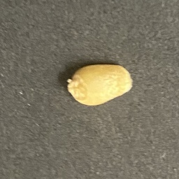
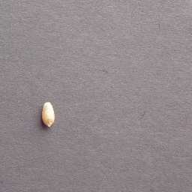
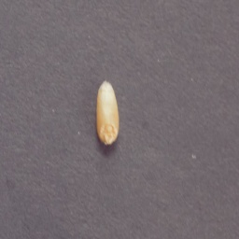
DATA SET DESCRIPTION
We used the wheat seed dataset , which is organized into three labelled classes:
Akbar
Uruj
Dilkash
Akbar
Uruj
dilkash
We have used total 375 data and each class has 125 data each .

Slide 4
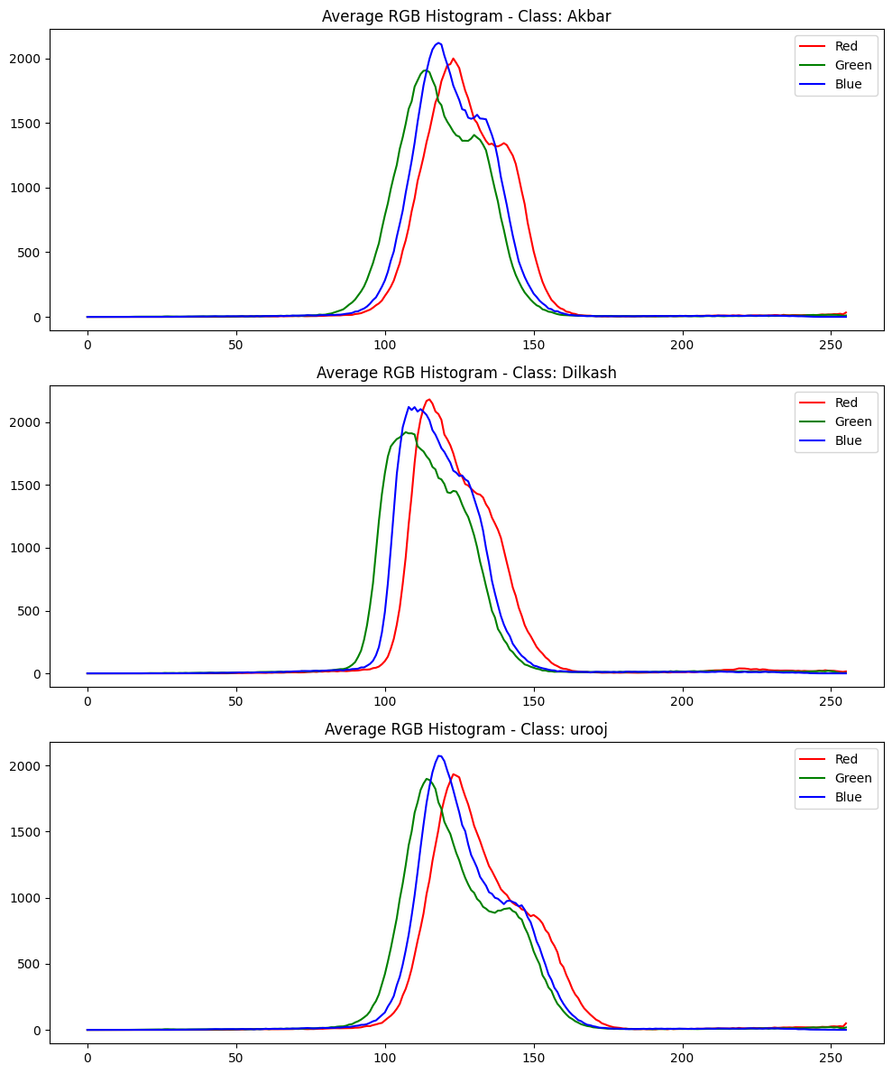
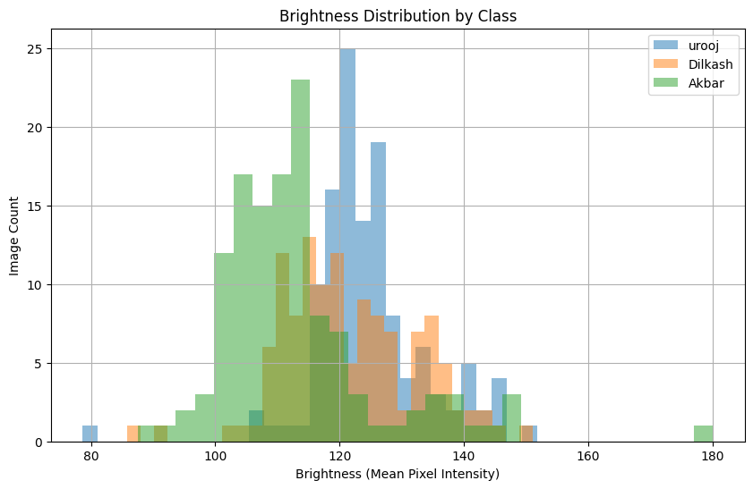
RGB HISTOGRAM
BRIGHTNESS DISTRIBUTION
The RGB histograms show similar color patterns across all three classes, with most pixel values concentrated in the mid range. Urooj images are slightly brighter, while Akbar appears a bit darker and more compact. Overall, color differences are subtle, so color alone may not strongly separate the classes.
The brightness distributions of the three classes overlap but show clear shifts. Urooj images are generally brighter, Akbar images are comparatively darker, while Dilkash falls in between. This variation suggests brightness can help the model differentiate between classes, but overlap may still cause confusion.

Slide 5
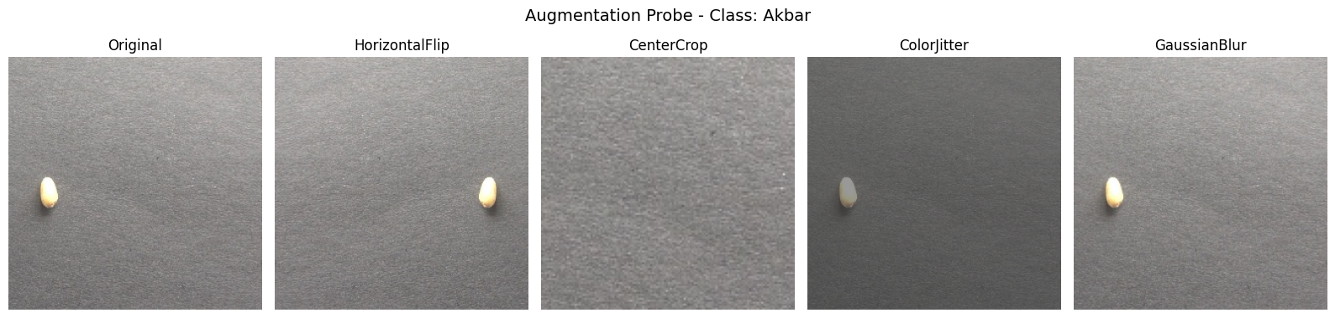
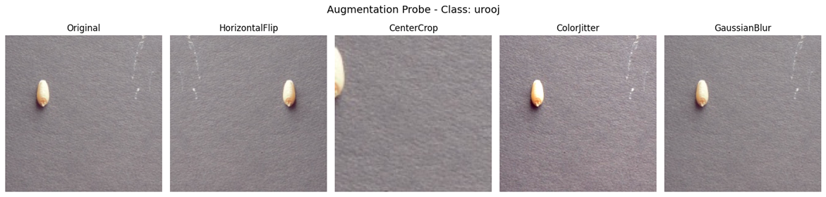
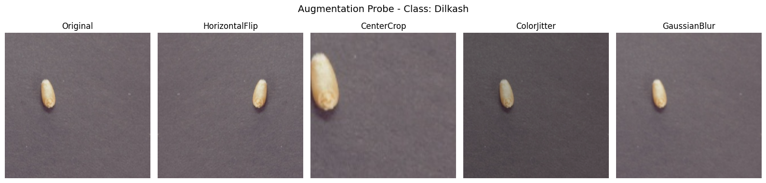
The only augmentation that is clearly harmful is center crop. If the center crop is dimension is too low, it may not even keep the object in focus. Gausian blurs effect also differs based on how zoomed in the photo is. Horizontal flip seems useless if the position of the object in image is not fixed. The model will see objects in different position nonethless even if we don't use HorizontalFlip

Slide 6
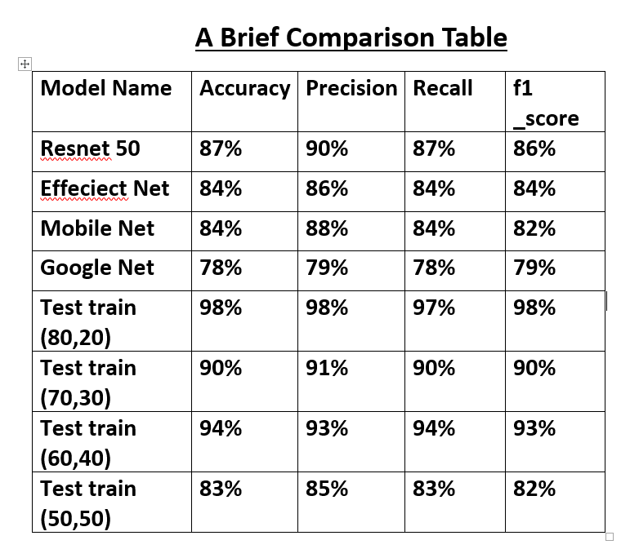
TASK – 2

Slide 7
we select the following SSL methods:
SimCLR (A Simple Framework for Contrastive Learning of Visual Representations)
BYOL (Bootstrap Your Own Latent)
Barlow Twins

Slide 8
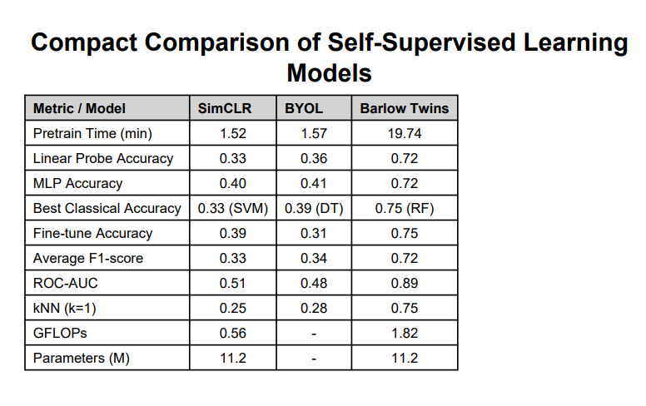
Comparison Table Preparation of SIMCLR , BYOL , BARLOW TWINS

Slide 9
conclusion
Barlow Twins achieves the best overall performance, delivering the highest accuracy, F1-score, and ROC-AUC across most evaluation settings, indicating strong representation learning. However, it requires significantly more pre training time and computational resources. SimCLR is the most efficient model, offering fast training with stable but moderate performance. BYOL shows balanced results but does not outperform the other two models in this experiment. Overall, Barlow Twins is best for performance, while SimCLR is best for efficiency.

