Slide 1


Slide 2
GROUP MEMBERS
SCRUM MASTER:
EESHAN VAIDYA
FRONTEND | BACKEND
ADITI PALKAR | HUZAIFA FAIZEE
ATHARVA JOSHI | ATHARVA KARKAR
SAKSHI CHIKORDE | EESHAN VAIDYA
KOMAL SHRIMAL

Slide 3

TECHNOLOGIES USED
FRONT END:
HTML
CSS
BOOTSTRAP
BACK END:
PHP
JAVASCRIPT
SQL

Slide 4

WHAT IS SHAADI MUBARAK ABOUT?
OUR WEBSITE IS ALL ABOUT PLANNING YOUR WEDDING BEAUTIFUL AND DREAMY .
01
WE ARE PROVIDING THE FACILITIES FOR FULFILLING YOUR PRECIOUS DAY BY PROVIDING YOU
02
WITH VARIETY OF OPTIONS AND BEST DEALS ON OUR WEBSITE SHAADI MUBARAK.
03
CUSTOMIZE YOUR WEDDING WITH US.
04

Slide 5
NEED OF OUR WEDSITE
1.WE ARE PROVIDING THE USERS WITH ONE PLATFORM AND MULTIPLE FACILITY OPTIONS
01
2.KEEPING THE BURDEN OFF ,ON YOUR BIG DAY TO ENJOY YOUR TIME WITH YOUR LOVED ONES
02
3. TOWARDS EASY MANAGEMENT WEDDING.
03
4.PLAN YOUR OWN WEDDING
04

Slide 6
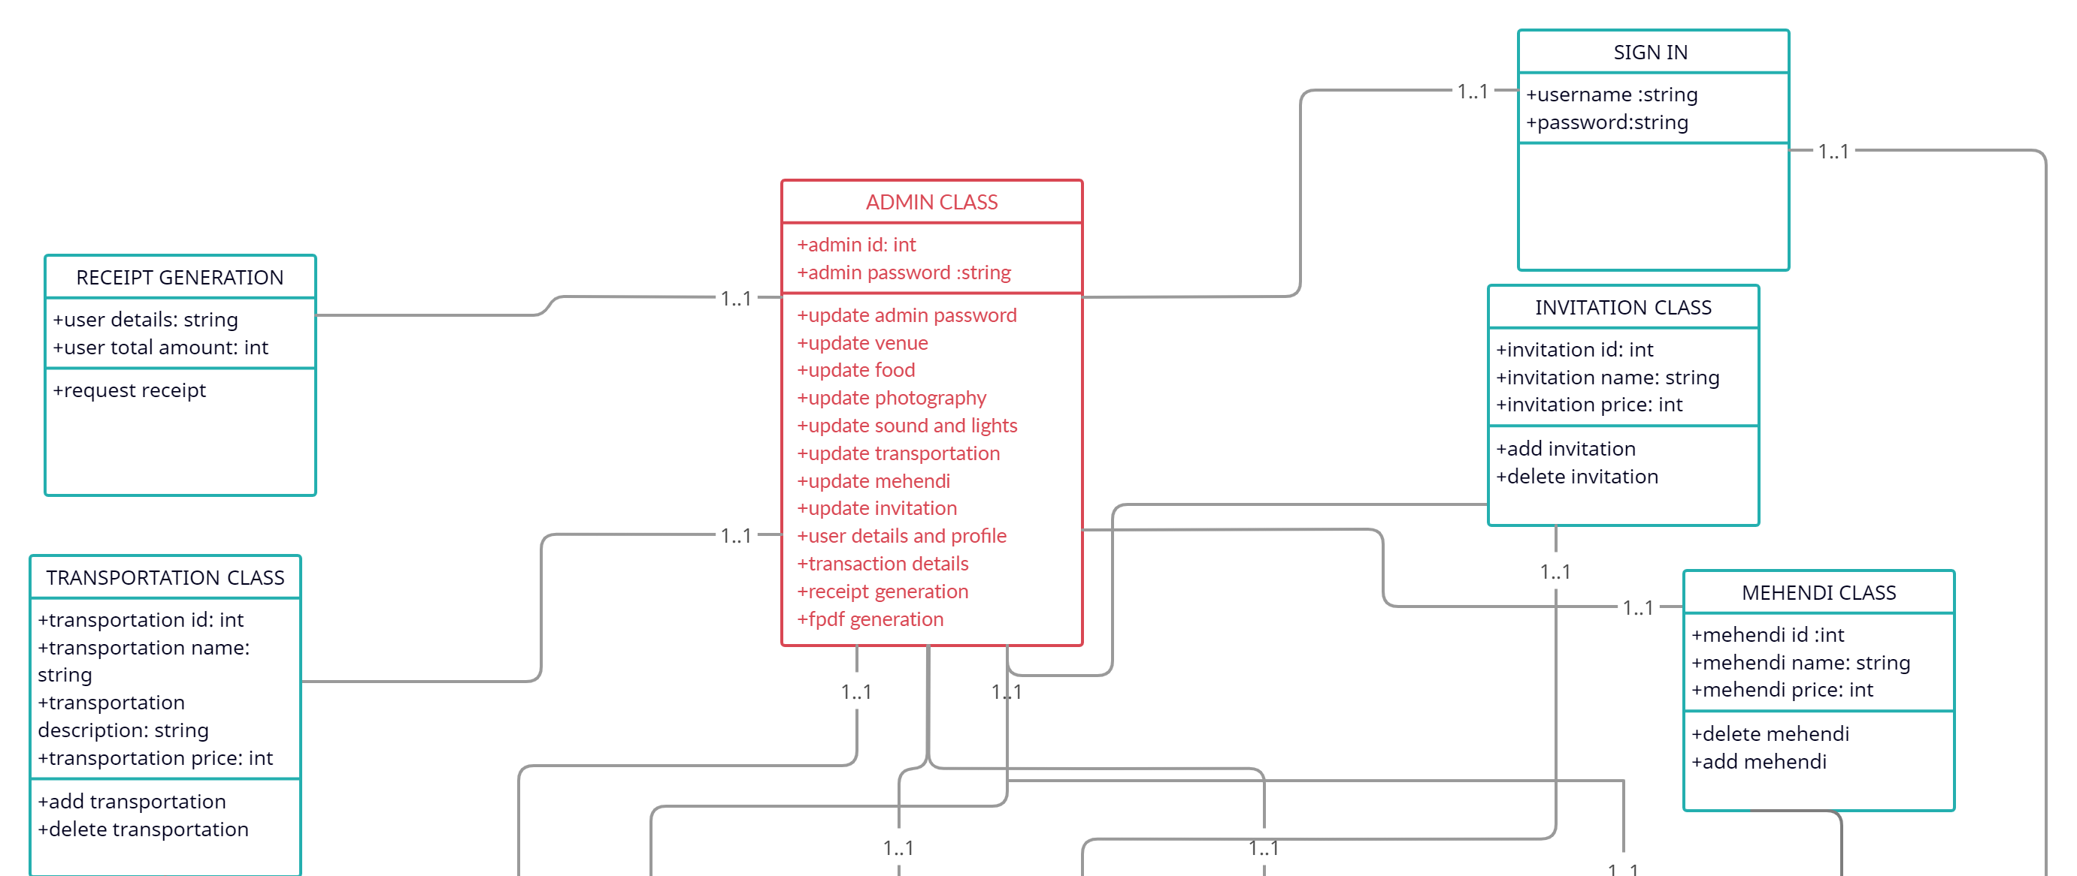
UML CLASS DIAGRAM CONTINUE…

Slide 7
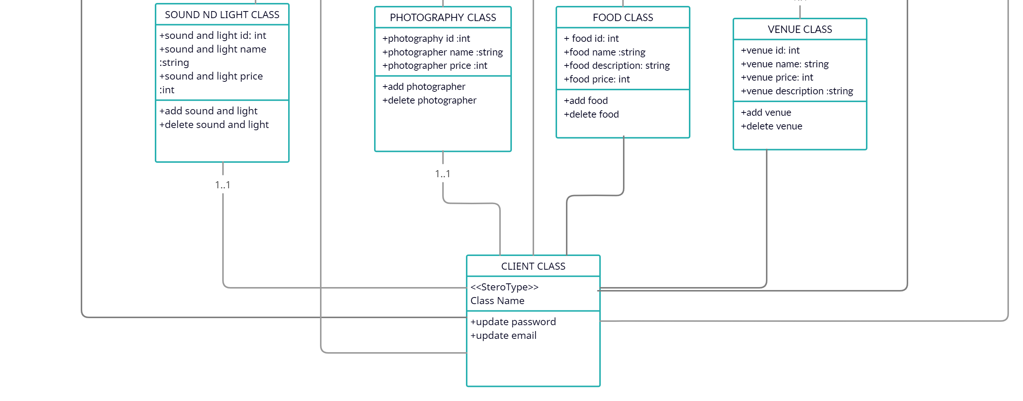
UML CLASS DIAGRAM CONTINUE…

Slide 8
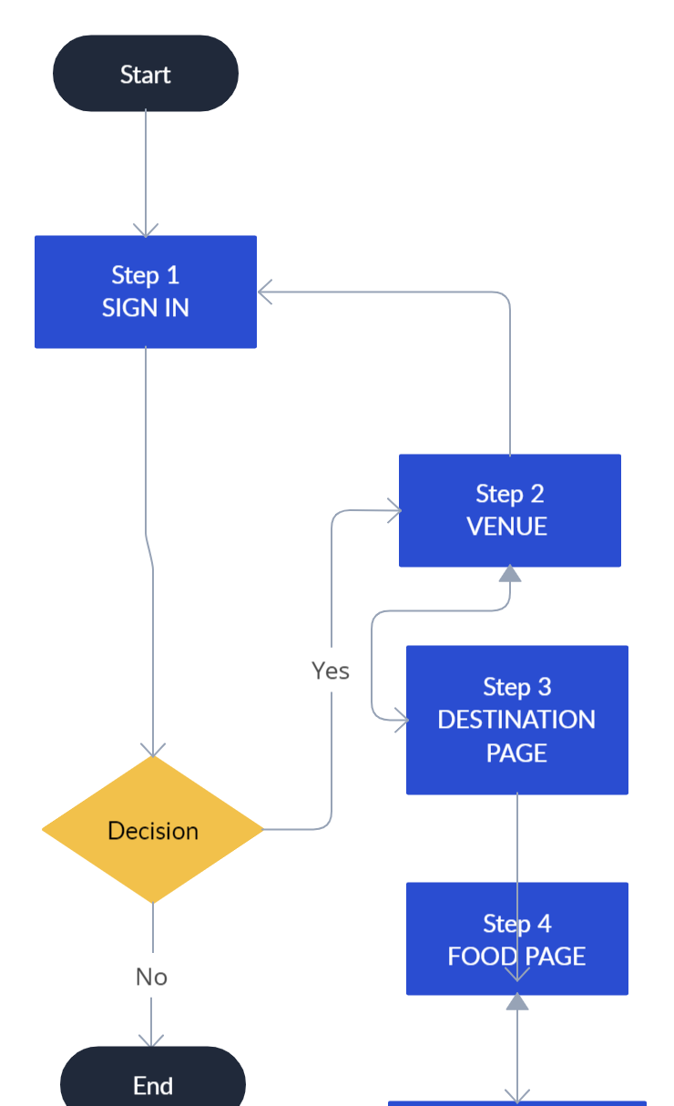
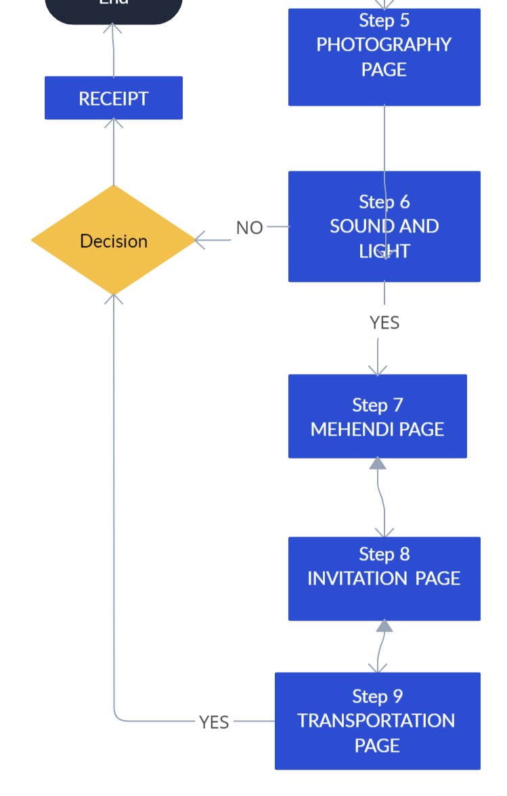
FLOW CHART OF THE WHOLE WEBSITE FOR USER

Slide 9
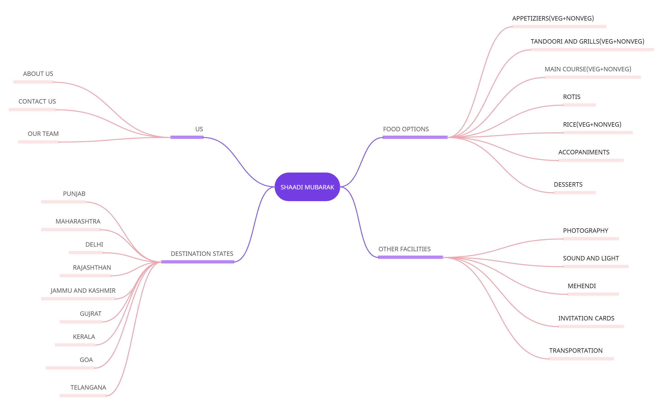
MIND MAP

Slide 10
PLANNING YOUR WEDDING??
SHAADI MUBARAK GOT YOU COVERED…

