Slide 1

Small Watering Station
Created by: Victor Tsekov

Slide 2
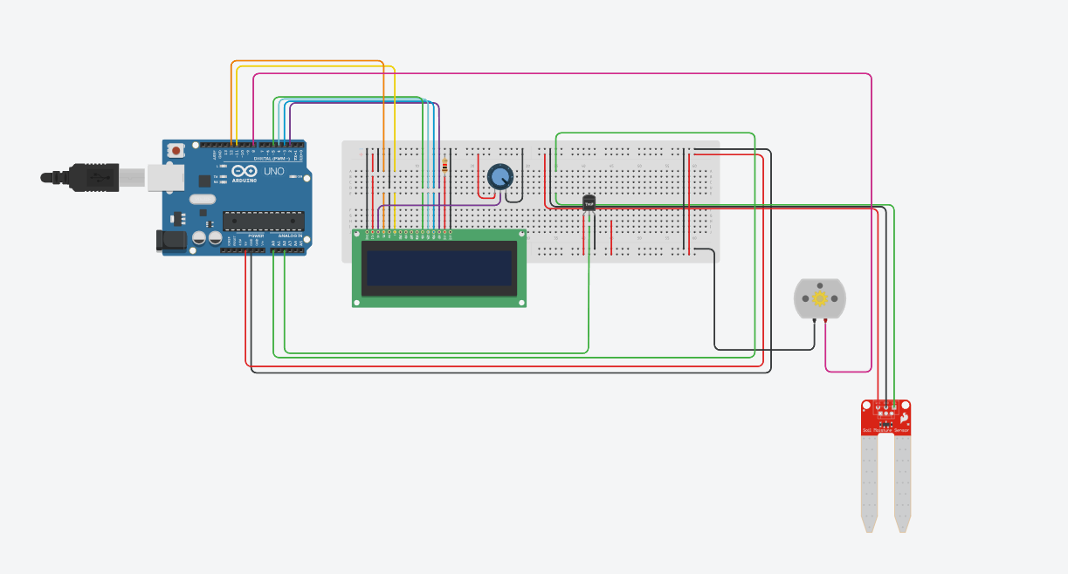
Under the cover

Slide 3
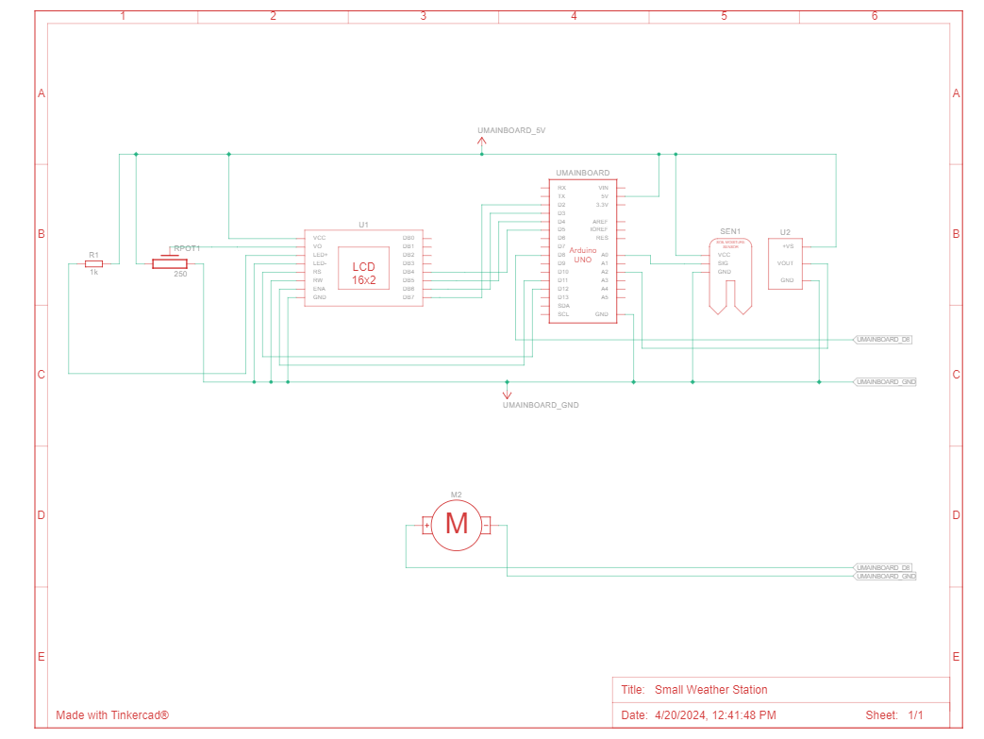
For the engineers

Slide 4

The components which make our product

Slide 5
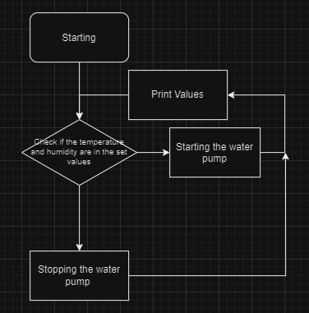
Now for the programmers

Slide 6

Source
…
if(air_temperature < 0)
{
lcd.setCursor(0,0);
lcd.write("Plant forzen ");
}
else if (air_temperature > 100)
{
lcd.setCursor(0,0);
lcd.write("Plant burned ");
}
else if(soil_moisture < 60 && air_temperature < 24)
{
digitalWrite(8,HIGH);
lcd.setCursor(0,0);
lcd.write("Watering ");
}
else
{
lcd.setCursor(0,0);
lcd.write("Monitoring ");
digitalWrite(8,LOW);
}
…
void setup()
{
lcd.begin(16, 2);
lcd.print("STARTING");
delay(1000);
lcd.clear();
pinMode(A0,INPUT);
Serial.begin(9600);
pinMode(8,OUTPUT);
}

Slide 7




Thanks for watching!
Used resources:

