Slide 1

Enterprise MFDM™ using Ansible AWX for Nutrien

Slide 2
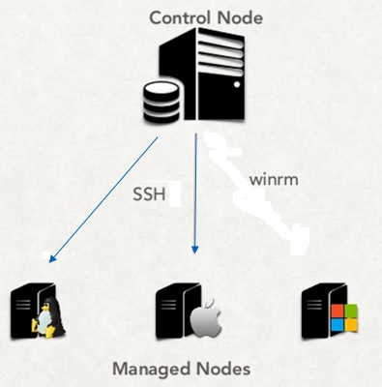


About Ansible
What is Ansible?
Market leading (~28%) Automation engine by Red Hat that automates the following:
provisioning(bare-metal, cloud)
configuration management
application deployment
Security and Compliance
Intra-service orchestration
TCS- Red Hat Relationship
Premier Partnership with Red Hat
Joint go-to-market strategy
Labs and online portal
Multiple awards to TCS
How Ansible works?
Two Licensing Models
Licensed and supported by Redhat
Includes Ansible Engine and built in modules
Open source version, no license charge
Includes Ansible Engine
Modules can be downloaded

Slide 3
Pre-requisites
Server, Port and Access Details
Server 1 - Development
AWX-D Instance + DB:
4 vCPUs
4 GB RAM
40 GB HDD
>2000 IOPS
RHEL 7.x
Server 2 – Production*
AWX-P Instance + DB:
16 vCPUs
16 GB RAM
100 GB HDD
>2000 IOPS
RHEL 7.x
Port Details
By default, we will use these TCP ports:
SSH (22)
WinRM (80, 43, 5985, 5986)
Access Details
The servers should be able to connect to internet and reach sites like Gitlab, Github, Ansible Galaxy, Google
We should be able to download software and install them, i.e., have admin rights
There should be Google Chrome or MEdge present
* HA not considered; 100 Forks considered

Slide 4
Ansible Automation Engine Logical Architecture
IT Landscape
ITSM Platform
Non-Automatable tickets, enriched tickets
Monitoring tools
INCIDENTS
Ticket Updating and resolution
IT USERS L2, L3
Ansible CoE
Incremental Automation by Account and CoE
Unresolved tickets post automation
SERVICE REQUESTS
ANSIBLE AUTOMATION
IT USERS
Automatable tickets
END USERS
Self Help Portal, ChatBots
CHANGE REQUESTS
Ticket Updating and resolution
Plugins and APIs
Playbooks
CMDB
TCS Private Modules
Public Modules
Target Node Data
Service Desk
Host Inventory

Slide 5
Thank you

