Slide 1
HOUSING
Factors that could influence residential home prices across United States over the next decade.
Name : K Jagannath
Date : 29 July 2022

Slide 2
Outline
Introduction
The U.S. house price cycle
Affordability
Location
Interest Rate and Inflation Rate
Mortgage Rate
Population - Rising Demand Limited Supply
Economy and Unemployment
Property , Sales and Income Tax Rate
Government Policies
How can we reduce the housing problem in coming years?
Source

Slide 3
Introduction
Housing prices are an important reflection of the economy, and housing price ranges are of great interest for both buyers and sellers. In this project “Factors that could influence house prices across U.S. over next decade” will be explained with graphs.
The real estate market in the United States has rebounded significantly from the housing crash of the late-2000s, with low interest rates and limited inventory creating an ideal environment for sellers in some parts of the country.
So how exactly are real estate prices determined? We’ve uncovered eight of the most important factors that affecting the housing market.

Slide 4
Introduction
Factors affecting U.S. House market:
Affordability
Location
Interest rate and Inflation rate
Mortgage rate
Population - Rising demand Limited supply
Economy and Unemployment
Property , Sales and Income Tax
Government Policies

Slide 5
The U.S. House price cycle
The housing market basically works on a cycle of supply and demand. When there is a large inventory of houses, It’s a buyer’s market and housing prices tend to fall.
The last housing crash began in second quarter of 2006. There was a 33.3% fall in the S&P/Case-Shiller composite-20 home price index from Q2 2006 to Q4 2011.Phoenix registered the biggest drop among twenty largest metro areas.
The U.S. housing market started to recover in the second half of 2012.
There are cycles that real estate markets move through that have been repeated since the 1800s which involve four phases: recovery, expansion, hyper supply and recession. It shows that the current market is still in the expansion phase and we won’t reach the peak bubble before a crash until 2024. The housing market crashes in 18-year cycle shows that next crash will occur in 2024 and lead to a great depression in 2026.

Slide 6
Section 1
Affordability

Slide 7
Affordability
Rising incomes mean that people are able to afford to spend more on housing. During periods of economic growth, demand for houses tends to rise. Also demand for housing tends to be a luxury good. So rise in income causes a bigger % rise in demand.

Slide 8
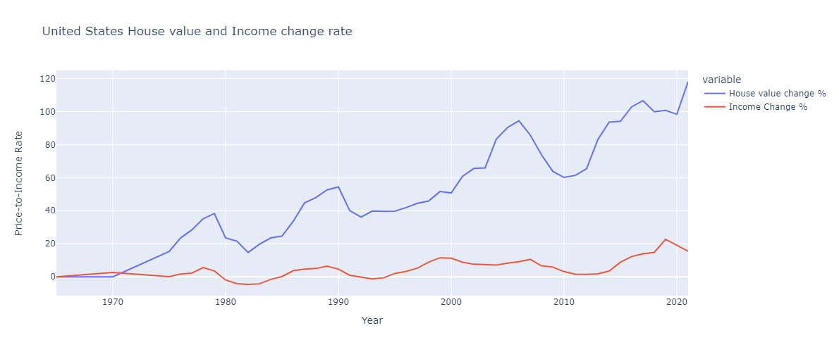

Slide 9
Affordability
This graph shows that house prices and therefore demand for housing can rise much faster than earnings, suggesting there are many other factors influencing demand.
We can see above since 1965, average home values showing a 118% increase. Meanwhile median household income crept up just 15%.
Home prices have increased 7.6x faster than income since 1965 and 3.1x faster than income since 2008, accounting for inflation.
The current average house-price-to-income ratio means it takes prospective home buyers 5.4 years to save enough to purchase a home. These exorbitant home prices also mean monthly mortgage payments place a major financial strain on homeowners, even if they manage to save enough to purchase a home.

Slide 10
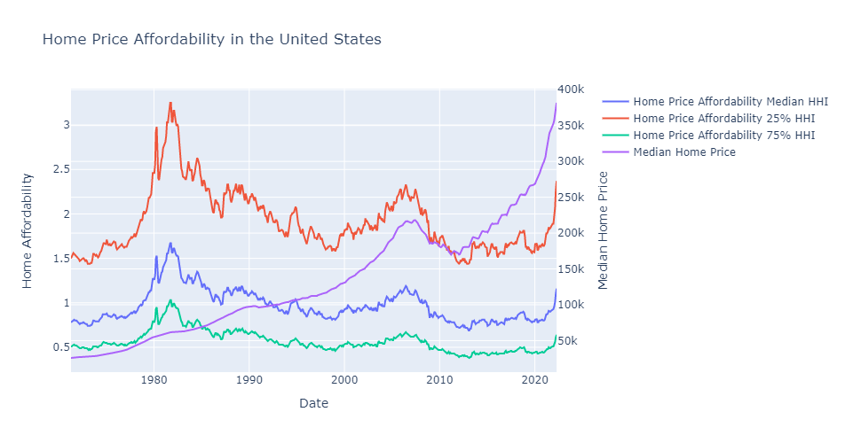

Slide 11
Affordability
To afford a home in 2021, Americans need an average income of $144,192 but the current median household income is actually $69,178.
Across the nation, the pandemic accelerated a major divide between home values and income. Though conventional wisdom suggests most home buyers offer 1% to 3% over asking price in competitive markets, low inventory and high demand drove some buyers to desperate measures. Today,It’s not uncommon to hear of people offering far more that the seller’s asking price with some even offering $1 million more than the listing price.

Slide 12
House value change - 0.03%
Income change - 2.7%
House value change - 60.11%
Income change - 5.9%
2000
2021
1970
2010
House value change - 50.74%
Income change - 11.29%
House value change - 118.04%
Income change - 15.45%

Slide 13
Section 2
Location

Slide 14
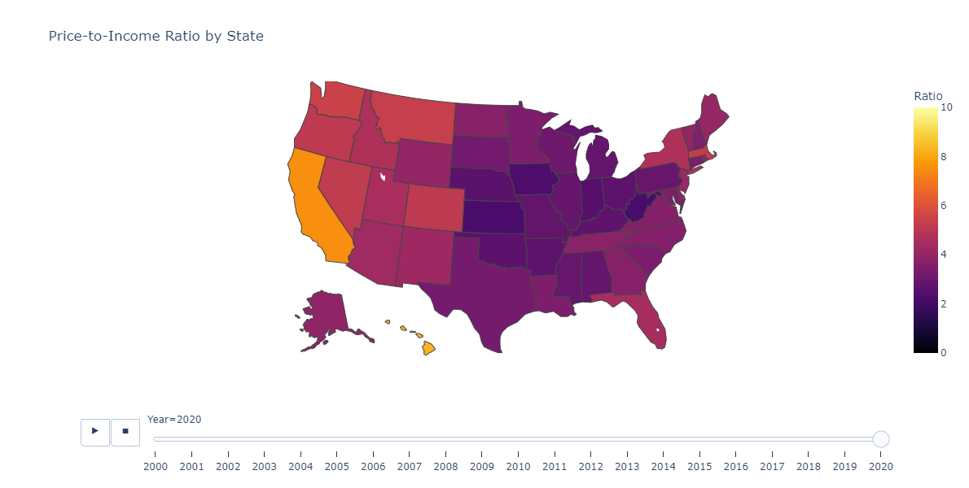
From 2019 to 2021, the average house-price-to-income ratio increased from 4.7 to 5.4 a 14.9% increase that’s more than a double the recommended ratio of 2.6. In other words, homes cost 5.4x what the average person earns in one year

Slide 15
California
Average house Price - $580,133.83
Median Income - $77,358
Ratio - 7.5
Washington
Average house Price - $438,538.58
Median Income - $81,083
Ratio - 5.41
Montana
Average house Price - $300,301.42
Median Income - $56,442
Ratio - 5.32
Nevada
Average house Price - $314,986.75
Median Income - $60,956
Ratio - 5.17
Colorado
Average house Price - $422,151.33
Median Income - $82,611
Ratio - 5.11

Slide 16
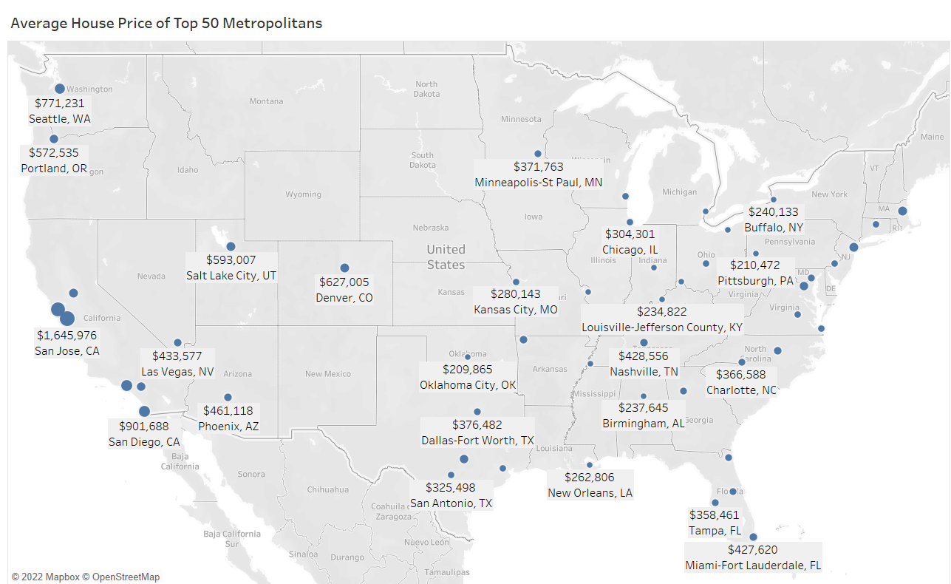

Slide 17
Location
The ratio of house prices to earnings influence the demand. As house prices rise relative to income you would expect fewer people to be able to afford. We all are familiar with the saying “Location Location Location”! If a location is very close to commercial or market areas, then the house prices are higher as compared to counterparts in the residential areas.
The process of retaining a property after the costs have been incurred by the owner is referred to as affordability. To put more simply, it is described as the relationship between the house prices, interest rates and wages.Comparable nearby properties or recently transacted house prices has long been used as a benchmark against home price.
We can see in this graph that the average house price of outer states of United States are much more higher than the inner one’s because Top 50 metro-cities were mostly located into those areas this leads to increase in house prices.

Slide 18
Section 3
Interest Rate and Inflation Rate

Slide 19
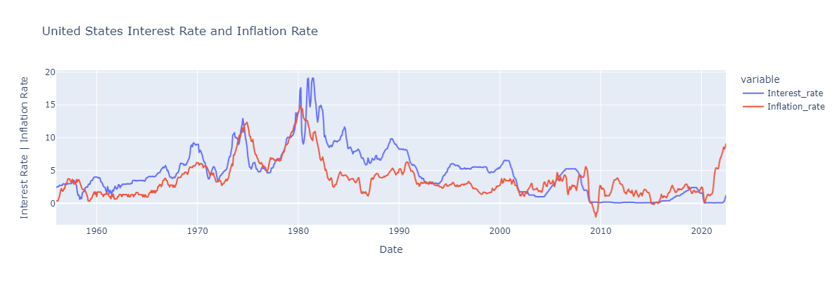

Slide 20
Interest Rate and Inflation Rate
Interest rates play a major role in determining the cost of mortgage interest repayments. When interest rates rise, so do mortgage rates. This makes buying a home more expensive.
Secondly, when inflation is rising, people have to spend more of their income on the daily necessities such as food, petrol and heating. Rising inflation tends to lead to slower house price growth.It can also make harder to get a mortgage. Its good time to sell a house before higher inflation leads to lower activity in property market.

Slide 21
Interest Rate and Inflation Rate
How rising inflation affect housing market ?
You might expect rising inflation means house prices will also rise, but this is not the case. Inflation is something that measures the rate at which the price of key goods and services change over time. When inflation is rising, it means these things are becoming more expensive. There are several different indexes that measure changes to inflation. The key one for the housing market is the Consumer Prices Index (CPI). But houses are not included in the basket of goods used to calculate the CPI. There is a separate index, known as the CPIH (Consumer Prices Index including owner occupiers Housing costs).

Slide 22
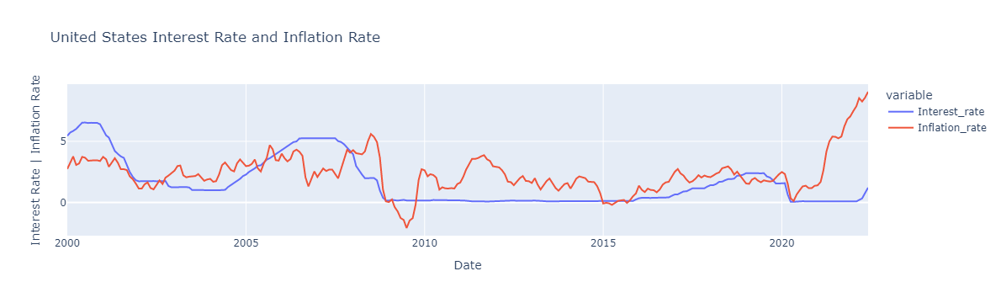

Slide 23
Interest Rate and Inflation Rate
We can see sharp increase of inflation from May 2020 , rate changed from 0.12% to 9.06% in June 2022.Rising inflation tends to lead to slower house price growth.There are two reasons for this:
The Fed’s tasks is to keep CPI inflation as close to 2% as possible. So, If inflation rises above this target, the Fed may raise interest rates to try to reduce it. This is a major factor in determining the affordability of housing. Mortgage payments take a high% of people’s disposable income (average is 25% but, for some homeowners it is higher). Therefore, even small changes in interest rates can deter people from buying.
When Inflation is rising people have to spend more of their income on the daily necessities.
As a result, house price growth tends to slow when inflation is rising.

Slide 24
1981
2008
2016
2020
All time high inflation and Interest rate
Financial Crisis
All time low rates
Coronavirus Pandemic
Following rampant inflation in the 1970s, Fed Chairman Paul Volcker raised interest rates to record highs.
SOURCE : CNBC (APR,2020)
Between 2007 and 2008, Interest rates fell from 5.1% to 2.3% in efforts to curtail the subprime mortgage and banking crisis.
SOURCE : Federal Reserve Board (SEP,2020)
Historical trends show that a ‘Lower for longer’ rate cycle is projected for the future.
SOURCE : Bank of England(JAN,2020).
Inflation rate rise in 2020 and 2021 in response to Coronavirus pandemic.

Slide 25
Section 4
Mortgage rate

Slide 26
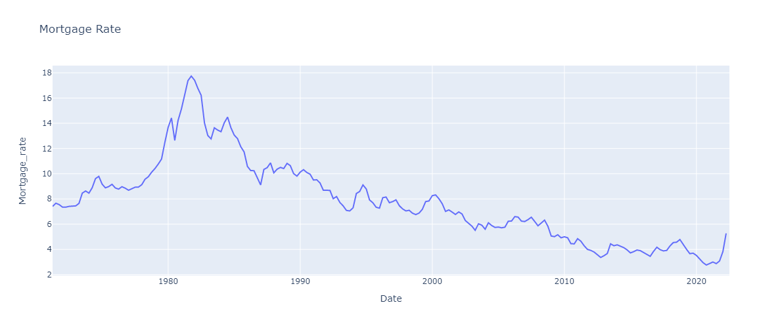

Slide 27
Mortgage rate
Another factor that determines the effective demand for houses is the mortgage rates always go lower but you should not expect them to. With inflation at 40-year highs and the Federal Reserve making aggressive rate hikes to combat it, Mortgage rates seem likely to rise in the near future. Fed does not set mortgage rates, but these rates follow the same general trend as the overall market. Wehn mortgage rates rise, home values fall.

Slide 28
Section 5
Population - Rising demand Limited Supply

Slide 29
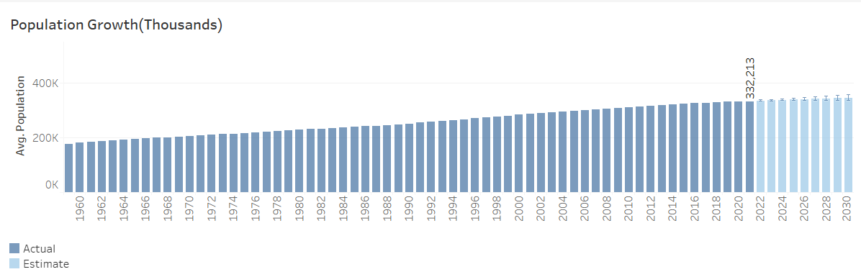
This tells us that in coming years we may see population may reach to 350 million by 2030.

Slide 30
Population
The average growth range of US population ranges from 0.38% to 0.9% every year. The United State is projected to grow by nearly 79 million people in the next 4 decades, from about 326 million to 404 million between 2017 and 2060. The population is projected to cross the 400-million mark in 2058. Population is a very important factor. It is not just the number of people but demographic changes leads to influence in house prices. E.g. growing number of single people living alone has led to increasing demand for houses. We know if demand increases price will increase.

Slide 31
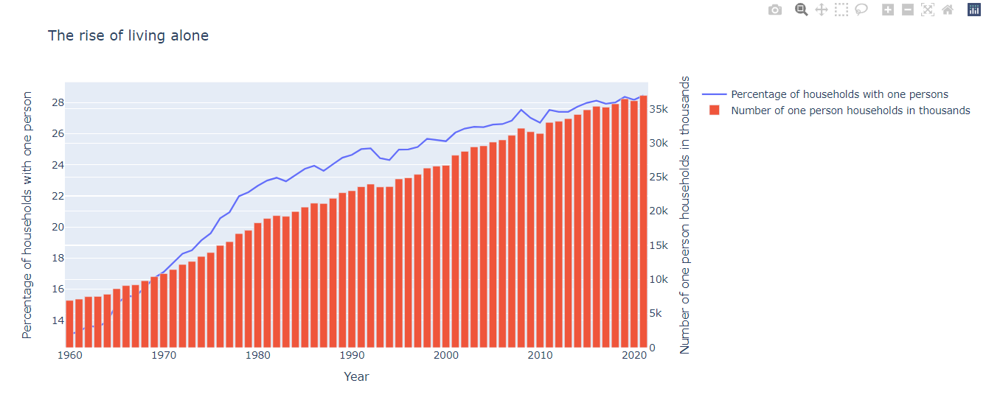
People are preffering to live alone increases demand in household market.

Slide 32
Population
In the above graph we can see that there are 28.46% of households with one person. An average annual rise of single person household is 1.1% over 2015-2030. There were 37 million one-person households in 2021, or 28% of all U.S. households. The number of families with their own children under age 18 in the household declined over the last two decades. The projections show that single-person households are set to reach about 41.4 million by 2030, which will again lead to increase in house prices in US.

Slide 33
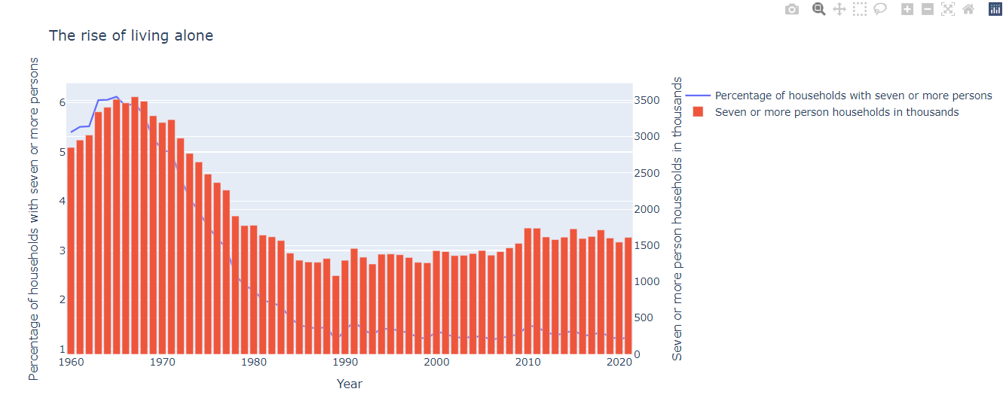

Slide 34
Population
The demand for housing does not just depend on the population but also the size of household. We can see above how the size of household “seven or more” decreasing since 1960. This shows that certain social and demographic factors are causing a rise in number of households ( faster than population ) such as :
Increased life expectancy, leading to more single old people
Divorce rates - increasing number of single parent families.

Slide 35
Section 6
Economy and Unemployment

Slide 36
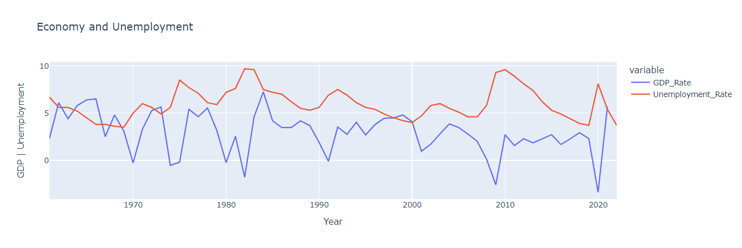

Slide 37
Economy and Unemployment
This graphs shows that economy is recovering and Unemployment is falling.The US economy contracted by 3.5% during 2020, in contrast to an annual growth of 2.2% in 2019 and the biggest decline since the demobilization from World War II in 1956, as the country was ravaged by the global pandemic last year.
In June 2022, the unemployment rate dropped to 3.7%, sharply down from 8.1% a year earlier and from a peak of 14.8% in April 2020 ( due to coronavirus pandemic), according to the U.S. Bureau of labor statistics. Now the unemployment rate is lower than the average unemployment rate 4.4% from 2015 to 2019.

Slide 38
Section 7
Property, Sales and Income Tax rate

Slide 39
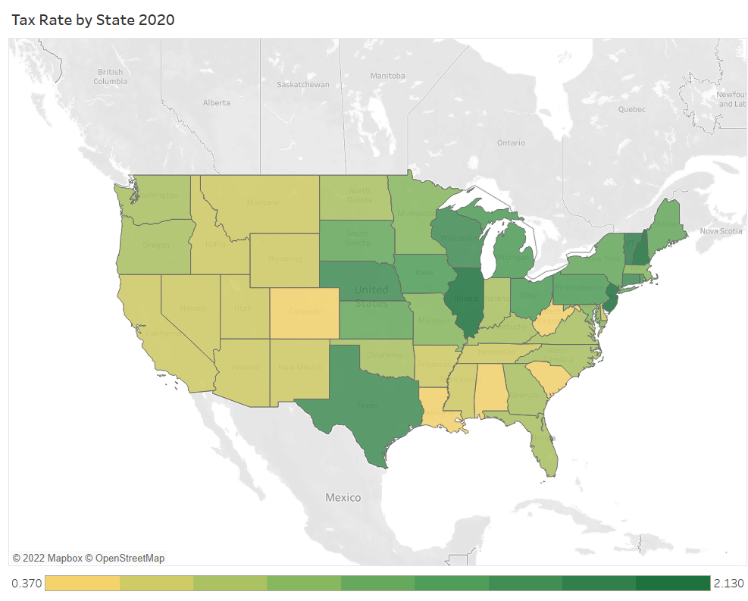
Scale is made by considering property tax rate in each state.

Slide 40
Property, Sales and Income tax rate
Employment income, as well as business and professional income, is subject to progressive federal income tax rates.
State governments in the U.S. levy their own taxes on income. Non-residents are subject to state income taxes in the state where they earn income. The rates are progressive and very from state to state. The income brackets are mostly the same as, or sometimes modified from the federal income tax brackets.

Slide 41
Section 8
Government Policies

Slide 42
More Stimulus Spending
Elimination of 1031 Exchange of High Earners
Elimination of the SALT Deduction Cap
Help for First-Time Homebuyers
Rental and Homeowners Assistance
Biden administration has promised $5.4 trillion in additional spending over the next 10 years.This includes spending for healthcare and health insurance, which would increase demand for the real estate that healthcare providers occupy. Biden pledged to spend another $1.6 trillion on infrastructure and research development.
The plan stipulates that additional federal spending will be paid for partially by “rolling back unproductive and unequal tax breaks for real estate investors with incomes over $400,000.” The 1031 exchange allows one to defer all capital gains taxes for the sale of a piece of real estate if the proceeds are reinvested in another piece ( or multiple pieces ) of real estate within a specific period of time.
SALT - This effectively lowers federal taxes more for individuals in high tax cities and states than individuals in low tax cities and states. By eliminating it would lower the incentives to move away from high-tax states. As home prices soar in low-tax states and suburbs outside of coastal cities, eliminating the SALT deduction cap will make it easier for higher earners to remain in high tax coastal states.
Biden’s proposal to provide a $15,000 tax credit for first-time home buyers would help those who would like to buy a home but have been unable to due to lack of a down payment, high home prices, or lingering student debt.
Upcoming $1.9 trillion stimulus package currently making its way through congress is $25 billion of rental assistance, which should be a huge boon to class B and class C residential landlords. Bill includes $10 billion for homeowner assistance with mortgage payments, property taxes and utilities. This should prevent a substantial number of foreclosures and thus pour fuel one already blazing housing market.

Slide 43
Help for Struggling Coastal Cities
Affordable Housing
Sustainable Building Standards/Regulations
Existing problems like homelessness and crime, makes urban areas less attractive places to live for higher income individuals, spurring them to move to the suburbs or other states. This then has the effect of reducing the tax base, causing cities to raise tax rates or look for other sources of income. Higher tax rates then make these cities even less attractive for high earners, pushing more of them to leave. It’s a deadly spiral. Biden is expected to push trillions of dollars to help struggling coastal cities, benefiting real estate in these places.
President Biden has made clear his desire for more affordable housing in America. This could manifest as tax incentives for building low-rent housing in expensive areas and encouraging changes to zoning laws.Problem of shortage of affordable housing nearly impossible to change at the federal level as the fundamental problems are mostly at the city level, and thus that’s where the solutions mostly lie as well. We find it doubtful that Biden’s policies will have a significant effect on housing costs.
Buildings account for roughly one third of total carbon emissions, which means that the commercial real estate industry will need to be marshaled in the fight against climate change. Biden wants to reduce the carbon footprint of american buildings by 50% by 2035.

Slide 44
Source
Housing Data - Zillow Research
You searched for Number of houses – Page 3 of 3 – DQYDJ – Don't Quit Your Day Job…
Historical Income Tables: Households (census.gov)
• Most populated U.S. cities: median household income 2019 | Statista
Search Results | FRED | St. Louis Fed (stlouisfed.org)
U.S. Bureau of Labor Statistics (bls.gov)
Freddie Mac - We Make Home Possible - Freddie Mac

Slide 45
Thank You

