Slide 1
Assessment and Screening September 28, 2017

Slide 2
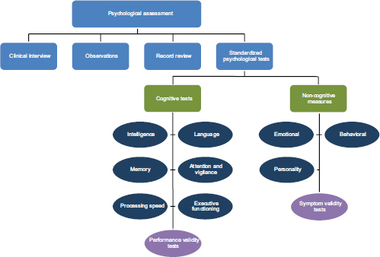
Psychological Testing/Assessment
Used to measure/observe a person’s behavior, determine what is causing symptoms, and inform diagnoses and treatment plans
A combination of these measures provides a fuller, more comprehensive picture of an individual’s behaviors and capabilities
Notes:
“Without standardized administration, the individual's performance may not accurately reflect his or her ability.” (NCBI)
Psychological assessment is never focused on a single test score.
A psychologist is there to evaluate the competencies as well as the limitations of the person, and report on them in an objective but helpful manner.
It is important to pay attention to agreement across measures as well as disagreeing information

Slide 3
Screening Instruments
Brief measures- interviews, questionnaires (ex: self, parent, or teacher report)
“Gate” questions within interviews
There are screening instruments for specific disorders, clusters of disorders, or general psychological distress
Why use screening instruments?
Short
Less costly than diagnostic interview
Reduces error introduced by respondent fatigue
Based on DSM criteria and many have been validated in different populations and languages
Notes:
used to differentiate typically developing populations from those with potentially clinical symptoms

Slide 4
Clinical Interviews
Instruments originally based on the DSM-III (updated)
Diagnostic Interview Schedule (DIS)
Composite International Diagnostic Interview (CIDI)
Further operationalized diagnostic criteria into specific interview questions
Can be structured, semi-structured, or open-ended
Goal of obtaining historical information or variables that may be related to presenting problems
Notes:
Committee on Psychological Testing, Including Validity Testing, for Social Security Administration Disability Determinations; Board on the Health of Select Populations; Institute of Medicine. Psychological Testing in the Service of Disability Determination. Washington (DC): National Academies Press (US); 2015 Jun 29. 3, Overview of Psychological Testing. Available from: https://www.ncbi.nlm.nih.gov/books/NBK305233/

Slide 5
KSADS
The Schedule for Affective Disorders and Schizophrenia (SADS)
KSADS (Kiddie-SADS) is a version of the SADS that is designed for school aged children 6-18 years.
Administered by interviewing the parent and child
Clinician determines a final consensus rating for each item
Screen for all disorders with follow up supplement for disorders endorsed
The K-SADS-PL was designed to obtain severity ratings of symptomatology, and assess present and lifetime history of psychiatric disorders.
Notes:
Current and past allows for better understanding of course of illness

Slide 6
KSADS Example Questions
Depressed Mood
Current:
In the past two weeks, how often have you felt sad, down, or depressed, with the down feeling lasting most of the day?
Not at all
Rarely
Several days
More than half the days
Nearly every day
Past:
If Current Symptoms:
Was there ever another a time in the past that you felt sad or down for most of the day, nearly every day, for two weeks or longer?
If No Current Symptoms:
Was there ever a time in the past that you felt sad or down for most of the day, nearly every day, for two weeks or longer?
Notes:
By assessing current and past can get a better sense of if there was a shift/change in behavior and what occurred in their life/environment around the same time of that change.

Slide 7
Other diagnostic interviews
Structured Clinical Interview for DSM-IV (SCID)
Schedule for Affective Disorders and Schizophrenia (SADS)
Mini-international neuropsychiatric interview (MINI)
World Health Organization Composite International Diagnostic Interview (CIDI)

Slide 8
Cognitive Tests
Can be separated into tests of ability and tests of achievement
Ability tests:
Verbal- language
Performance- problem solving
Can also be broken down into:
Speeded or powered tests
Process or product tests
Adaptive or linear
Scored either norm-referenced or criterion-referenced
Notes:
Both types have to do with what the patient has learned:
Achievement tests have to do with what learned in educational or training experiences
Ability tests- learning in the environment (less explicit)
*Some abilities are kind of both such as vocabulary (some intelligence tests are considered neuropsych measures; some subtests of IQ tests measure specific abilities such as WM)
Verbal- use language to ask questions and responses
Performance- minimize use of language to assess problem solving; many assess visuo-spatial skills
Speeded- idea is everyone could get them all right if had enough time
Powered: only factor influencing performance is how much the test-taker knows or can do.
*Most tests are a combo of speed and power
Product- only the actual response is deemed correct/incorrect
Process- how you got there, might get partial credit *useful to see how they problem solve/reason
Adaptive- performance on earlier items determines subsequent items difficulty until the appropriate level is reached/test is finished (GRE)
Linear- pre-arranged items (many of our items like the WISC or WIAT; can be by grade or age)
Norm referenced- ranked % compared to other test-takers in the distribution *Most intelligence tests
Criterion-referenced- score is compared to a fixed standard (CELF), licensure, used to make sure met minimal competency

Slide 9
Types of Error
Measurement Error: The difference between a measured value of quantity and its true value.
In statistics, an error is not a "mistake".
Random Error: An error in measurement caused by factors that vary from one measurement to another
Systematic Error: Systematic errors are errors associated with a flaw in the instrument, equipment, or in the design of the experiment.

Slide 10
Reliability
Reliable = consistent
Reliability is concerned with random error
Types:
Test-retest reliability
The consistency of measure from one time to another
Inter-rater reliability
The degree to which different raters/observers give consistent estimates of the same construct (kappa, correlation, concordance, ICC)
Internal consistency
The consistency of results across items in a test (Cronbach’s alpha)
Parallel-Forms Reliability
The consistency of the results of two tests constructed in the same way from the same content domain.
Notes:
Factors that can affect reliability:
time between test administrations
similarity of content and expectations of subjects
physical or emotional changes within participant
environmental changes
test-based factors like poor instructions or comfortability or administrator
subjective scoring
guessing.

Slide 11
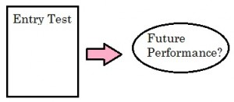
Validity
Validity = accuracy
Validity is concerned with systematic errors
*Assessing measure validity usually involves comparing two different measures of the same construct (convergence)
Types:
External validity
Results of the study are generalizable;
Internal validity
The study’s design and procedures are rigorous
Construct Validity
The measure accurately captures the construct of interest
It is able to distinguish between people with and without those attributes/characteristics
Content Validity
The scale contains all of the important items that accurately measure the construct of interest
No statistical means of assessing content validity; Typically relies on expert consensus
Criterion Validity
The measure predicts an outcome
The measure forecasts future performance (predictive validity)
The assessment of the measure agrees with a measure already shown to be valid/measure the same construct (concurrent validity)
Notes:
“validity refers not to the measure itself (i.e., a psychological test is not valid or invalid) or the scores derived from the measure, but rather the interpretation and use of the measure's scores. To be valid, the interpretation of test scores must be grounded in psychological theory and empirical evidence that demonstrates a relationship between the test and what it purports to measure” (https://www.ncbi.nlm.nih.gov/books/NBK305233/)
According to the book “Neuropsychological assessment in the age of evidence-based practice: Diagnostic and treatment evaluations.”- criterion validity is of the utmost important in choosing tools/assessments to include in a neuropsych eval because it should directly predict cognitive functioning. *Important to choose tests with the most evidence of criterion validity.
Bowden, S. C. (Ed.). (2017). Neuropsychological Assessment in the Age of Evidence-Based Practice: Diagnostic and Treatment Evaluations. Oxford University Press.

Slide 12
Validity continued…
Performance validity
Symptom validity
Ecological validity
Notes:
Suboptimal performance, poor effort, and inflated reports of symptoms or exaggeration are all sources of error and affect validity. Clinicians should be able to detect these and consider when evaluating/interpreting data.

Slide 13
Sensitivity & Specificity
Sensitivity
Proportion of people with a disease who test positive for disease
If you screen positive, how likely is it that you are truly positive?
With a highly sensitive test, few cases of disease are missed
Important when you want to avoid false negative, don’t want to ‘miss’ true disease
Specificity
Proportion of patients without the disease who test negative
If you screen negative, how likely is it that you are truly negative?
Important when false positives can be harmful
Notes:
Ex: ADHD is a neurobiological disorder affecting frontal-subcortical circuitry, which explains cognitive, academic, and behavioral impairments. However, also explains symptoms of many other mental disorders (and attention problems) and we also see common comorbidity with SLD, anxiety, and other neuropsychiatric diagnoses. Differentiating ADHD from other disorders solely based on behavioral criteria results in high heterogeneity which limits the sensitivity and specificity of neuropsychological tests.
A possible solution to this is combining neuropsychological data with behavioral rating scales for differential diagnosis.= requires integration of data sources.

Slide 14
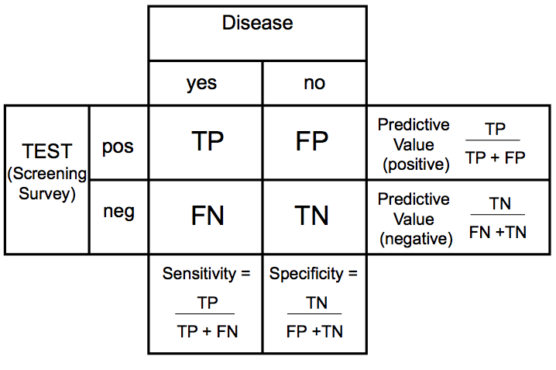
Measuring validity of a screening instrument

Slide 15
Test Fairness
Bias is the presence of systematic error in the measurement of a psychological construct.
Must address test fairness so no group is disproportionately and unfairly disadvantaged by the testing process
Research should demonstrate that measures can be fairly and equivalently used within a diverse population.
Language- some cultural groups have no available tests with norms that are appropriately representative for them.
Notes:
To ensure equivalence in psychological testing must consider functional, conceptual, scalar, linguistic and metric properties of the measures and whether these are consistent across groups.
“Relevant considerations pertain to issues of equivalence in psychological testing as characterized by the following (Suzuki et al., 2014, p. 260):
1.Functional: Whether the construct being measured occurs with equal frequency across groups;
2.Conceptual: Whether the item information is familiar across groups and means the same thing in various cultures;
3.Scalar: Whether average score differences reflect the same degree, intensity, or magnitude for different cultural groups;
4.Linguistic: Whether the language used has similar meaning across groups; and
5.Metric: Whether the scale measures the same behavioral qualities or characteristics and the measure has similar psychometric properties in different cultures. “ (NCBI)

Slide 16
Neuropsychological Assessment

Slide 17
Neuropsychological Assessment
Requires integration of many data sources (history, observation, objective and qualitative data analysis)
Testing highlights the individual’s strengths and impairments
Is both nomothetic and idiographic
Neuropsychologists must understand neurological structure or systems underlying cognitive, emotional, or behavioral function in order to interpret the data obtained from neuropsychological testing.

Slide 18
Neuropsychological Assessment
Can measure:
Attention and concentration
Verbal and visual memory
Auditory and visual processing
Visual-spatial functioning
Language and Reading skills
Sensory Development and Sensory Integration
Gross and fine motor development
Social Skill Development
Executive Functioning
Emotional and Personality development

Slide 19
Neuropsychology is an Evolving Field
Neuropsychology is no longer limited to examining individuals with brain injury or illness
Clinical neuropsychology used to focus on differential diagnosis- now assessments used to address treatment planning, implementation, monitoring, and evaluation of response to treatment.
Findings in the last 40 years have led to a changes in neuropsychological theory and practice, demonstrated by 5 phases of assessment:
Notes:
Clinical psychologists are more and more using knowledge of brain-behavior relationships in assessment and treatment activities.

Slide 20
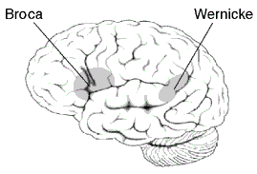
1. Foundation Phase
Neurological exam, clinical assessment, and patient interview main components
Broca and Wernicke- neurological assessment
Late 1800s field became focused on psychometric intelligence test development
Notes:
*Main idea- specific functions are related to specific regions of the brain, however few objective tools were available for research or practice
(Galton, Spearman, Simon and Binet) Field focused on developing intelligence tests. By early 1900s localization of brain function was supported by psychometric test research.
Lashley-brain systems rather than distinct regions and the amount of brain damage determined test performance, not solely location.
This systems understanding of the brain and emphasis on IQ scores led to clinical focus on individual’s level of performance (not pattern of performance)

Slide 21
2. Divergent Phase
Early 20th c- Eastern and Western neuropsychology diverged
Eastern | Western
Clinical neuropsych assessment | Psychometric Interpretation
Began brain mapping | Spearman & Wechsler
Qualitative & Quantitative | Single tests of disability

Slide 22
3. Fixed-Battery Phase
Development of standardized test batteries to localize brain dysfunction
Emphasis on normative data, reliability, and validity
4. Flexible-Battery Phase
Integration of neuropsychological assessment data from various sources
Focus on pattern of performance in individuals
Functional profiles- strengths and weaknesses of individuals
5. Cognitive Hypothesis-Testing Phase
Still uses flexible-battery approach, used for evaluation and intervention of wide range of disorders.
Identifies relationships between strengths and weaknesses
Used to link assessment results to interventions
Notes:
3. Western psychometric focus led to this.
Advantage- same measures used across clients, because of this clinicians may have greater clinical insight into test performance deviations (seen it before)
Con- some subtests lack psychometric integrity, limiting sensitivity and specificity; may not fully capture some functions, costly and timely, subtests not discrete
* Psychometric integrity- true measure of performance, can’t have seen or completed this test before.
4. push for understanding relationship between brain and psychosocial factors. Goal of expanding neuropsych assessment beyond differential diagnosis to also include treatment planning and intervention monitoring. *This approach is predominant in neuropsychology today (Western hemisphere). Empirical efforts have focused on normative populations.
5. Example of utility of this approach: Specific learning disorders identification. Assessing processing strengths and weaknesses. Specifically, the concordance-discordance model (introduced by Hale & Fiorello in 2004) establishes a cognitive strength, and cognitive weakness, and an achievement deficit associated with the cognitive weakness. This model has revealed important brain-behavior characteristics in kids with various types of SLD even with profile differences among the subtypes of SLD.

Slide 23
Conclusions
Phases show how field has grown
Demonstrates how the research has guided practice and how integrated they are.
Goal is to link assessment to treatment efficacy of intervention.
Practice must be interpretive and psychometrics have limitations
The same normative score may not mean the same thing for everyone.
Particularly when working with children, must use a neurodevelopmental perspective that recognizes brain-behavior relationships are dynamic and changing.
Notes:
Neuropsychology has become more interdisciplinary and takes into account data and information from various areas of a person’s life as well as draws from other fields of science.
Brain-behavior relationships may vary for individuals, even though valid for larger populations- neuroimaging studies have shown that not every brain processes info the same way- individuals with disabilities may use different brain areas or systems and even within this group individuals may use different areas to compensate for deficits.
There is not one phenotype.
Must understand data and information obtained from assessments within this neurodevelopmental framework and use it to guide interpretation.

Slide 24
References
Bowden, S. C. (Ed.). (2017). Neuropsychological Assessment in the Age of Evidence-Based Practice: Diagnostic and Treatment Evaluations. Oxford University Press.
Committee on Psychological Testing, Including Validity Testing, for Social Security Administration Disability Determinations; Board on the Health of Select Populations; Institute of Medicine. Psychological Testing in the Service of Disability Determination. Washington (DC): National Academies Press (US); 2015 Jun 29. 3, Overview of Psychological Testing. Available from: https://www.ncbi.nlm.nih.gov/books/NBK305233/
Eabon, M., & Abrahamson, D. (n.d.). Understanding psychological testing and assessment. Retrieved September 21, 2017, from http://www.apa.org/helpcenter/assessment.aspx
Framingham, J. (2016, July 17). What is Psychological Assessment? Retrieved September 21, 2017, from https://psychcentral.com/lib/what-is-psychological-assessment/
Gandhi, P. (n.d.). Neuro Assessment & Development Center. Retrieved September 21, 2017, from https://www.neurodevelop.com/neuropsychological_testing
Hale, J. B., Wilcox, G., & Reddy, L. A. (2016). Neuropsychological Assessment. In APA Handbook of Clinical Psychology: Applications and Methods (Vol. 3, pp. 139-165). Washington, DC: American Psychological Association.
Rolon-Arroyo, B., Arnold, D. H., Harvey, E. A., & Marshall, N. (2016). Assessing Attention and Disruptive Behavior Symptoms in Preschool-Age Children: The Utility of the Diagnostic Interview Schedule for Children. Journal of Child and Family Studies, 25(1), 65–76. http://doi.org/10.1007/s10826-015-0203-x

