Slide 1
Assessment and Screening July 7, 2016

Slide 2
Overview
Diagnostic Interviews
Questionnaires/Screening Tools
Measurement Error
Reliability
Validity

Slide 3
Development of diagnostic interviews
Early attempts to estimate burden of psychopathology were based on hospital records, interviews with local doctors, household informants, questionnaires without diagnostic criteria
Interest in developing standardized personal interviews came out of WWII
Neuropsychiatric Screening Adjunct (NSA)

Slide 4
Development of diagnostic interviews
Instruments originally based on the DSM-III
Diagnostic Interview Schedule (DIS)
Composite International Diagnostic Interview (CIDI)
Further operationalized diagnostic criteria into specific interview questions
These instruments have been updated based on changes to the DSM
Often considered “gold standard” of psychiatric diagnosis

Slide 5
KSADS
The Schedule for Affective Disorders and Schizophrenia (SADS)
KSADS (Kiddie-SADS) is a version of the SADS that is designed for school aged children 6-18 years.
Administered by interviewing the parent and child
Clinician determines a final consensus rating for each item
Screen for all disorders with follow up supplement for disorders endorsed
The K-SADS-PL was designed to obtain severity ratings of symptomatology, and assess present and lifetime history of psychiatric disorders.

Slide 6
KSADS Example Questions
Depressed Mood
Current:
In the past two weeks, how often have you felt sad, down, or depressed, with the down feeling lasting most of the day?
Not at all
Rarely
Several days
More than half the days
Nearly every day
Past:
If Current Symptoms:
Was there ever another a time in the past that you felt sad or down for most of the day, nearly every day, for two weeks or longer?
If No Current Symptoms:
Was there ever a time in the past that you felt sad or down for most of the day, nearly every day, for two weeks or longer?

Slide 7
Other Diagnostic Interviews
Structured Clinical Interview for DSM-IV (SCID)
Schedule for Affective Disorders and Schizophrenia (SADS)
Mini-international neuropsychiatric interview (MINI)
World Health Organization Composite International Diagnostic Interview (CIDI)
Schedules for Clinical Assessment in Neuropsychiatry (SCAN)
Diagnostic Interview for Genetic Studies (DIGS)

Slide 8
Screening Instruments
Screening instruments are brief measures used to differentiate typically developing populations from those with potentially clinical symptoms
Brief interview
Self report questionnaires
Parent report questionnaires
Teacher report questionnaires
There are screening instruments for specific disorders, clusters of disorders, or general psychological distress

Slide 9
Why use screening instruments?
Shorter than diagnostic interview
Less costly than diagnostic interview
Does not require licensed clinician
Some diagnostic interviews can be administered by a lay interviewer, but training is costly
Many screening instruments are based on DSM criteria and have been validated in different populations and languages

Slide 10
Screening for ADHD using the SWAN
QUESTIONS:
Give close attention to detail and avoid careless mistakes
Sustain attention on tasks or play activities
Listen when spoken to directly
Follow through on instructions & finish school work/chores
Organize tasks and activities
Engage in tasks that require sustained mental effort
Keep track of things necessary for activities
Ignore extraneous stimuli
Remember daily activities
Sit still (control movement of hands/ feet or control squirming)
Stay seated (when required by class rules/social conventions)
Modulate motor activity (inhibit inappropriate running/climbing)
Play quietly (keep noise level reasonable)
Settle down and rest (control constant activity)
Modulate verbal activity (control excess talking)
Reflect on questions (control blurting out answers)
Await turn (stand in line and take turns)
Enter into conversations & games (control interrupting/intruding)
ANSWER CHOICES:
-3=Far Below Average; -2=Below Average; -1=Slightly Below Average; 0=Average; 1=Slightly Above Average; 2=Above Average; 3=Far Above Average

Slide 11
Measurement Error
Measurement Error: The difference between a measured value of quantity and its true value.
In statistics, an error is not a "mistake". Variability is an inherent part of things being measured and of the measurement process.
Random Error
An error in measurement caused by factors that vary from one measurement to another
Random errors usually result from the experimenter's inability to take the same measurement in exactly the same way to get exact the same number.
Systematic Error
Systematic errors are errors associated with a flaw in the instrument, equipment, or in the design of the experiment.

Slide 12
Reliability
Reliable = consistent
Consistent results over repeated applications.
Reliability is concerned with random error; e.g., same survey given at two times of the day that gives different results (low correlation) for the same participants is likely not reliable

Slide 13
Measuring reliability
Test-retest reliability
The consistency of measure from one time to another
Inter-rater reliability
The degree to which different raters/observers give consistent estimates of the same construct (kappa, correlation, concordance, ICC)
Internal consistency
The consistency of results across items in a test (Cronbach’s alpha)
Parallel-Forms Reliability
The the consistency of the results of two tests constructed in the same way from the same content domain.

Slide 14
Are we sure it’s reliable?
If test-retest agreement is high, is the interview truly reliable?
If test-retest agreement is low, is the interview unreliable?

Slide 15
Validity
Validity = accuracy
A valid measure actually assesses what it intends to measure.
Validity is concerned with systematic errors; e.g., Is depression captured by a certain score on a self-rating scale?
Assessing measure validity usually involves comparing two different measures of the same construct(e.g., self-rating scales versus diagnostic interview)

Slide 16
Measuring Validity
Construct Validity
The measure accurately captures the construct of interest
It is able to distinguish between people with and without those attributes/characteristics
Content Validity
The scale contains all of the important items that accurately measure the construct of interest
No statistical means of assessing content validity; Typically relies on expert consensus
Criterion Validity/Predictive Validity
The measure forecasts future performance (predictive validity)
The assessment of the measure agrees with a measure already shown to be valid (concurrent validity)

Slide 17
Reliability and Validity
Valid measures can be unreliable
Reliable measures may not be valid

Slide 18
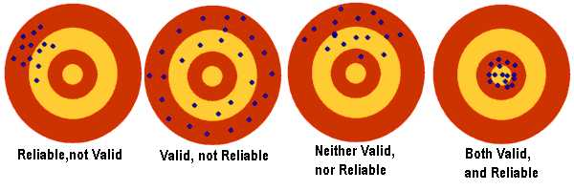
Validity vs Reliability
Notes:
\

Slide 19
Sensitivity & Specificity
Sensitivity
Proportion of people with a disease who test positive for disease
If you screen positive, how likely is it that you are truly positive?
With a highly sensitive test, few cases of disease are missed
Specificity
Proportion of patients without the disease who test negative
If you screen negative, how likely is it that you are truly negative?

Slide 20
Sensitivity vs. Specificity
Often a trade off between sensitivity and specificity
When to use a sensitive test:
When you want to avoid false negative, don’t want to ‘miss’ true disease
Consider consequences of a false negative result
Infectiousness
Rapidly advancing disease
During early stages of diagnosis
When to use a specific test:
Often used to confirm diagnosis
Important when false positives can be harmful
Consider consequences of a false positive result
Diagnosis can have negative impact on mental health
Unnecessary invasive testing or treatment

Slide 21
Positive & Negative Predictive Value
Positive Predictive Value
Probability that those who screen positive truly have disease
Negative Predictive Value
Probability that those who screen negative truly don’t have disease

Slide 22
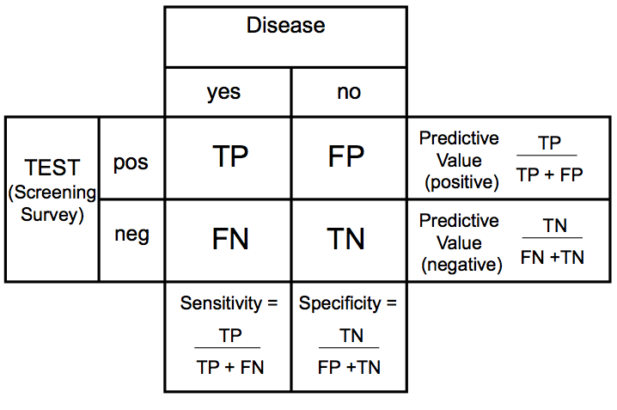
Measuring validity of a screening instrument

Slide 23
Assessing validity of a diagnostic interview
Do the interview’s questions accurately and exhaustively map onto the symptoms and other criteria in the DSM?
Are the skip rules correct, so that respondents are not asked questions to which only one answer is logically possible?
Do respondents understand the questions as intended?
Do the respondents have the information necessary to answer the questions?
Are the questions acceptable to respondents?
Was the interviewing situation conducive to honest and complete answers?
Have the respondent’s responses been correctly entered into the data base?
Does the computer diagnostic program accurately map onto the diagnostic algorithms of the Manual?
Does the computer program distinguish cases where a disorder’s absence is equivocal from cases known to be negative?

Slide 24
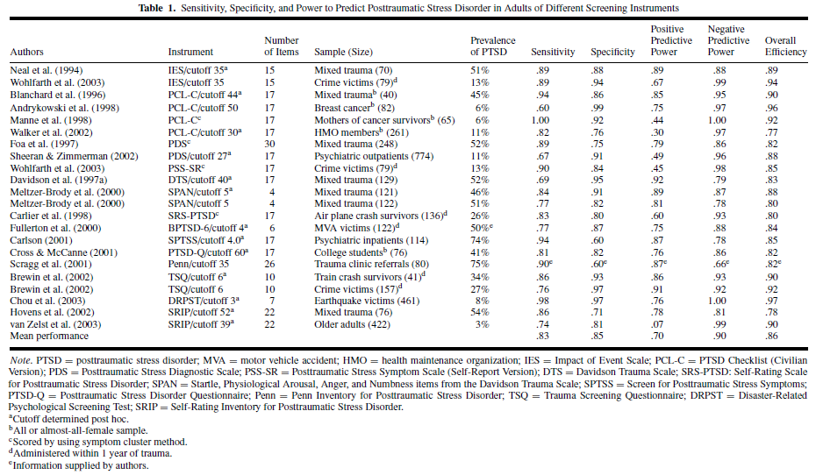
Comparing psychometrics of instruments

Slide 25
Conclusion
It is important to carefully consider the strengths and weaknesses of different assessment tools
Selecting instruments for a research study
Developing new interviews or rating scales
Literature review
Data analysis & research projects

Slide 26
References
Robins LN. Birth and development of psychiatric interviews. Chapter 11 in Textbook in Psychiatric Epidemiology. Second Edition. Tsuang MT, Tohen M. eds. Wiley-Liss, 2002.
Goldstein JM, Simpson JC. Validity: Definitions and application to psychiatric research. Chapter 5 In Textbook in Psychiatric Epidemiology. Second Edition. Tsuang MT, Tohen M. eds. Wiley-Liss, 2002.
First MB. DSM-IV and psychiatric epidemiology. Chapter 13 in Textbook in Psychiatric Epidemiology. Second Edition. Tsuang MT, Tohen M. eds. Wiley-Liss, 2002.
Brewin C. Systematic review of screening instruments for adults at risk of PTSD. Journal of Traumatic Stress. 2005;18(1):53-62.

