Slide 1

Collaborative Visual analytics with rcloud
INLS 641 Presentation
Bo Zhou

Slide 2
Abstract
Role of data science team is emerging, especially in larger organization
Individual analysts work on loosely related problems and then share with other groups
Problems when moving results from exploratory data analyses (EDA) into automated visualizations, diagnostics and reports
RCloud, supporting collaborative data analysis, visualization and web deployment

Slide 3
introduction
Previous work has identified important areas for improvement:
Discoverability – A lack of transparency in accessing the work of other team members (DB Connection, Data Cleaning)
Technology Transfer – From Exploratory Data Analyses to Deployment
Coexistence – Richness of interactive visualization tools is separated from the power of statistical programming
Interviews with Data Scientists:
“I could look at other peoples’ code and play with their code and data sets as well”
“We also share exploratory analyses and reports so that we can still exchange knowledge even if the work didn’t make it into a larger project.”
“It is important to have testing frameworks so you can go back and test all of your data.”

Slide 4
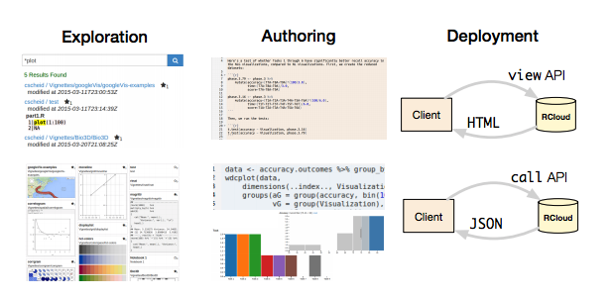
RCloud
A software environment supporting the end-to-end visual analytics process for individuals and teams and their work within larger organizations.
RCloud knits together some familiar tools, and provides new features to find data and code; create experimental notebooks; run experiments; annotate and deploy experiments as end-user websites or as reusable, callable services; and to share, search and recommend these artifacts.

Slide 5
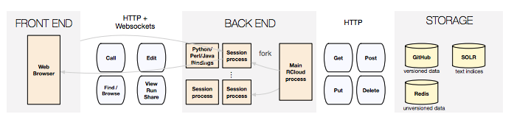
System design and implementation -Notebook
Main unit of computation in RCloud is a notebook. Note book holds a sequence of cells, each of which is a snippet of code or hypertext in Markdown.
Two Main Contribution: “Always Deployed” & “No Save Button”
Version Control is built on top of Github’s gists, which are an HTTP interface for simplified repositories.

Slide 6
System design and implementation - Reputation and interest
A side benefit of centralizing the execution and storage of notebooks is that it becomes feasible to collect usage information that is lost in conventional environments.
Automatic Recommendations (Famous by Amazon, Netflix)
Explicit Interest – Starring, count of stars
Implicit Interest – clickthrough counts and execution counts

Slide 7
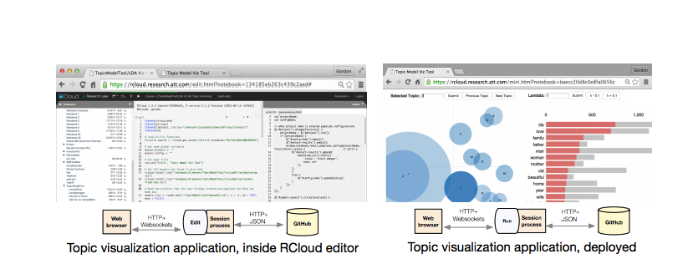
System design and implementation - Deployment of notebooks
Every notebook in Rcloud is named by URL, and notebooks by default are visible in the entire organization.
“Share-by-URL” button

Slide 8
Two way communication
Provide full access to the R statistical programming language during the development of a data analysis notebook.
The R layer that communicates with Javascript does not expose unprotected evaluation of arbitrary functions. Instead, every function that the R layer intends to expose is associated with a large, cryptographically-safe random number (a “hash”).
The same idea of exposing functionality via hashes can be used to give the server-side of RCloud access to Javascript functions.
As a result, the features required to provide safe access to R from the client, and Javascript access from the R side, also enable full two-way communication between the languages. (Leaflet.js to R)

Slide 9
evaluations
13 current or recent users are interviewed
Sharing results - Lilo says, “The best part is how easily you can share code. You can find a working example, rather than wearing out Google and finding questionable examples that may or may not work.”
Forking - “It’s one of the handiest functions, because instead of having to find it, copy, paste it, you just hit Fork, rename it, and it’s done. It’s pretty amazing.”
“Users can always fork the notebooks and make changes, but I feel that if the owner of the notebook [adds a user interface], it’s easier to run.” (Show some options)

Slide 10
Limitation
Versioning and Upgrading – RCloud does not separate its development and deployment environments, and the version of shared notebook is by default.
Textual search is easy, Relevant search is hard - Search might come from obsolete and erroneous notebooks. In addition, important metadata is not easily searchable. Relying on users to tag notebooks is a conscious effect.
Collaboration is still hard sometime - Although popular, forking poses a problem when dozens of versions of a notebook proliferate. A fully general solution seems intractable. Use git’s ideal of decentralized code repo.

Slide 11
Conclusion and future work
Designed, implemented and deployed a prototype visual analytics environment for data exploration, sharing, presentation, and publishing. It is a step toward practical “DevOps for data science” and reproducible, publishable data science experiments.
RCloud was readily accepted as a platform for deployment of visualizations and interactive exploration tools at our organization. Notebook sharing and publishing were eagerly adopted.
On the other hand, features for single-user data exploration that compete with existing mature tools, were not readily accepted (Bad design or ‘mere’ change aversion? )

