Slide 1

Finite State Machines
Chapter 5

Slide 2
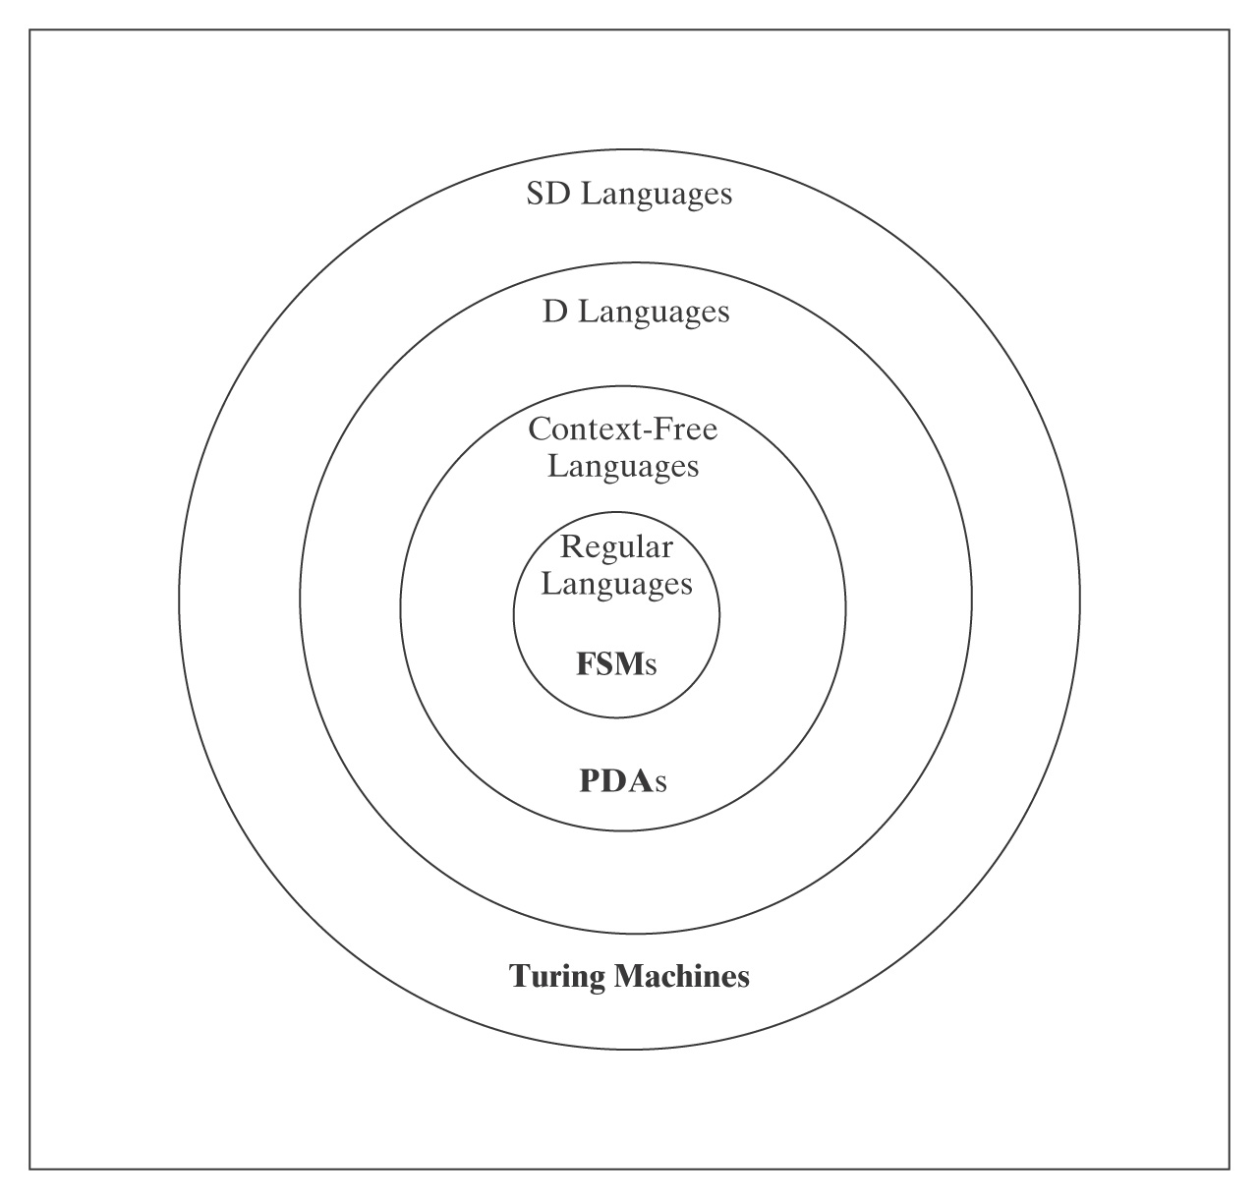
Languages and Machines

Slide 3
Regular Languages
Regular Language
L
Regular Expression
Accepts
Finite State Machine

Slide 4
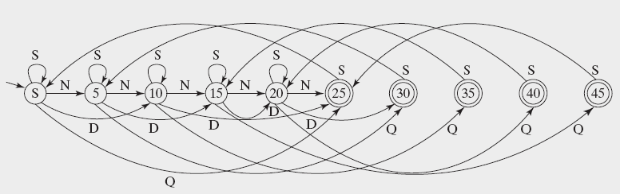
Finite State Machines
An FSM to accept $.50 in change:

Slide 5
Definition of a DFSM
M = (K, Σ, δ, s, A), where:
K is a finite set of states
Σ is an alphabet
s ∈ K is the initial state
A ⊆ K is the set of accepting states, and
δ is the transition function from (K × Σ) to K

Slide 6
Accepting by a DFSM
Informally, M accepts a string w iff M ends up in some element of A (an accept state) when it has finished reading w.
The language accepted by M, denoted L(M), is the set of all strings accepted by M.

Slide 7
Configurations of DFSMs
A configuration of a DFSM M is an element of:
K × Σ*
It captures the two things that can make a difference to M’s future behavior:
• its current state
• the input that is still left to read.
The initial configuration of a DFSM M, on input w, is:
(s_{M}, w)

Slide 8
The Yields Relations
The yields-in-one-step relation |-_{M}:
(q, w) |-_{M} (q', w') iff
• w = a w' for some symbol a ∈ Σ, and
• δ (q, a) = q'
|-_{M} * is the reflexive, transitive closure of |-_{M}.

Slide 9
Computations Using FSMs
A computation by M is a finite sequence of configurations C₀, C₁, …, C_{n} for some n ≥ 0 such that:
• C₀ is an initial configuration,
• C_{n} is of the form (q, ε), for some state q ∈ K_{M},
• C₀ |-_{M} C₁ |-_{M} C₂ |-_{M} … |-_{M} C_{n}.

Slide 10
Accepting and Rejecting
A DFSM M accepts a string w iff:
(s, w) |-_{M} * (q, ε), for some q ∈ A.
A DFSM M rejects a string w iff:
(s, w) |-_{M}* (q, ε), for some q ∉ A_{M}.
The language accepted by M, denoted L(M), is the set of all strings accepted by M.
Theorem: Every DFSM M, on input s, halts in |s| steps.

Slide 11
An Example Computation
An FSM to accept odd integers:
even odd
even
q₀ q₁
odd
On input 235, the configurations are:
(q₀, 235) |-_{M} (q₀, 35)
|-_{M}
|-_{M}
Thus (q₀, 235) |-_{M}* (q₁, ε)

Slide 12
Regular Languages
A language is regular iff it is accepted by some FSM.

Slide 13
A Very Simple Example
L = {w ∈ {a, b}* :
every a is immediately followed by a b}.

Slide 14
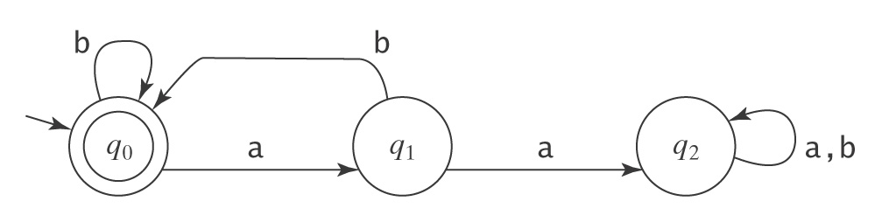
A Very Simple Example
L = {w ∈ {a, b}* :
every a is immediately followed by a b}.

Slide 15
Parity Checking
L = {w ∈ {0, 1}* : w has odd parity}.

Slide 16
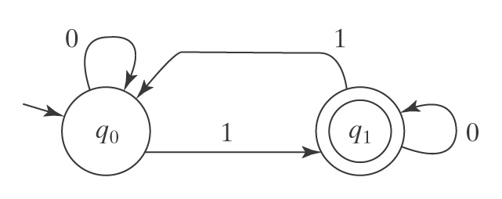
Parity Checking
L = {w ∈ {0, 1}* : w has odd parity}.

Slide 17
No More Than One b
L = {w ∈ {a, b}* : every a region in w is of even length}.

Slide 18
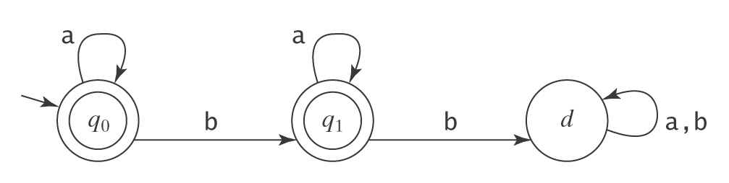
No More Than One b
L = {w ∈ {a, b}* : w has no more than 1 b}.

Slide 19
Checking Consecutive Characters
L = {w ∈ {a, b}* :
no two consecutive characters are the same}.

Slide 20
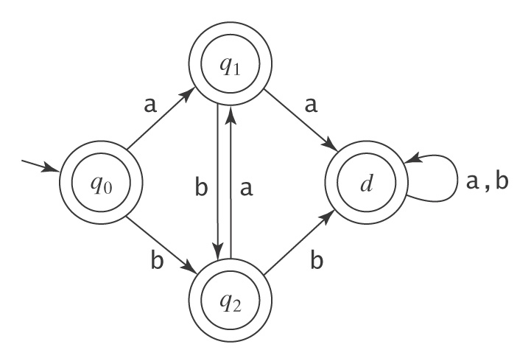
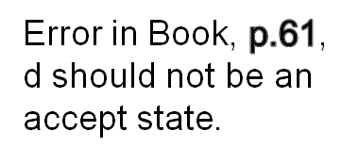
Checking Consecutive Characters
L = {w ∈ {a, b}* :
no two consecutive characters are the same}.

Slide 21
Dead States
L =
{w ∈ {a, b}* : every a region in w is of even length}

Slide 22
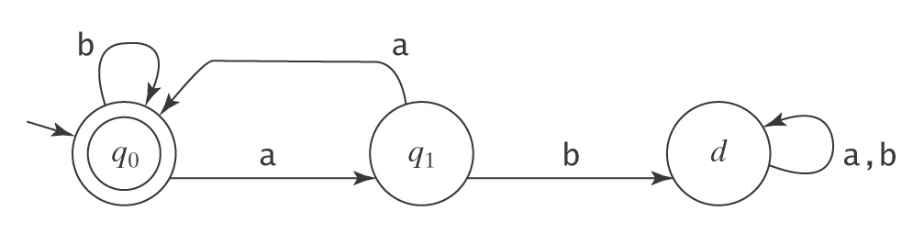
Dead States
L =
{w ∈ {a, b}* : every a region in w is of even length}

Slide 23
Dead States
L =
{w ∈ {a, b}* : every b in w is surrounded by a’s}

Slide 24
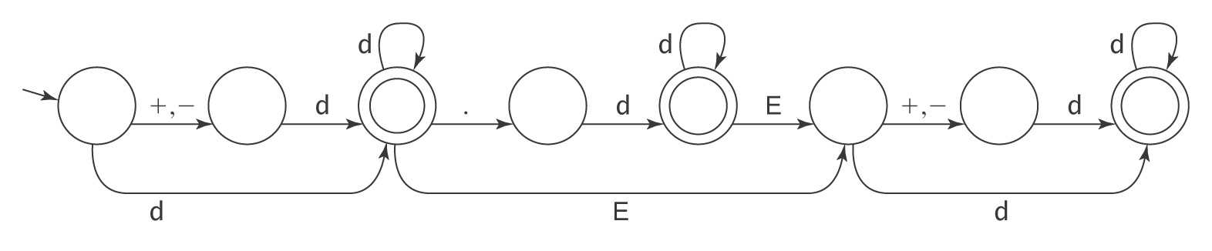
The Language of Floating Point Numbers is Regular
Example strings:
+3.0, 3.0, 0.3E1, 0.3E+1, -0.3E+1, -3E8
The language is accepted by the DFSM:

Slide 25
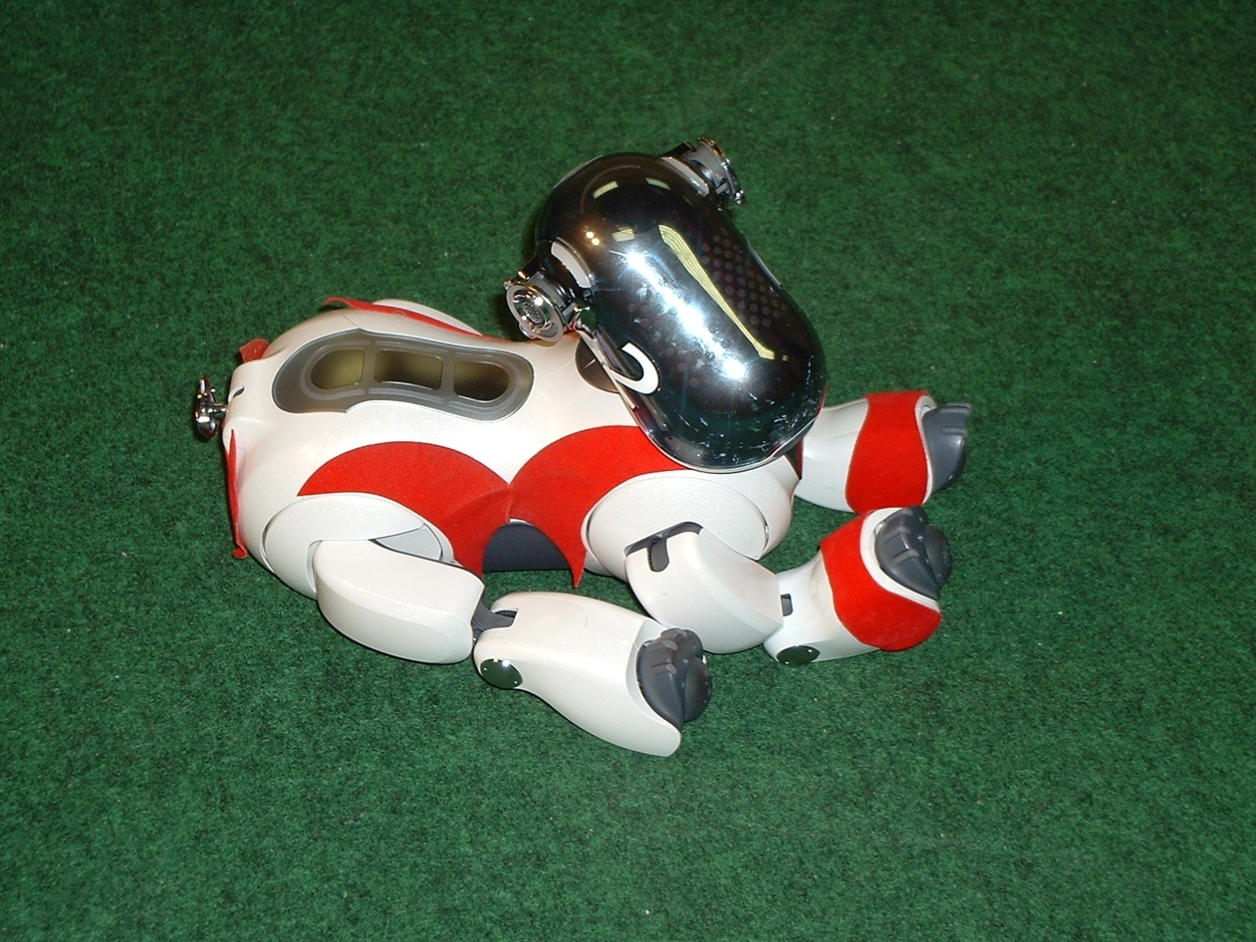
Controlling a Soccer-Playing Robot

Slide 26
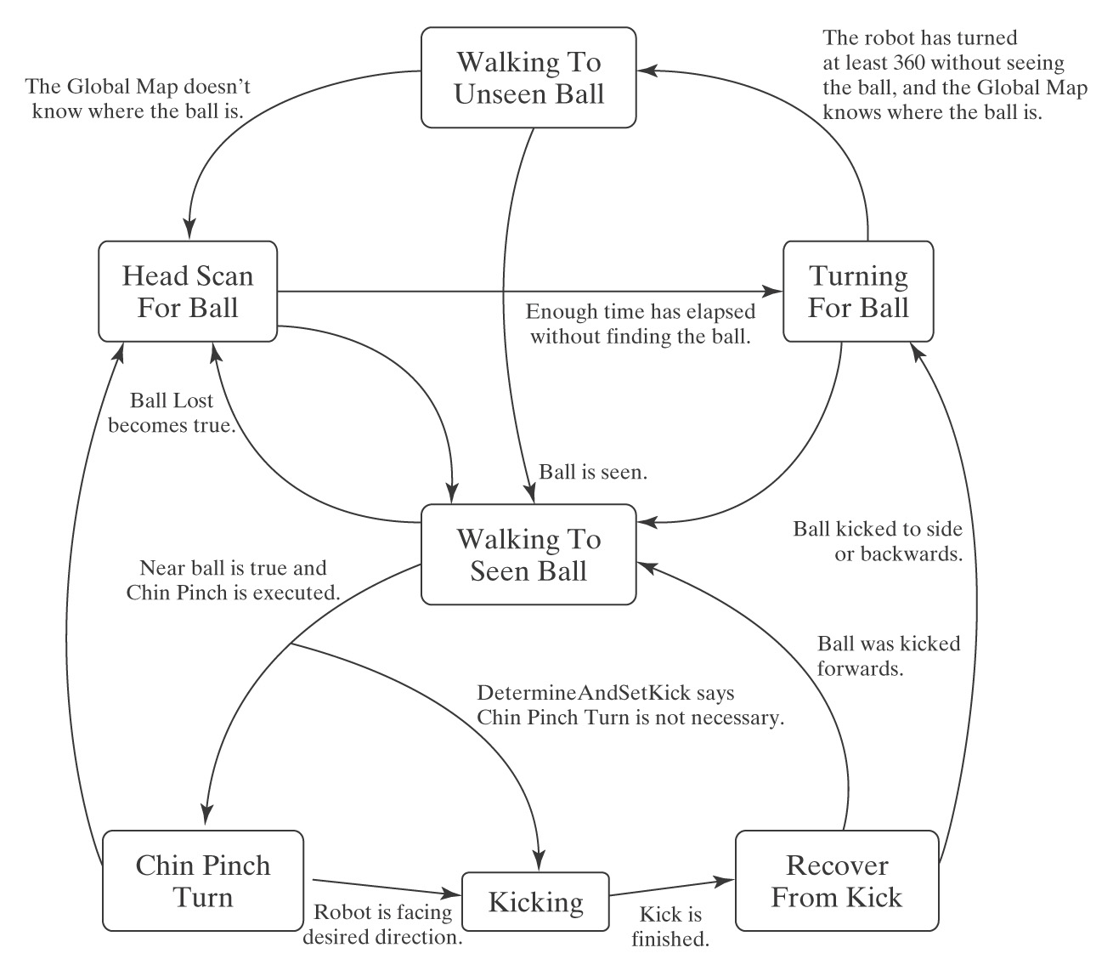
A Simple Controller

Slide 27
Programming FSMs
Cluster strings that share a “future”.
Let L = {w ∈ {a, b}* : w contains an even number of a’s and an odd number of b’s}

Slide 28
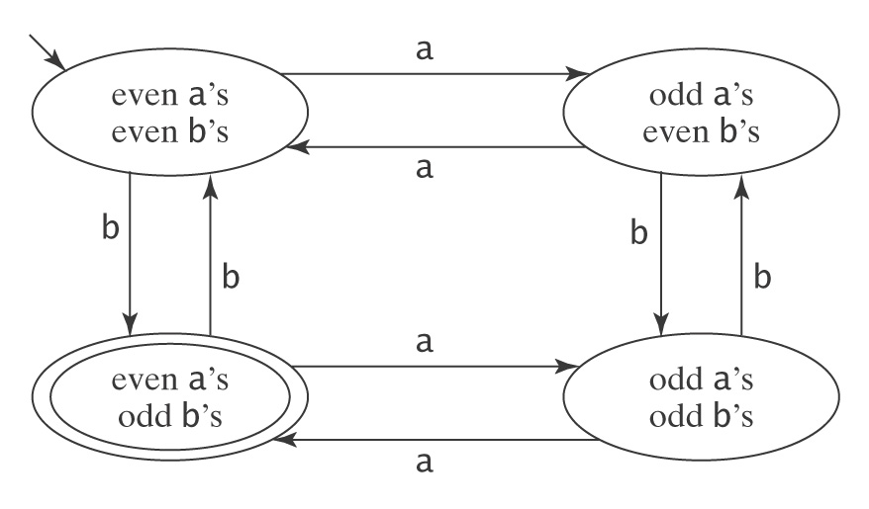
Even a’s Odd b’s

Slide 29
Vowels in Alphabetical Order
L = {w ∈ {a - z}* : all five vowels, a, e, i, o, and u,
occur in w in alphabetical order}.

Slide 30
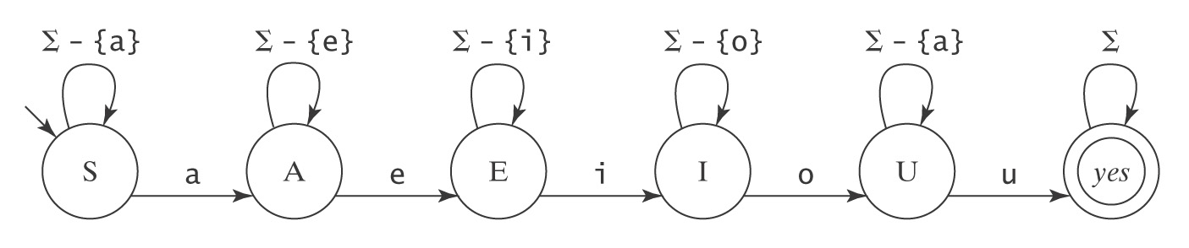
Vowels in Alphabetical Order
L = {w ∈ {a - z}* : all five vowels, a, e, i, o, and u,
occur in w in alphabetical order}.

Slide 31
Programming FSMs
L = {w ∈ {a, b}* : w does not contain the substring aab}.
Notes:
Start by building an FSM for not L. Then swap accepting and nonaccepting states.
Note that this foreshadows the claim that we will make later that the regular languages are closed under complement.

Slide 32
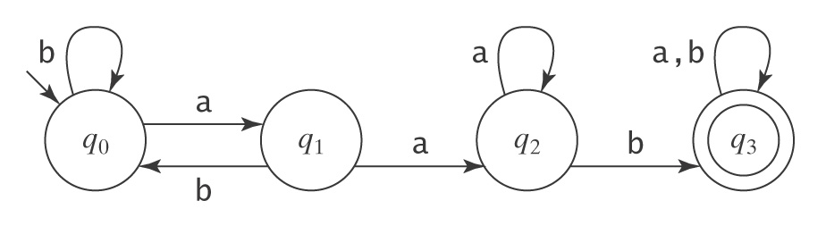
Programming FSMs
L = {w ∈ {a, b}* : w does not contain the substring aab}.
Start with a machine for ¬L:
How must it be changed?

Slide 33
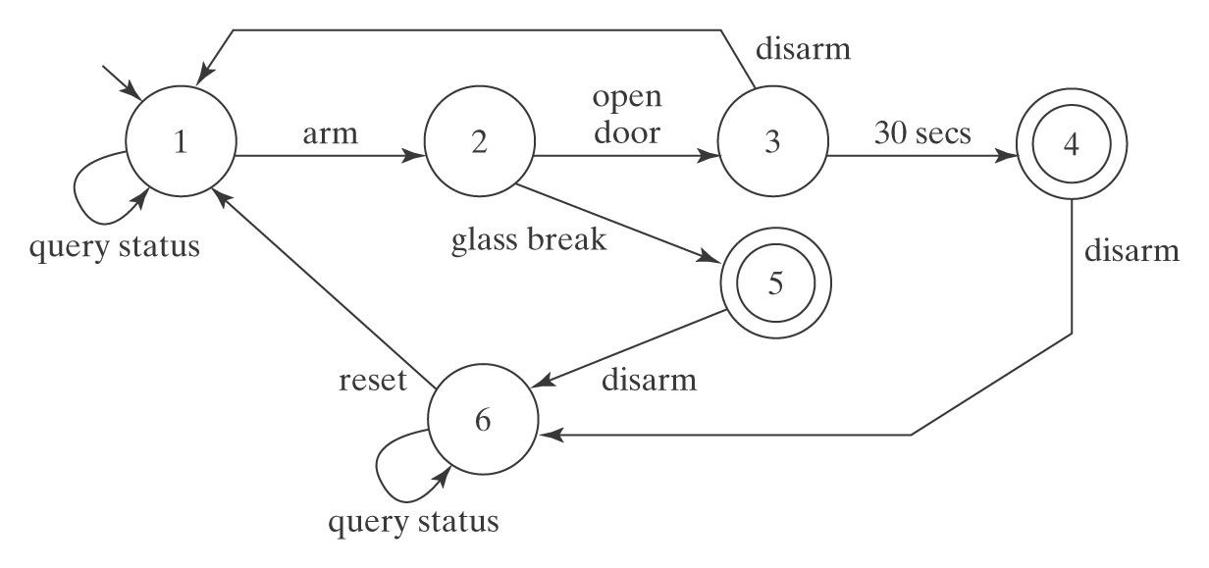
A Building Security System
L = {event sequences such that the alarm should sound}

Slide 34
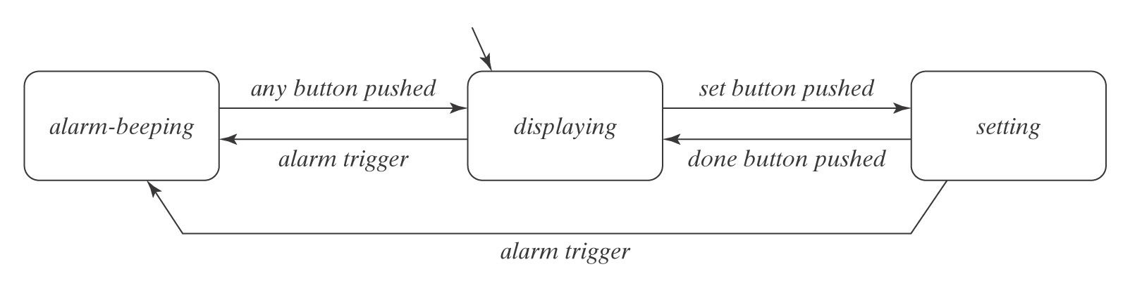
Finite State Representations in Software Engineering
A high-level state chart model of a digital watch.

Slide 35
The Missing Letter Language
Let Σ = {a, b, c, d}.
Let L_{Missing} =
{w : there is a symbol a_{i} ∈ Σ not appearing in w}.
Try to make a DFSM for L_{Missing}:
Notes:
Try it deterministically.

Slide 36
Definition of an NDFSM
M = (K, Σ, Δ, s, A), where:
K is a finite set of states
Σ is an alphabet
s ∈ K is the initial state
A ⊆ K is the set of accepting states, and
Δ is the transition relation. It is a finite subset of
(K × (Σ ∪ {ε})) × K

Slide 37
Accepting by an NDFSM
M accepts a string w iff there exists some path along which w drives M to some element of A.
The language accepted by M, denoted L(M), is the set of all strings accepted by M.

Slide 38
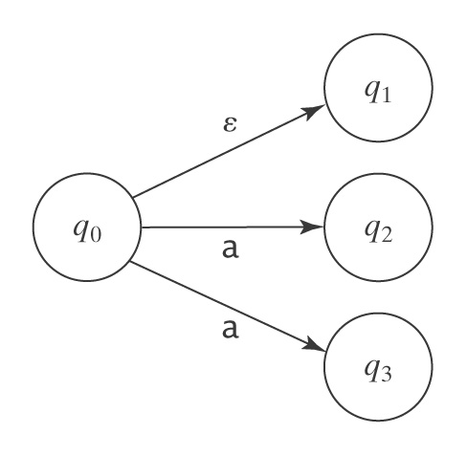
Sources of Nondeterminism

Slide 39
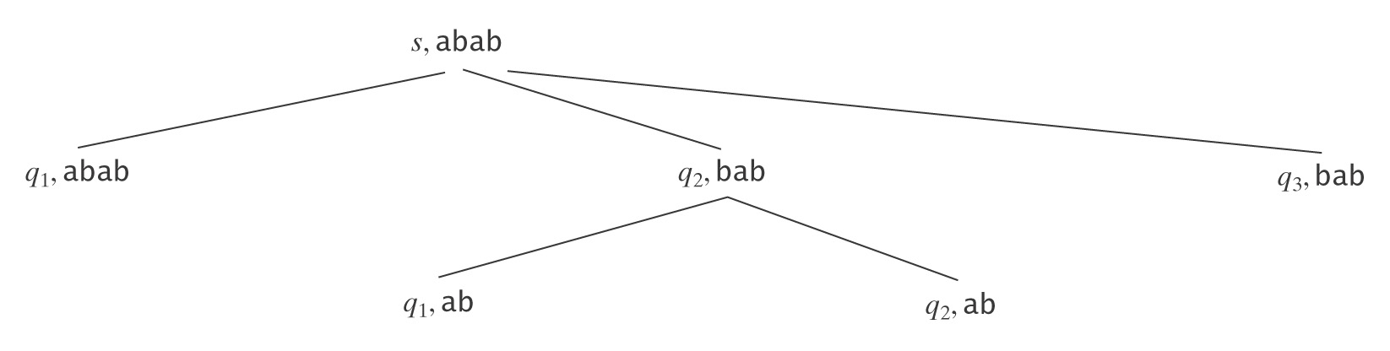
Analyzing Nondeterministic FSMs
Two approaches:
• Explore a search tree:
• Follow all paths in parallel

Slide 40
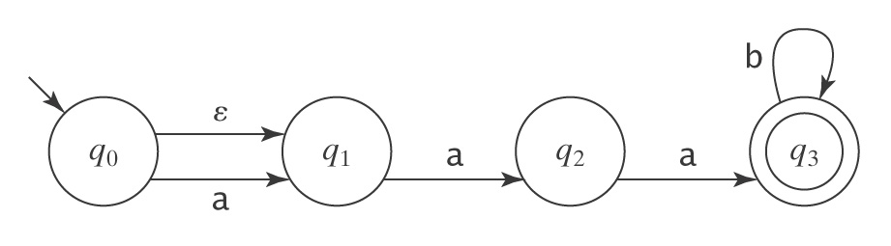
Optional Substrings
L = {w ∈ {a, b}* : w is made up of an optional a followed by aa followed by zero or more b’s}.

Slide 41
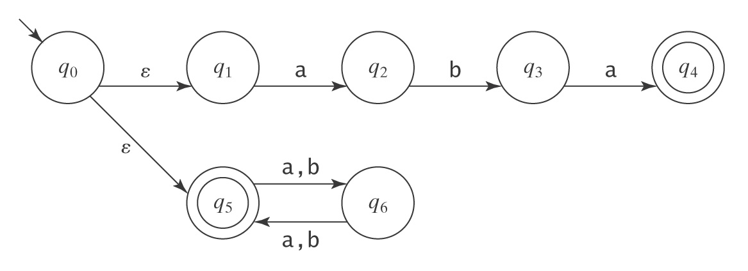
Multiple Sublanguages
L = {w ∈ {a, b}* : w = aba or |w| is even}.

Slide 42
The Missing Letter Language
Let Σ = {a, b, c, d}. Let L_{Missing} = {w : there is a symbol a_{i} ∈ Σ not appearing in w}

Slide 43
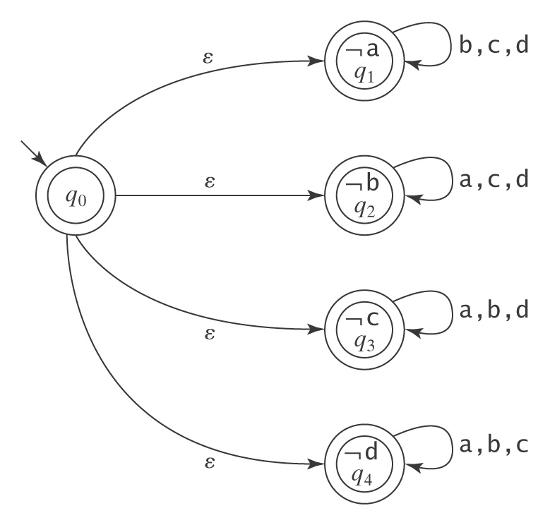
The Missing Letter Language

Slide 44
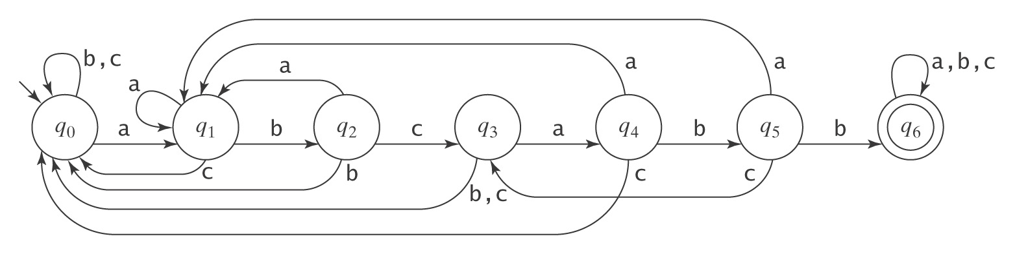
Pattern Matching
L = {w ∈ {a, b, c}* : ∃x, y ∈ {a, b, c}* (w = x abcabb y)}.
A DFSM:

Slide 45
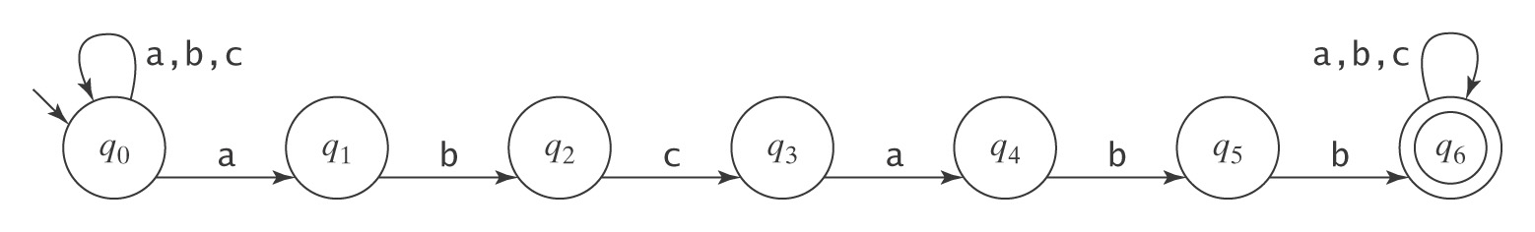
Pattern Matching
L = {w ∈ {a, b, c}* : ∃x, y ∈ {a, b, c}* (w = x abcabb y)}.
An NDFSM:

Slide 46
Pattern Matching with NDFSMs
L = {w ∈ {a, b}* :
∃x, y ∈ {a, b}* : w = x aabbb y or
w = x abbab y }

Slide 47
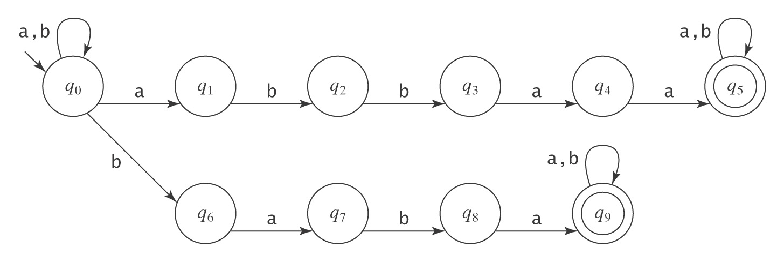
Multiple Keywords
L = {w ∈ {a, b}* : ∃x, y ∈ {a, b}*
((w = x abbaa y) ∨ (w = x baba y))}.

Slide 48
Checking from the End
L = {w ∈ {a, b}* :
the fourth to the last character is a}

Slide 49
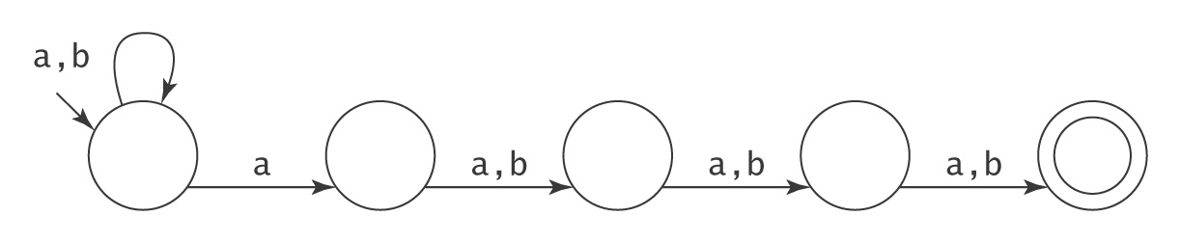
Checking from the End
L = {w ∈ {a, b}* :
the fourth to the last character is a}
Notes:
Try it with aabaaa.

Slide 50
Another Pattern Matching Example
L = {w ∈ {0, 1}* : w is the binary encoding of a positive integer that is divisible by 16 or is odd}

Slide 51
Another NDFSM
L₁= {w ∈ {a, b}*: aa occurs in w}
L₂= {x ∈ {a, b}*: bb occurs in x}
L₃= {y : ∈ L₁ or L₂ }
M₁ =
M₂=
M₃=

Slide 52
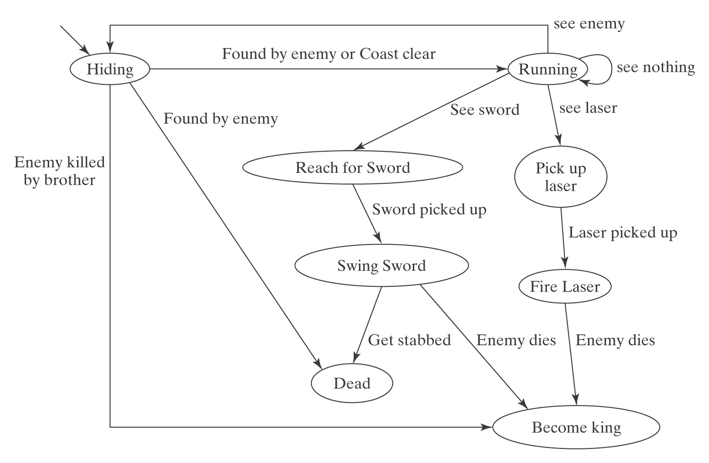
A “Real” Example

Slide 53
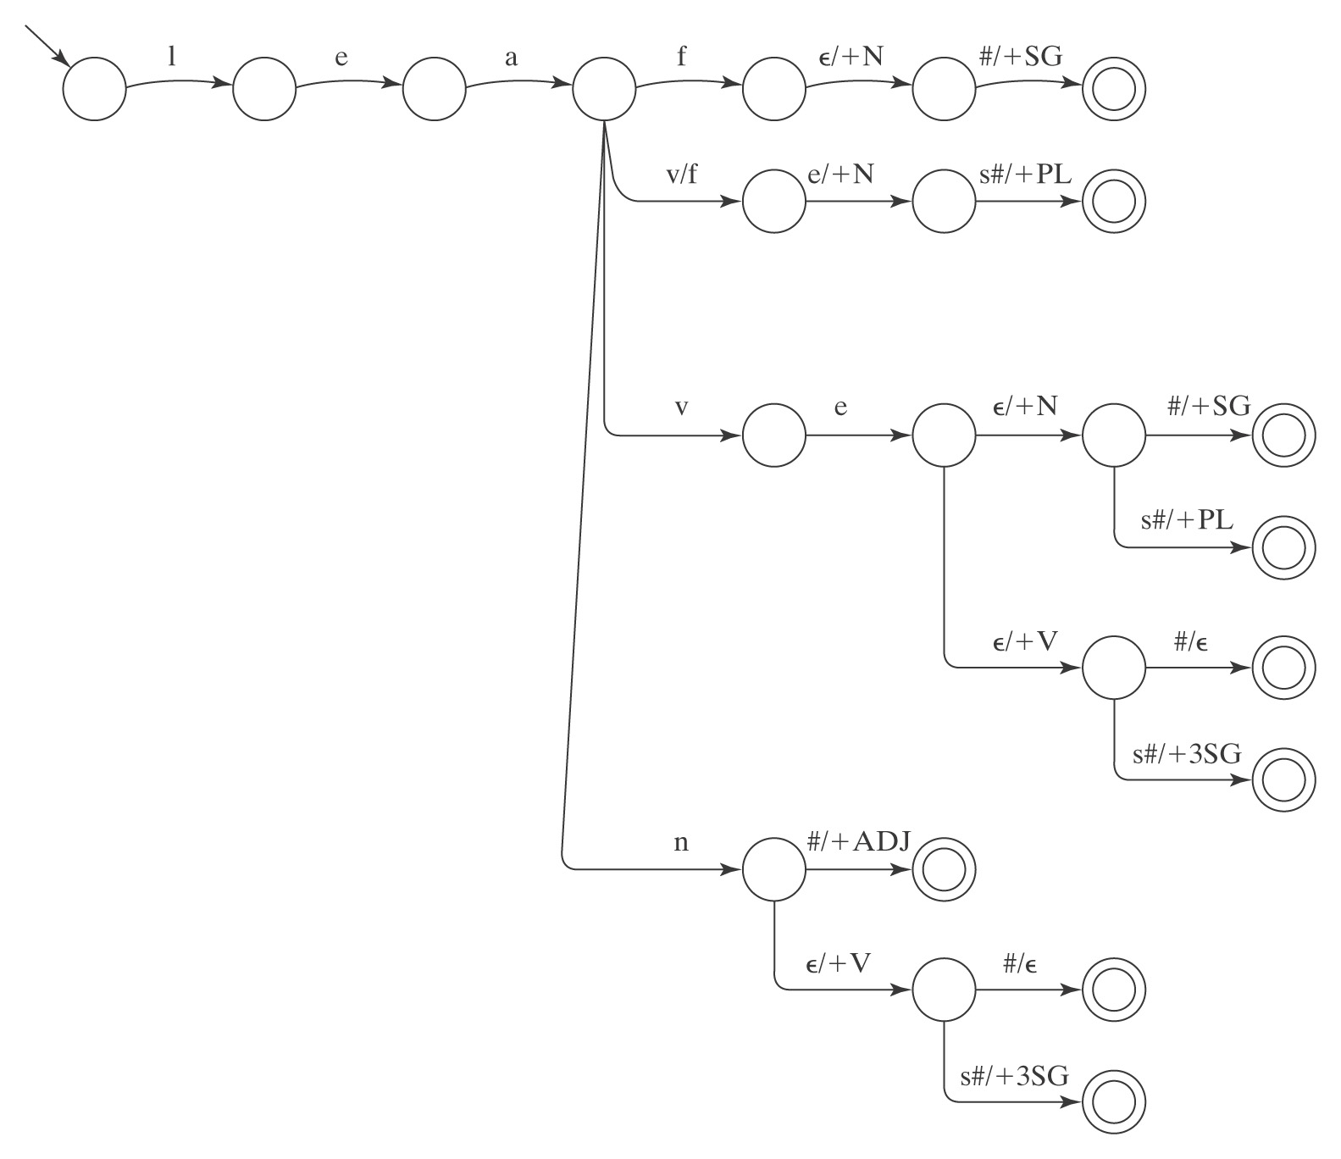
English Morphology

Slide 54
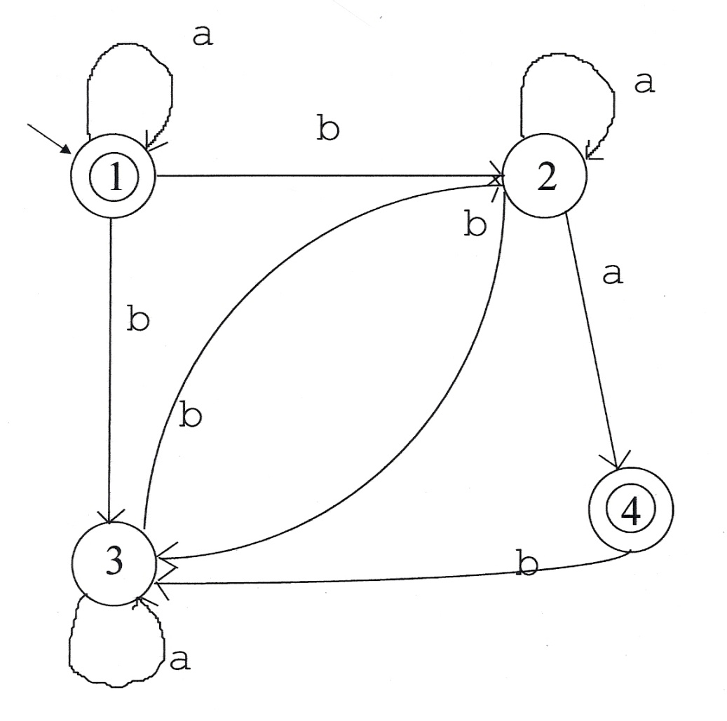
Analyzing Nondeterministic FSMs
Does this FSM accept:
baaba
Remember: we just have to find one accepting path.

Slide 55
Analyzing Nondeterministic FSMs
Two approaches:
• Explore a search tree:
• Follow all paths in parallel

Slide 56
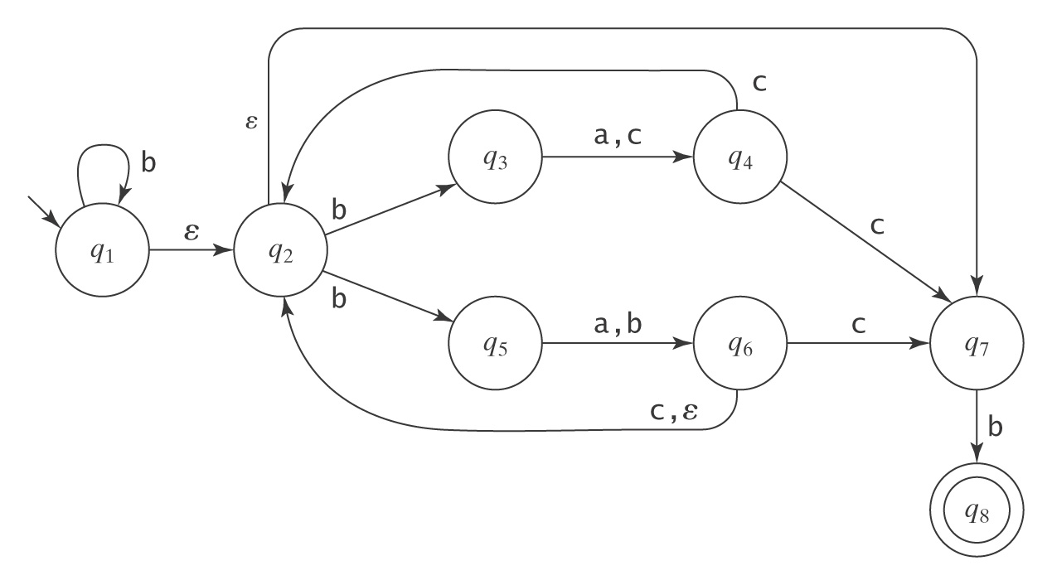
Another Nondeterministic Example
b* (b(a ∪ c)c ∪ b(a ∪ b) (c ∪ ε))* b
Notes:
Try it on bbacb.

Slide 57
Dealing with ε Transitions
eps(q) = {p ∈ K : (q, w) |-*_{M} (p, w)}.
eps(q) is the closure of {q} under the relation
{(p, r) : there is a transition (p, ε, r) ∈ Δ}.
How shall we compute eps(q)?

Slide 58
An Algorithm to Compute eps(q)
eps(q: state) =
result = {q}.
While there exists some p ∈ result and
some r ∉ result and
some transition (p, ε, r) ∈ Δ do:
Insert r into result.
Return result.

Slide 59
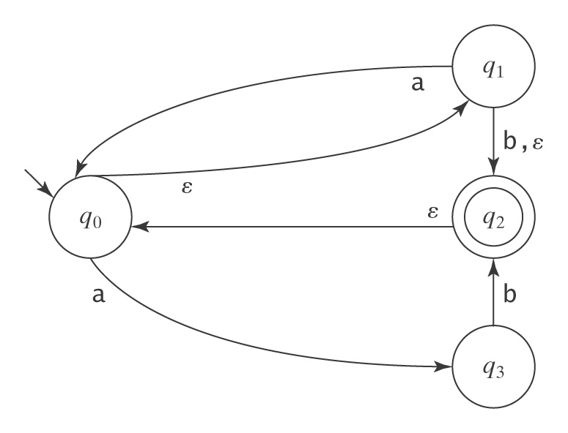
An Example of eps
eps(q₀) =
eps(q₁) =
eps(q₂) =
eps(q₃) =

Slide 60
Simulating a NDFSM
ndfsmsimulate(M: NDFSM, w: string) =
current-state = eps(s).
While any input symbols in w remain to be read do:
  c = get-next-symbol(w).
  next-state = ∅.
  For each state q in current-state do:
    For each state p such that (q, c, p) ∈ Δ do:
      next-state = next-state ∪ eps(p).
  current-state = next-state.
If current-state contains any states in A, accept. Else reject.

Slide 61
Nondeterministic and
Deterministic FSMs
Clearly: {Languages accepted by a DFSM} ⊆
{Languages accepted by a NDFSM}
More interestingly:
Theorem:
For each NDFSM, there is an equivalent DFSM.

Slide 62
Nondeterministic and
Deterministic FSMs
Theorem: For each NDFSM, there is an
equivalent DFSM.
Proof: By construction:
Given a NDFSM M = (K, Σ, Δ, s, A),
we construct M' = (K', Σ, δ', s', A'), where
K' = P(K)
s' = eps(s)
A' = {Q ⊆ K : Q ∩ A ≠ ∅}
δ'(Q, a) = ∪{eps(p): p ∈ K and
(q, a, p) ∈ Δ for some q ∈ Q}

Slide 63
An Algorithm for Constructing the Deterministic FSM
1. Compute the eps(q)’s.
2. Compute s' = eps(s).
3. Compute δ‘.
4. Compute K' = a subset of P(K).
5. Compute A' = {Q ∈ K' : Q ∩ A ≠ ∅}.

Slide 64
The Algorithm ndfsmtodfsm
ndfsmtodfsm(M: NDFSM) =
1. For each state q in K_{M} do:
  1.1 Compute eps(q).
2. s' = eps(s)
3. Compute δ':
  3.1 active-states = {s'}.
  3.2 δ' = ∅.
  3.3 While there exists some element Q of active-states for
  which δ' has not yet been computed do:
For each character c in Σ_{M} do:
new-state = ∅.
For each state q in Q do:
For each state p such that (q, c, p) ∈ Δ do:
new-state = new-state ∪ eps(p).
Add the transition (Q, c, new-state) to δ'.
If new-state ∉ active-states then insert it.
4. K' = active-states.
5. A' = {Q ∈ K' : Q ∩ A ≠ ∅ }.

Slide 65
An Example

Slide 66



The Number of States May Grow Exponentially
|Σ| = n
No. of states after 0 chars: = 1
No. of new states after 1 char: = n
No. of new states after 2 chars: = n(n-1)/2
No. of new states after 3 chars: = n(n-1)(n-2)/6
Total number of states after n chars: 2^{n}

Slide 67
Another Hard Example
L = {w ∈ {a, b}* :
the fourth to the last character is a}

Slide 68
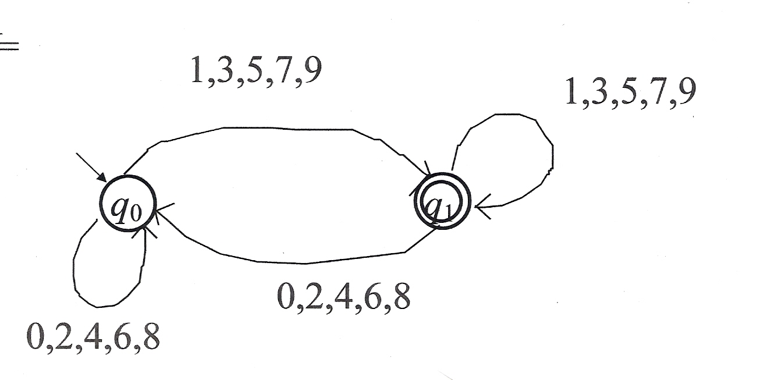
If the Original FSM is Deterministic
M
1. Compute the eps(q)s:
2. s' = eps(q0) =
3. Compute δ'
({q0}, odd, {q1}) ({q0}, even, {q0})
({q1}, odd, {q1}) ({q1}, even, {q0})
4. K' = {{q0}, {q1}}
5. A' = { {q1} }
M' = M

Slide 69
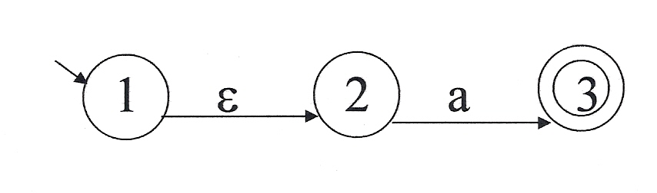
The Real Meaning of “Determinism”
Let M =
Is M deterministic?
An FSM is deterministic, in the most general definition of determinism, if, for each input and state, there is at most one possible transition.
• DFSMs are always deterministic. Why?
• NDFSMs can be deterministic (even with ε-transitions and implicit
dead states), but the formalism allows nondeterminism, in general.
• Determinism implies uniquely defined machine behavior.

Slide 70
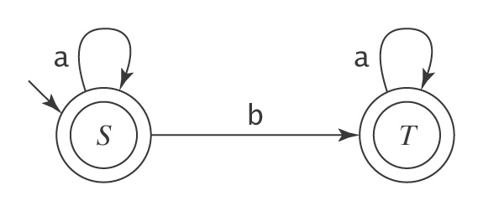
Deterministic FSMs as Algorithms
L = {w ∈ {a, b}* : w contains no more than one b}:

Slide 71
Deterministic FSMs as Algorithms
until accept or reject do:
S: s = get-next-symbol
if s = end-of-file then accept
else if s = a then go to S
else if s = b then go to T
T: s = get-next-symbol
if s = end-of-file then accept
else if s = a then go to T
else if s = b then reject
end

Slide 72
Deterministic FSMs as Algorithms
until accept or reject do:
S: s = get-next-symbol
if s = end-of-file then accept
else if s = a then go to S
else if s = b then go to T
T: s = get-next-symbol
if s = end-of-file then accept
else if s = a then go to T
else if s = b then reject
end
Length of Program: |K| × (|Σ| + 2)
Time required to analyze string w: O(|w| × |Σ|)
We have to write new code for every new FSM.

Slide 73
A Deterministic FSM Interpreter
dfsmsimulate(M: DFSM, w: string) =
1. st = s.
2. Repeat
  2.1 c = get-next-symbol(w).
  2.2 If c ≠ end-of-file then
    2.2.1 st = δ(st, c).
  until c = end-of-file.
3. If st ∈ A then accept else reject.
Input: aabaa

Slide 74
Nondeterministic FSMs as Algorithms
Real computers are deterministic, so we have three choices if we want to execute a NDFSM:
1. Convert the NDFSM to a deterministic one:
• Conversion can take time and space 2^{|K|}.
• Time to analyze string w: O(|w|)
2. Simulate the behavior of the nondeterministic one by
constructing sets of states "on the fly" during execution
• No conversion cost
• Time to analyze string w: O(|w| × |K|²)
3. Do a depth-first search of all paths through the
nondeterministic machine.

Slide 75
A NDFSM Interpreter
ndfsmsimulate(M = (K, Σ, Δ, s, A): NDFSM, w: string) =
1. Declare the set st.
2. Declare the set st1.
3. st = eps(s).
4. Repeat
  4.1 c = get-next-symbol(w).
  4.2 If c ≠ end-of-file then do
    4.2.1 st1 = ∅.
    4.2.2 For all q ∈ st do
      4.2.2.1 For all r ∈ Δ(q, c) do
        4.2.2.1.1 st1 = st1 ∪ eps(r).
    4.2.3 st = st1.
    4.2.4 If st = ∅ then exit.
until c = end-of-file.
6. If st ∩ A ≠ ∅ then accept else reject.

