Slide 1

Regular Expressions
Chapter 6

Slide 2
Regular Languages
Regular Language
L
Regular Expression
Accepts
Finite State Machine

Slide 3
Regular Expressions
The regular expressions over an alphabet Σ are all and only the strings that can be obtained as follows:
1. ∅ is a regular expression.
2. ε is a regular expression.
3. Every element of Σ is a regular expression.
4. If α , β are regular expressions, then so is αβ.
5. If α , β are regular expressions, then so is α∪β.
6. If α is a regular expression, then so is α*.
7. α is a regular expression, then so is α⁺.
8. If α is a regular expression, then so is (α).

Slide 4
Regular Expression Examples
If Σ = {a, b}, the following are regular expressions:
∅
ε
a
(a ∪ b)*
abba ∪ ε

Slide 5
Regular Expressions Define Languages
Define L, a semantic interpretation function for regular expressions:
1. L(∅) = ∅.
2. L(ε) = {ε}.
3. L(c), where c ∈ Σ = {c}.
4. L(αβ) = L(α) L(β).
5. L(α ∪ β) = L(α) ∪ L(β).
6. L(α*) = (L(α))*.
7. L(α⁺) = L(αα*) = L(α) (L(α))*. If L(α) is equal to ∅, then L(α⁺) is also equal to ∅. Otherwise L(α⁺) is the language that is formed by concatenating together one or more strings drawn from L(α).
8. L((α)) = L(α).

Slide 6
The Role of the Rules
Rules 1, 3, 4, 5, and 6 give the language its power to define sets.
Rule 8 has as its only role grouping other operators.
Rules 2 and 7 appear to add functionality to the regular expression language, but they don’t.
2. ε is a regular expression.
7. α is a regular expression, then so is α⁺.

Slide 7
Analyzing a Regular Expression
L((a ∪ b)*b) = L((a ∪ b)*) L(b)
= (L((a ∪ b)))* L(b)
= (L(a) ∪ L(b))* L(b)
= ({a} ∪ {b})* {b}
= {a, b}* {b}.

Slide 8
Examples
L( a*b* ) =
L( (a ∪ b)* ) =
L( (a ∪ b)*a*b* ) =
L( (a ∪ b)*abba(a ∪ b)* ) =

Slide 9
Going the Other Way
L = {w ∈ {a, b}*: |w| is even}

Slide 10
Going the Other Way
L = {w ∈ {a, b}*: |w| is even}
((a ∪ b) (a ∪ b))*
(aa ∪ ab ∪ ba ∪ bb)*

Slide 11
Going the Other Way
L = {w ∈ {a, b}*: |w| is even}
(a ∪ b) (a ∪ b))*
(aa ∪ ab ∪ ba ∪ bb)*
L = {w ∈ {a, b}*: w contains an odd number of a’s}

Slide 12
Going the Other Way
L = {w ∈ {a, b}*: |w| is even}
(a ∪ b) (a ∪ b))*
(aa ∪ ab ∪ ba ∪ bb)*
L = {w ∈ {a, b}*: w contains an odd number of a’s}
b* (ab*ab*)* a b*
b* a b* (ab*ab*)*

Slide 13
More Regular Expression Examples
L ( (aa*) ∪ ε ) =
L ( (a ∪ ε)* ) =
L = {w ∈ {a, b}*: there is no more than one b in w}
L = {w ∈ {a, b}* : no two consecutive letters in w are the
same}

Slide 14
Common Idioms
(α ∪ ε)
(a ∪ b)*

Slide 15
Operator Precedence in Regular Expressions
Regular Arithmetic
Expressions Expressions
Highest Kleene star exponentiation
concatenation multiplication
Lowest union addition
a b* ∪ c d* x y² + i j²

Slide 16
The Details Matter
a* ∪ b* ≠ (a ∪ b)*
(ab)* ≠ a*b*

Slide 17
The Details Matter
L₁ = {w ∈ {a, b}* : every a is immediately followed a b}
A regular expression for L₁:
(b  ab)*
A FSM for L₁:
b
b
a

Slide 18
Kleene’s Theorem
Finite state machines and regular expressions define the same class of languages. To prove this, we must show:
Theorem: Any language that can be defined with a regular expression can be accepted by some FSM and so is regular.
Theorem: Every regular language (i.e., every language that can be accepted by some DFSM) can be defined with a regular expression.

Slide 19
For Every Regular Expression
There is a Corresponding FSM
We’ll show this by construction. An FSM for:
∅:

Slide 20
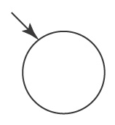
For Every Regular Expression
There is a Corresponding FSM
We’ll show this by construction. An FSM for:
∅:

Slide 21
For Every Regular Expression
There is a Corresponding FSM
We’ll show this by construction. An FSM for:
∅:
A single element of Σ:

Slide 22
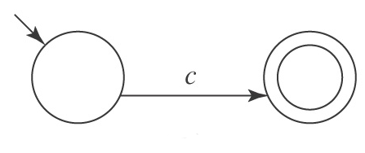
For Every Regular Expression
There is a Corresponding FSM
We’ll show this by construction. An FSM for:
∅:
A single element of Σ:

Slide 23
For Every Regular Expression
There is a Corresponding FSM
We’ll show this by construction. An FSM for:
∅:
A single element of Σ:
ε (∅*):

Slide 24
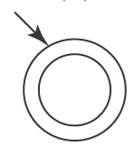
For Every Regular Expression
There is a Corresponding FSM
We’ll show this by construction. An FSM for:
∅:
A single element of Σ:
ε (∅*):

Slide 25
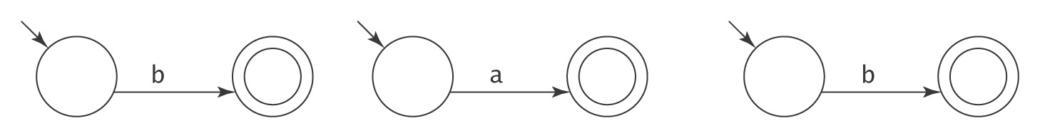
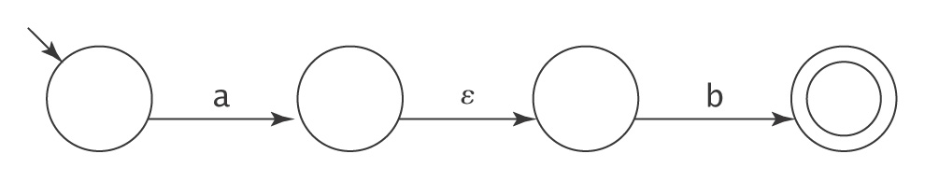
An Example
(b ∪ ab)*
An FSM for b An FSM for a An FSM for b
An FSM for ab:

Slide 26
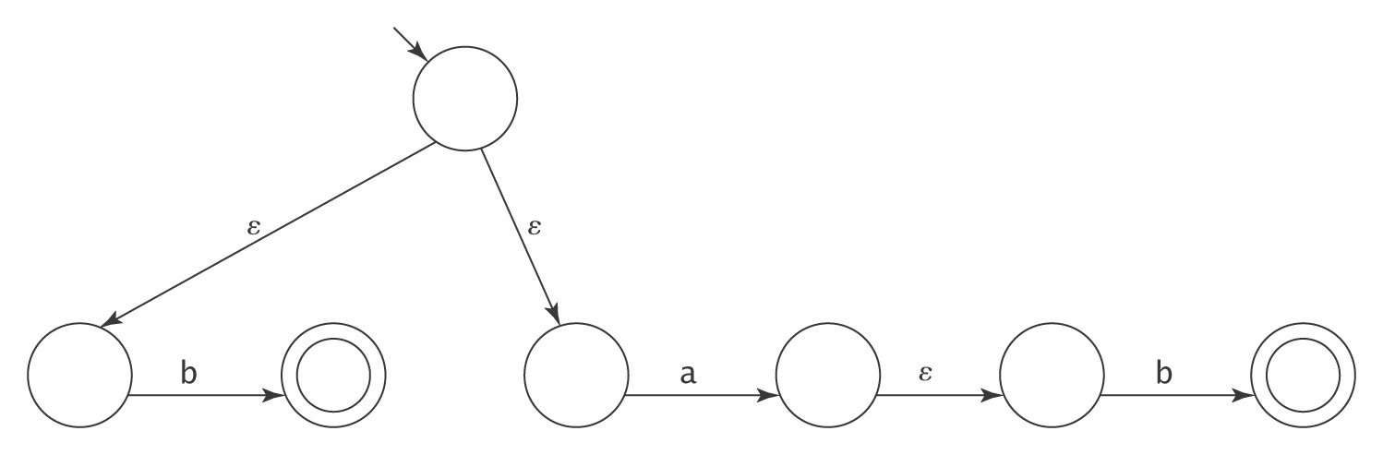
An Example
(b ∪ ab)*
An FSM for (b ∪ ab):

Slide 27
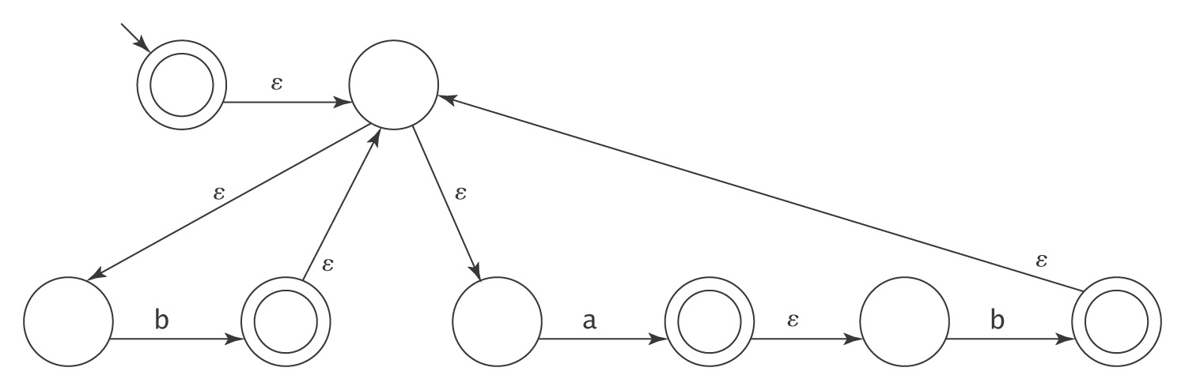
An Example
(b ∪ ab)*
An FSM for (b ∪ ab)*:
Error in Book, Not an Accept State

Slide 28
The Algorithm regextofsm
regextofsm(α: regular expression) =
Beginning with the primitive subexpressions of α and
working outwards until an FSM for all of α has been
built do:
  Construct an FSM as described above.

Slide 29
For Every FSM There is a Corresponding Regular Expression
We’ll show this by construction.
The key idea is that we’ll allow arbitrary regular expressions to label the transitions of an FSM.

Slide 30
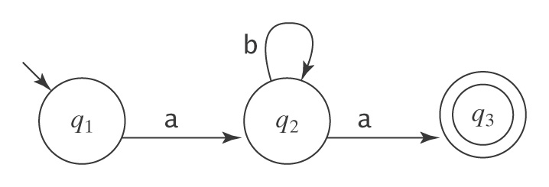
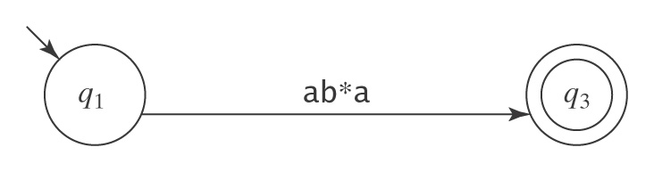
A Simple Example
Let M be:
Suppose we rip out state 2:

Slide 31
The Algorithm fsmtoregexheuristic
fsmtoregexheuristic(M: FSM) =
1. Remove unreachable states from M.
2. If M has no accepting states then return ∅.
3. If the start state of M is part of a loop, create a new start state s
and connect s to M’s start state via an ε-transition.
4. If there is more than one accepting state of M or there are any
transitions out of any of them, create a new accepting state and
connect each of M’s accepting states to it via an ε-transition. The
old accepting states no longer accept.
5. If M has only one state then return ε.
6. Until only the start state and the accepting state remain do:
  6.1 Select rip (not s or an accepting state).
  6.2 Remove rip from M.
  6.3 *Modify the transitions among the remaining states so M
  accepts the same strings.
7. Return the regular expression that labels the one remaining
transition from the start state to the accepting state.

Slide 32
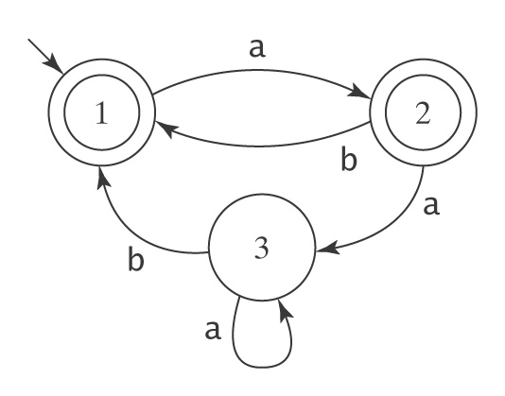
An Example
1. Create a new initial state and a new, unique accepting state, neither of which is part of a loop.

Slide 33
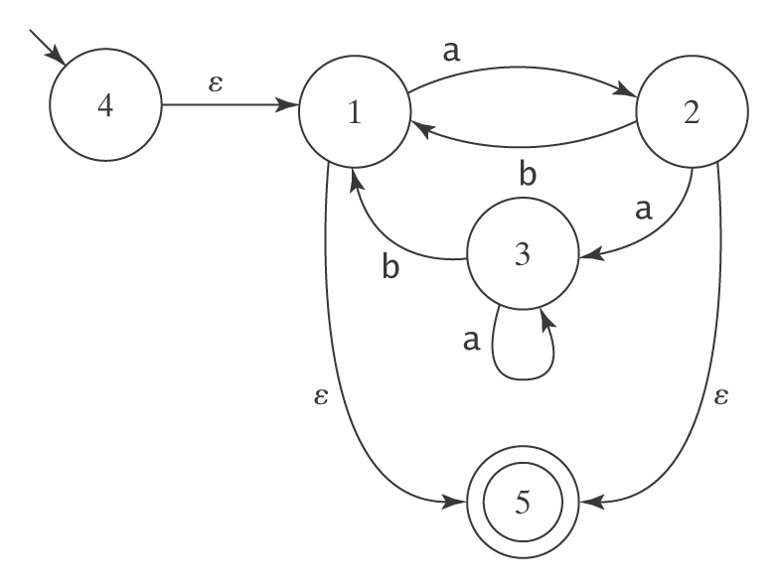
An Example, Continued
2. Remove states and arcs and replace with arcs labelled
with larger and larger regular expressions.

Slide 34
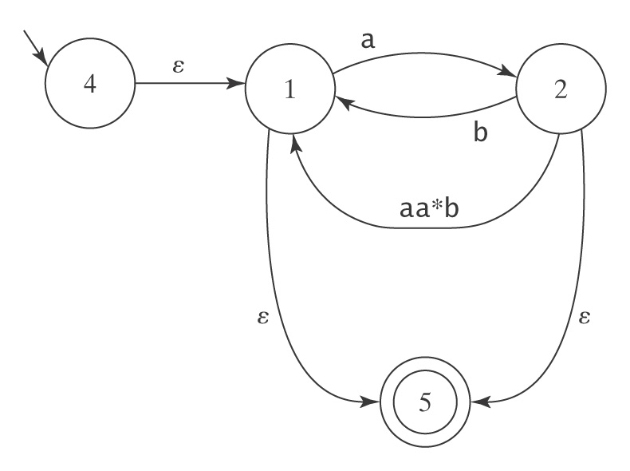
An Example, Continued
Remove state 3:

Slide 35
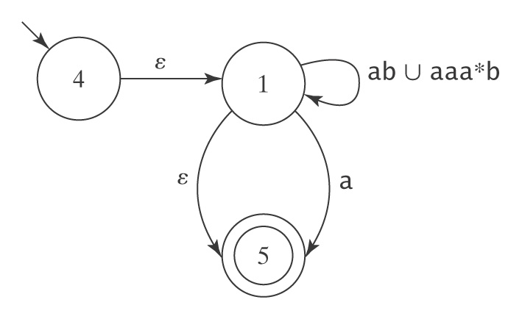
An Example, Continued
Remove state 2:

Slide 36
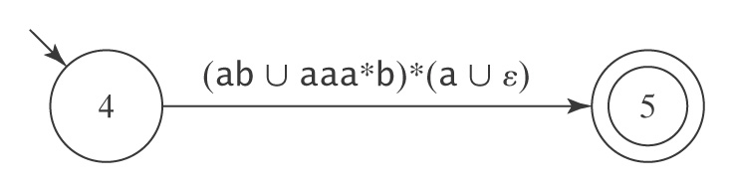
An Example, Continued
Remove state 1:

Slide 37
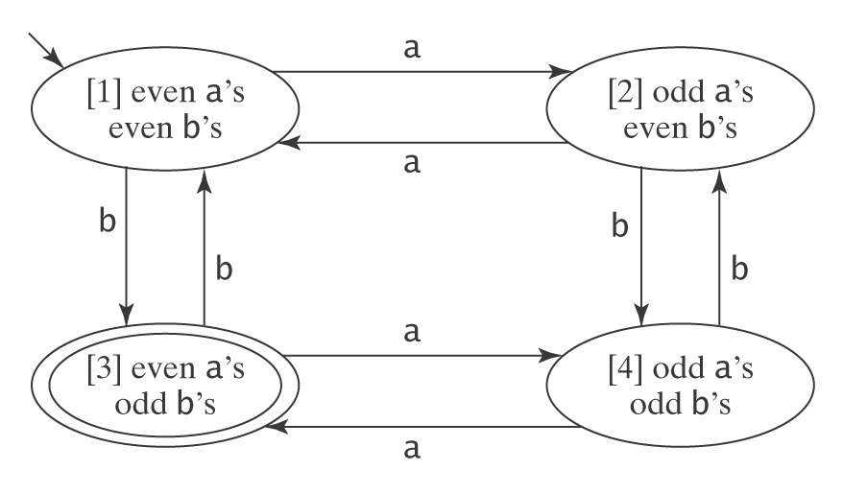
When It’s Hard
M =

Slide 38
When It’s Hard
A regular expression for M:
a (aa)*
∪ (aa)* b(b(aa)*b)* ba(aa)*
∪ [a(aa)* b ∪ (b ∪ a(aa)* b) (b(aa)* b)* (a ∪ ba(aa)*b)]
[b(aa)* b ∪ (a ∪ b(aa)* ab) (b(aa)* b)* (a ∪ ba(aa)*b)]*
[b(aa)* ∪ (a ∪ b(aa)* ab) (b(aa)* b)* ba(aa)*]
Notes:
This is the shortest one I’ve been able to construct for this example.

Slide 39
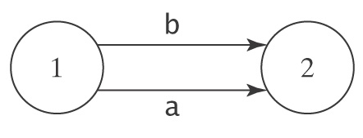
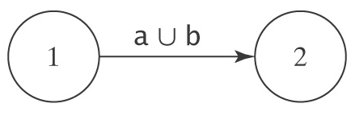
Further Modifications to M Before We Start
We require that, from every state other than the accepting state there must be exactly one transition to every state (including itself) except the start state. And into every state other than the start state there must be exactly one transition from every state (including itself) except the accepting state.
1. If there is more than one transition between states p and q,
collapse them into a single transition:
becomes:

Slide 40
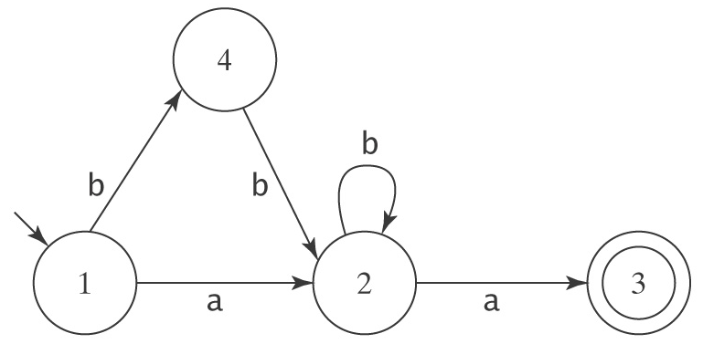
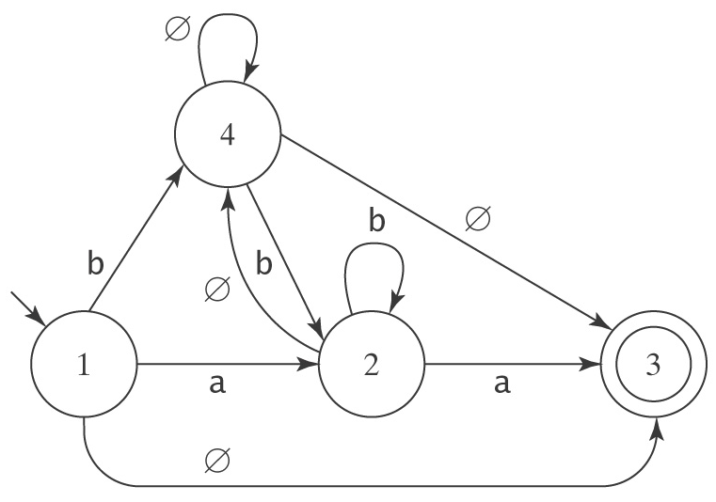
Further Modifications to M Before We Start
2. If any of the required transitions are missing, add them:
becomes:

Slide 41
Ripping Out States
3. Choose a state. Rip it out. Restore functionality.
Suppose we rip state 2.

Slide 42
What Happens When We Rip?
Consider any pair of states p and q. Once we remove rip, how can M get from p to q?
● It can still take the transition that went directly from p
to q, or
● It can take the transition from p to rip. Then, it can take the
transition from rip back to itself zero or more times. Then it can
take the transition from rip to q.

Slide 43
Defining R(p, q)
After removing rip, the new regular expression that should label the transition from p to q is:
R(p, q) /* Go directly from p to q
∪ /* or
R(p, rip) /* Go from p to rip, then
R(rip, rip)* /* Go from rip back to itself
any number of times, then
R(rip, q) /* Go from rip to q
Without the comments, we have:
R′ = R(p, q) ∪ R(p, rip) R(rip, rip)* R(rip, q)

Slide 44
Returning to Our Example
R′ = R(p, q) ∪ R(p, rip) R(rip, rip)* R(p, rip)
Let rip be state 2. Then:
R′ (1, 3) = R(1, 3) ∪ R(1, rip)R(rip, rip)*R(rip, 3)
= R(1, 3) ∪ R(1, 2)R(2, 2)*R(2, 3)
= ∅ ∪ a b* a
= ab*a

Slide 45
The Algorithm fsmtoregex
fsmtoregex(M: FSM) =
1. M′ = standardize(M: FSM).
2. Return buildregex(M′).
standardize(M: FSM) =
1. Remove unreachable states from M.
2. If necessary, create a new start state.
3. If necessary, create a new accepting state.
4. If there is more than one transition between states p
and q, collapse them.
5. If any transitions are missing, create them with label
∅.

Slide 46
The Algorithm fsmtoregex
buildregex(M: FSM) =
1. If M has no accepting states then return ∅.
2. If M has only one state, then return ε.
3. Until only the start and accepting states remain do:
  3.1 Select some state rip of M.
  3.2 For every transition from p to q, if both p
  and q are not rip then do
    Compute the new label R′ for the transition
    from p to q:
    R′ (p, q) = R(p, q) ∪ R(p, rip) R(rip, rip)* R(rip, q)
  3.3 Remove rip and all transitions into and out of it.
4. Return the regular expression that labels the
transition from the start state to the accepting state.

Slide 47
Simplifying Regular Expressions
Regex’s describe sets:
● Union is commutative: α ∪ β = β ∪ α.
● Union is associative: (α ∪ β) ∪ γ = α ∪ (β ∪ γ).
● ∅ is the identity for union: α ∪ ∅ = ∅ ∪ α = α.
● Union is idempotent: α ∪ α = α.
Concatenation:
● Concatenation is associative: (αβ)γ = α(βγ).
● ε is the identity for concatenation: α ε = ε α = α.
● ∅ is a zero for concatenation: α ∅ = ∅ α = ∅.
Concatenation distributes over union:
● (α ∪ β) γ = (α γ) ∪ (β γ).
● γ (α ∪ β) = (γ α) ∪ (γ β).
Kleene star:
● ∅* = ε.
● ε* = ε.
●(α*)* = α*.
● α*α* = α*.
●(α ∪ β)* = (α*β*)*.

