Slide 1

Regular Grammars
Chapter 7

Slide 2

Regular Grammars
A regular grammar G is a quadruple (V, Σ, R, S), where:
● V is the rule alphabet, which contains nonterminals and terminals,
● Σ (the set of terminals) is a subset of V,
● R (the set of rules) is a finite set of rules of the form:
X → Y,
● S (the start symbol) is a nonterminal.

Slide 3
Regular Grammars
In a regular grammar, all rules in R must:
● have a left hand side that is a single nonterminal
● have a right hand side that is:
● ε, or
● a single terminal, or
● a single terminal followed by a single nonterminal.
Legal: S → a, S → ε, and T → aS
Not legal: S → aSa and aSa → T

Slide 4
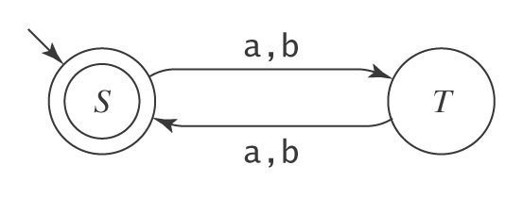
Regular Grammar Example
L = {w ∈ {a, b}* : |w| is even} ((aa) ∪ (ab) ∪ (ba) ∪ (bb))*

Slide 5
Regular Grammar Example
L = {w ∈ {a, b}* : |w| is even} ((aa) ∪ (ab) ∪ (ba) ∪ (bb))*
S → ε
S → aT
S → bT
T → a
T → b
T → aS
T → bS

Slide 6
Regular Languages and Regular Grammars
Theorem: The class of languages that can be defined with regular grammars is exactly the regular languages.
Proof: By two constructions.

Slide 7
Regular Languages and Regular Grammars
Regular grammar → FSM:
grammartofsm(G = (V, Σ, R, S)) =
1. Create in M a separate state for each nonterminal in V.
2. Start state is the state corresponding to S .
3. If there are any rules in R of the form X → w, for some
w ∈ Σ, create a new state labeled #.
4. For each rule of the form X → w Y, add a transition from
X to Y labeled w.
5. For each rule of the form X → w, add a transition from X
to # labeled w.
6. For each rule of the form X → ε, mark state X as
accepting.
7. Mark state # as accepting.
FSM → Regular grammar: Similarly.

Slide 8
Example 1 - Even Length Strings
S → ε T → a
S → aT T → b
S → bT T → aS
T → bS

Slide 9
Strings that End with aaaa
L = {w ∈ {a, b}* : w ends with the pattern aaaa}.
S → aS
S → bS
S → aB
B → aC
C → aD
D → a

Slide 10
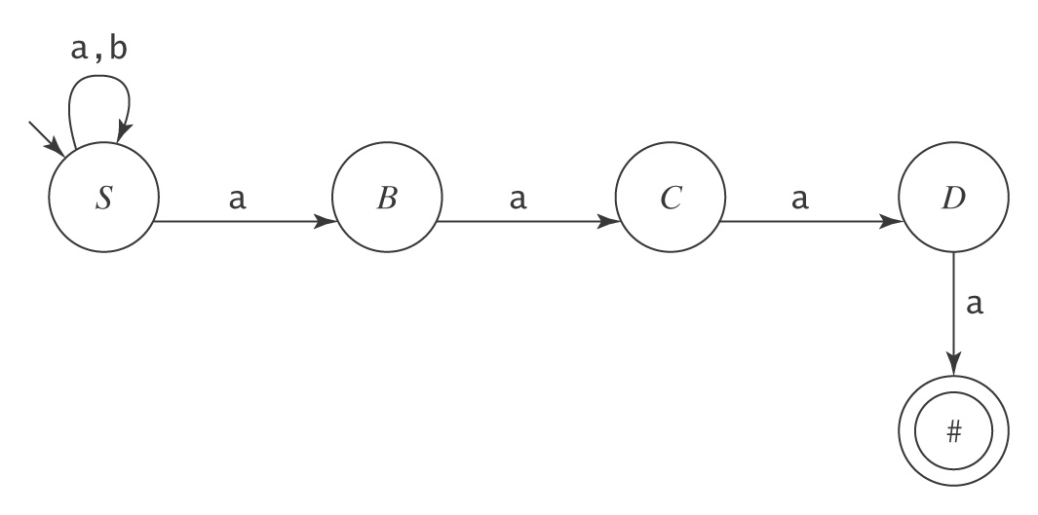
Strings that End with aaaa
L = {w ∈ {a, b}* : w ends with the pattern aaaa}.
S → aS
S → bS
S → aB
B → aC
C → aD
D → a

Slide 11
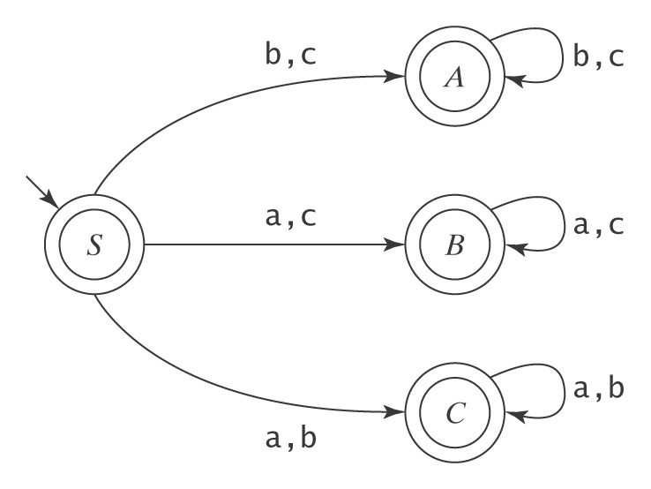
Example 2 – One Character Missing
S → ε A → bA C → aC
S → aB A → cA C → bC
S → aC A → ε C → ε
S → bA B → aB
S → bC B → cB
S → cA B → ε
S → cB

