Slide 1

Pushdown Automata
Chapter 12

Slide 2
Recognizing Context-Free Languages
Two notions of recognition:
(1) Say yes or no, just like with FSMs
(2) Say yes or no, AND
if yes, describe the structure
a + b * c

Slide 3
Just Recognizing
  We need a device similar to an FSM except that it needs more power.
  The insight: Precisely what it needs is a stack, which gives it an unlimited amount of memory with a restricted structure.
  Example: Bal (the balanced parentheses language)
  (((()))

Slide 4
Definition of a Pushdown Automaton
  M = (K, Σ, Γ, Δ, s, A), where:
  K is a finite set of states
  Σ is the input alphabet
  Γ is the stack alphabet
  s ∈ K is the initial state
  A ⊆ K is the set of accepting states, and
  Δ is the transition relation. It is a finite subset of
  (K × (Σ ∪ {ε}) × Γ*) × (K × Γ*)
  state input or ε string of state string of
  symbols symbols
  to pop to push
  from top on top
  of stack of stack

Slide 5
Definition of a Pushdown Automaton
  A configuration of M is an element of K × Σ* × Γ*.
  The initial configuration of M is (s, w, ε).

Slide 6
Manipulating the Stack
  c will be written as cab
  a
  b
  If c₁c₂…c_{n} is pushed onto the stack:
  c₁
  c₂
  c_{n}
  c
  a
  b
  c₁c₂…c_{n}cab

Slide 7
Computations
A computation by M is a finite sequence of configurations C₀, C₁, …, C_{n} for some n ≥ 0 such that:
● C₀ is an initial configuration,
● C_{n} is of the form (q, ε, γ), for some state q ∈ K_{M} and
some string γ in Γ*, and
● C₀ |-_{M} C₁ |-_{M} C₂ |-_{M} … |-_{M} C_{n}.

Slide 8
Nondeterminism
If M is in some configuration (q₁, s, γ) it is possible that:
● Δ contains exactly one transition that matches.
● Δ contains more than one transition that matches.
● Δ contains no transition that matches.

Slide 9
Accepting
A computation C of M is an accepting computation iff:
● C = (s, w, ε) |-_{M}* (q, ε, ε), and
● q ∈ A.
M accepts a string w iff at least one of its computations accepts.
Other paths may:
● Read all the input and halt in a nonaccepting state,
● Read all the input and halt in an accepting state with the stack not
empty,
● Loop forever and never finish reading the input, or
● Reach a dead end where no more input can be read.
The language accepted by M, denoted L(M), is the set of all strings accepted by M.

Slide 10
Rejecting
A computation C of M is a rejecting computation iff:
● C = (s, w, ε) |-_{M}* (q, w′, α),
● C is not an accepting computation, and
● M has no moves that it can make from (q, ε, α).
M rejects a string w iff all of its computations reject.
So note that it is possible that, on input w, M neither accepts nor rejects.

Slide 11
A PDA for Balanced Parentheses

Slide 12
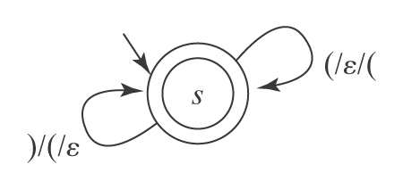
A PDA for Balanced Parentheses
M = (K, Σ, Γ, Δ, s, A), where:
K = {s} the states
Σ = {(, )} the input alphabet
Γ = {(} the stack alphabet
A = {s}
Δ contains:
((s, (, ε**), (s, ( ))
((s, ), ( ), (s, ε))
**Important: This does not mean that the stack is empty

Slide 13
A PDA for A^{n}B^{n} = {a^{n}b^{n}: n ≥ 0}

Slide 14
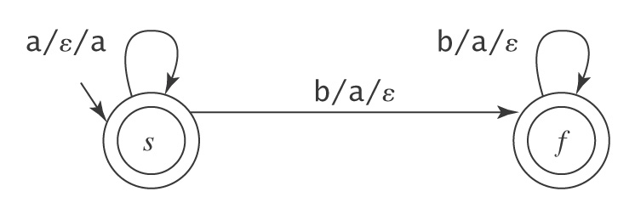
A PDA for A^{n}B^{n} = {a^{n}b^{n}: n ≥ 0}

Slide 15
A PDA for {wcw^{R}: w ∈ {a, b}*}

Slide 16
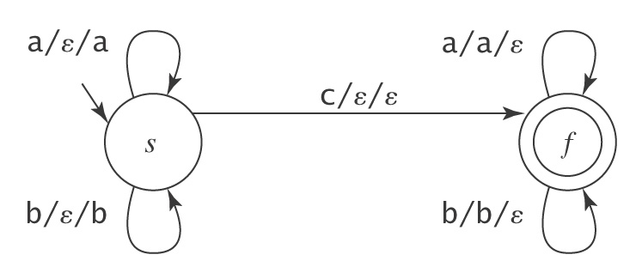
A PDA for {wcw^{R}: w ∈ {a, b}*}
M = (K, Σ, Γ, Δ, s, A), where:
K = {s, f} the states
Σ = {a, b, c} the input alphabet
Γ = {a, b} the stack alphabet
A = {f} the accepting states
Δ contains: ((s, a, ε), (s, a))
((s, b, ε), (s, b))
((s, c, ε), (f, ε))
((f, a, a), (f, ε))
((f, b, b), (f, ε))

Slide 17
A PDA for {a^{n}b^{2n}: n ≥ 0}

Slide 18
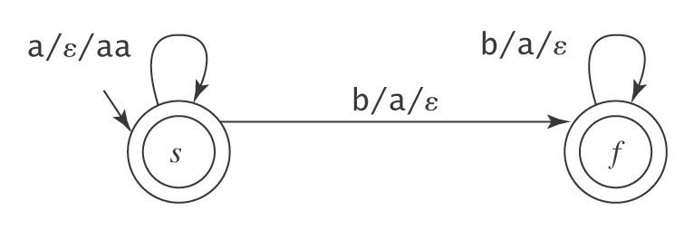
A PDA for {a^{n}b^{2n}: n ≥ 0}

Slide 19
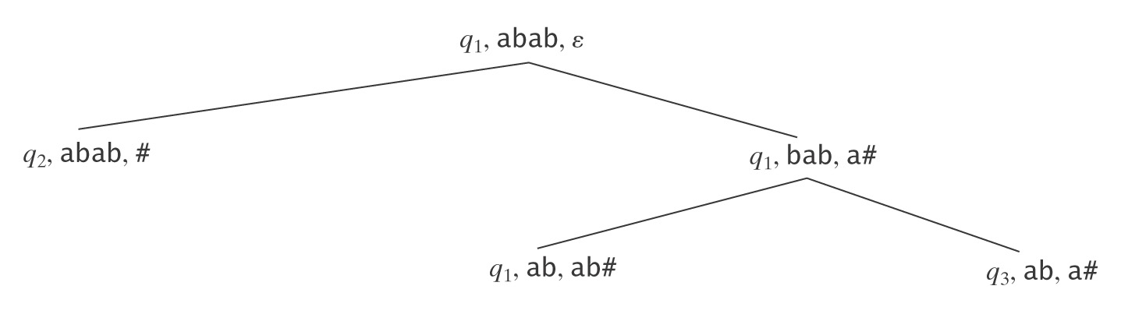
Exploiting Nondeterminism
A PDA M is deterministic iff:
● Δ_{M} contains no pairs of transitions that compete with each other, and
● Whenever M is in an accepting configuration it has no available moves.
But many useful PDAs are not deterministic.

Slide 20
A PDA for PalEven ={ww^{R}: w ∈ {a, b}*}
S → ε
S → aSa
S → bSb
A PDA:

Slide 21
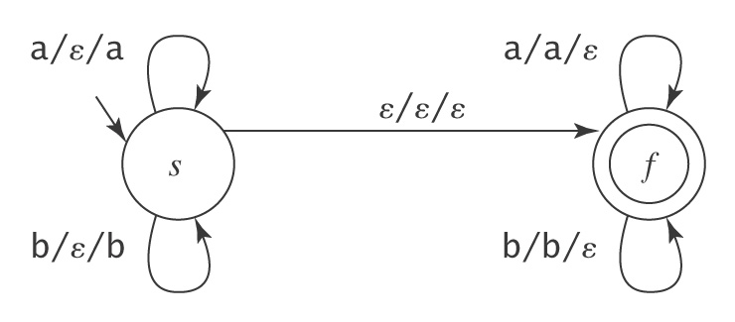
A PDA for PalEven ={ww^{R}: w ∈ {a, b}*}
S → ε
S → aSa
S → bSb
A PDA:

Slide 22
A PDA for {w ∈ {a, b}* : #_{a}(w) = #_{b}(w)}

Slide 23
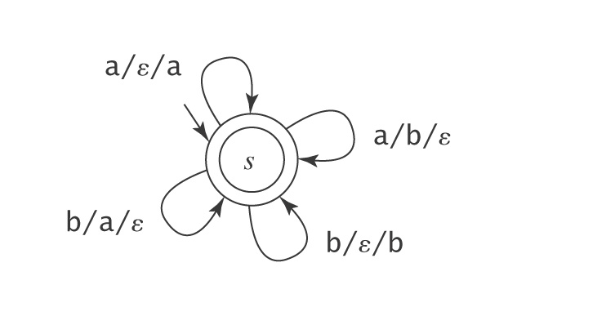
A PDA for {w ∈ {a, b}* : #_{a}(w) = #_{b}(w)}

Slide 24
More on Nondeterminism
Accepting Mismatches
L = {a^{m}b^{n} : m ≠ n; m, n > 0}
Start with the case where n = m:
b/a/ε
a/ε/a
b/a/ε
1
2

Slide 25
More on Nondeterminism
Accepting Mismatches
L = {a^{m}b^{n} : m ≠ n; m, n > 0}
Start with the case where n = m:
b/a/ε
a/ε/a
b/a/ε
1
2
● If stack and input are empty, halt and reject.
● If input is empty but stack is not (m > n) (accept):
● If stack is empty but input is not (m < n) (accept):

Slide 26
More on Nondeterminism
Accepting Mismatches
L = {a^{m}b^{n} : m ≠ n; m, n > 0}
b/a/ε
a/ε/a
b/a/ε
1
2
● If input is empty but stack is not (m < n) (accept):
a/ε/a
b/a/ε
ε/a/ε
b/a/ε
ε/a/ε
1
2
3

Slide 27
More on Nondeterminism
Accepting Mismatches
L = {a^{m}b^{n} : m ≠ n; m, n > 0}
b/a/ε
a/ε/a
b/a/ε
1
2
● If stack is empty but input is not (m > n) (accept):
b/a/ε
b/ε/ε
a/ε/a
b/a/ε
b/ε/ε
1
2
4

Slide 28
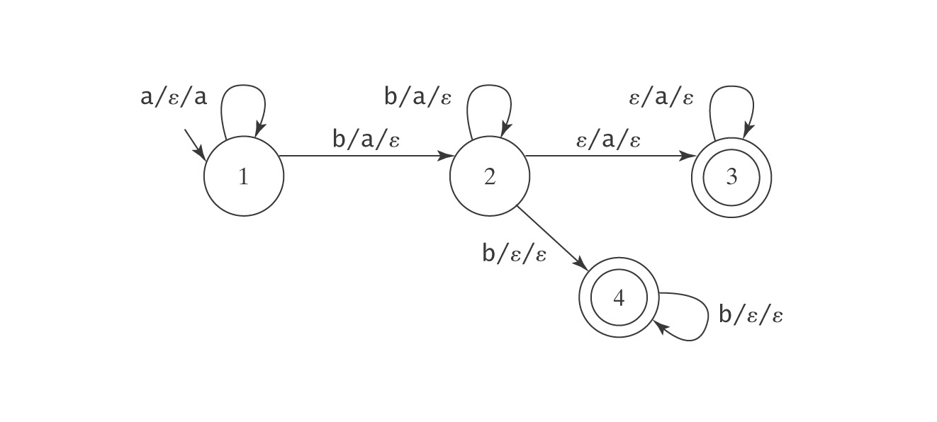
Putting It Together
L = {a^{m}b^{n} : m ≠ n; m, n > 0}
● Jumping to the input clearing state 4:
Need to detect bottom of stack.
● Jumping to the stack clearing state 3:
Need to detect end of input.

Slide 29
The Power of Nondeterminism
Consider A^{n}B^{n}C^{n} = {a^{n}b^{n}c^{n}: n ≥ 0}.
PDA for it?

Slide 30
The Power of Nondeterminism
Consider A^{n}B^{n}C^{n} = {a^{n}b^{n}c^{n}: n ≥ 0}.
Now consider L = ¬ A^{n}B^{n}C^{n}. L is the union of two languages:
1. {w ∈ {a, b, c}* : the letters are out of order}, and
2. {a^{i}b^{j}c^{k}: i, j, k ≥ 0 and (i ≠ j or j ≠ k)} (in other words,
unequal numbers of a’s, b’s, and c’s).

Slide 31
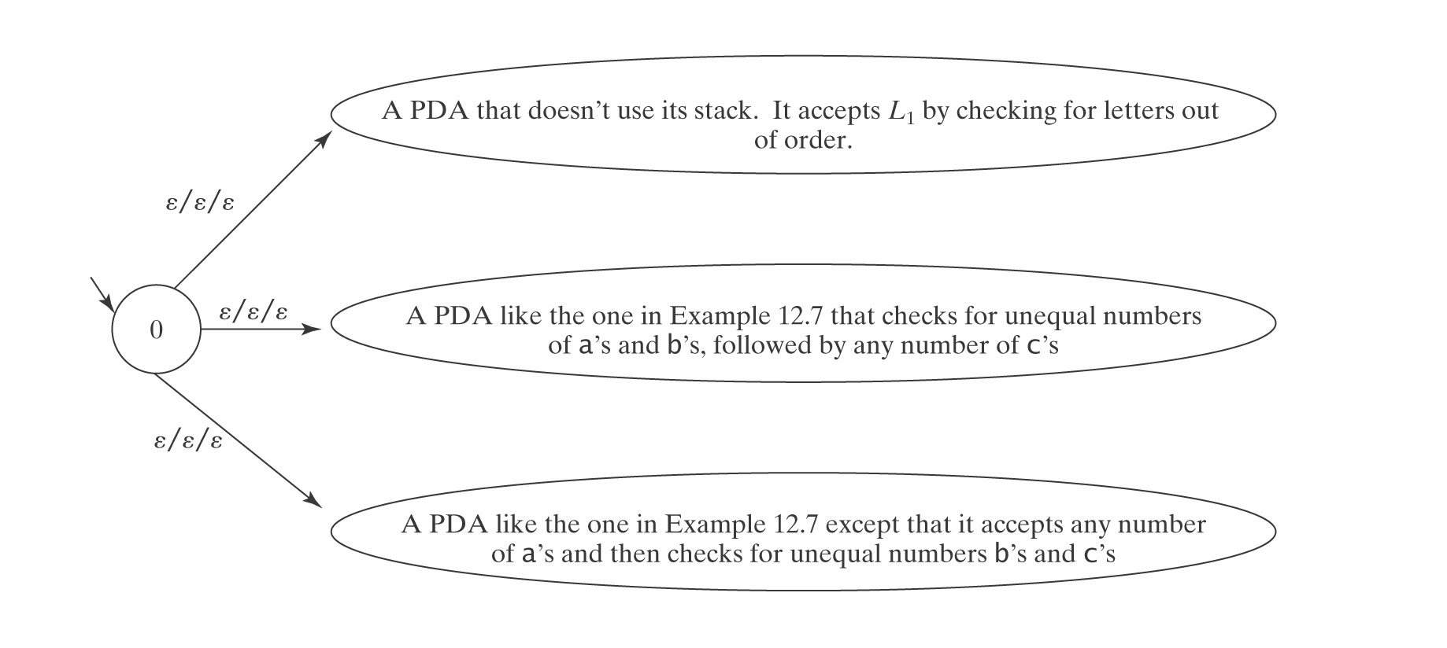
A PDA for L = ¬A^{n}B^{n}C^{n}

Slide 32
Are the Context-Free Languages Closed Under Complement?
¬A^{n}B^{n}C^{n} is context free.
If the CF languages were closed under complement, then
¬¬A^{n}B^{n}C^{n} = A^{n}B^{n}C^{n}
would also be context-free.
But we will prove that it is not.

Slide 33
L = {a^{n}b^{m}c^{p}: n, m, p ≥ 0 and n ≠ m or m ≠ p}
S → NC /* n ≠ m, then arbitrary c's
S → QP /* arbitrary a's, then p ≠ m
N → A /* more a's than b's
N → B /* more b's than a's
A → a
A → aA
A → aAb
B → b
B → Bb
B → aBb
C → ε | cC /* add any number of c's
P → B' /* more b's than c's
P → C' /* more c's than b's
B' → b
B' → bB'
B' → bB'c
C' → c | C'c
C' → C'c
C' → bC'c
Q → ε | aQ /* prefix with any number of a's

Slide 34
Reducing Nondeterminism
● Jumping to the input clearing state 4:
Need to detect bottom of stack, so push # onto the
stack before we start.
● Jumping to the stack clearing state 3:
Need to detect end of input. Add to L a termination
character (e.g., $)

Slide 35
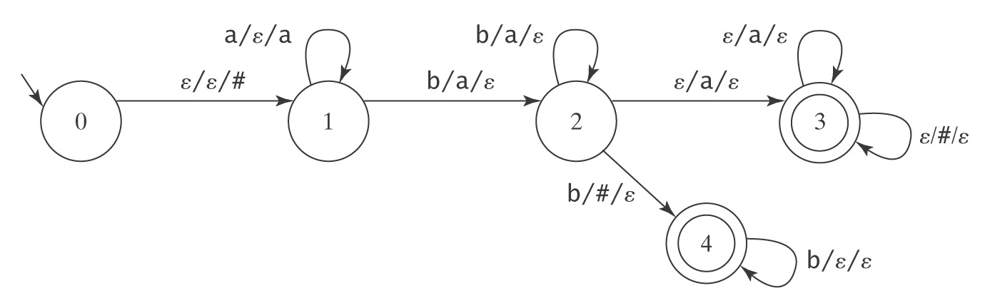
Reducing Nondeterminism
● Jumping to the input clearing state 4:

Slide 36
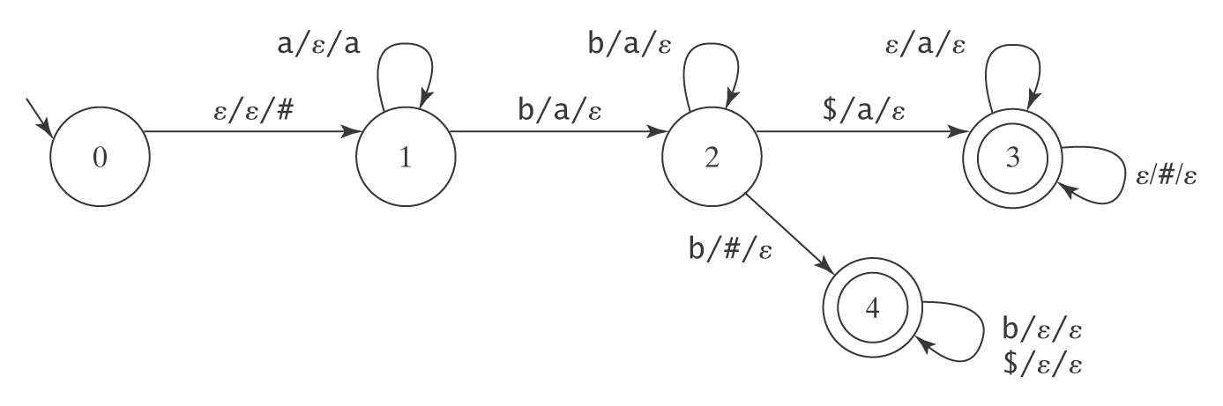
Reducing Nondeterminism
● Jumping to the stack clearing state 3:

Slide 37
PDAs and Context-Free Grammars
Theorem: The class of languages accepted by PDAs is exactly the class of context-free languages.
Recall: context-free languages are languages that
can be defined with context-free grammars.
Restate theorem:
Can describe with context-free grammar
Can accept by PDA

Slide 38
Going One Way
Lemma: Each context-free language is accepted by some PDA.
Proof (by construction):
The idea: Let the stack do the work.
Two approaches:
Top down
Bottom up

Slide 39
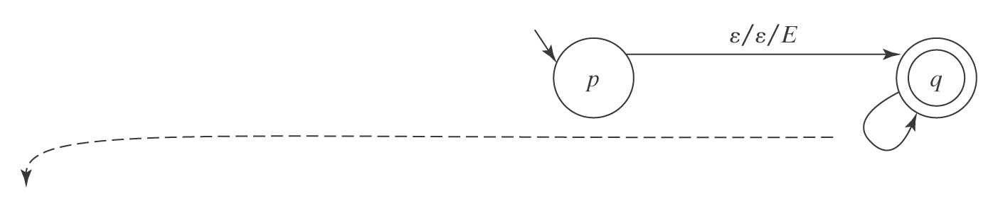
Top Down
The idea: Let the stack keep track of expectations.
Example: Arithmetic expressions
E → E + T
E → T
T → T ∗ F
T → F
F → (E)
F → id
(1) (q, ε, E), (q, E+T) (7) (q, id, id), (q, ε)
(2) (q, ε, E), (q, T) (8) (q, (, ( ), (q, ε)
(3) (q, ε, T), (q, T*F) (9) (q, ), ) ), (q, ε)
(4) (q, ε, T), (q, F) (10) (q, +, +), (q, ε)
(5) (q, ε, F), (q, (E) ) (11) (q, ∗, ∗), (q, ε)
(6) (q, ε, F), (q, id)

Slide 40
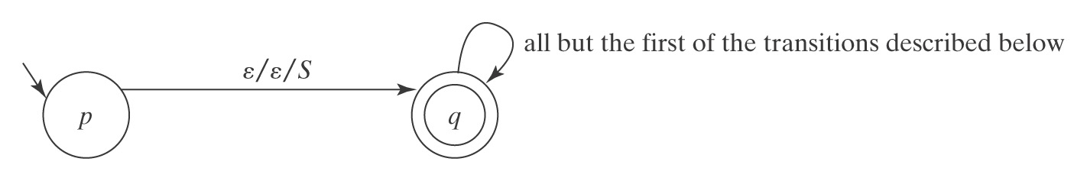
A Top-Down Parser
The outline of M is:
M = ({p, q}, Σ, V, Δ, p, {q}), where Δ contains:
● The start-up transition ((p, ε, ε), (q, S)).
● For each rule X → s₁s₂…s_{n}. in R, the transition:
((q, ε, X), (q, s₁s₂…s_{n})).
● For each character c ∈ Σ, the transition:
((q, c, c), (q, ε)).

Slide 41
Example of the Construction
L = {a^{n}b*a^{n}}
0 (p, ε, ε), (q, S)
(1) S → ε 1 (q, ε, S), (q, ε)
(2) S → B 2 (q, ε, S), (q, B)
(3) S → aSa 3 (q, ε, S), (q, aSa)
(4) B → ε 4 (q, ε, B), (q, ε)
(5) B → bB 5 (q, ε, B), (q, bB)
6 (q, a, a), (q, ε)
input = a a b b a a 7 (q, b, b), (q, ε)
trans state unread input stack
p a a b b a a ε
0 q a a b b a a S
3 q a a b b a a aSa
6 q a b b a a Sa
3 q a b b a a aSaa
6 q b b a a Saa
2 q b b a a Baa
5 q b b a a bBaa
7 q b a a Baa
5 q b a a bBaa
7 q a a Baa
4 q a a aa
6 q a a
6 q ε ε

Slide 42
Another Example
L = {a^{n}b^{m}c^{p}d^{q} : m + n = p + q}

Slide 43
Another Example
L = {a^{n}b^{m}c^{p}d^{q} : m + n = p + q}
(1) S → aSd
(2) S → T
(3) S → U
(4) T → aTc
(5) T → V
(6) U → bUd
(7) U → V
(8) V → bVc
(9) V → ε
input = a a b c d d

Slide 44
Another Example
L = {a^{n}b^{m}c^{p}d^{q} : m + n = p + q}
0 (p, ε, ε), (q, S)
(1) S → aSd 1 (q, ε, S), (q, aSd)
(2) S → T 2 (q, ε, S), (q, T)
(3) S → U 3 (q, ε, S), (q, U)
(4) T → aTc 4 (q, ε, T), (q, aTc)
(5) T → V 5 (q, ε, T), (q, V)
(6) U → bUd 6 (q, ε, U), (q, bUd)
(7) U → V 7 (q, ε, U), (q, V)
(8) V → bVc 8 (q, ε, V), (q, bVc)
(9) V → ε 9 (q, ε, V), (q, ε)
10 (q, a, a), (q, ε)
11 (q, b, b), (q, ε)
input = a a b c d d 12 (q, c, c), (q, ε)
13 (q, d, d), (q, ε)
trans state unread input stack

Slide 45
Notice Nondeterminism
Machines constructed with the algorithm are often nondeterministic, even when they needn't be. This happens even with trivial languages.
Example: A^{n}B^{n} = {a^{n}b^{n}: n ≥ 0}
A grammar for A^{n}B^{n} is: A PDA M for A^{n}B^{n} is:
(0) ((p, ε, ε), (q, S))
[1] S → aSb (1) ((q, ε, S), (q, aSb))
[2] S → ε (2) ((q, ε, S), (q, ε))
(3) ((q, a, a), (q, ε))
(4) ((q, b, b), (q, ε))
But transitions 1 and 2 make M nondeterministic.
A directly constructed machine for A^{n}B^{n}:

Slide 46
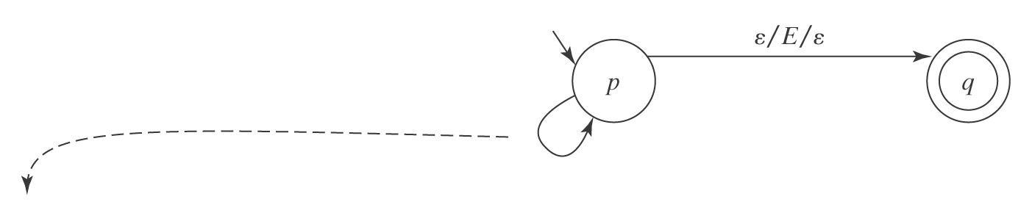
Bottom-Up
The idea: Let the stack keep track of what has been found.
(1) E → E + T
(2) E → T
(3) T → T ∗ F
(4) T → F
(5) F → (E)
(6) F → id
Reduce Transitions:
(1) (p, ε, T + E), (p, E)
(2) (p, ε, T), (p, E)
(3) (p, ε, F ∗ T), (p, T)
(4) (p, ε, F), (p, T)
(5) (p, ε, )E( ), (p, F)
(6) (p, ε, id), (p, F)
Shift Transitions
(7) (p, id, ε), (p, id)
(8) (p, (, ε), (p, ()
(9) (p, ), ε), (p, ))
(10) (p, +, ε), (p, +)
(11) (p, ∗, ε), (p, ∗)

Slide 47
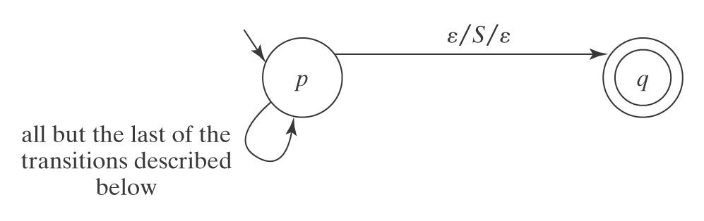
A Bottom-Up Parser
The outline of M is:
M = ({p, q}, Σ, V, Δ, p, {q}), where Δ contains:
● The shift transitions: ((p, c, ε), (p, c)), for each c ∈ Σ.
● The reduce transitions: ((p, ε, (s₁s₂…s_{n}.)^{R}), (p, X)), for each rule
X → s₁s₂…s_{n}. in G.
● The finish up transition: ((p, ε, S), (q, ε)).

Slide 48
Going The Other Way
Lemma: If a language is accepted by a pushdown automaton M, it is context-free (i.e., it can be described by a context-free grammar).
Proof (by construction):
Step 1: Convert M to restricted normal form:
● M has a start state s′ that does nothing except push a special
symbol # onto the stack and then transfer to a state s from which
the rest of the computation begins. There must be no transitions
back to s′.
● M has a single accepting state a. All transitions into a pop # and
read no input.
● Every transition in M, except the one from s′, pops exactly one
symbol from the stack.

Slide 49
Nondeterminism and Halting
1. There are context-free languages for which no deterministic PDA exists.
2. It is possible that a PDA may
● not halt,
● not ever finish reading its input.
3. There exists no algorithm to minimize a PDA. It is undecidable whether a PDA is minimal.

Slide 50
Solutions to the Problem
● For NDFSMs:
● Convert to deterministic, or
● Simulate all paths in parallel.
● For NDPDAs:
● Formal solutions that usually involve changing the
grammar.
● Practical solutions that:
● Preserve the structure of the grammar, but
● Only work on a subset of the CFLs.

Slide 51
Alternative Equivalent Definitions of a PDA
Accept by accepting state at end of string (i.e., we don't care about the stack).
From M (in our definition) we build M′ (in this one):
1. Initially, let M′ = M.
2. Create a new start state s′. Add the transition:
((s′, ε, ε), (s, #)).
3. Create a new accepting state q_{a}.
4. For each accepting state a in M do,
  4.1 Add the transition ((a, ε, #), (q_{a}, ε)).
5. Make q_{a} the only accepting state in M′.

Slide 52
Comparing Regular and
Context-Free Languages
  Regular Languages Context-Free Languages
  ● regular exprs.
  ● or
  ● regular grammars ● context-free grammars
  ● recognize ● parse
  ● = DFSMs ● = NDPDAs

