Slide 1

Context-Free and
Noncontext-Free Languages
Chapter 13

Slide 2
Languages That Are and
Are Not Context-Free
a*b* is regular.
A^{n}B^{n} = {a^{n}b^{n} : n ≥ 0} is context-free but not regular.
A^{n}B^{n}C^{n} = {a^{n}b^{n}c^{n} : n ≥ 0} is not context-free.

Slide 3
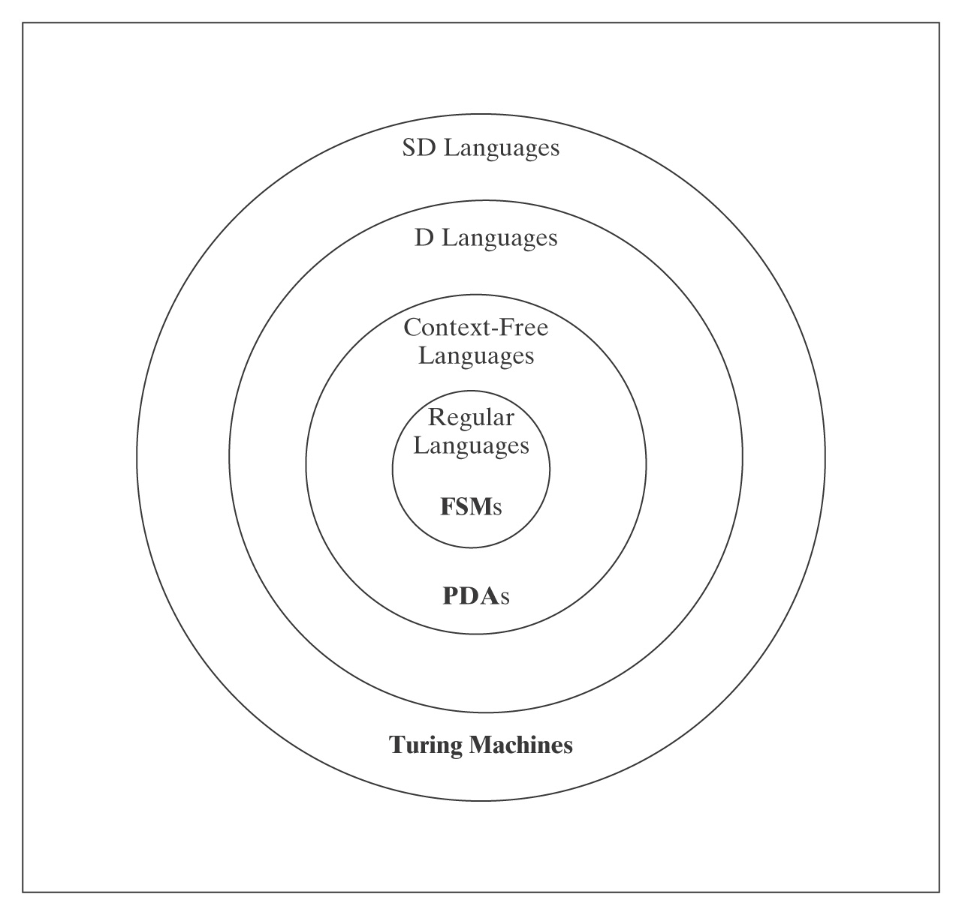
Languages and Machines

Slide 4
The Regular and the CF Languages
  Theorem: The regular languages are a proper subset of the context-free languages.
  Proof: In two parts:
  Every regular language is CF.
  There exists at least one language that is CF but not regular.

Slide 5
The Regular and the CF Languages
  Lemma: Every regular language is CF.
  Proof: Every FSM is (trivially) a PDA:
  Given an FSM M = (K, Σ, Δ, s, A) and elements of δ of the form: ( p, c, q )
  old state, input, new state
  Construct a PDA M' = (K, Σ, {∅}, Δ, s, A). Each (p, c, q) becomes:
  (( p, c, ε ), (q, ε ))
  old state, input, don't new state don't
  look at push on
  stack stack
  In other words, we just don’t use the stack.

Slide 6
There Exists at Least One Language that is CF but Not Regular
  Lemma: There exists at least one language that is CF but not regular
  Proof: {a^{n}b^{n}, n ≥ 0} is context-free but not regular.
  So the regular languages are a proper subset of the context-free languages.

Slide 7
Showing that L is Context-Free
Techniques for showing that a language L is context-free:
1. Exhibit a context-free grammar for L.
2. Exhibit a PDA for L.
3. Use the closure properties of context-free languages.
Unfortunately, these are weaker than they are for
regular languages.

Slide 8
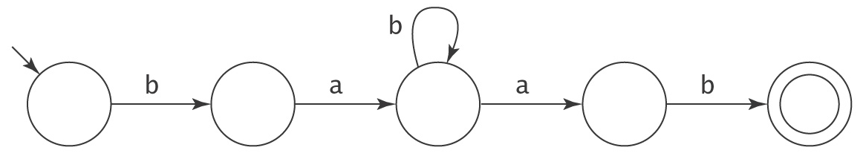
Showing that L is Not Context-Free
Remember the pumping argument for regular languages:

Slide 9
A Review of Parse Trees
A parse tree, derived by a grammar G = (V, Σ, R, S), is a rooted, ordered tree in which:
● Every leaf node is labeled with an element of Σ ∪ {ε},
● The root node is labeled S,
● Every other node is labeled with some element of V - Σ,
● If m is a nonleaf node labeled X and the children of m are labeled x₁, x₂, …, x_{n}, then the rule X → x₁, x₂, …, x_{n} is in R.

Slide 10
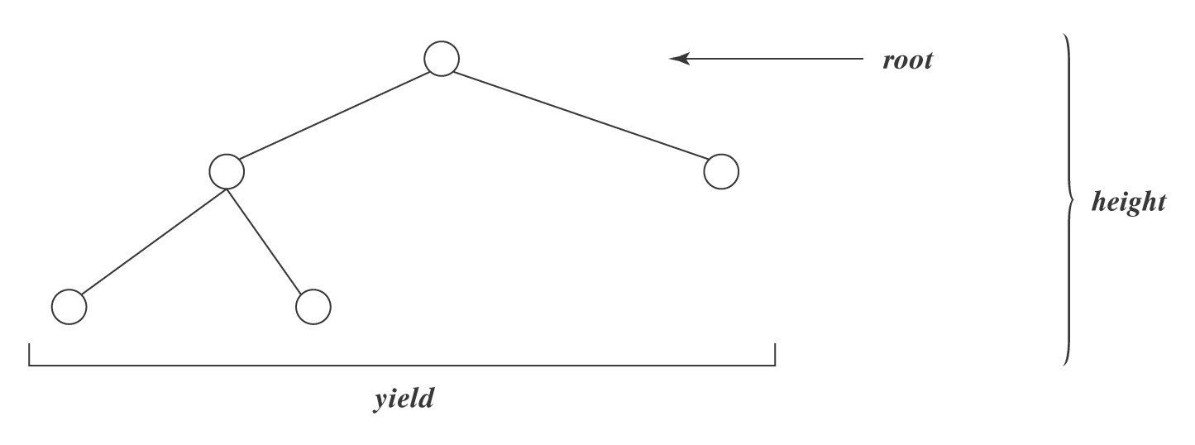
Some Tree Basics
The height of a tree is the length of the longest path from the root to any leaf.
The branching factor of a tree is the largest number of daughter nodes associated with any node in the tree.
Theorem: The length of the yield of any tree T with height h and branching factor b is ≤ b^{h}.

Slide 11
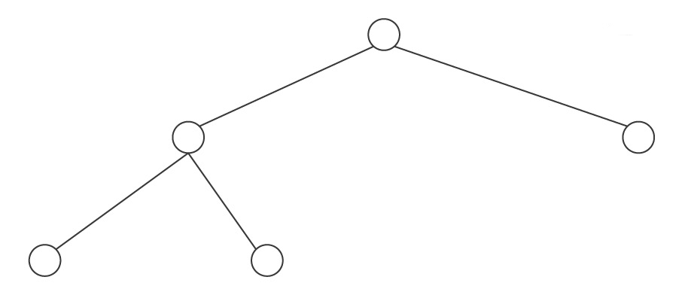
From Grammars to Trees
Given a context-free grammar G:
● Let n be the number of nonterminal symbols in G.
● Let b be the branching factor of G
Suppose that T is generated by G and no nonterminal appears more than once on any path:
The maximum height of T is:
The maximum length of T’s yield is:

Slide 12
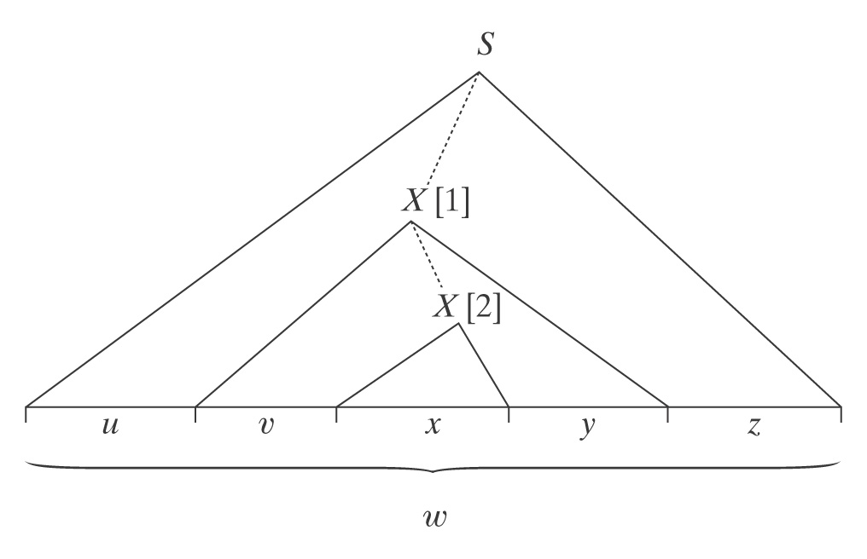
The Context-Free Pumping Theorem
This time we use parse trees, not automata as the basis for our argument.
If w is “long”, then its parse trees must look like:
Choose one such tree such that there’s no other with fewer nodes.

Slide 13
The Context-Free Pumping Theorem
There is another derivation in G:
S ⇒* uXz ⇒* uxz,
in which, at the point labeled [1], the nonrecursive rule₂ is used.
So uxz is also in L(G).

Slide 14
The Context-Free Pumping Theorem
There are infinitely many derivations in G, such as:
S ⇒* uXz ⇒* uvXyz ⇒* uvvXyyz ⇒* uvvxyyz
Those derivations produce the strings:
uv²xy²z, uv³xy³z, …
So all of those strings are also in L(G).

Slide 15
The Context-Free Pumping Theorem
If rule₁ = X → Xa, we could get v = ε.
If rule₁ = X → aX, we could get y = ε.
But it is not possible that both v and y are ε. If they were, then the derivation S ⇒* uXz ⇒* uxz would also yield w and it would create a parse tree with fewer nodes. But that contradicts the assumption that we started with a tree with the smallest possible number of nodes.

Slide 16
The Context-Free Pumping Theorem
The height of the subtree rooted at [1] is at most:

Slide 17
The Context-Free Pumping Theorem
If L is a context-free language, then
∃k ≥ 1 (∀ strings w ∈ L, where |w| ≥ k
(∃u, v, x, y, z ( w = uvxyz,
vy ≠ ε,
|vxy| ≤ k and
∀q ≥ 0 (uv^{q}xy^{q}z is in L)))).

Slide 18
What Is k?
k serves two roles:
● How long must w be to guarantee it is pumpable?
● What’s the bound on |vxy|?
Let n be the number of nonterminals in G.
Let b be the branching factor of G.

Slide 19
How Long Must w be?
If height(T) > n, then some nonterminal occurs more than once on some path. So T is pumpable.
If height(T) ≤ n, then |uvxyz| ≤ b^{n}.
So if |uvxyz| > b^{n}, w = uvxyz must be pumpable.

Slide 20
What’s the Bound on |vxy|?
Assume that we are considering the bottom-most two instances of a repeated nonterminal. Then the yield of the upper one has length at most b^{n+1}.
Assuming b ≥ 2, b^{n+1} > b^{n}.
So let k = b^{n+1}.

Slide 21

The Context-Free Pumping Theorem
If L is a context-free language, then ∃k ≥ 1, such that
∀ strings w ∈ L, where |w| ≥ k,
∃ u, v, x, y, z, such that: w = uvxyz,and
vy ≠ ε, and
|vxy| ≤ k, and
∀q ≥ 0, uv^{q}xy^{q}z is in L.
Proof: L is generated by some CFG G = (V, Σ, R, S) with n nonterminal symbols and branching factor b. Let k be b^{n + 1}. The longest string that can be generated by G with no repeated nonterminals in the resulting parse tree has length b^{n}. Assuming that b ≥ 2, it must be the case that b^{n + 1} > b^{n}. So let w be any string in L(G) where |w| ≥ k. Let T be any smallest parse tree for w. T must have height at least n + 1. Choose some path in T of length at least n + 1. Let X be the bottom-most repeated nonterminal along that path. Then w can be rewritten as uvxyz. The tree rooted at [1] has height at most n + 1. Thus its yield, vxy, has length less than or equal to b^{n + 1}, which is k. vy ≠ ε since if vy were ε then there would be a smaller parse tree for w and we chose T so that that wasn’t so. uxz must be in L because rule₂ could have been used immediately at [1]. For any q ≥ 1, uv^{q}xy^{q}z must be in L because rule₁ could have been used q times before finally using rule₂.

Slide 22
Regular vs CF Pumping Theorems
Similarities:
● We choose w, the string to be pumped.
● We choose a value for q that shows that w isn’t pumpable.
● We may apply closure theorems before we start.
Differences:
● Two regions, v and y, must be pumped in tandem.
● We don’t know anything about where in the strings v and y will
fall. All we know is that they are reasonably “close together”, i.e.,
|vxy| ≤ k.
● Either v or y could be empty, although not both.

Slide 23
An Example of Pumping: A^{n}B^{n}C^{n}
A^{n}B^{n}C^{n} = {a^{n}b^{n}c^{n}, n ≥ 0}

Slide 24
An Example of Pumping: A^{n}B^{n}C^{n}
A^{n}B^{n}C^{n} = {a^{n}b^{n}c^{n}, n ≥ 0}
Choose w = a^{k} b^{k} c^{k}
1 | 2 | 3

Slide 25
An Example of Pumping: A^{n}B^{n}C^{n}
A^{n}B^{n}C^{n} = {a^{n}b^{n}c^{n}, n ≥0}
Choose w = a^{k} b^{k} c^{k}
1 | 2 | 3
If either v or y spans regions, then let q = 2 (i.e., pump in once). The resulting string will have letters out of order and thus not be in A^{n}B^{n}C^{n}.
If both v and y each contain only one distinct character then set q to 2. Additional copies of at most two different characters are added, leaving the third unchanged. There are no longer equal numbers of the three letters, so the resulting string is not in A^{n}B^{n}C^{n}.

Slide 26
Another Example of Pumping
L = {a^{n}b^{m}a^{n}, n, m ≥ 0 and n ≥ m}.
Let w =

Slide 27
Another Example of Pumping
L = {a^{n}b^{m}a^{n}, n, m ≥ 0 and n ≥ m}.
Let w = a^{k}b^{k}a^{k}
aaa … aaabbb … bbbaaa … aaa
| 1 | 2 | 3 |

Slide 28
Nested and Cross-Serial Dependencies
PalEven = {ww^{R} : w ∈ {a, b}*}
a a b b a a
The dependencies are nested.
WcW = {wcw : w ∈ {a, b}*}
a a b c a a b
Cross-serial dependencies.

Slide 29
WcW = {wcw : w ∈ {a, b}*}

Slide 30
WcW = {wcw : w ∈ {a, b}*}
Let w = a^{k}b^{k}ca^{k}b^{k}.
aaa … aaabbb … bbbcaaa … aaabbb … bbb
| 1 | 2 |3| 4 | 5 |
Call the part before c the left side and the part after c the right side.
● If v or y overlaps region 3, set q to 0. The resulting string will no
longer contain a c.
● If both v and y occur before region 3 or they both occur after
region 3, then set q to 2. One side will be longer than the other.
● If either v or y overlaps region 1, then set q to 2. In order to make
the right side match, something would have to be pumped into
region 4. Violates |vxy| ≤ k.
● If either v or y overlaps region 2, then set q to 2. In order to make
the right side match, something would have to be pumped into
region 5. Violates |vxy| ≤ k.

Slide 31
Closure Theorems for Context-Free Languages
The context-free languages are closed under:
● Union
● Concatenation
● Kleene star
● Reverse
● Letter substitution

Slide 32
Closure Under Union
Let G₁ = (V₁, Σ₁, R₁, S₁), and
G₂ = (V₂, Σ₂, R₂, S₂).
Assume that G₁ and G₂ have disjoint sets of nonterminals,
not including S.
Let L = L(G₁) ∪ L(G₂).
We can show that L is CF by exhibiting a CFG for
it:

Slide 33
Closure Under Union
Let G₁ = (V₁, Σ₁, R₁, S₁), and
G₂ = (V₂, Σ₂, R₂, S₂).
Assume that G₁ and G₂ have disjoint sets of nonterminals,
not including S.
Let L = L(G₁) ∪ L(G₂).
We can show that L is CF by exhibiting a CFG for
it:
G = (V₁ ∪ V₂ ∪ {S}, Σ₁ ∪ Σ₂,
R₁ ∪ R₂ ∪ {S → S₁, S → S₂},
S)

Slide 34
Closure Under Concatenation
Let G₁ = (V₁, Σ₁, R₁, S₁), and
G₂ = (V₂, Σ₂, R₂, S₂).
Assume that G₁ and G₂ have disjoint sets of nonterminals,
not including S.
Let L = L(G₁)L(G₂).
We can show that L is CF by exhibiting a CFG for it:

Slide 35
Closure Under Concatenation
Let G₁ = (V₁, Σ₁, R₁, S₁), and
G₂ = (V₂, Σ₂, R₂, S₂).
Assume that G₁ and G₂ have disjoint sets of nonterminals,
not including S.
Let L = L(G₁)L(G₂).
We can show that L is CF by exhibiting a CFG for it:
G = (V₁ ∪ V₂ ∪ {S}, Σ₁ ∪ Σ₂,
R₁ ∪ R₂ ∪ {S → S₁ S₂},
S)

Slide 36
Closure Under Kleene Star
Let G = (V, Σ, R, S₁).
Assume that G does not have the nonterminal S.
Let L = L(G)*.
We can show that L is CF by exhibiting a CFG for it:

Slide 37
Closure Under Kleene Star
Let G = (V, Σ, R, S₁).
Assume that G does not have the nonterminal S.
Let L = L(G)*.
We can show that L is CF by exhibiting a CFG for it:
G = (V₁ ∪ {S}, Σ₁,
R₁ ∪ {S → ε, S → S S₁},
S)

Slide 38
Closure Under Reverse
L^{R}= {w ∈ Σ* : w = x^{R} for some x ∈ L}.
Let G = (V, Σ, R, S) be in Chomsky normal form.
Every rule in G is of the form X → BC or X → a, where X, B, and C are elements of V - Σ and a ∈ Σ.
● X → a: L(X) = {a}. {a}^{R} = {a}.
● X → BC: L(X) = L(B)L(C). (L(B)L(C))^{R} = L(C)^{R}L(B)^{R}.
Construct, from G, a new grammar G′, such that L(G′) = L^{R}:
G′ = (V_{G}, Σ_{G}, R′, S_{G}), where R′ is constructed as follows:
● For every rule in G of the form X → BC, add to R′ the rule X → CB.
● For every rule in G of the form X → a, add to R′ the rule X → a.

Slide 39
What About Intersection and Complement?
Closure under complement implies closure under intersection, since:
L₁ ∩ L₂ = ¬(¬L₁ ∪ ¬L₂)
But are the CFLs closed under either complement or intersection?
We proved closure for regular languages two different ways:
1. Given a DFSM for L, construct a DFSM for ¬L by swapping accepting and rejecting states. If closed under complement and union, must be closed under intersection.
2. Given automata for L₁ and L₂, construct an automaton for L₁ ∩ L₂ by simulating the parallel operation of the two original machines,
using states that are the Cartesian product of the sets of states of
the two original machines.
Does either work here?

Slide 40
Closure Under Intersection
The context-free languages are not closed under
intersection:
The proof is by counterexample. Let:
L₁ = {a^{n}b^{n}c^{m}: n, m ≥ 0} /* equal a’s and b’s.
L₂ = {a^{m}b^{n}c^{n}: n, m ≥ 0} /* equal b’s and c’s.
Both L₁ and L₂ are context-free, since there exist
straightforward context-free grammars for them.
But now consider:
L = L₁ ∩ L₂
=

Slide 41
Closure Under Intersection
The context-free languages are not closed under
intersection:
The proof is by counterexample. Let:
L₁ = {a^{n}b^{n}c^{m}: n, m ≥ 0} /* equal a’s and b’s.
L₂ = {a^{m}b^{n}c^{n}: n, m ≥ 0} /* equal b’s and c’s.
Both L₁ and L₂ are context-free, since there exist
straightforward context-free grammars for them.
But now consider:
L = L₁ ∩ L₂
= {a^{n}b^{n}c^{n}: n ≥ 0}

Slide 42
Closure Under Complement
L₁ ∩ L₂ = ¬(¬L₁ ∪ ¬L₂)
The context-free languages are closed under union, so if they were closed under complement, they would be closed under intersection (which they are not).

Slide 43
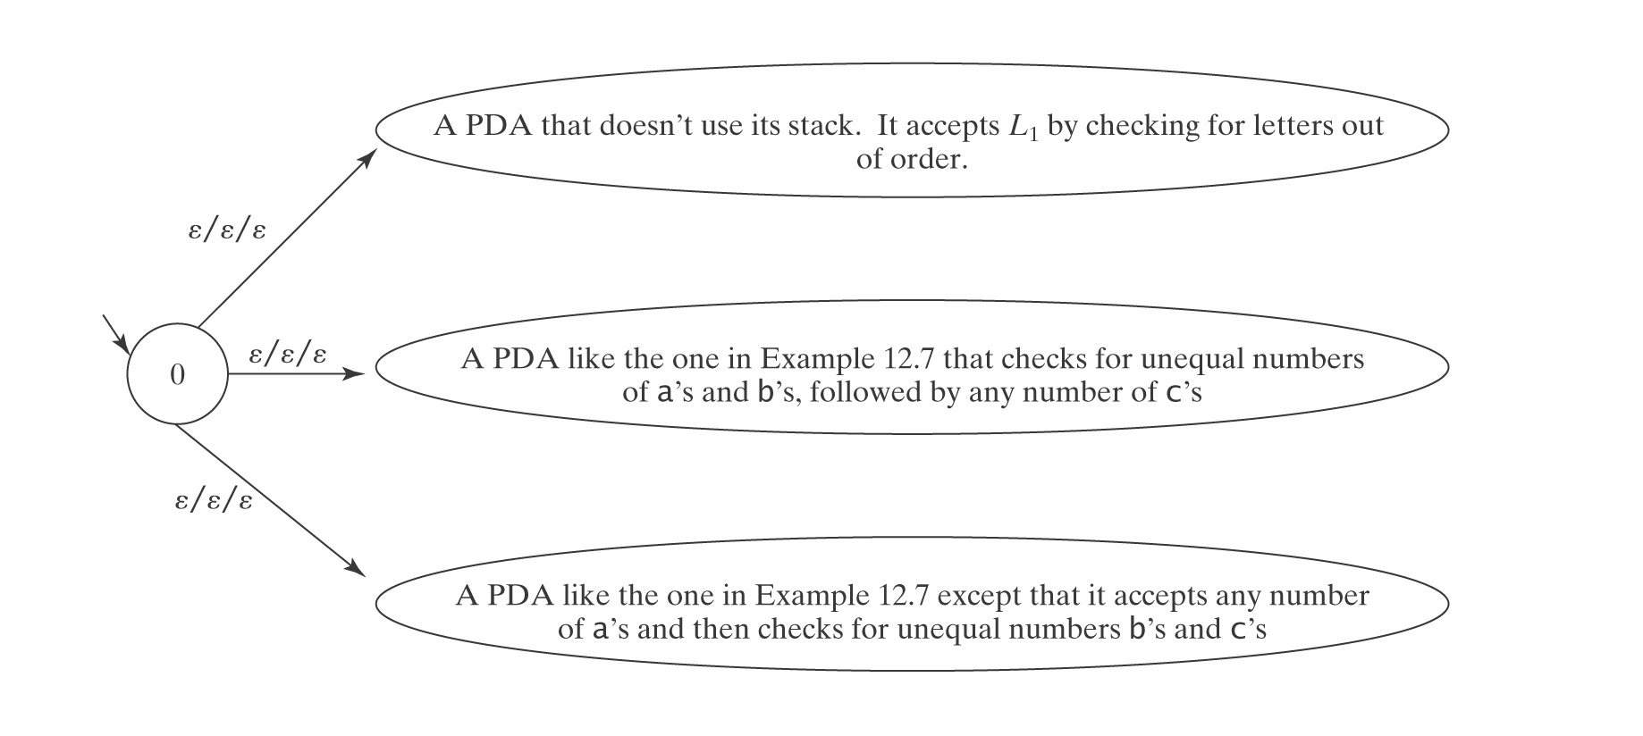
Closure Under Complement
An Example
¬A^{n}B^{n}C^{n} is context-free:
But ¬(¬A^{n}B^{n}C^{n}) = A^{n}B^{n}C^{n} is not context-free.

Slide 44
Closure Under Difference
Are the context-free languages closed under difference?

Slide 45
Closure Under Difference
Are the context-free languages closed under difference?
¬L = Σ* - L.
Σ* is context-free. So, if the context-free languages were closed under difference, the complement of any context-free language would necessarily be context-free. But we just showed that that is not so.

Slide 46
The Deterministic CF Languages are Closed Under Complement
  Given a PDA M, we want to:
  ● Complete M.
  ● Swap accepting and nonaccepting configurations.
  ● Accept (¬L)$, not ¬L(M).
  A deterministic PDA may fail to accept an input string w because:
  1. Its computation ends before it finishes reading w.
  2. Its computation ends in an accepting state but the stack is not empty.
  3. Its computation loops forever, following ε-transitions, without ever
  halting in either an accepting or a nonaccepting state.
  4. Its computation ends in a nonaccepting state.
  If we simply swap accepting and nonaccepting states we will correctly fail to accept every string that M would have accepted (i.e., every string in L$). But we will not necessarily accept every string in (¬L)$.
  A construction that solves these problems exists.

Slide 47
DCFLs Under Intersection and Union
  L₁ ∩ L₂ = ¬(¬L₁ ∪ ¬L₂).
  The DCFLs are closed under complement. What about intersection and union?

Slide 48
DCFLs are Not Closed Under Union
  L₁ = {a^{i}b^{j}c^{k}, i, j, k ≥ 0 and i ≠ j}. (a DCFL)
  L₂ = {a^{i}b^{j}c^{k}, i, j, k ≥ 0 and j ≠ k}. (a DCFL)
  L′ = L₁ ∪ L₂.
  = {a^{i}b^{j}c^{k}, i, j, k ≥ 0 and (i ≠ j) or (j ≠ k)}.
  L′′ = ¬L′.
  = {a^{i}b^{j}c^{k}, i, j, k ≥ 0 and i = j = k} ∪
  {w ∈ {a, b, c}* : the letters are out of order}.
  L′′′ = L′′ ∩ a*b*c*.
  = {a^{n}b^{n}c^{n}, n ≥0}.
  L′′′ is not even CF, much less DCF.

Slide 49
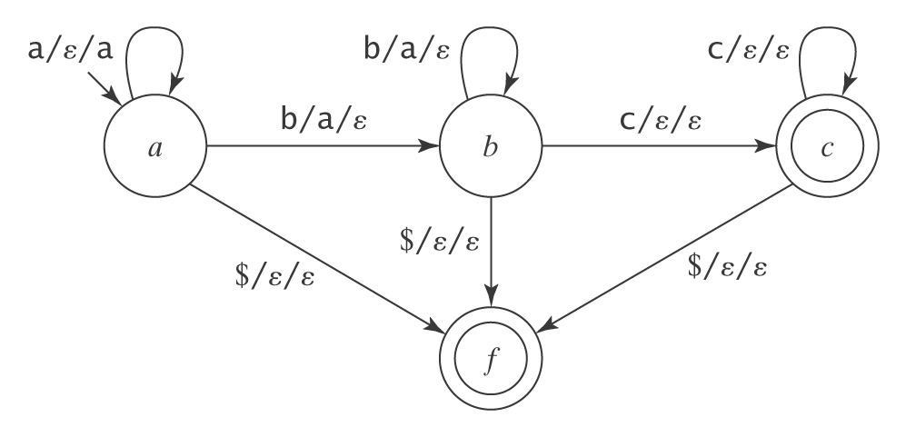
DCFLs are Not Closed Under Intersection
L₁ = {a^{i}b^{j}c^{k}, i, j, k ≥ 0 and i = j}.
L₂ = {a^{i}b^{j}c^{k}, i, j, k ≥ 0 and j = k}.
L′ = L₁ ∩ L₂
=
L₁ and L₂ are deterministic context-free:

