Slide 1

Parsing
Chapter 15

Slide 2
The Job of a Parser
Given a context-free grammar G:
Examine a string and decide whether or not it is a syntactically well-formed member of L(G), and
If it is, assign to it a parse tree that describes its structure and thus can be used as the basis for further interpretation.

Slide 3
Problems with Solutions So Far
We want to use a natural grammar that will produce a natural parse tree. But:
  decideCFLusingGrammar, requires a grammar that is in Chomsky normal form.
  decideCFLusingPDA, requires a grammar that is in Greibach normal form.
We want an efficient parser. But both procedures require search and take time that grows exponentially in the length of the input string.
All either procedure does is to determine membership in L(G). It does not produce parse trees.

Slide 4
Easy Issues
Actually building parse trees: Augment the parser with a function that builds a chunk of tree every time a rule is applied.
Using lookahead to reduce nondeterminism: It is often possible to reduce (or even eliminate) nondeterminism by allowing the parser to look ahead at the next one or more input symbols before it makes a decision about what to do.

Slide 5
Dividing the Process
Lexical analysis:
done in linear time with a DFSM
Parsing:
  done in, at worst O(n³) time.

Slide 6
Lexical Analysis
level = observation - 17.5;
Lexical analysis produces a stream of tokens:
id = id - id

Slide 7
Specifying id with a Grammar
id → identifier | integer | float
identifier → letter alphanum
alphanum → letter alphnum | digit alphnum | ε
integer → - unsignedint | unsignedint
unsignedint → digit | digit unsignedint
digit → 0 | 1 | 2 | 3 | 4 | 5 | 6 | 7 | 8 | 9
….

Slide 8
Using Reg Ex’s to Specify an FSM
There exist simple tools for building lexical analyzers.
The first important such tool: Lex

Slide 9
Top-Down, Depth-First Parsing
S → NP VP $
NP → the N | N | ProperNoun
N → cat | dogs | bear | girl | chocolate | rifle
ProperNoun → Chris | Fluffy
VP → V | V NP
V → like | likes | thinks | shot | smells
Input: the cat likes chocolate $

Slide 10
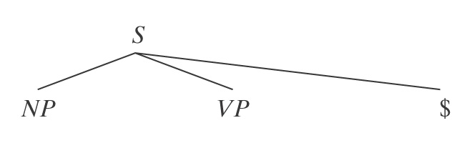
Top-Down, Depth-First Parsing
S → NP VP $
NP → the N | N | ProperNoun
N → cat | dogs | bear | girl | chocolate | rifle
ProperNoun → Chris | Fluffy
VP → V | V NP
V → like | likes | thinks | shot | smells
Input: the cat likes chocolate $

Slide 11
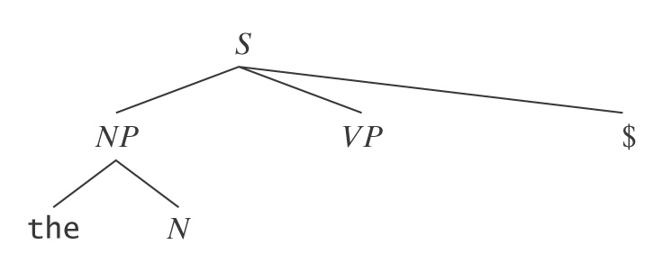
Top-Down, Depth-First Parsing
S → NP VP $
NP → the N | N | ProperNoun
N → cat | dogs | bear | girl | chocolate | rifle
ProperNoun → Chris | Fluffy
VP → V | V NP
V → like | likes | thinks | shot | smells
Input: the cat likes chocolate $

Slide 12
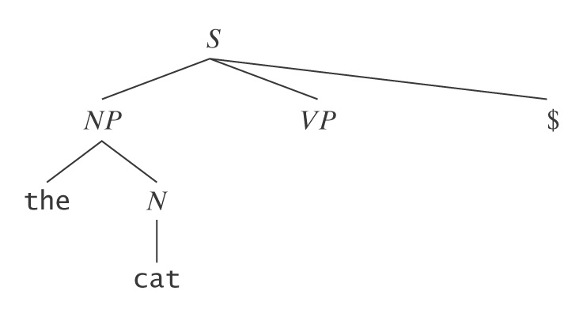
Top-Down, Depth-First Parsing
S → NP VP $
NP → the N | N | ProperNoun
N → cat | dogs | bear | girl | chocolate | rifle
ProperNoun → Chris | Fluffy
VP → V | V NP
V → like | likes | thinks | shot | smells
Input: the cat likes chocolate $

Slide 13
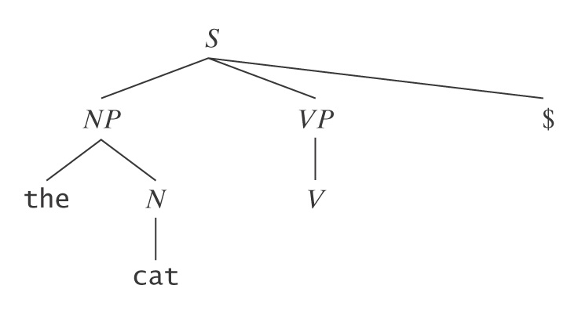
Top-Down, Depth-First Parsing
S → NP VP $
NP → the N | N | ProperNoun
N → cat | dogs | bear | girl | chocolate | rifle
ProperNoun → Chris | Fluffy
VP → V | V NP
V → like | likes | thinks | shot | smells
Input: the cat likes chocolate $

Slide 14
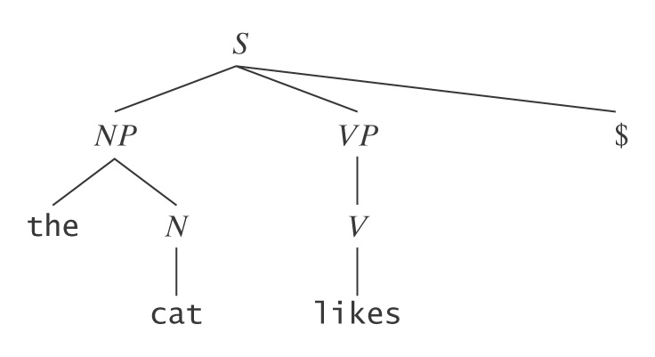
Top-Down, Depth-First Parsing
S → NP VP $
NP → the N | N | ProperNoun
N → cat | dogs | bear | girl | chocolate | rifle
ProperNoun → Chris | Fluffy
VP → V | V NP
V → like | likes | thinks | shot | smells
Input: the cat likes chocolate $
Fail

Slide 15
Top-Down, Depth-First Parsing
S → NP VP $
NP → the N | N | ProperNoun
N → cat | dogs | bear | girl | chocolate | rifle
ProperNoun → Chris | Fluffy
VP → V | V NP
V → like | likes | thinks | shot | smells
Input: the cat likes chocolate $
Backup to:

Slide 16
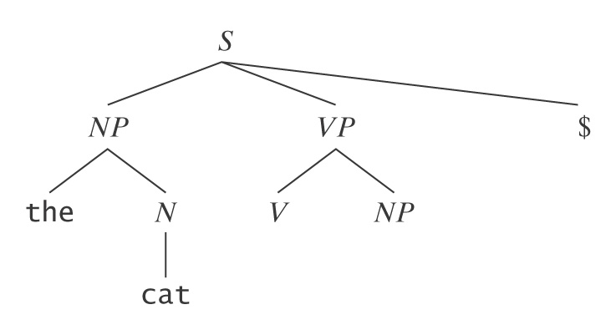
Top-Down, Depth-First Parsing
S → NP VP $
NP → the N | N | ProperNoun
N → cat | dogs | bear | girl | chocolate | rifle
ProperNoun → Chris | Fluffy
VP → V | V NP
V → like | likes | thinks | shot | smells
Input: the cat likes chocolate $

Slide 17
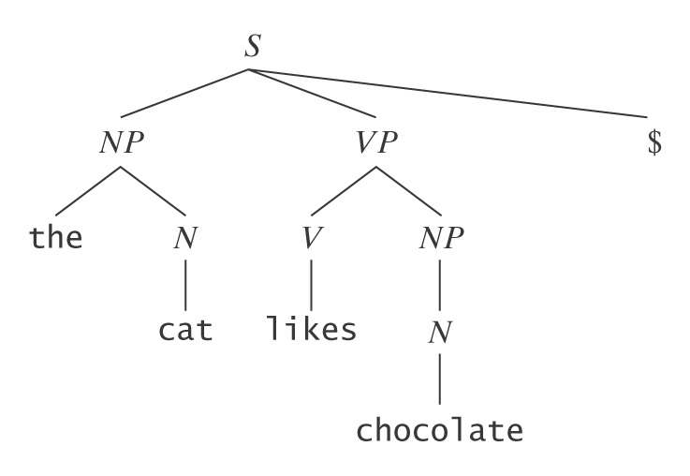
Top-Down, Depth-First Parsing
S → NP VP $
NP → the N | N | ProperNoun
N → cat | dogs | bear | girl | chocolate | rifle
ProperNoun → Chris | Fluffy
VP → V | V NP
V → like | likes | thinks | shot | smells
Input: the cat likes chocolate $
Built,
unbuilt,
built again

Slide 18
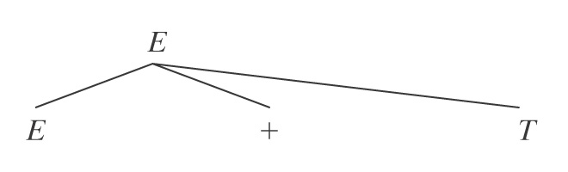
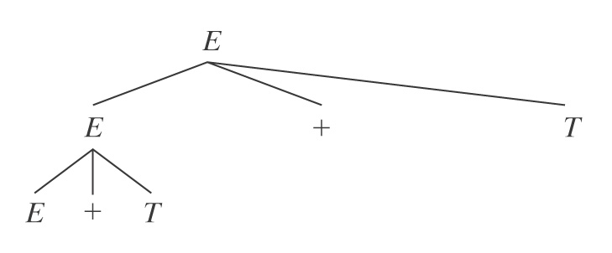
Left-Recursive Rules
E → E + T
E → T
T → T ∗ F
T → F
F → (E)
F → id
On input: id + id + id :
Then:
And so forth.

Slide 19
Indirect Left Recursion
S → Ya
Y → Sa
Y → ε
This form too can be eliminated.

Slide 20
Using Lookahead and Left Factoring
Goal: Procrastinate branching as long as possible. To do that, we will:
Change the parsing algorithm so that it exploits the ability to look one symbol ahead in the input before it makes a decision about what to do next, and
Change the grammar to help the parser procrastinate decisions.

Slide 21
LL(k) Grammars
An LL(k) grammar allows a predictive parser:
that scans its input Left to right
to build a Left-most derivation
if it is allowed k lookahead symbols.
Every LL(k) grammar is unambiguous (because every string it generates has a unique left-most derivation).
But not every unambiguous grammar is LL(k).

Slide 22
Recursive Descent Parsing
A → BA | a
B → bB | b
A(n: parse tree node labeled A) =
case (lookahead = b : /* Use A → BA.
Invoke B on a new daughter node labeled B.
Invoke A on a new daughter node labeled A.
lookahead = a : /* Use A → a.
Create a new daughter node labeled a.

Slide 23
LR(k) Grammars
G is LR(k), for any positive integer k, iff it is possible to build a deterministic parser for G that:
scans its input Left to right and,
for any input string in L(G), builds a Rightmost derivation,
looking ahead at most k symbols.
A language is LR(k) iff there is an LR(k) grammar for it.

Slide 24
LR(k) Grammars
The class of LR(k) languages is exactly the class of deterministic context-free languages.
If a language is LR(k), for some k, then it is also LR(1).

