Slide 1

Turing Machines
Chapter 17

Slide 2
Languages and Machines
SD
D
Context-Free
Languages
Regular
Languages
reg exps
FSMs
cfgs
PDAs
unrestricted grammars
Turing Machines

Slide 3
Grammars, SD Languages, and Turing Machines
L
SD Language
Unrestricted Grammar
Accepts
Turing Machine

Slide 4
Turing Machines
  Can we come up with a new kind of automaton that has two properties:
  ● powerful enough to describe all computable things
  unlike FSMs and PDAs.
  ● simple enough that we can reason formally about it
  like FSMs and PDAs,
  unlike real computers.

Slide 5
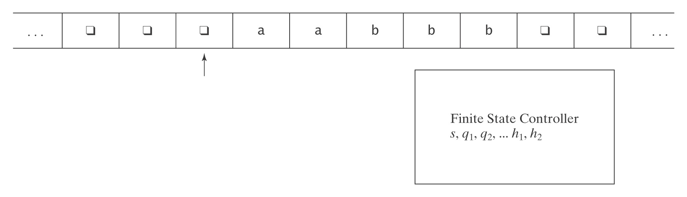
Turing Machines
  At each step, the machine must:
  ● choose its next state,
  ● write on the current square, and
  ● move left or right.

Slide 6
A Formal Definition
A Turing machine M is a sixtuple (K, Σ, Γ, δ, s, H):
● K is a finite set of states;
● Σ is the input alphabet, which does not contain ;
● Γ is the tape alphabet, which must contain  and have Σ as a
subset.
● s ∈ K is the initial state;
● H ⊆ K is the set of halting states;
● δ is the transition function:
(K - H) × Γ to K × Γ × {→, ←}
non-halting × tape state × tape × action
state char char (R or L)

Slide 7
Notes on the Definition
1. The input tape is infinite in both directions.
2. δ is a function, not a relation. So this is a definition for
deterministic Turing machines.
3. δ must be defined for all state, input pairs unless the state is
a halting state.
4. Turing machines do not necessarily halt (unlike FSM's and
PDAs). Why? To halt, they must enter a halting state.
Otherwise they loop.
5. Turing machines generate output so they can compute
functions.

Slide 8
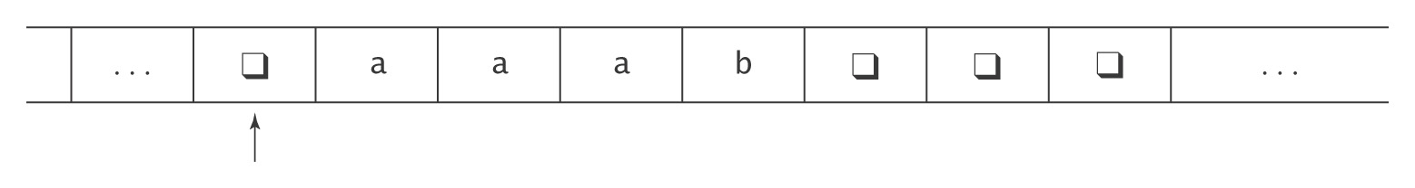
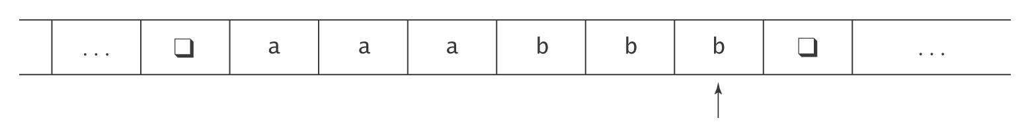
An Example
M takes as input a string in the language:
{a^{i}b^{j}, 0 ≤ j ≤ i},
and adds b’s as required to make the number of b’s equal the number of a’s.
The input to M will look like this:
The output should be:

Slide 9
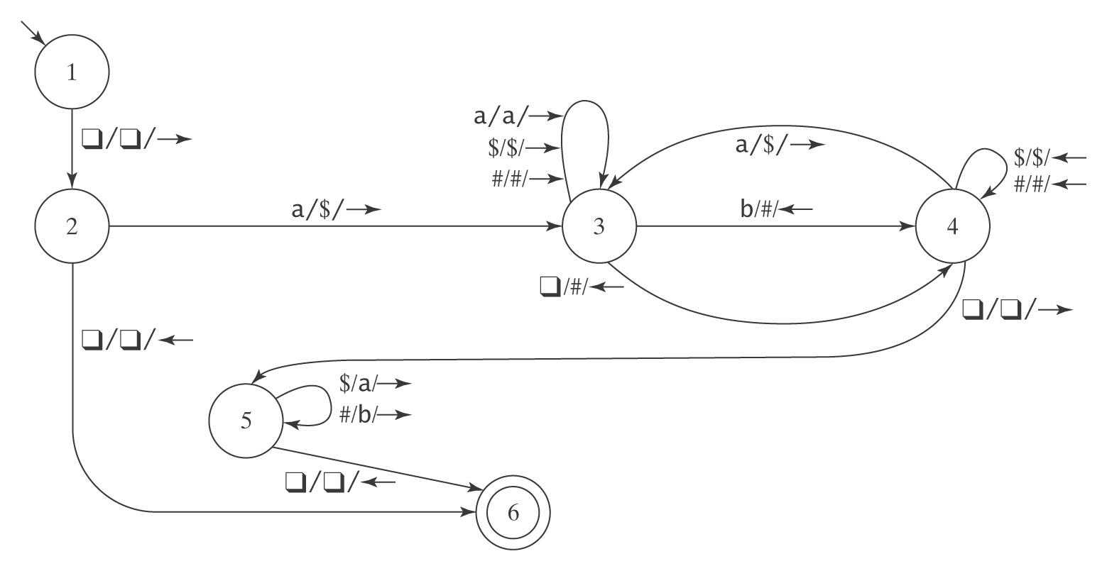
The Details
K = {1, 2, 3, 4, 5, 6}, Σ = {a, b}, Γ = {a, b, , $, #},
s = 1, H = {6}, δ =

Slide 10
Notes on Programming
The machine has a strong procedural feel, with one phase coming after another.
There are common idioms, like scan left until you find a blank
There are two common ways to scan back and forth marking things off.
Often there is a final phase to fix up the output.
Even a very simple machine is a nuisance to write.

Slide 11
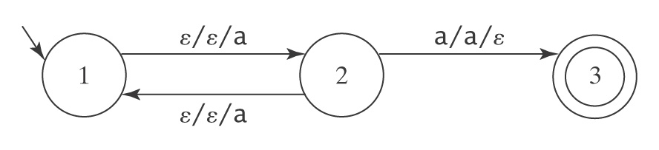
Halting
● A DFSM M, on input w, is guaranteed to halt in |w| steps.
● A PDA M, on input w, is not guaranteed to halt. To see
why, consider again M =
But there exists an algorithm to construct an equivalent PDA
M′ that is guaranteed to halt.
A TM M, on input w, is not guaranteed to halt. And there exists no algorithm to construct one that is guaranteed to do so.

Slide 12
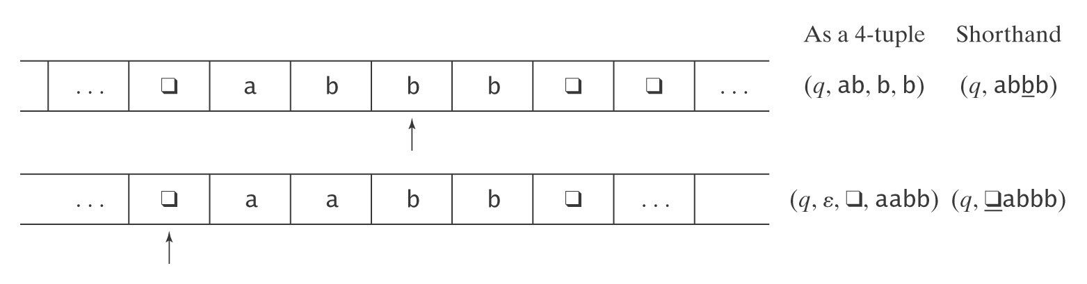
Example Configurations
(1) (q, ab, b, b) = (q, abbb)
(2) (q, ε, , aabb) = (q, aabb)
Initial configuration is (s, w).

Slide 13
Yields
(q₁, w₁) |-_{M} (q₂, w₂) iff (q₂, w₂) is derivable, via δ, in one step.
For any TM M, let |-_{M}* be the reflexive, transitive closure of |-_{M}.
Configuration C₁ yields configuration C₂ if: C₁ |-_{M}* C₂.
A path through M is a sequence of configurations C₀, C₁, …, C_{n} for some n ≥ 0 such that C₀ is the initial configuration and:
C₀ |-_{M} C₁ |-_{M} C₂ |-_{M} … |-_{M} C_{n}.
A computation by M is a path that halts.
If a computation is of length n or has n steps, we write:
C₀ |-_{M}^{n} C_{n}

Slide 14
A Notation for Turing Machines
(1) Define some basic machines
● Symbol writing machines
For each x ∈ Γ, define M_{x}, written just x, to be a machine that writes x.
● Head moving machines
R: for each x ∈ Γ, δ(s, x) = (h, x, →)
L: for each x ∈ Γ, δ(s, x) = (h, x, ←)
● Machines that simply halt:
h, which simply halts.
n, which halts and rejects.
y, which halts and accepts.

Slide 15
Checking Inputs and Combining Machines
Next we need to describe how to:
● Check the tape and branch based on what character
we see, and
● Combine the basic machines to form larger ones.
To do this, we need two forms:
● M₁ M₂
● M₁ <condition> M₂

Slide 16
A Notation for Turing Machines, Cont'd
Example:
>M₁ a M₂
b
M₃
● Start in the start state of M₁.
● Compute until M₁ reaches a halt state.
● Examine the tape and take the appropriate transition.
● Start in the start state of the next machine, etc.
● Halt if any component reaches a halt state and has no place
to go.
● If any component fails to halt, then the entire machine may fail
to halt.

Slide 17
Turing Machines as Language Recognizers
Convention: We will write the input on the tape as:
w, w contains no s
The initial configuration of M will then be:
(s, w)
Let M = (K, Σ, Γ, δ, s, {y, n}).
● M accepts a string w iff (s, w) |-_{M}* (y, w′) for some string w′.
● M rejects a string w iff (s, w) |-_{M}* (n, w′) for some string w′.

Slide 18
Turing Machines as Language Recognizers
M decides a language L ⊆ Σ* iff:
For any string w ∈ Σ* it is true that:
if w ∈ L then M accepts w, and
if w ∉ L then M rejects w.
A language L is decidable iff there is a Turing machine M that decides it. In this case, we will say that L is in D.

Slide 19
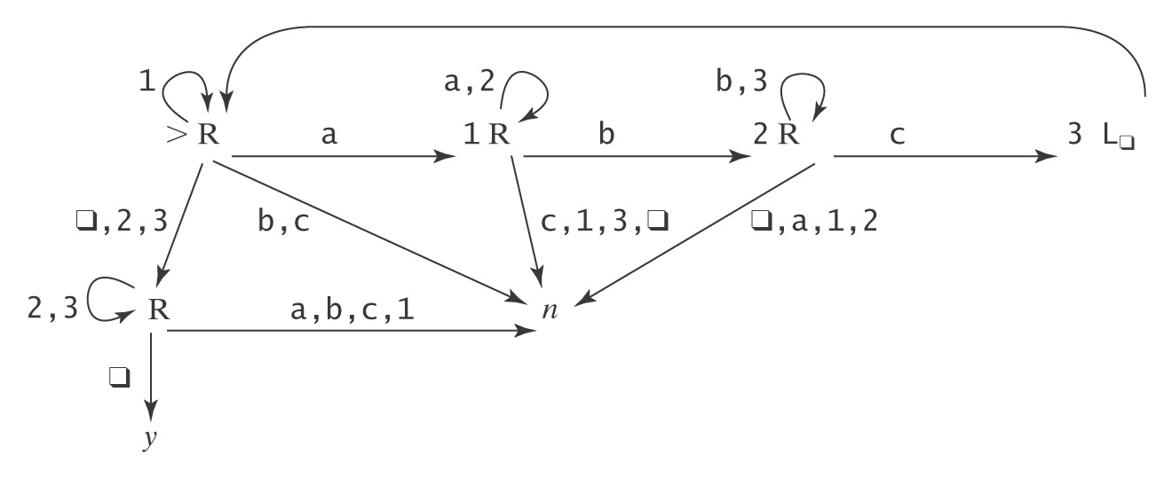
A Deciding Example
A^{n}B^{n}C^{n} = {a^{n}b^{n}c^{n} : n ≥ 0}
Example: aabbcc
Example: aaccb

Slide 20
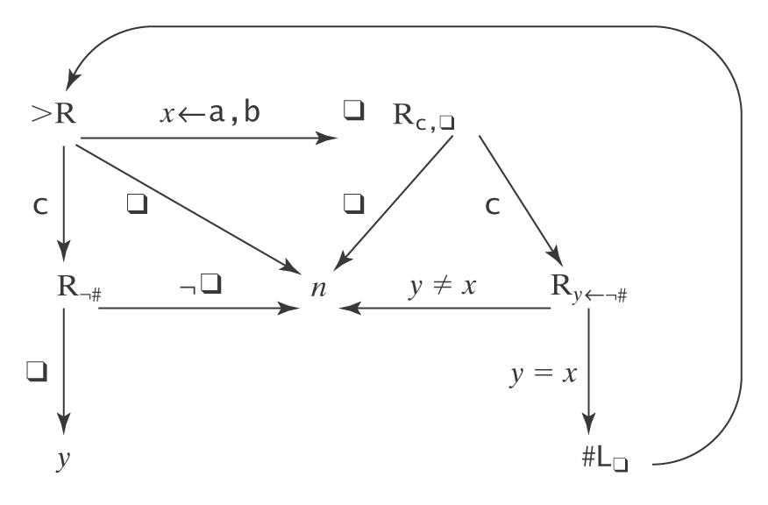
Another Deciding Example
WcW = {wcw : w ∈ {a, b}*}
Example: abbcabb 
Example: acabb

Slide 21
Semideciding a Language
Let Σ_{M} be the input alphabet to a TM M. Let L ⊆ Σ_{M}*.
M semidecides L iff, for any string w ∈ Σ_{M}*:
● w ∈ L → M accepts w
● w ∉ L → M does not accept w. M may either:
reject or
fail to halt.
A language L is semidecidable iff there is a Turing machine that semidecides it. We define the set SD to be the set of all semidecidable languages.

Slide 22
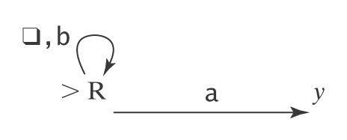
Example of Semideciding
Let L = b*a(a ∪ b)*
We can build M to semidecide L:
1. Loop
  1.1 Move one square to the right. If the character under
  the read head is an a, halt and accept.
In our macro language, M is:

Slide 23
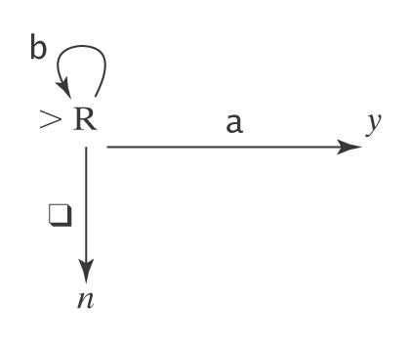
Example of Semideciding
L = b*a(a ∪ b)*. We can also decide L:
  Loop:
    1.1 Move one square to the right.
    1.2 If the character under the read/write head is
    an a, halt and accept.
    1.3 If it is , halt and reject.
In our macro language, M is:

Slide 24
Why Are We Working with Our Hands Tied Behind Our Backs?
Turing machines Are more powerful than any of
the other formalisms we have
studied so far. ☺
Turing machines Are a lot harder to work with than
all the real computers we have
available.
☹
Why bother?
The very simplicity that makes it hard to program Turing machines makes it possible to reason formally about what they can do. If we can, once, show that anything a real computer can do can be done (albeit clumsily) on a Turing machine, then we have a way to reason about what real computers can do.

