Slide 1
CSC 520: Kerbal engine optimizer
By: matt jones
Csc 521 Advisor: Dr. bo hatfield
Notes:
Greeting
Brief overview of what KSP is and the point of the game

Slide 2
Overview
Objectives
Problem Specification
Solution Process/Design
Sequence Diagram
UML Diagram
Visual Design Hierarchy
Benchmarks
Tools
Schedule
Grading
Deliverables
Notes:
Not much to say
Quickly go over whats on the slide and move on

Slide 3
Objectives
Gain an increase in the understanding of Java
Learn more about creating GUI’s
Learn to use Amazon Web Service using DynamoDB
Gain a better understanding of a project's life cycle
Increase players enjoyment of Kerbal Space Program by streamlining the building process
Notes:
First multi-stage program
Enjoy easy to use GUIs that function well
AWS is a commonly used database and it would be good to knowledge
Life cycles of projects can very but its important to have a base idea

Slide 4
Problem specifications
Building rockets in KSP is easy, building them correctly… is much harder
Finding the correct engine and fuel amount is difficult, every engine has a different ISP, and each planet has different gravity and atmospheric pressure to account for
Calculating the math for each engine is tedious at best

Slide 5
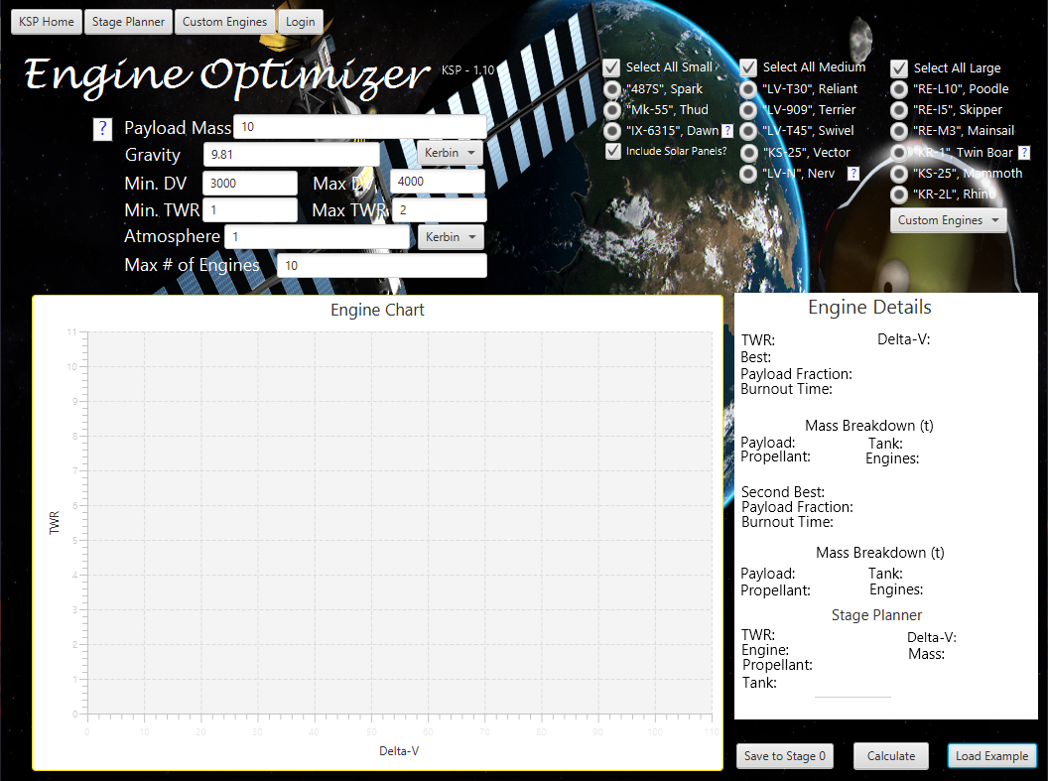
Problem specifications
My app will allow the user to:
Select engine(s) to test
Input desired DV, TWR for their journey
Output the results and allow the user to select a specific DV/TWR point to see detailed results
Make an account so they can create custom engines to test for and track previous tests

Slide 6
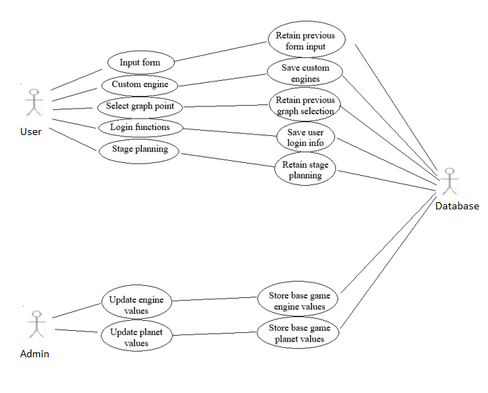
Sequence diagram

Slide 7
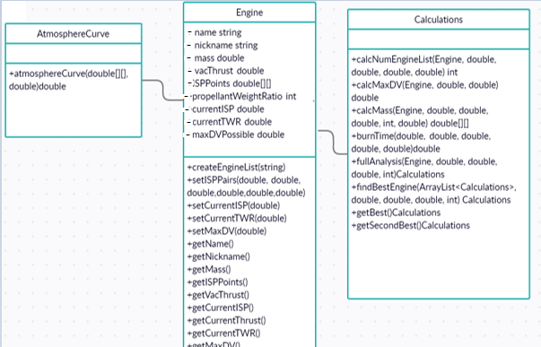
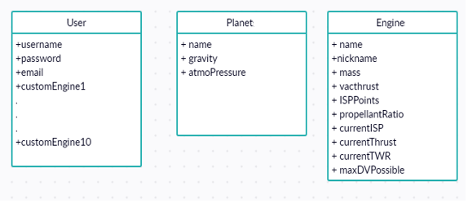
Uml Preliminary DB design

Slide 8
Benchmark
Benchmark one – core functionality
Handle user input, do calculations, output the values and allow user to select DV/TWR point
Benchmark two – database creation
Create database to store users, custom engines, base planet and engine values
Benchmark three – user functions
Allow users to create accounts that will store basic info and custom engines
Benchmark four – support for KSP 2
Bonus benchmark that establishes the base for KSP 2

Slide 9
tools
Git: main version control
GitHub: back up and allow advisor to view my progress
Trello: used to help track progress of project
NetBeans IDE: main IDE for development
Scene Builder: creation of the user interfaces
Amazon Web Services: intended database creation using DynamoDB
Hardware: mainly PC but support could be made for Mac users if they install Java

Slide 10
Time schedule
Benchmark one: Weeks 1 – 5
Benchmark two: Weeks 6 – 8
Benchmark three: Weeks 9 -12
Final testing and report/presentation: Weeks 13 – 14
Benchmark four: Pending, will be split up amongst respective benchmarks or as time allows

Slide 11
Grading
Project fully completed – A
Project half completed – A
Project started – A
Basically, do anything – get an A, that works right…

Slide 12
Grading Revised
Benchmark one: 45%
Benchmark two : 25%
Planet and engine database: 15%
User and custom engine database 10%
Benchmark three: 20%
User account 10%
Custom engine 5%
Stage planner 5%
Presentation: 10%

Slide 13
deliverables
Proposal and presentation files
UML diagram
Source code
Documentation of project functionality
Sample output of a running project
Executables
Project postmortem
List of uncompleted areas(if applicable)

Slide 15
Questions?

