Slide 1
CSC 520: Kerbal engine optimizer
By: matt jones
Csc 521 Advisor: Dr. bo hatfield
Notes:
Greeting
Brief overview of what KSP is and the point of the game

Slide 2
Overview
Objectives
Problem Specification
Solution Process/Design
Sequence Diagram
UML Diagram
Visual Design Hierarchy
Benchmarks
Tools
Schedule
Grading
Deliverables
Notes:
Not much to say
Quickly go over whats on the slide and move on

Slide 3
Objectives
Gain an increase in the understanding of Java
Learn more about creating GUI’s
Learn to use Amazon Web Service using DynamoDB
Gain a better understanding of a project's life cycle
Increase players enjoyment of Kerbal Space Program by streamlining the building process
Notes:
First multi-stage program
Enjoy easy to use GUIs that function well
AWS is a commonly used database and it would be good to knowledge
Life cycles of projects can very but its important to have a base idea

Slide 4
Problem specifications
Building rockets in KSP is easy, building them correctly… is much harder
Finding the correct engine and fuel amount is difficult, every engine has a different ISP, and each planet has different gravity and atmospheric pressure to account for
Calculating the math for each engine is tedious at best
My app will allow the user to:
Select engine(s) to test
Input desired DV, TWR for their journey
Output the results and allow the user to select a specific DV/TWR point to see detailed results
Make an account so they can create custom engines to test for and track previous tests

Slide 5
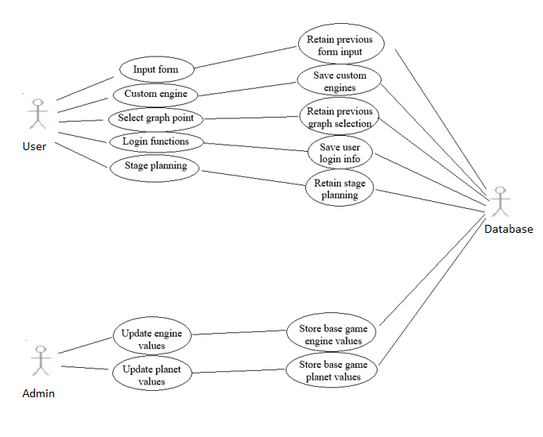
Sequence diagram

Slide 6
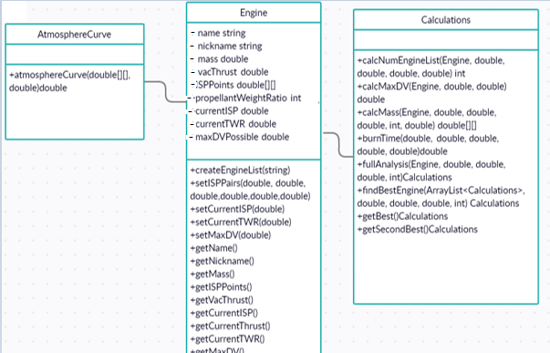
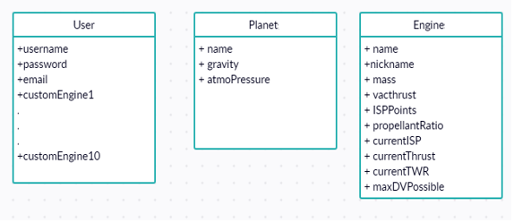
Uml Preliminary DB design

Slide 7
Benchmark
Benchmark one – core functionality
Handle user input, do calculations, output the values and allow user to select DV/TWR point
Benchmark two – database creation
Create database to store users, custom engines, base planet and engine values
Benchmark three – user functions
Allow users to create accounts that will store basic info and custom engines
Benchmark four – support for KSP 2
Bonus benchmark that establishes the base for KSP 2

Slide 8
tools
Git: main version control
GitHub: back up and allow advisor to view my progress
Trello: used to help track progress of project
NetBeans IDE: main IDE for development
Scene Builder: creation of the user interfaces
Amazon Web Services: intended database creation using DynamoDB
Hardware: mainly PC but support could be made for Mac users if they install Java

Slide 9
Time schedule
Benchmark one: Weeks 1 – 5
Benchmark two: Weeks 6 – 8
Benchmark three: Weeks 9 -12
Final testing and report/presentation: Weeks 13 – 14
Benchmark four: Pending, will be split up amongst respective benchmarks or as time allows

Slide 10
Grading
Project fully completed – A
Project half completed – A
Project started – A
Basically, do anything – get an A, that works right…

Slide 11
Grading Revised
Benchmark one: 45%
Benchmark two : 25%
Planet and engine database: 15%
User and custom engine database 10%
Benchmark three: 20%
User account 10%
Custom engine 5%
Stage planner 5%
Presentation: 10%

Slide 12
deliverables
Proposal and presentation files
UML diagram
Source code
Documentation of project functionality
Sample output of a running project
Executables
Project postmortem
List of uncompleted areas(if applicable)

Slide 13
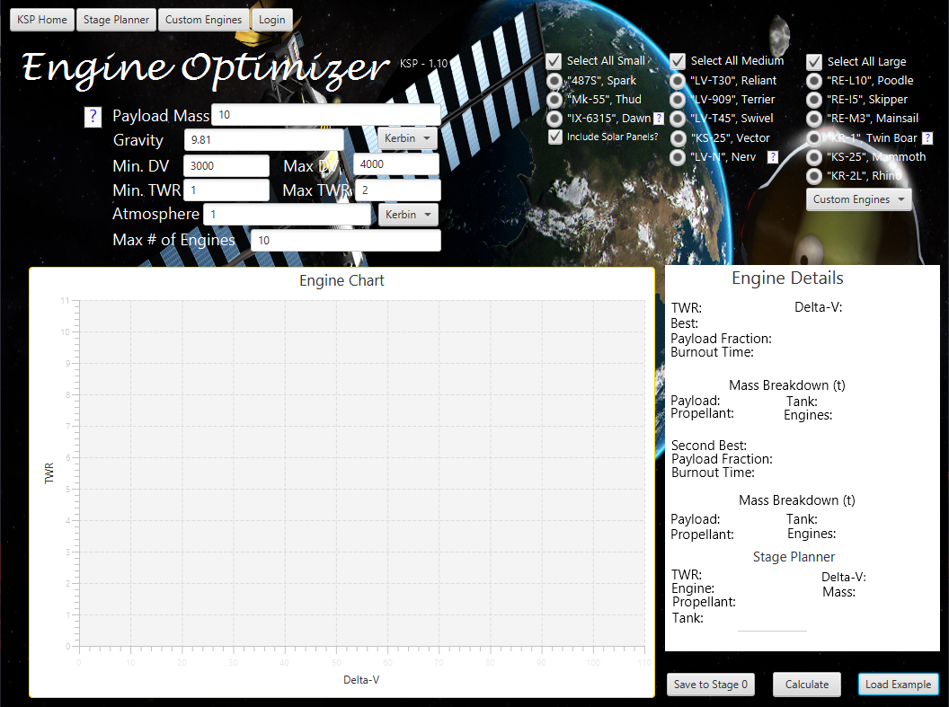

Slide 14
Questions?

