Slide 1

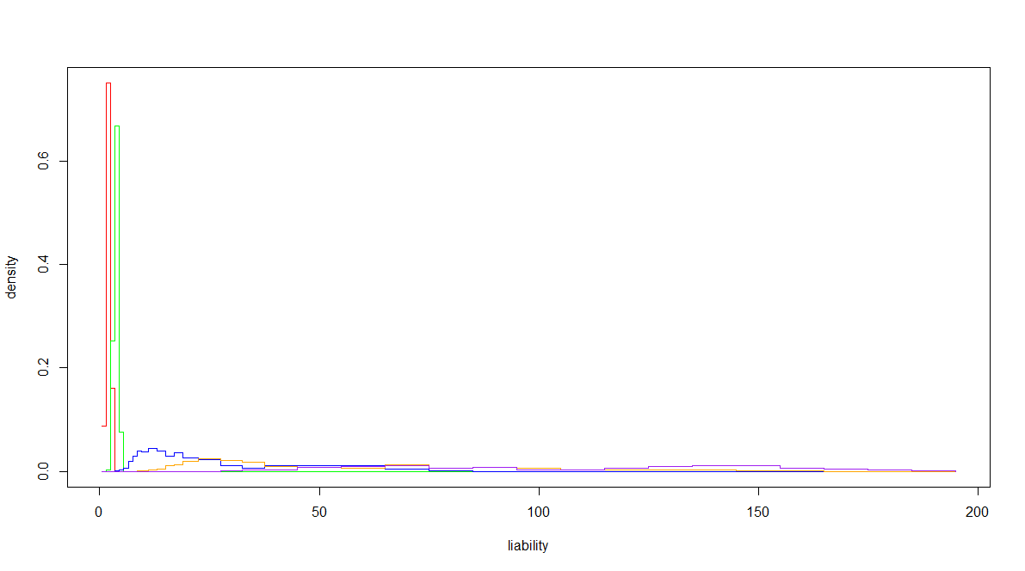
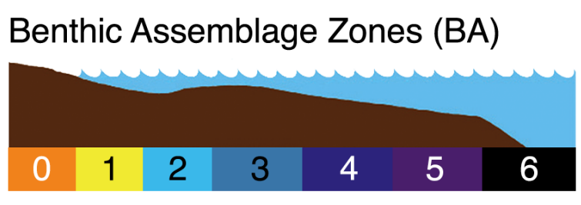
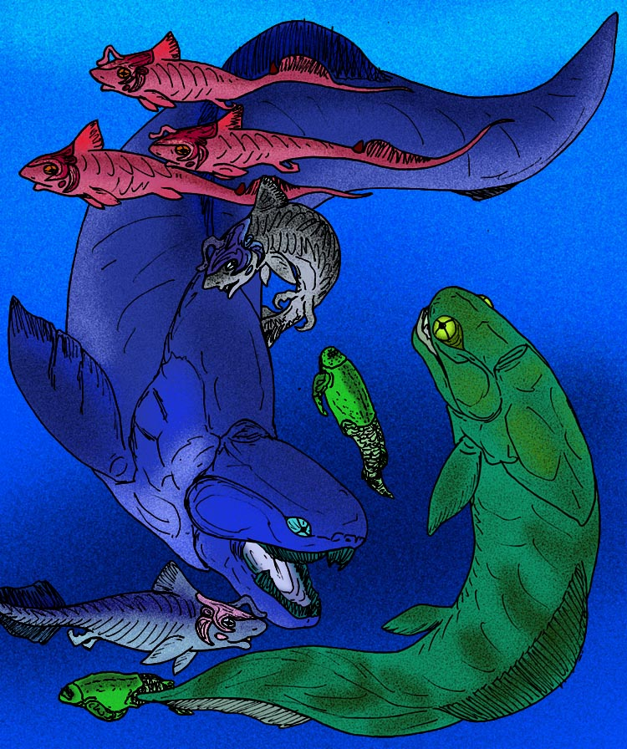
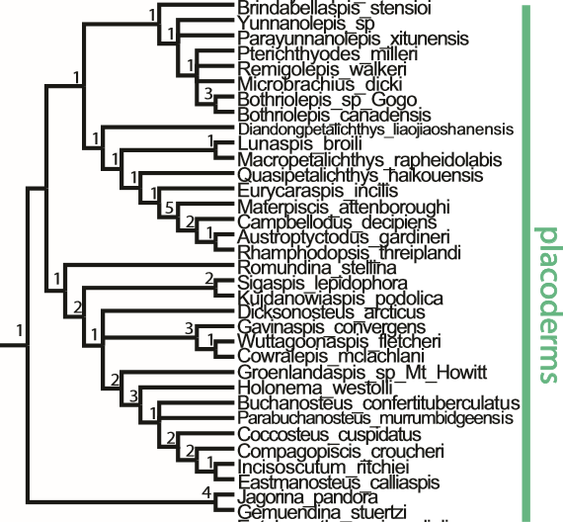
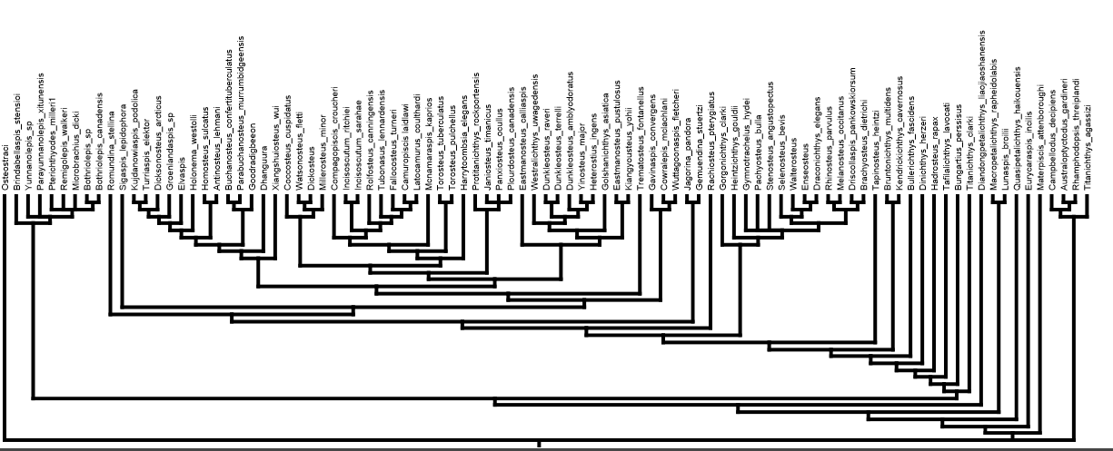
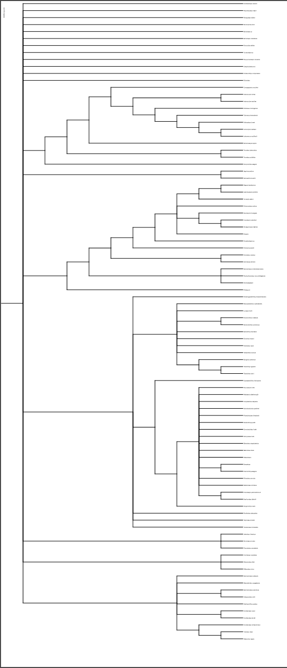
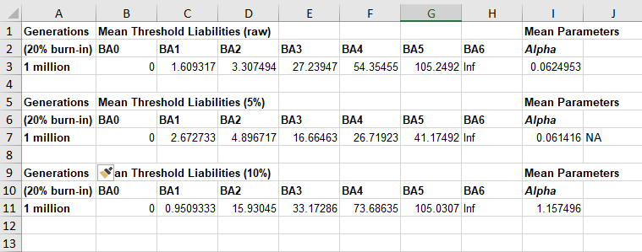
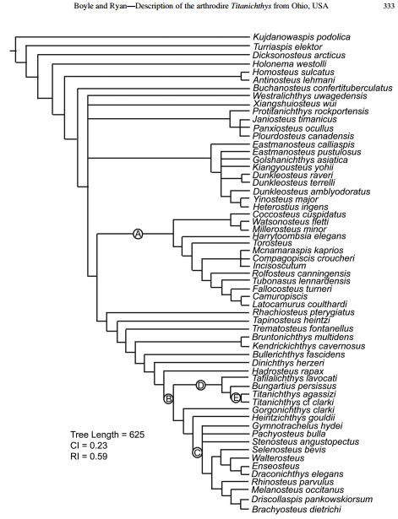
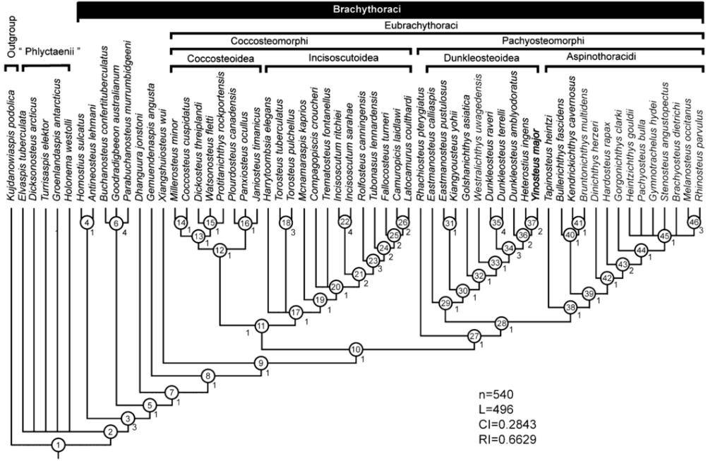
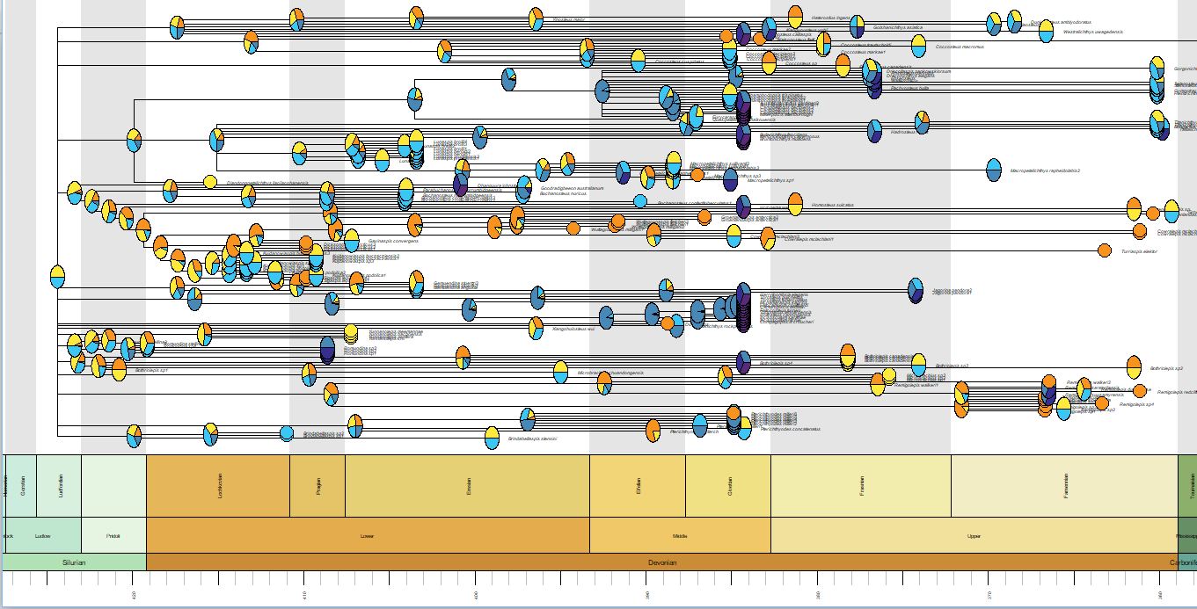
Estimating Placoderms Origination Environment via ancThresh Model
Charles Sansone (COL 2019), Dr. Lauren Sallan, and Dr. Ivan Sansom
1. Introduction
Placoderms are an ancient extinct class or armored fish that existed from 430mya to 360mya. Notably, placoderms were the first fish to develop true teeth, and were among the first to develop jaws. Therefore, Placoderms are a sister group to living jawed vertebrates.
This project hoped to reveal the ancestral habitats of placoderms and therefore the setting where the origination of jaws occurred. Whichever Benthic Assemblage (BA) zone it occurred in would inform us as to whether Placodermi were an apex predator in open water, in competition with invertebrates in reefs, etc. The origination environment would also tell us whether the diversity of placoderms, and thus jawed fishes, originated in a restricted environment, or as a result of transitions.
We categorized 6 different BA zones total, labeling them with numbers 0-5. In order, they were freshwater, shoreline, subtidal, fore-reef, back-reef, shelf/slope, and open water. We first gathered data on likely BA zones of the fauna of the placoderm occurrences. We created a PCM table of all the occurrences and the probability distributions of which BA zones they likely occurred in.
2. Phylogeny
Since no single phylogeny exists that contains all the important placoderm species, and since many phylogenies contradict each other, we needed to make a super tree that combined many different trees. We chose 3 trees from 3 recent papers and combined them via a Matrix Representation by Parsimony (MRP) method. Using Mesquite, we created an MRP matrix of the 3 trees and then imported it into MrBayes. We ran a Markov K (MK) model on the matrix. It simulated 5000000 generations, sampled every 100, and waited for the average standard deviation to fall below 0.10. We imported 12,500 of the sampled generations and made a majority consensus tree of them.
We then collected data on 175 occurrences of Placoderms in the majority-consensus tree, namely the fauna and age ranges. Via the “Equals” method developed by Graeme T. Lloyd in R and based on the Brusatte et al. (2008) method, we timescaled the whole tree based on the tip ages. This gave us ages for the inner nodes in addition to the tip nodes, thereby allowing us to apply the ancTresh toolkit in the next step.
4. Thresholds
Figure 5: BA 1-5 Combined Distributions
King et al. 2016
Figure 1: BA Zones
Figure 2: Various Placoderms
3. Ancestral States
Now we ran ancThresh, a method developed in R by Liam Revell. We ran ancThresh 3 different times with 3 models: BM, OU, and Lambda, to see which one was the best fit. Since each time it had the lowest Deviance Information Criterion (DIC) value, the OU model was superior. ancThresh assumes an underlying continuous-valued “liability” that causes discrete-valued character changes (like BA zones) after crossing certain thresholds.
As you can see, the OU plot shows a definite change of Placoderms from BA 0 and BA 1 to BA 2 and farther as liability (x-axis) increases.
Boyle and Ryan 2017
Zhu et al. 2015
Figure 3: Recent Trees, 12,500 Sampled Most Parsimonious Trees, Majority Consensus Tree
Figure 6:Mean Values for Thresholds
Our results from ancThresh gave probability density functions for BA zones 1-5 as liability increases. The table below shows the mean values for each of these distributions, and gives a clear picture of how difficult or not it is to transition between different habitats. For example, a large jump from 20 to 100 would signify difficulty in going from one zone to the next. This can also tells us how much constraint there was on dispersal of placoderms
6. Results
Our findings show that placoderms, and thus jawed fishes, primarily originated in BA1/2, since the ancThresh phylogeny chart shows most Placodermi as being BA 1 (yellow) or BA 2 (light blue). Therefore, we can surmise that Placodermi competed with their jawless relatives, which we previously found originated in the same setting. Our mean threshold liability values showed that movement into freshwater was easy, but dispersal into deep water was more difficult. This was shown by larger liability increases being required to reach higher BA zones. Therefore most major groups continued to originate in shallow water. Nevertheless, several groups do disperse onto the reef and open ocean later in their evolutionary history, coincident with the disappearance of jawless fishes from the same habitats.
Acknowledgements
I would like to acknowledge Dr. Lauren Sallan, my faculty mentor under Penn Earth & Environmental Science
PURM for funding my research
University of Pennsylvania College of Arts and Sciences
Figure 4: ancThresh OU BA Changes as Liability Increases

