Slide 1
Individual Project Life around the world
Chi-Lin Hung
2023.11.07

Slide 2
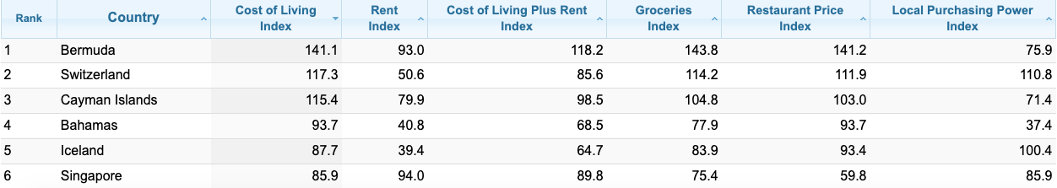
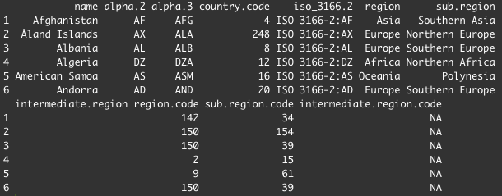
Data Source
Cost of Living Index by Country 2023 Mid-Year
https://www.numbeo.com/cost-of-living/rankings_by_country.jsp
ISO 3166-1 country lists merged with their UN Geoscheme regional codes
https://github.com/lukes/ISO-3166-Countries-with-Regional-Codes/blob/master/all/all.csv

Slide 3
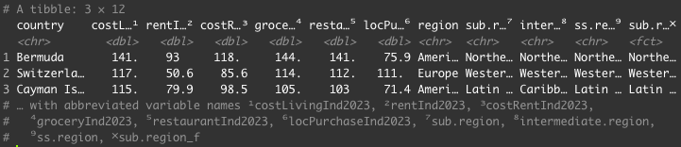
Data Cleaning
add new country names & subregion columns in all.csv
rename columns in Cost of Living Index by Country file
merge two datasets
fill NA

Slide 4
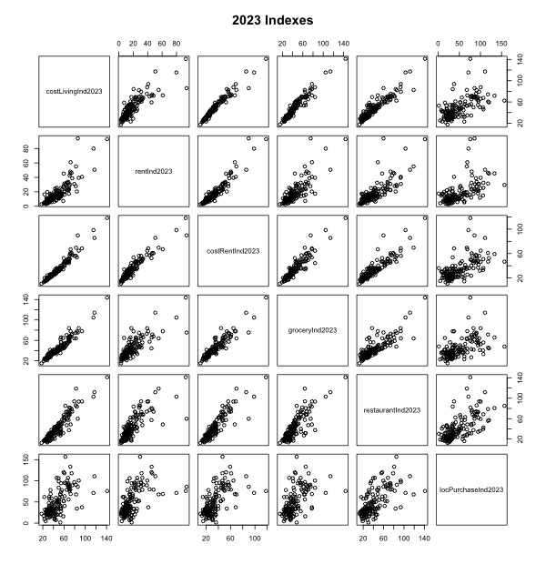
Scatter Plot
Columns:
Cost of Living
Rent
Cost of Living and Rent
Grocery
Restaurant
Local Purchase Power
linear relations for all

Slide 5
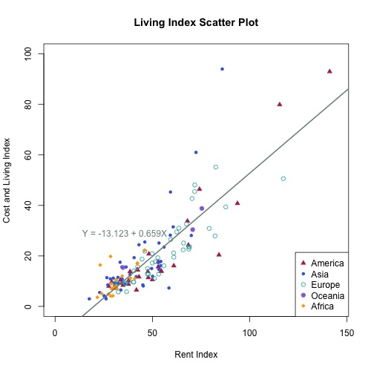
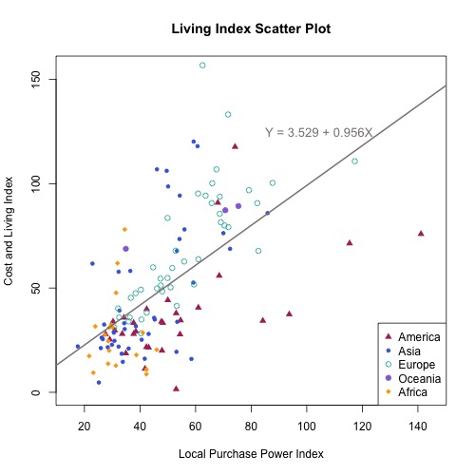
Scatter Plot

Slide 6
Scatter Plot
Columns:
Cost of Living
Rent
Cost of Living and Rent
Grocery
Restaurant
Local Purchase Power
linear relations for all

Slide 7
Terms
Cost of Living
the amount of money needed to cover basic expenses such as housing, food, taxes, and healthcare in a certain place or time period
Purchasing Power
the value of money in terms of the real goods and services it can purchase. The purchasing power of a currency decreases over time as the goods and services in a country go up in price.

Slide 8
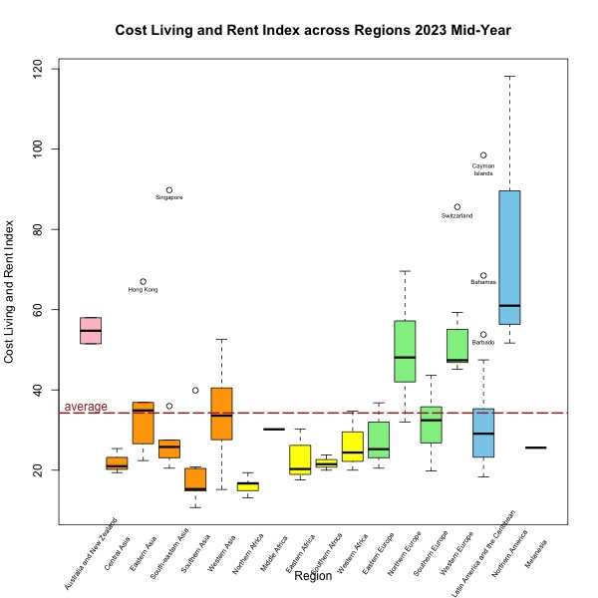
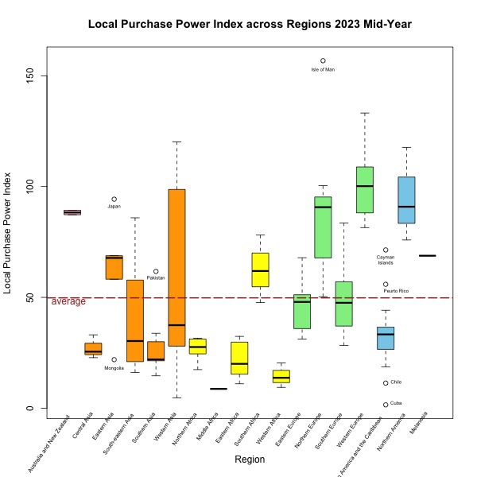
BOX Plot

Slide 9
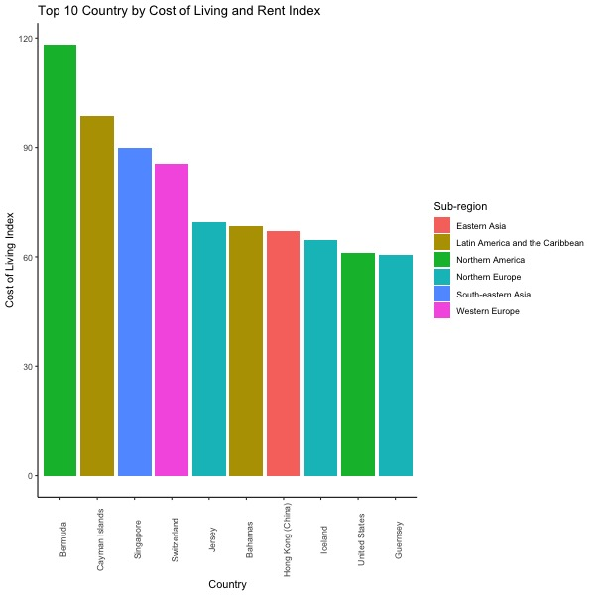
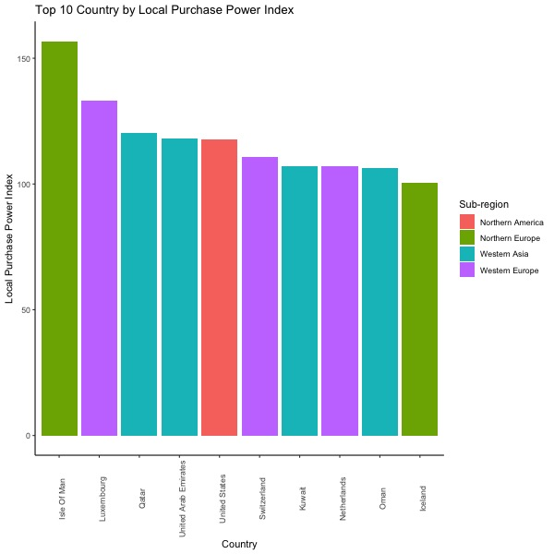
Bar Plot

Slide 10
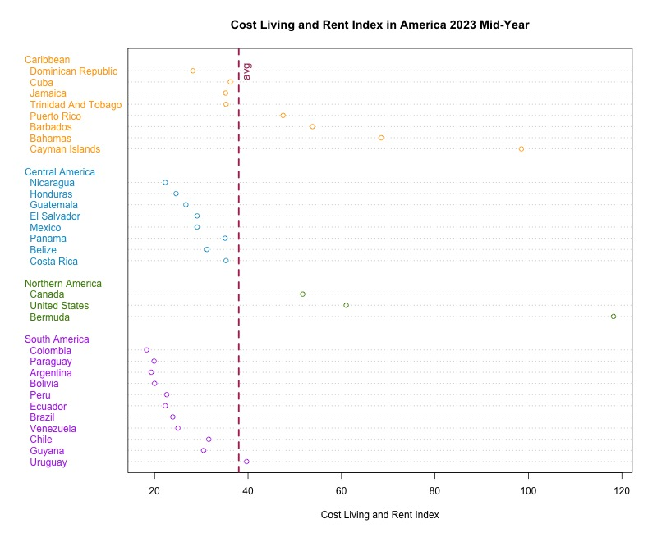
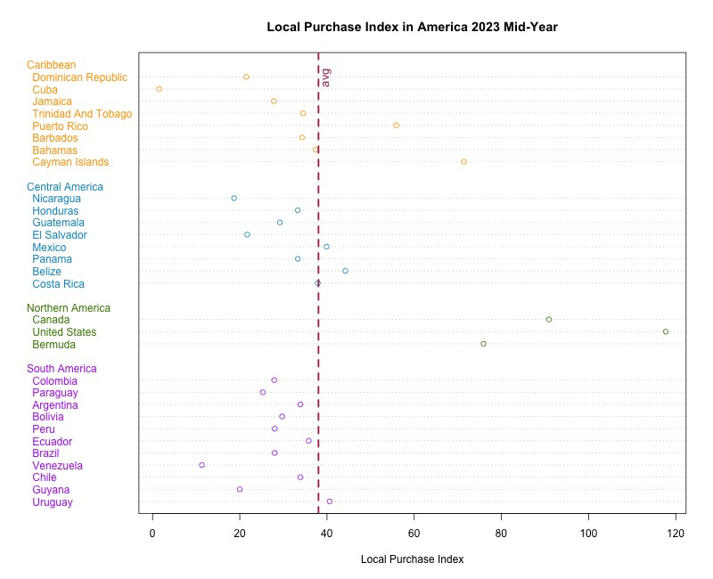
Dot chart
America

Slide 11
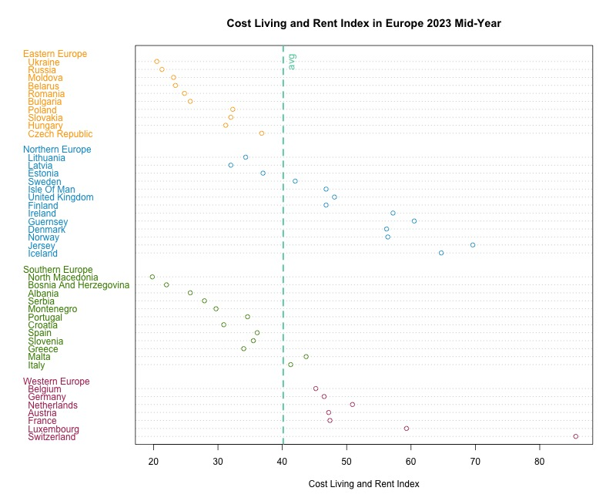
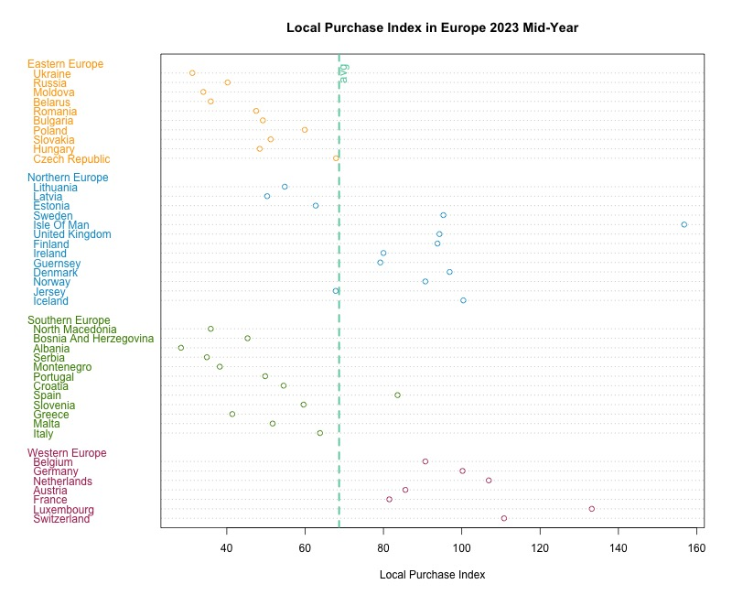
Dot chart
Europe

Slide 12
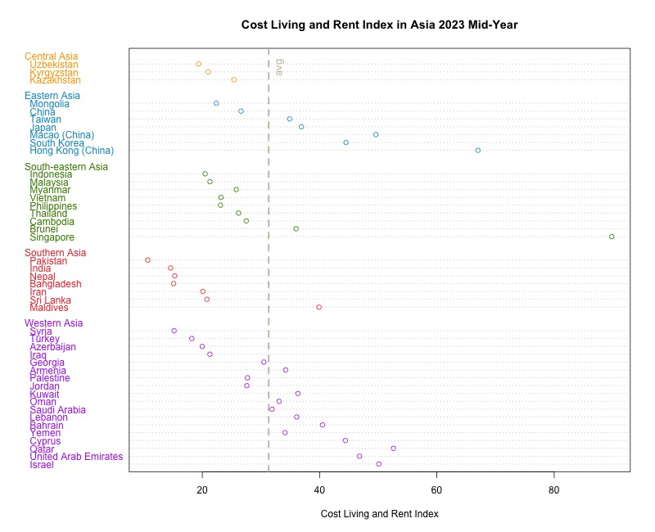
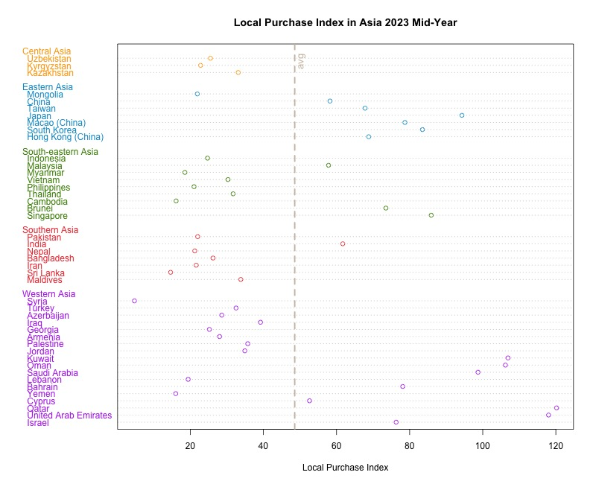
Dot chart
Asia

Slide 13
Conclusion and Limitations
 | Europe | Asia | America
luxurious | Western e.g., Luxembourg, Switzerland Northern e.g., Isle of Man, Iceland | Western e.g., Qatar, Israel Eastern e.g., Hong Kong, South Korea | Northern -> the United State, Canada, Bermuda
affordable | Eastern e.g., Ukraine, Belarus Southern e.g., North Macedonia, Albania | Central Asia e.g., Uzbekistan Southern Asia e.g., Pakistan, India South-eastern Asia (except Singapore) | Central e.g., Nicaragua, Honduras South e.g., Colombia, Paraguay
Notes:
Limitation Not enough time looking into cities

Slide 14
Thank you

