Slide 1
System diagram, NTT, Coder, Timing
蔡奇佑

Slide 2
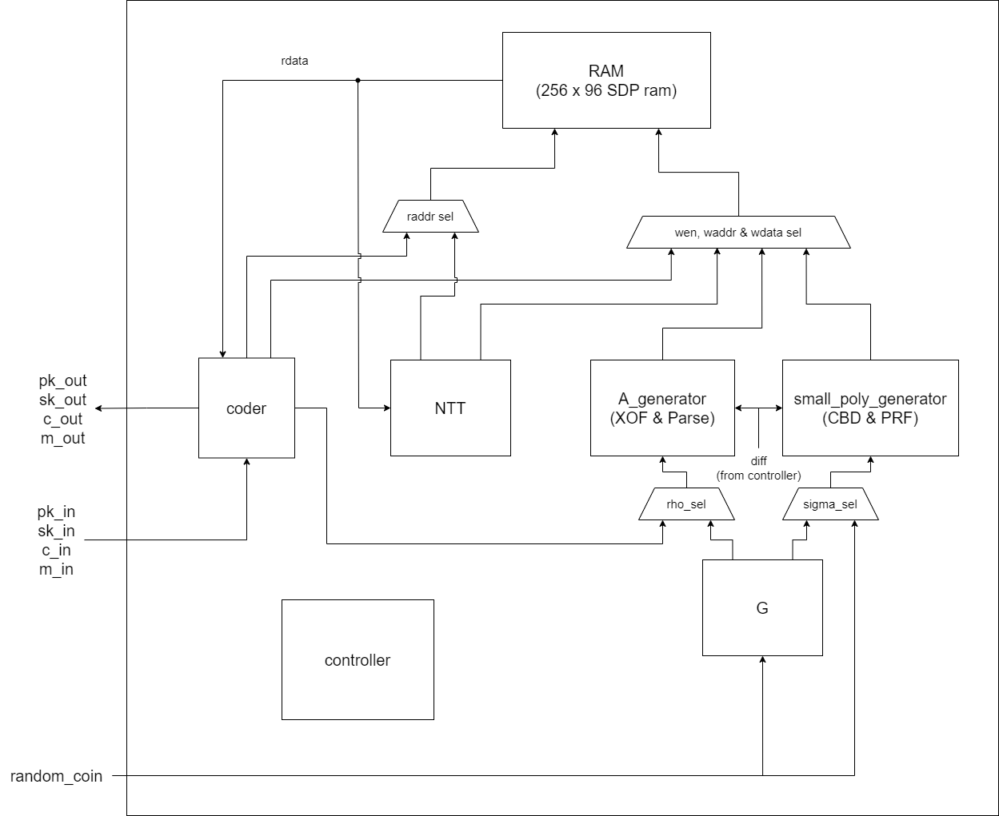
System Diagram

Slide 3
NTT processer

Slide 4
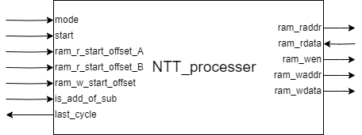
Port

Slide 5
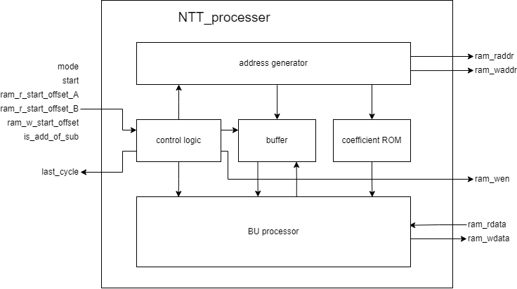
NTT processor

Slide 6
Timing & Memory Arrange
parallel memory access

Slide 7
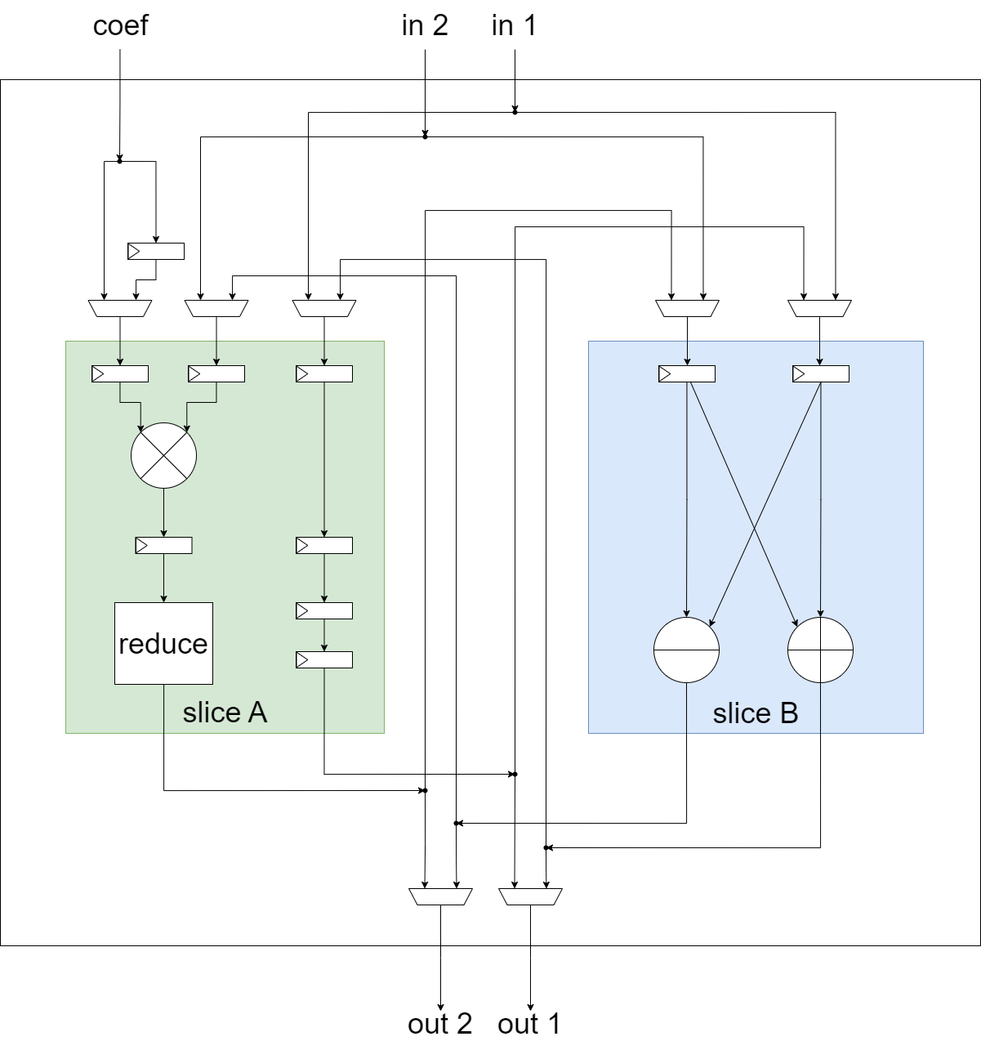
Butterfly Unit
mul_reduce

Slide 8
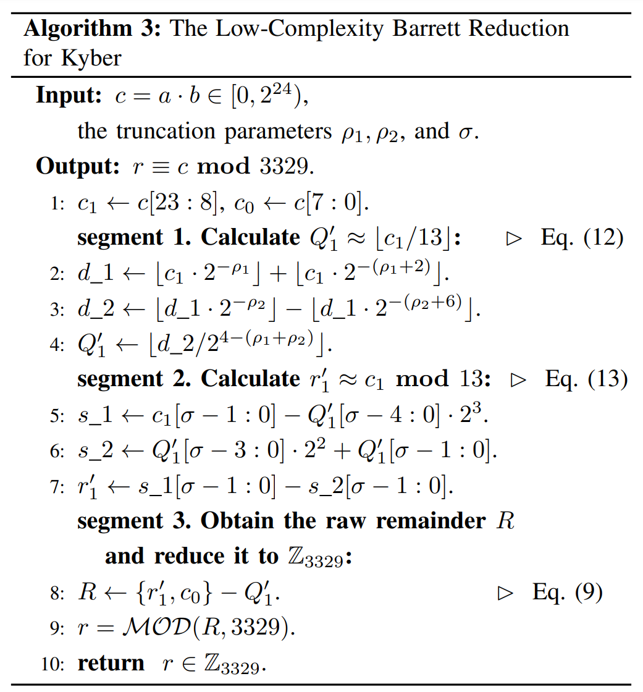
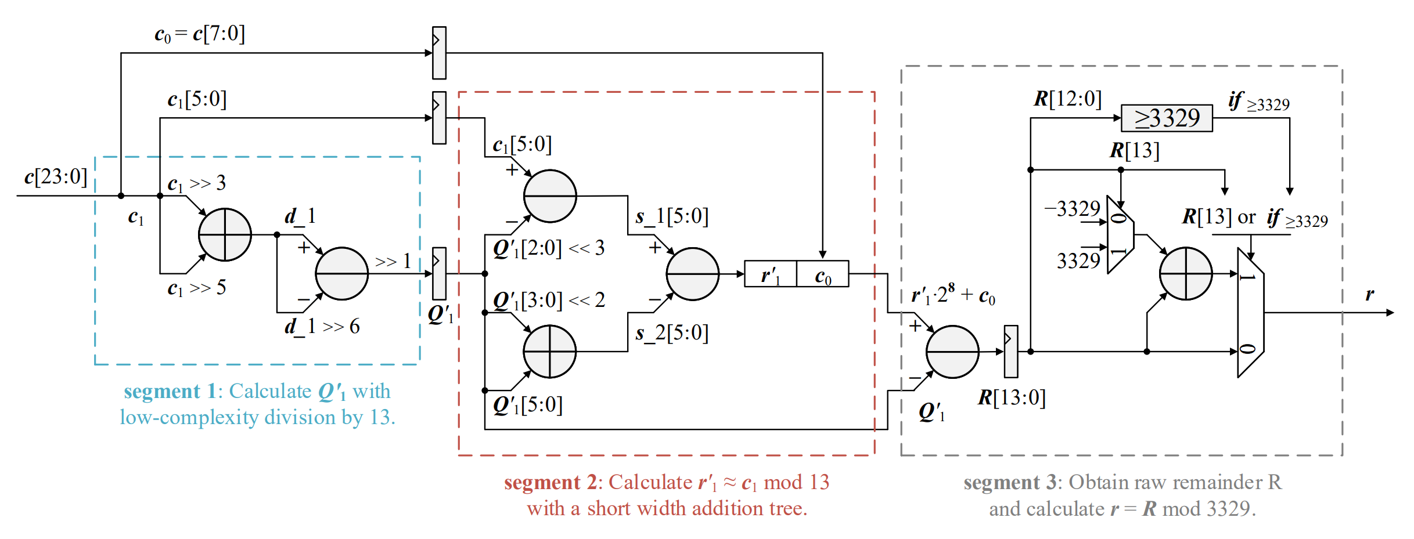
Low-Complexity Barrett Reduction
Notes:
那也就順邊展示他的演算法以及依此畫出的圖，第一部分就是剛剛提到的估計Q1的部分，用到縮減的加減法器，第二部分就是估計r1，那減3個東西，可以先減一個，然後其他兩個先加起來再減，很簡單的分配律，最後第三部分再根據一開始的推導r1可以和c0先接在一起再減Q1，之後調整輸出的區間即可。

Slide 9
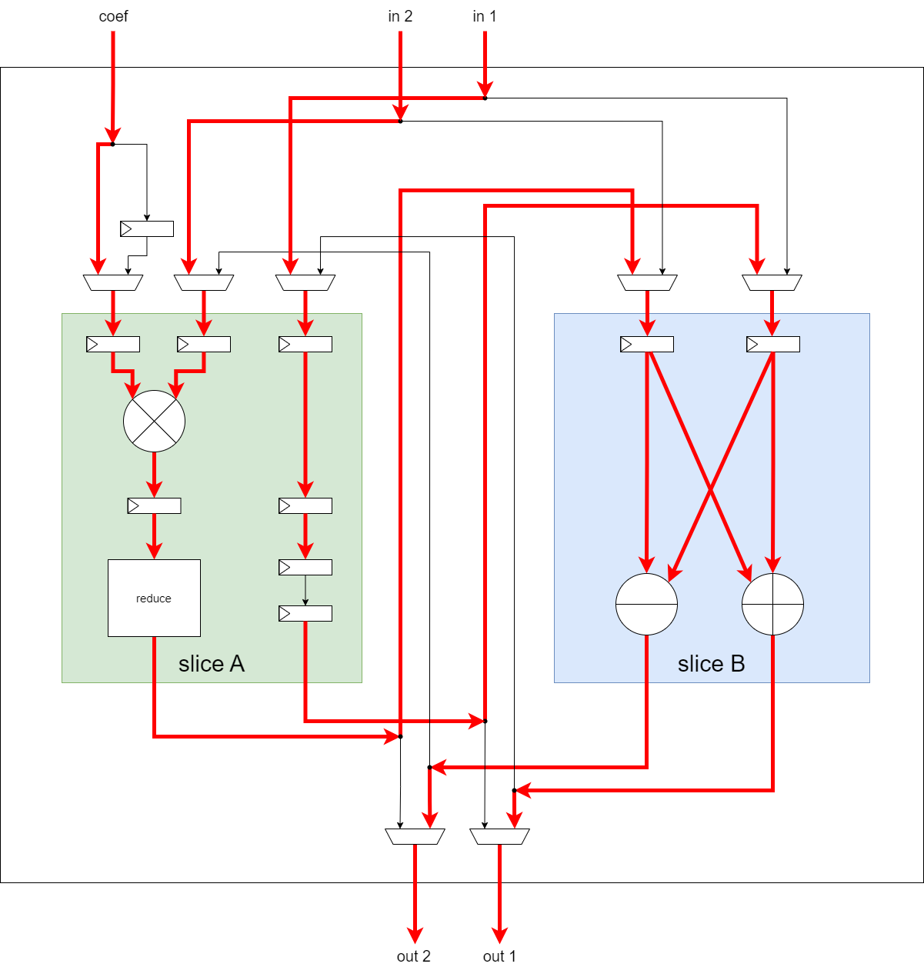
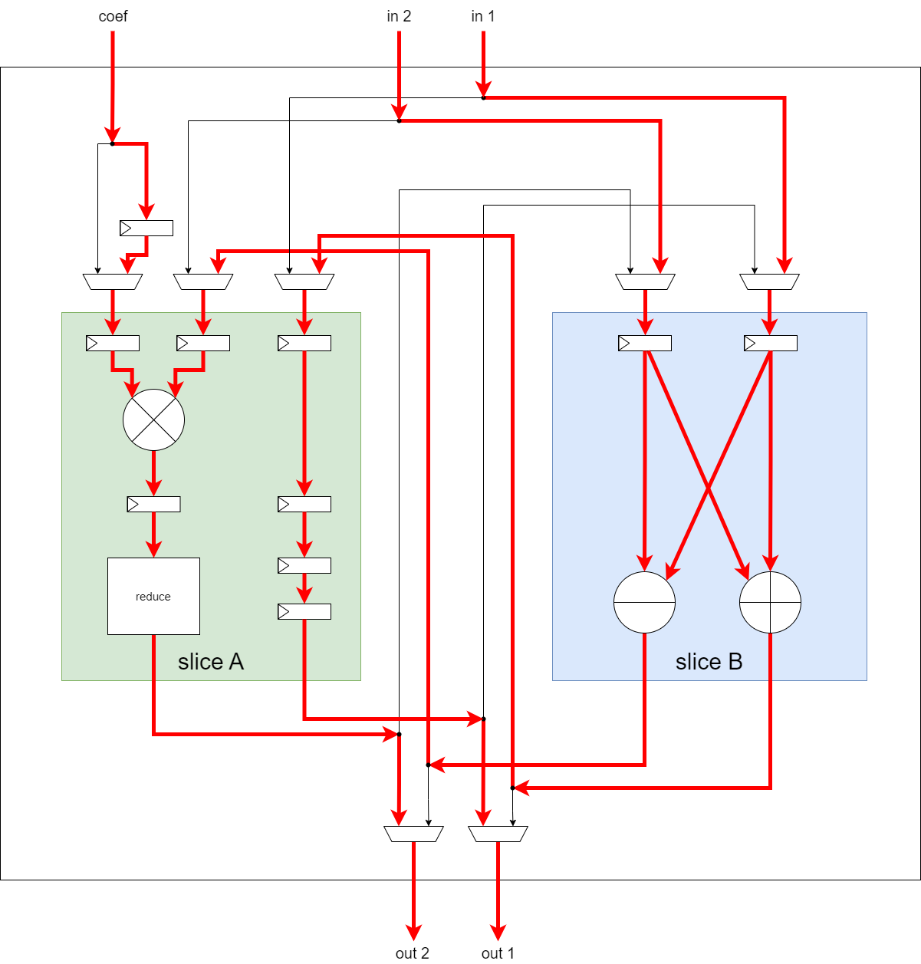
mode 0
mode 1

Slide 10
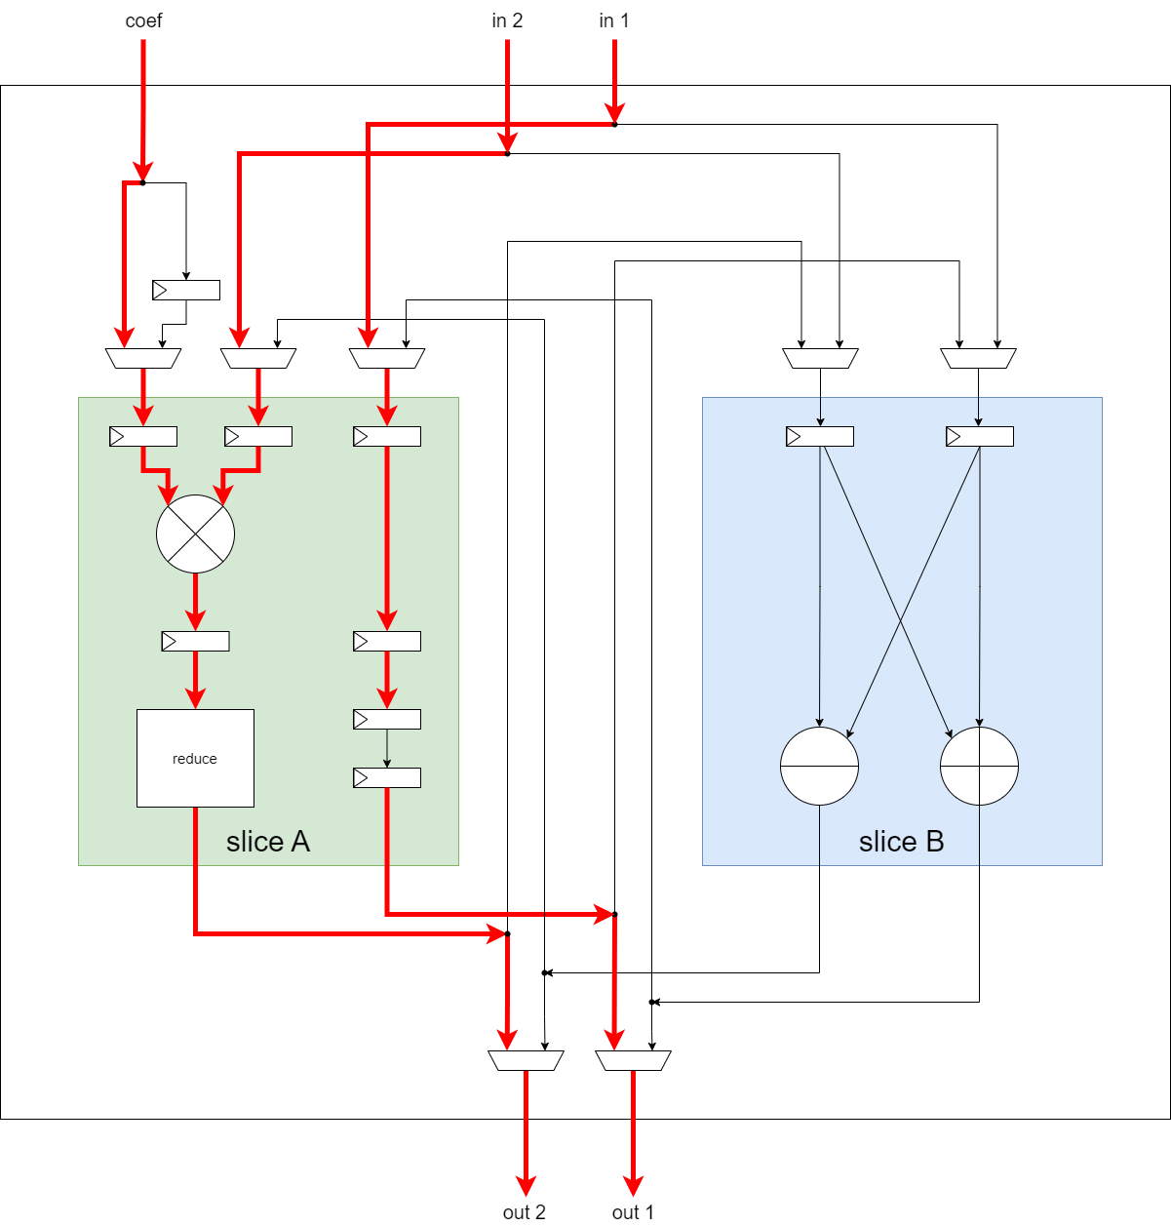
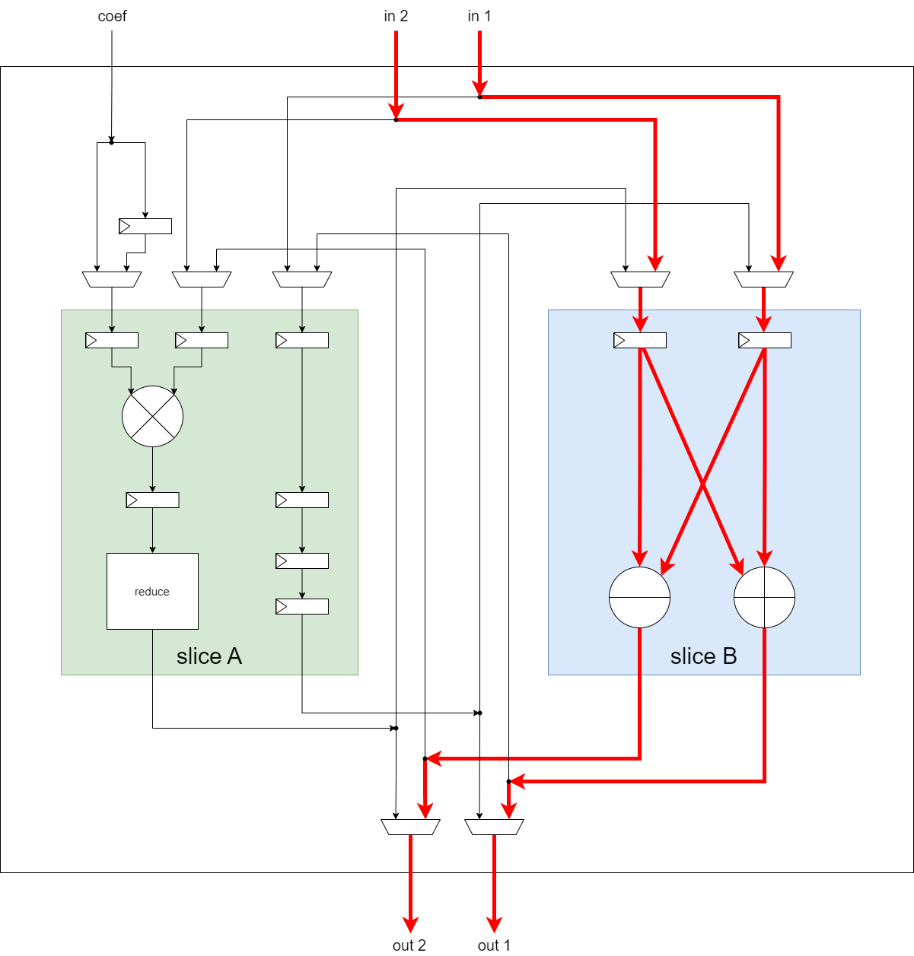
mode 2
mode 3

Slide 11
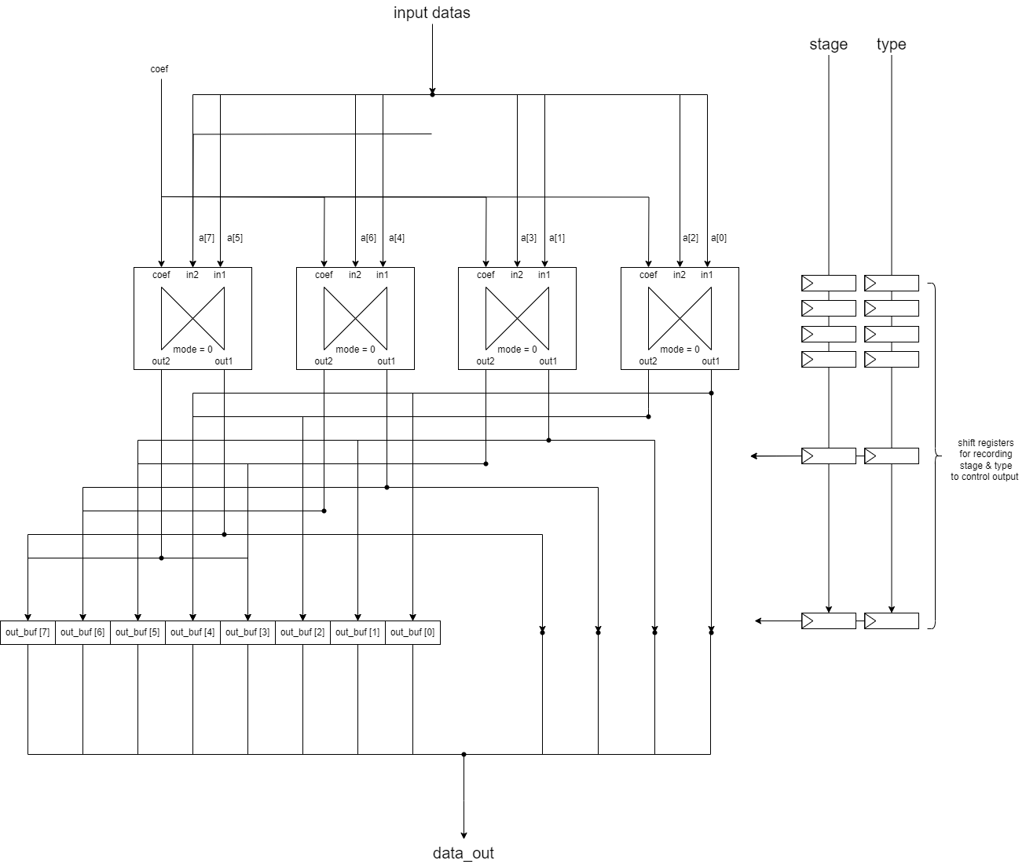
BU processor in NTT mode (mode = 00)

Slide 12
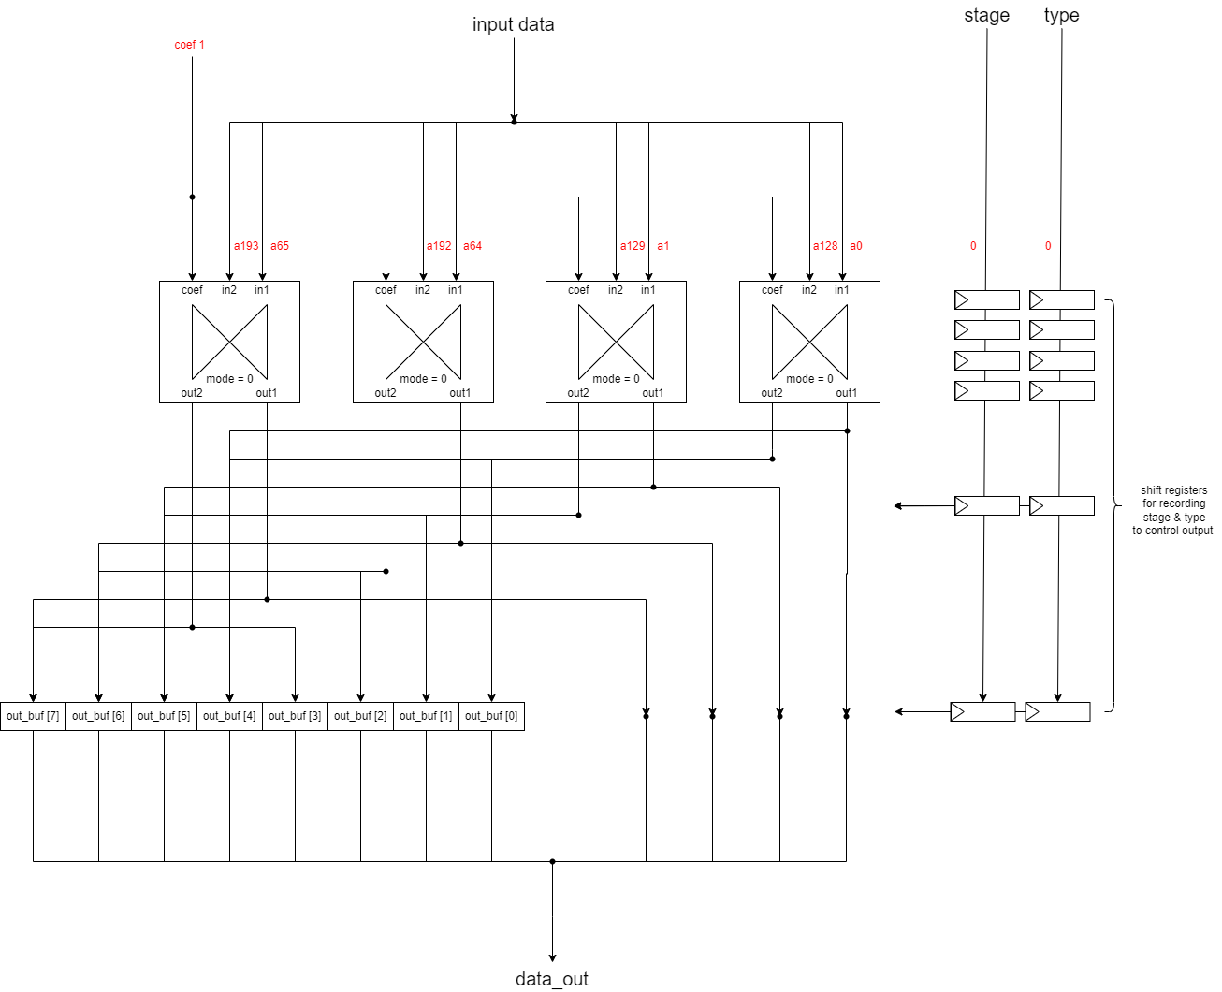
NTT cycle 0 (stage = 0~4)

Slide 13
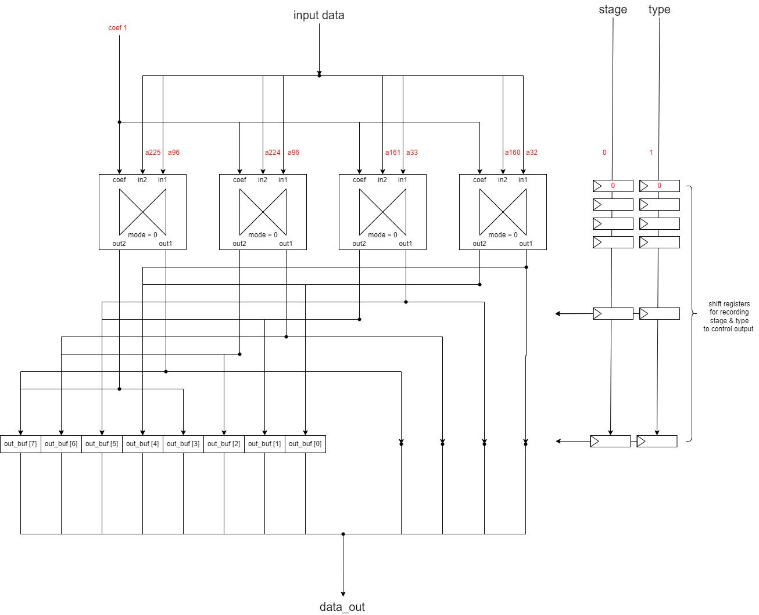
NTT cycle 1 (stage = 0~4)

Slide 14
經過3個cycle後

Slide 15
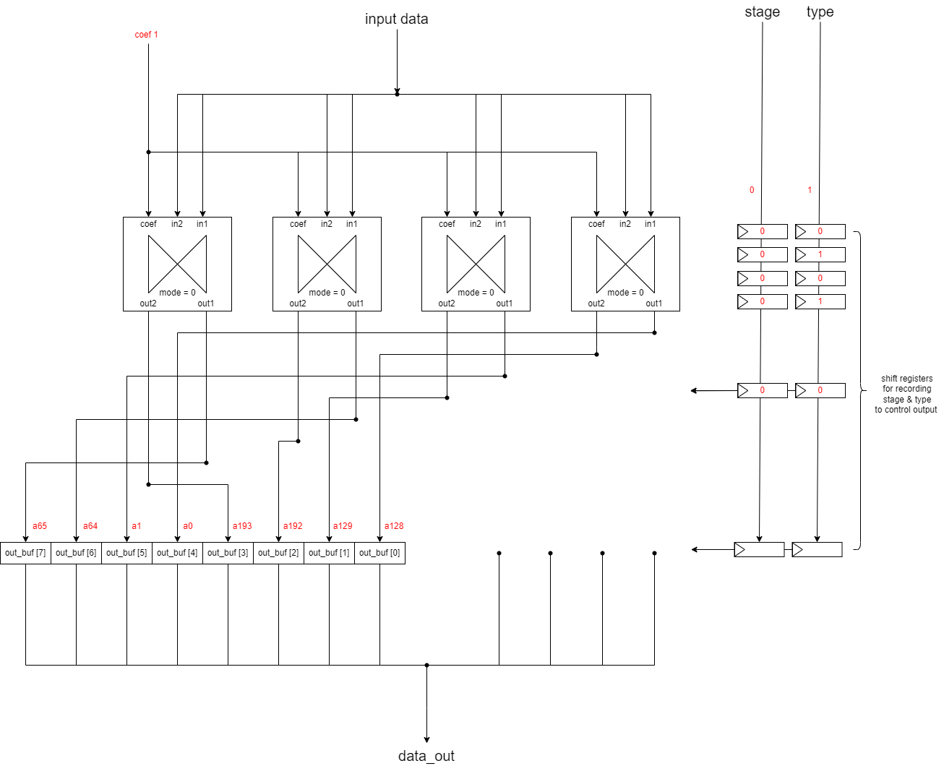
NTT cycle 5 (stage = 0~4)

Slide 16
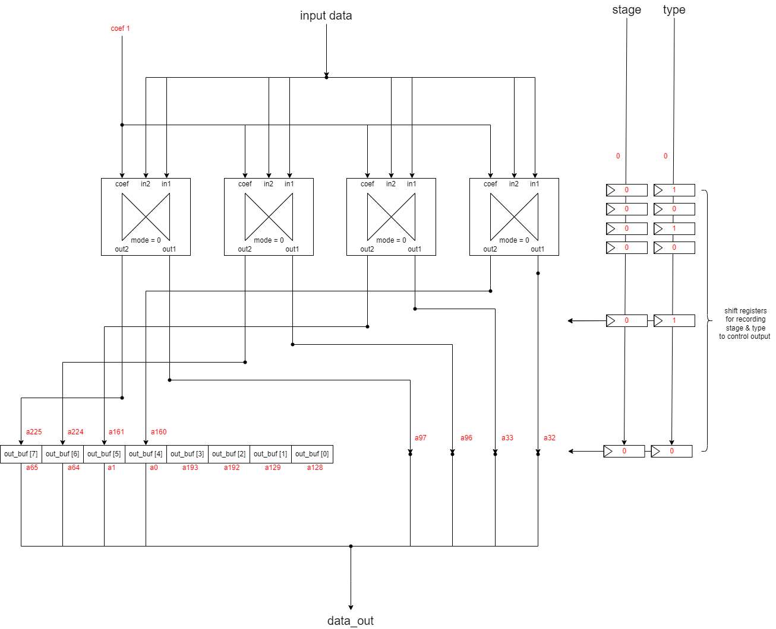
NTT cycle 6 (stage = 0~4)

Slide 17
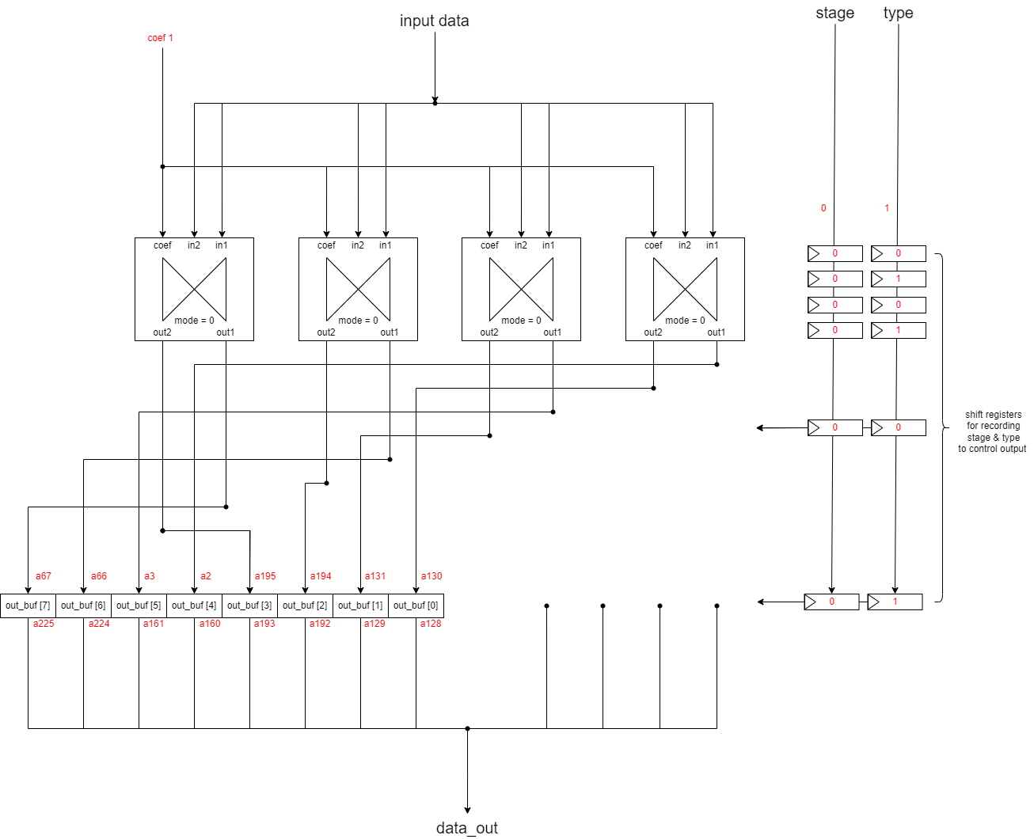
NTT cycle 7 (stage = 0~4)

Slide 18
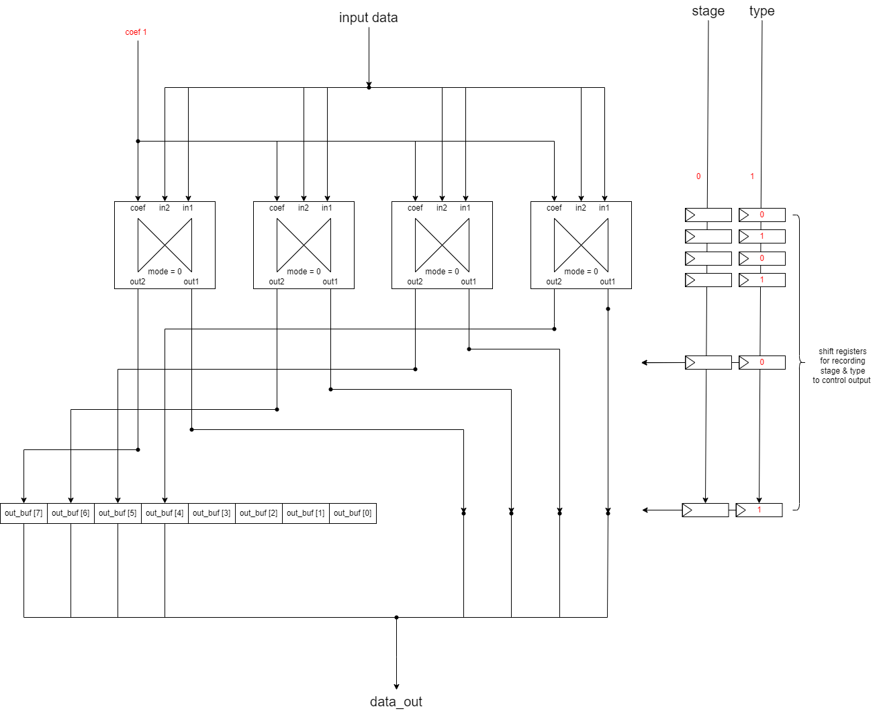
NTT cycle 8, 10, ... (stage = 0~4)

Slide 19
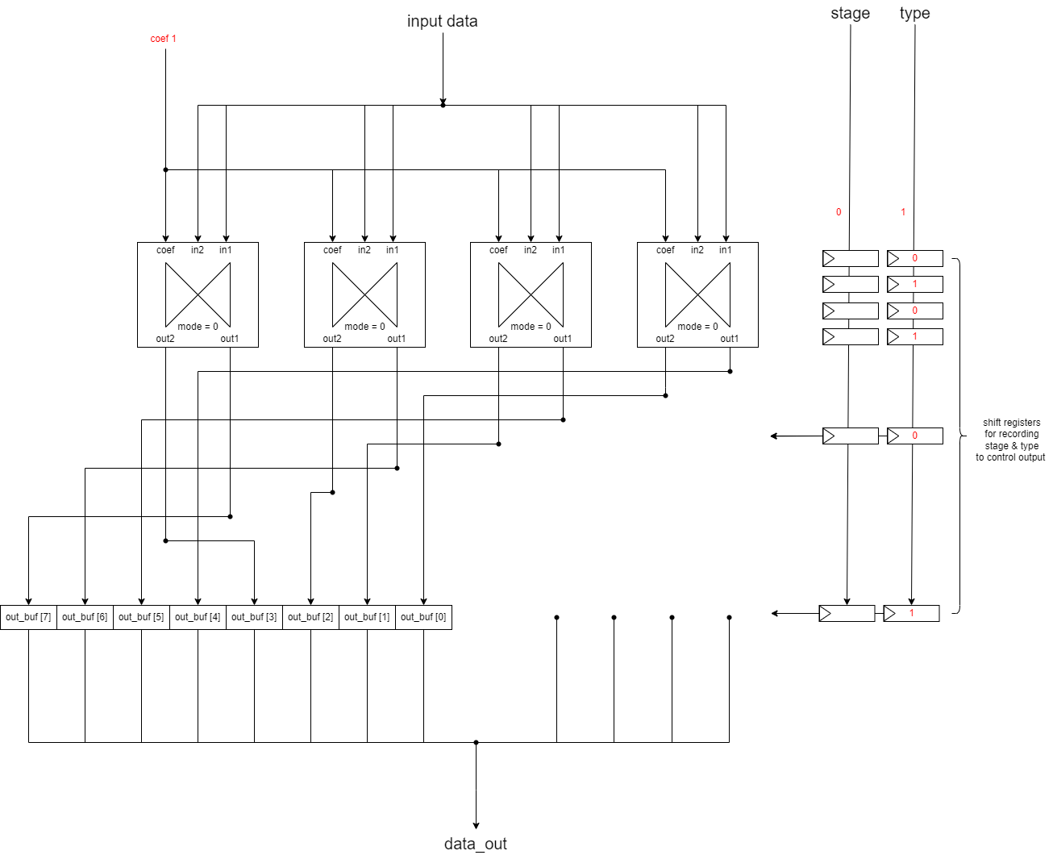
NTT cycle 9, 11, ... (stage = 0~4)

Slide 20
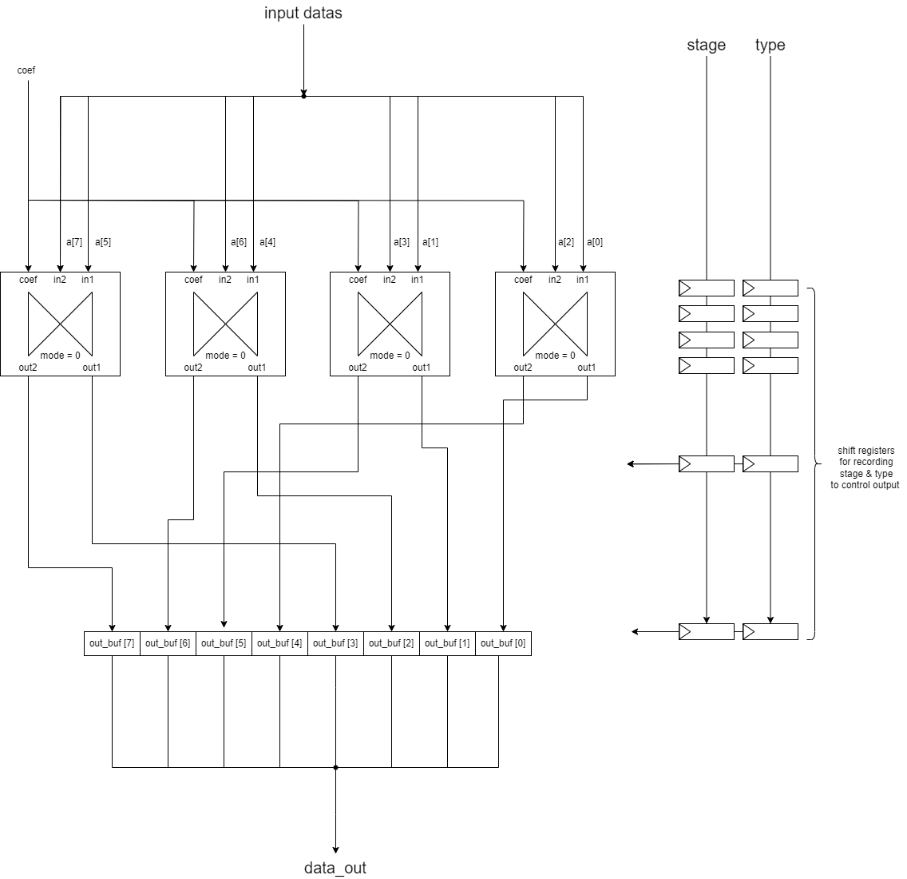
NTT stage 5

Slide 21

NTT stage 6

Slide 22
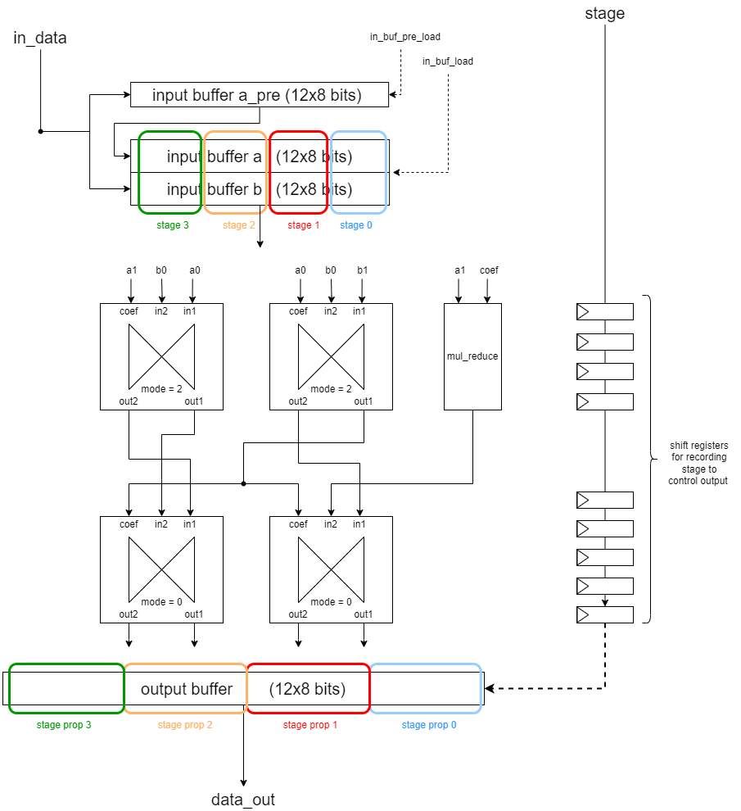
BU processor in MULT mode (mode = 10)
$$\left(a_{1} x+a_{0}\right)∗\left(b_{1} x+b_{0}\right) mod (x−z)$$
= $a_{1}b_{1}{ x}^{2}+\left(a_{1}b_{0}+a_{0}b_{1}\right) x+a_{0}b_{0} mod (x−z)$
= $\left(a_{1}b_{0}+a_{0}b_{1}\right) x+{{(a}_{1}b_{1}z+a}_{0}b_{0}) mod (x−z)$
$$step 1 :\left(a_{1}∗b_{0}\right)、\left(a_{0}∗b_{0}\right)、{(a}_{1}∗z)$$
$$step 2 :{(a}_{1}b_{0}+a_{0}∗b_{1})、{(a}_{0}b_{0}+{b_{0}∗a}_{1}z)$$

Slide 23
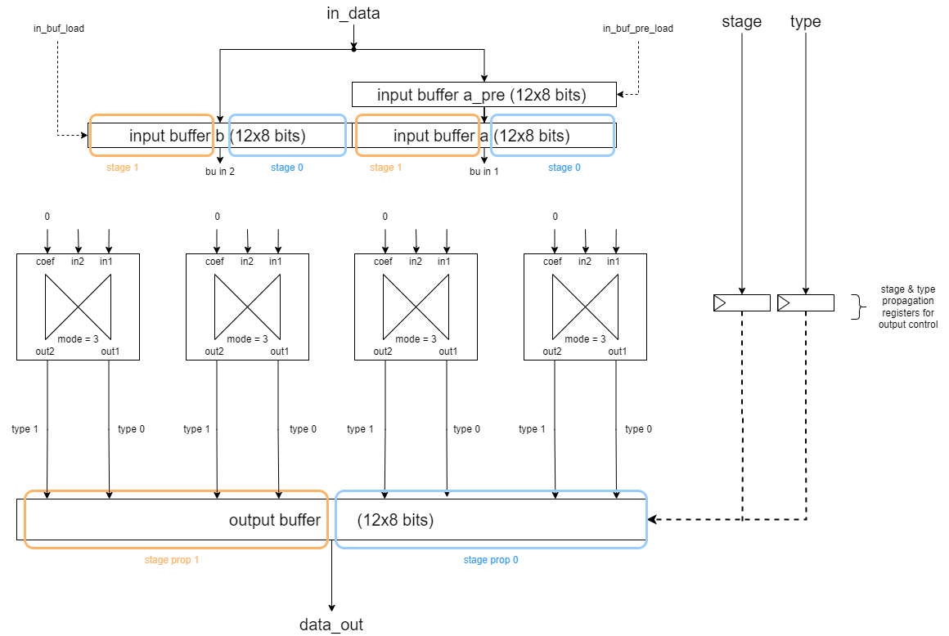
BU processor in ADD or SUB mode (mode = 11)

Slide 24
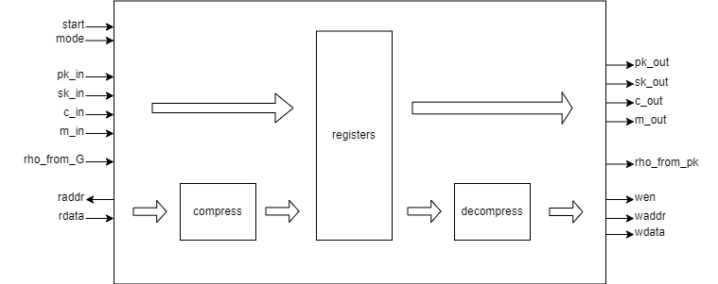
coder

Slide 25
Timing arrange

