Slide 1
Massaging the data
By Charlie Hill

Slide 2
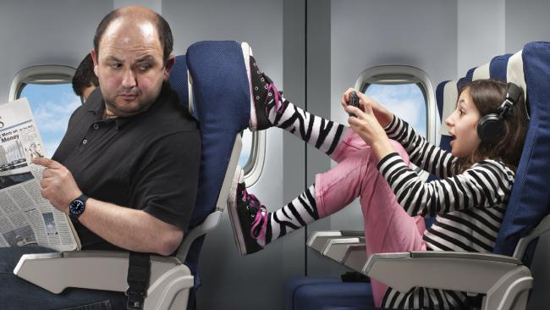
Problem
Flying can be traumatizing

Slide 3
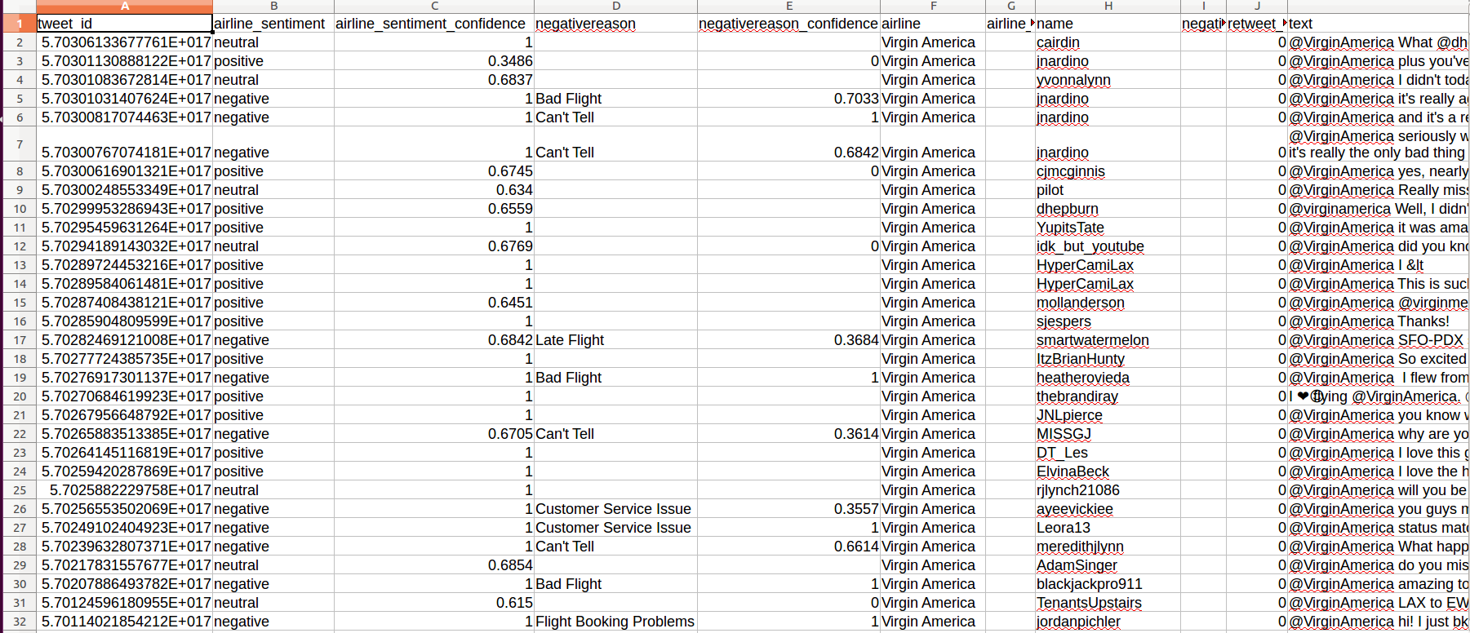
Twitter Sentiment

Slide 4
Massaging the data
Natural Language Toolkit - nltk
Tokenize, lemmatize and remove stopwords
X becomes our parsed tweets
Y becomes our sentiment
Sklearn’s CountVectorizer and Transform methods
Logistic Regression

Slide 5

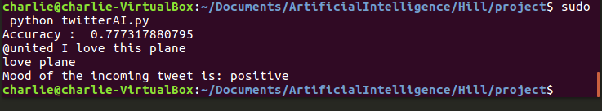
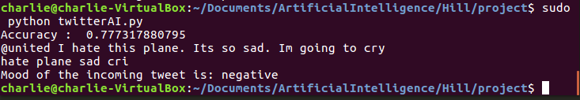
Current Output

Slide 6
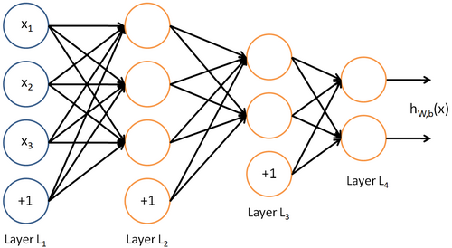
Using a multi output neural network

Slide 7
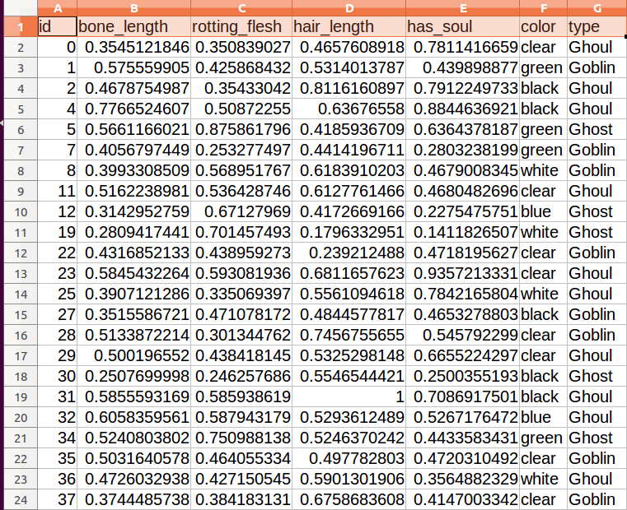
Working with more simple data
Kaggle halloween competition

Slide 8
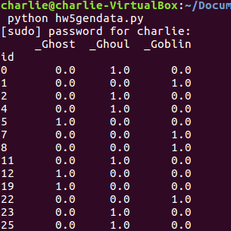
Massaging the data
X becomes Bone_length, rotting_flesh, hair_length and has_soul
4 features
Color of the monster appears to be just noise
pandas.get_dummies
Y becomes the type of monster

Slide 9

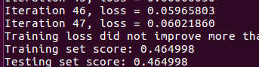
Into the neural network
Usually around 20 to 40 neurons using MLP
My best score has been 0.465 but on average its 0.45

