Slide 1
Massaging the data
By Charlie Hill

Slide 2
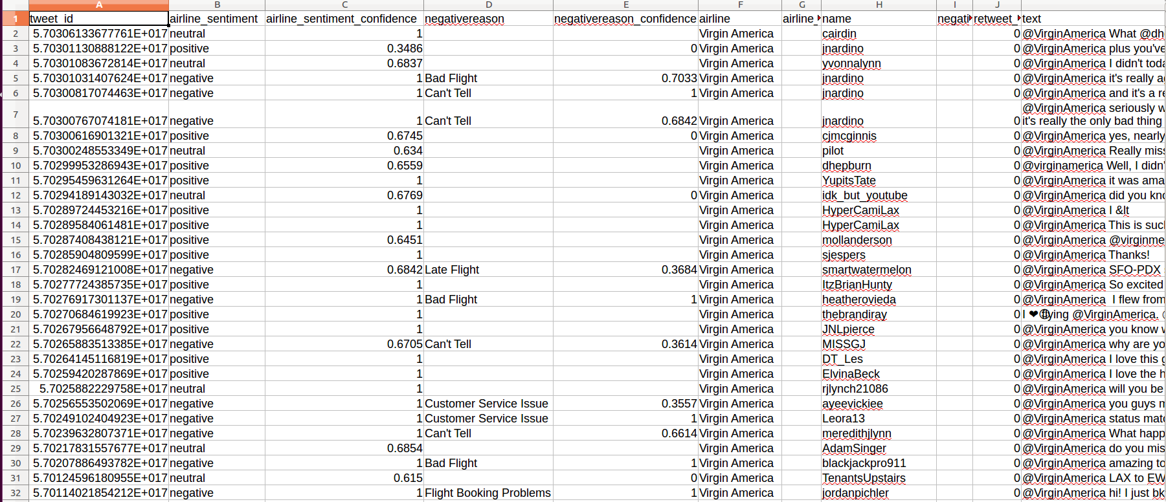
Twitter Sentiment

Slide 3
Massaging the data
Natural Language Toolkit - nltk
Tokenize, lemmatize and remove stopwords
X becomes our parsed tweets
Y becomes our sentiment
Sklearn’s CountVectorizer and Transform methods
Logistic Regression

Slide 4

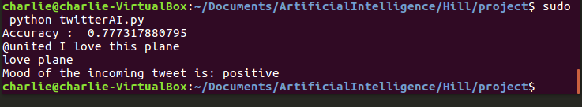
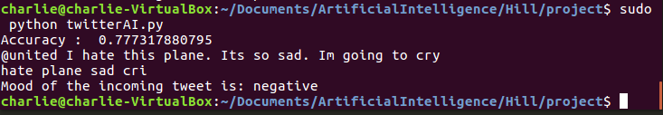
Current Output

Slide 5
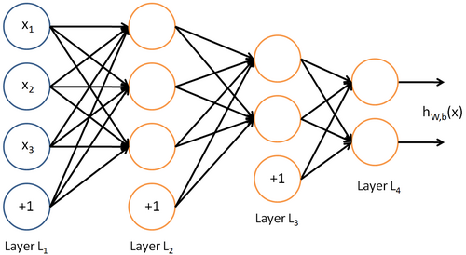
Using a multi output neural network

Slide 6
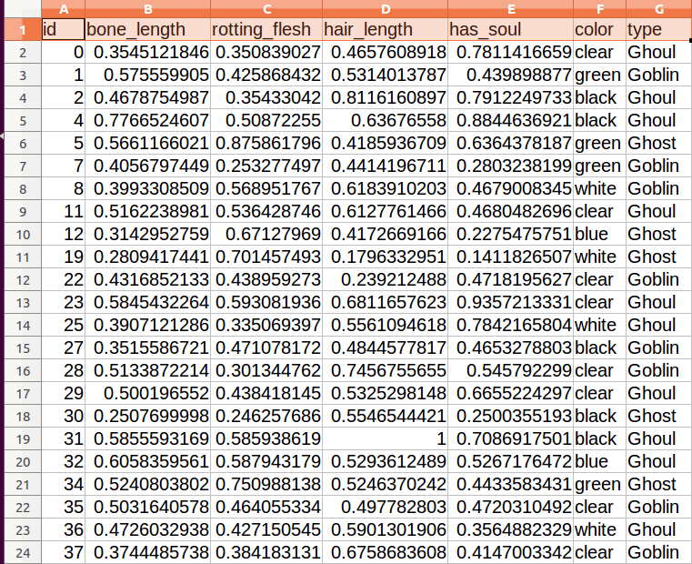
Working with more simple data
Kaggle halloween competition

Slide 7
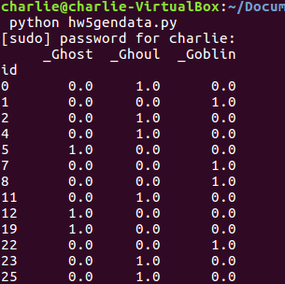
Massaging the data
X becomes Bone_length, rotting_flesh, hair_length and has_soul
4 dimensions
Color of the monster appears to be just noise
Y becomes the type of monster

Slide 8
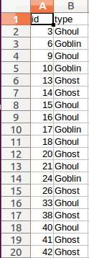
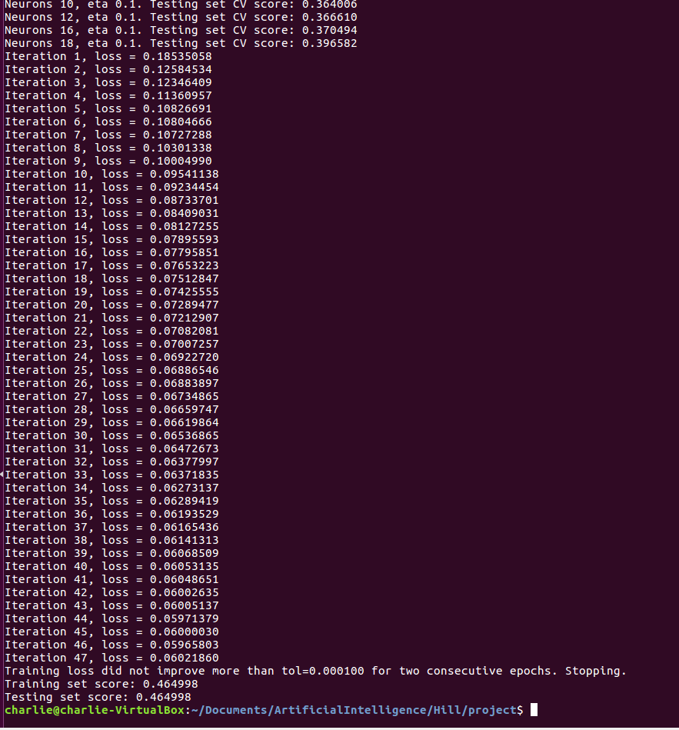

Into the neural network

