Slide 1

Automated Restaurant Food Billing System
Student Name: K. Kushal Kumar
Student ID: 2520040031
Cluster: 2
Section: 6
Under the Guidance
of
Supervisor Name: NM Deepika
Assistant Professor
Department of CSE

Slide 2
Outline
Abstract
Existing System
Proposed System
System Architecture
Project Modules
Objectives
Co’s Attainments - FWD
Co1
Co2 …….. 5. Co5
Screen Shots for FWD
Conclusion
Geo-Tagged Photos

Slide 3
Abstract
Web-based restaurant billing management system
Developed using HTML, CSS, and JavaScript
Digital menu with veg, non-veg, biryani, and drinks
Automatic billing and calculation system
Generates unique invoice numbers
Supports multiple payment methods
Stores invoices digitally using LocalStorage
Allows searching and managing invoices
Provides dashboard for sales analysis
Supports bill printing and PDF download

Slide 4
Existing System
Manual billing using paper registers
Orders written by cashier or waiter
Calculations done using calculator
Records stored in notebooks
Difficult to search previous bills
High chance of human errors

Slide 5
Proposed system
Automated restaurant billing web application
Menu database with many food items
Automatic price and total calculation
Unique invoice number generation
Supports multiple payment methods
Stores invoices digitally
Allows search, delete, print and download invoices

Slide 6
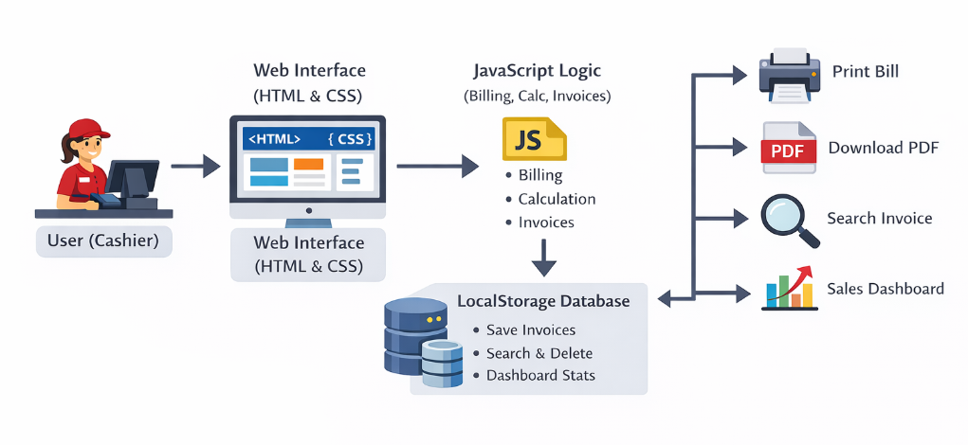
System architecture

Slide 7
Project modules
1. Login & Authentication Module:
Uses HTML forms and JavaScript validation to verify user login.
User credentials are stored and managed using LocalStorage for authentication.
2. Menu Management Module:
Menu items are stored using a JavaScript menu database (object).
Users can select items from a dropdown menu with category filters (Veg, Non-Veg, Biryani, Drinks).
3. Billing Module:
Generates bills dynamically using JavaScript arrays and DOM manipulation.
Automatically calculates subtotal, tax (5%), discount, and final total.
4. User Interface Module:
Interface designed using HTML for structure and CSS for styling.
Provides interactive UI features such as theme toggle and responsive layout

Slide 8
5. Invoice Management Module:
Each bill is assigned a unique invoice number automatically.
Invoice data is saved and retrieved using LocalStorage-based invoice storage.
6. Payment Processing Module:
Supports multiple payment methods such as Cash, Card, and UPI.
Payment information is stored along with the invoice transaction details.
7. Dashboard & Reporting Module:
Displays total invoices generated and total sales revenue.
Shows today’s sales statistics using dynamic JavaScript calculations.
8. Bill Output Module:
Allows users to print bills using JavaScript print functionality.
Supports downloading invoices as PDF using the jsPDF library.

Slide 9
objectives
To develop a web-based restaurant billing system using HTML, CSS, and JavaScript.
To automate the restaurant billing process and reduce manual work.
To provide a digital menu management system for veg and non-veg food items.
To automatically calculate subtotal, tax, discount, and final bill amount.
To store and manage invoice records using LocalStorage.
To enable invoice search, deletion, and management.
To generate printable and downloadable bills in PDF format.
To display sales statistics through a dashboard for better monitoring.

Slide 10
Co’s Attainments - FWD
CO1 – HTML Fundamentals:
HTML page structure (DOCTYPE, head, body)
Forms and input fields
Tables for bill display
Navigation layout
CO2 – CSS Styling:
External CSS file linking
Page layout and styling
Grid layout for dashboard cards
Responsive UI design
CO3 – JavaScript Programming:
Variables, arrays, and objects
Functions and conditional statements
Billing calculations (subtotal, tax, total)

Slide 11
CO4 – DOM Manipulation:
Dynamic table creation
Event handling (onclick, onkeyup)
Updating UI using DOM methods
Menu filtering and dropdown updates
CO5 – Web Storage & Application Features:
LocalStorage for storing invoices
Authentication using LocalStorage
Invoice search and delete
Dynamic dashboard update

Slide 12
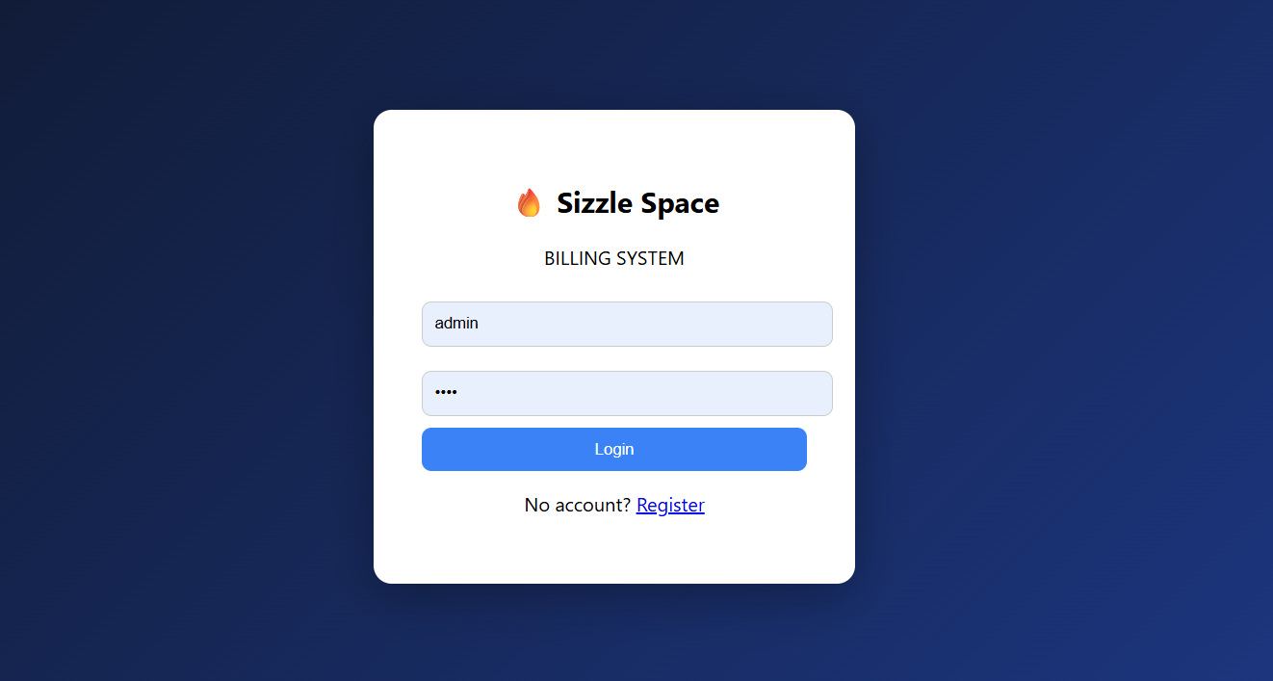
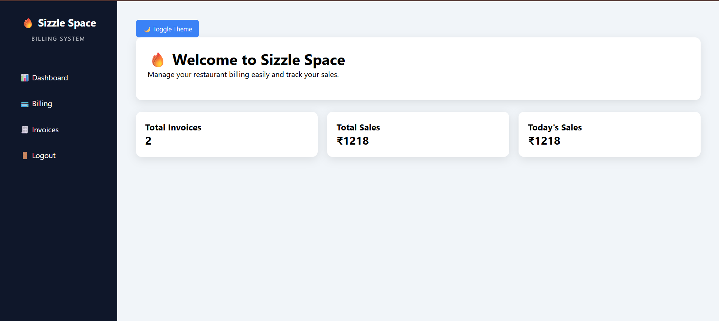
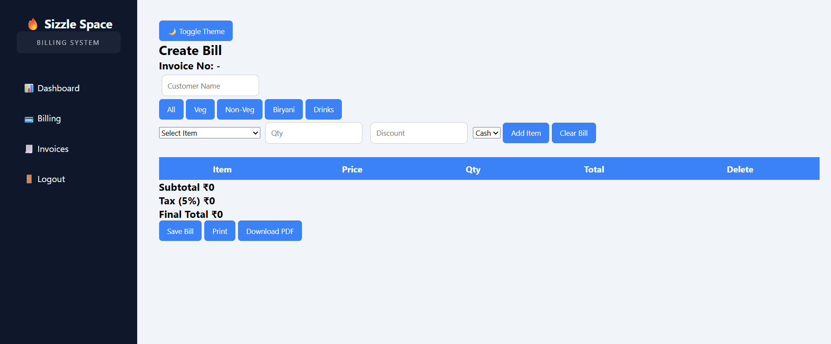
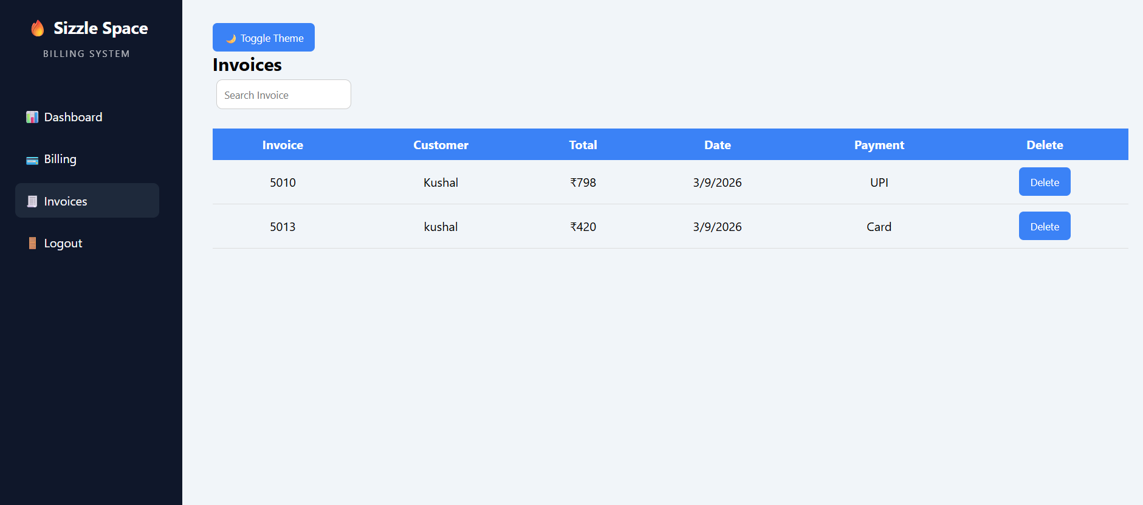
Screenshots of the project

Slide 13
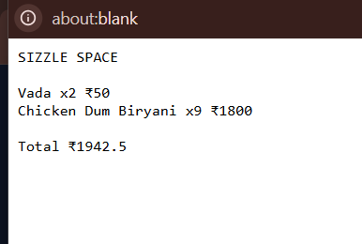
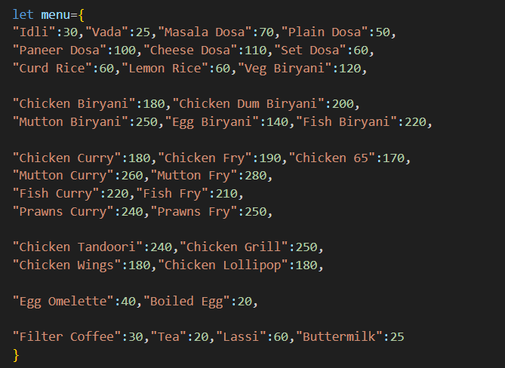
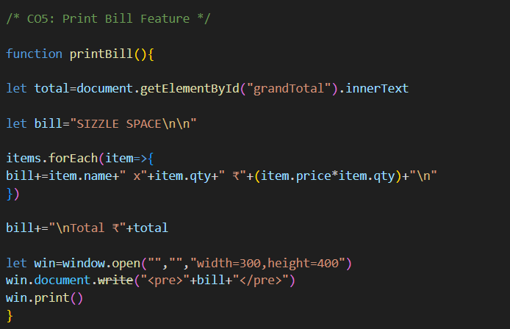
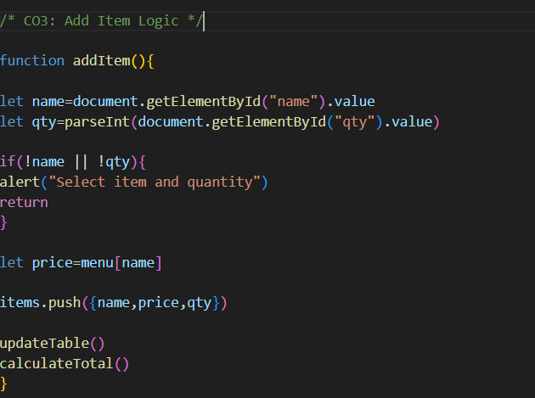
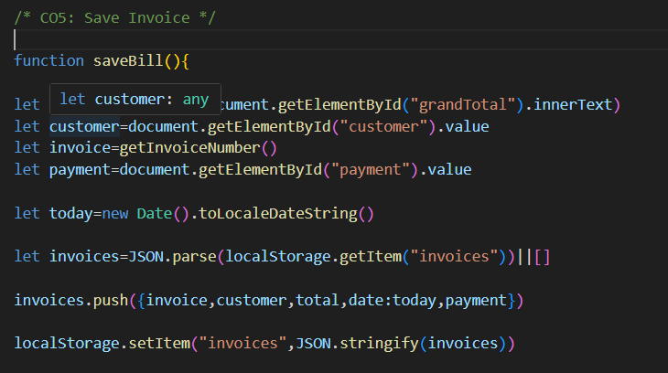

Slide 14
conclusion
The system provides an efficient digital solution for restaurant billing operations by automating bill generation and calculations.
It enables structured menu management, invoice generation, and transaction tracking through an interactive user interface.
The implementation of LocalStorage allows secure storage and retrieval of invoice data for effective record management.
Additional features such as menu categorization, dashboard analytics, invoice search, printing, and PDF generation enhance usability and functionality.
Overall, the proposed system improves accuracy, reduces manual errors, and increases operational efficiency compared to traditional manual billing systems.

Slide 15
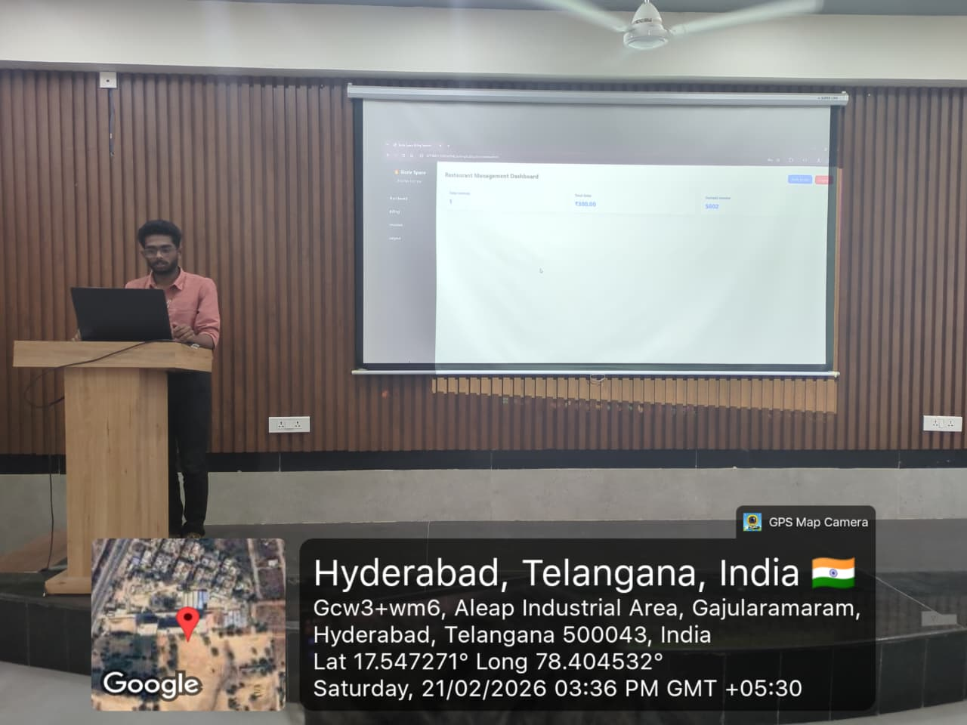
Geo-tag photo

Slide 16
THANK YOU

