Slide 1
Convergence node
Sensor node
Central node
Report data
Forward data

Slide 2
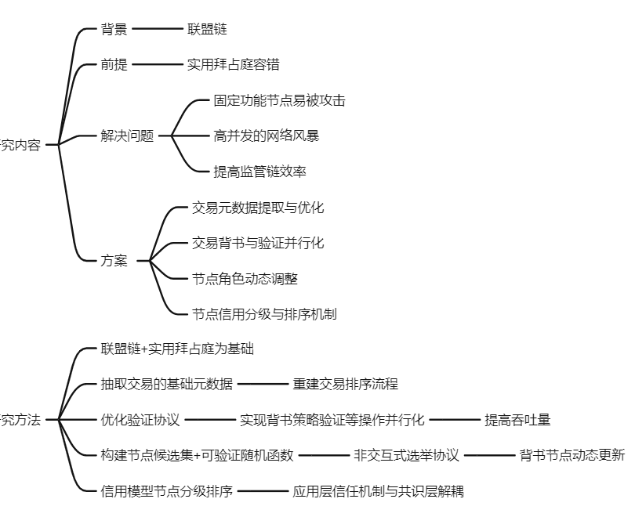
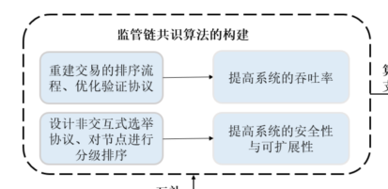

Slide 3
Network Performance
Node Indicators
Report
Periodically
Throughput
Data Valid
Convergence node
Query
Aperiodically
Average Delay
Work Efficiency
Sensor node
Stability
Computational power
Central node
Online duration
Report data
Blocklist
Connectivity
Forward data
Allowlist
Processing Delay

Slide 4








网络层
共识层
感知层

Slide 5
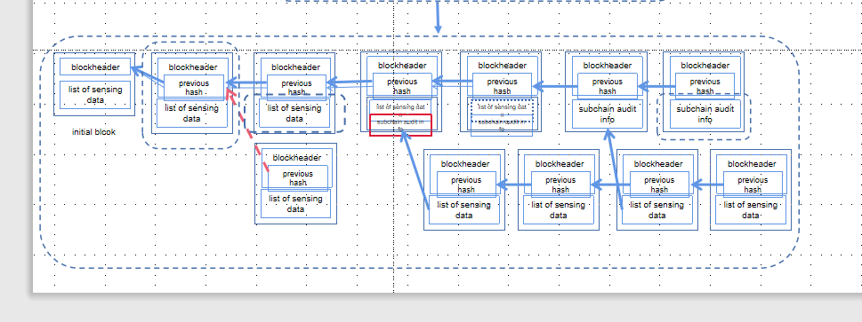
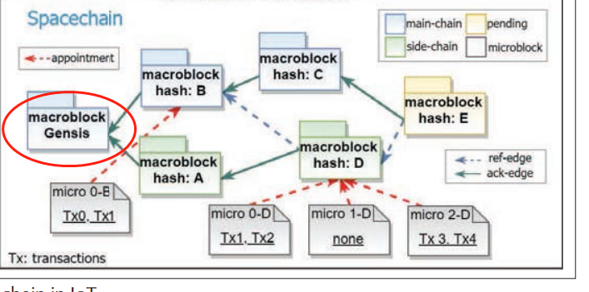

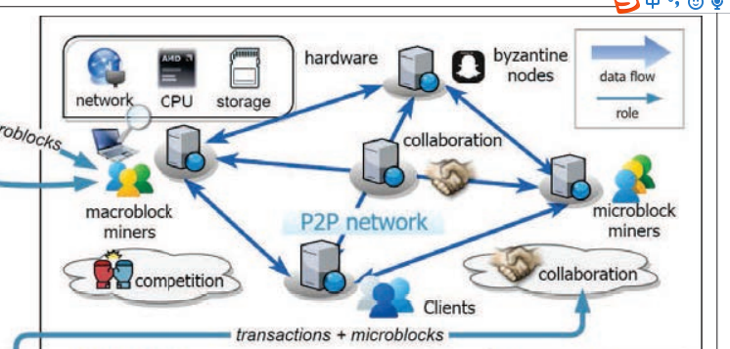










体现出：（1）新增节点（2）三级节点（3）可信和恶意节点（4）分布式（5）侧链节点

Slide 6



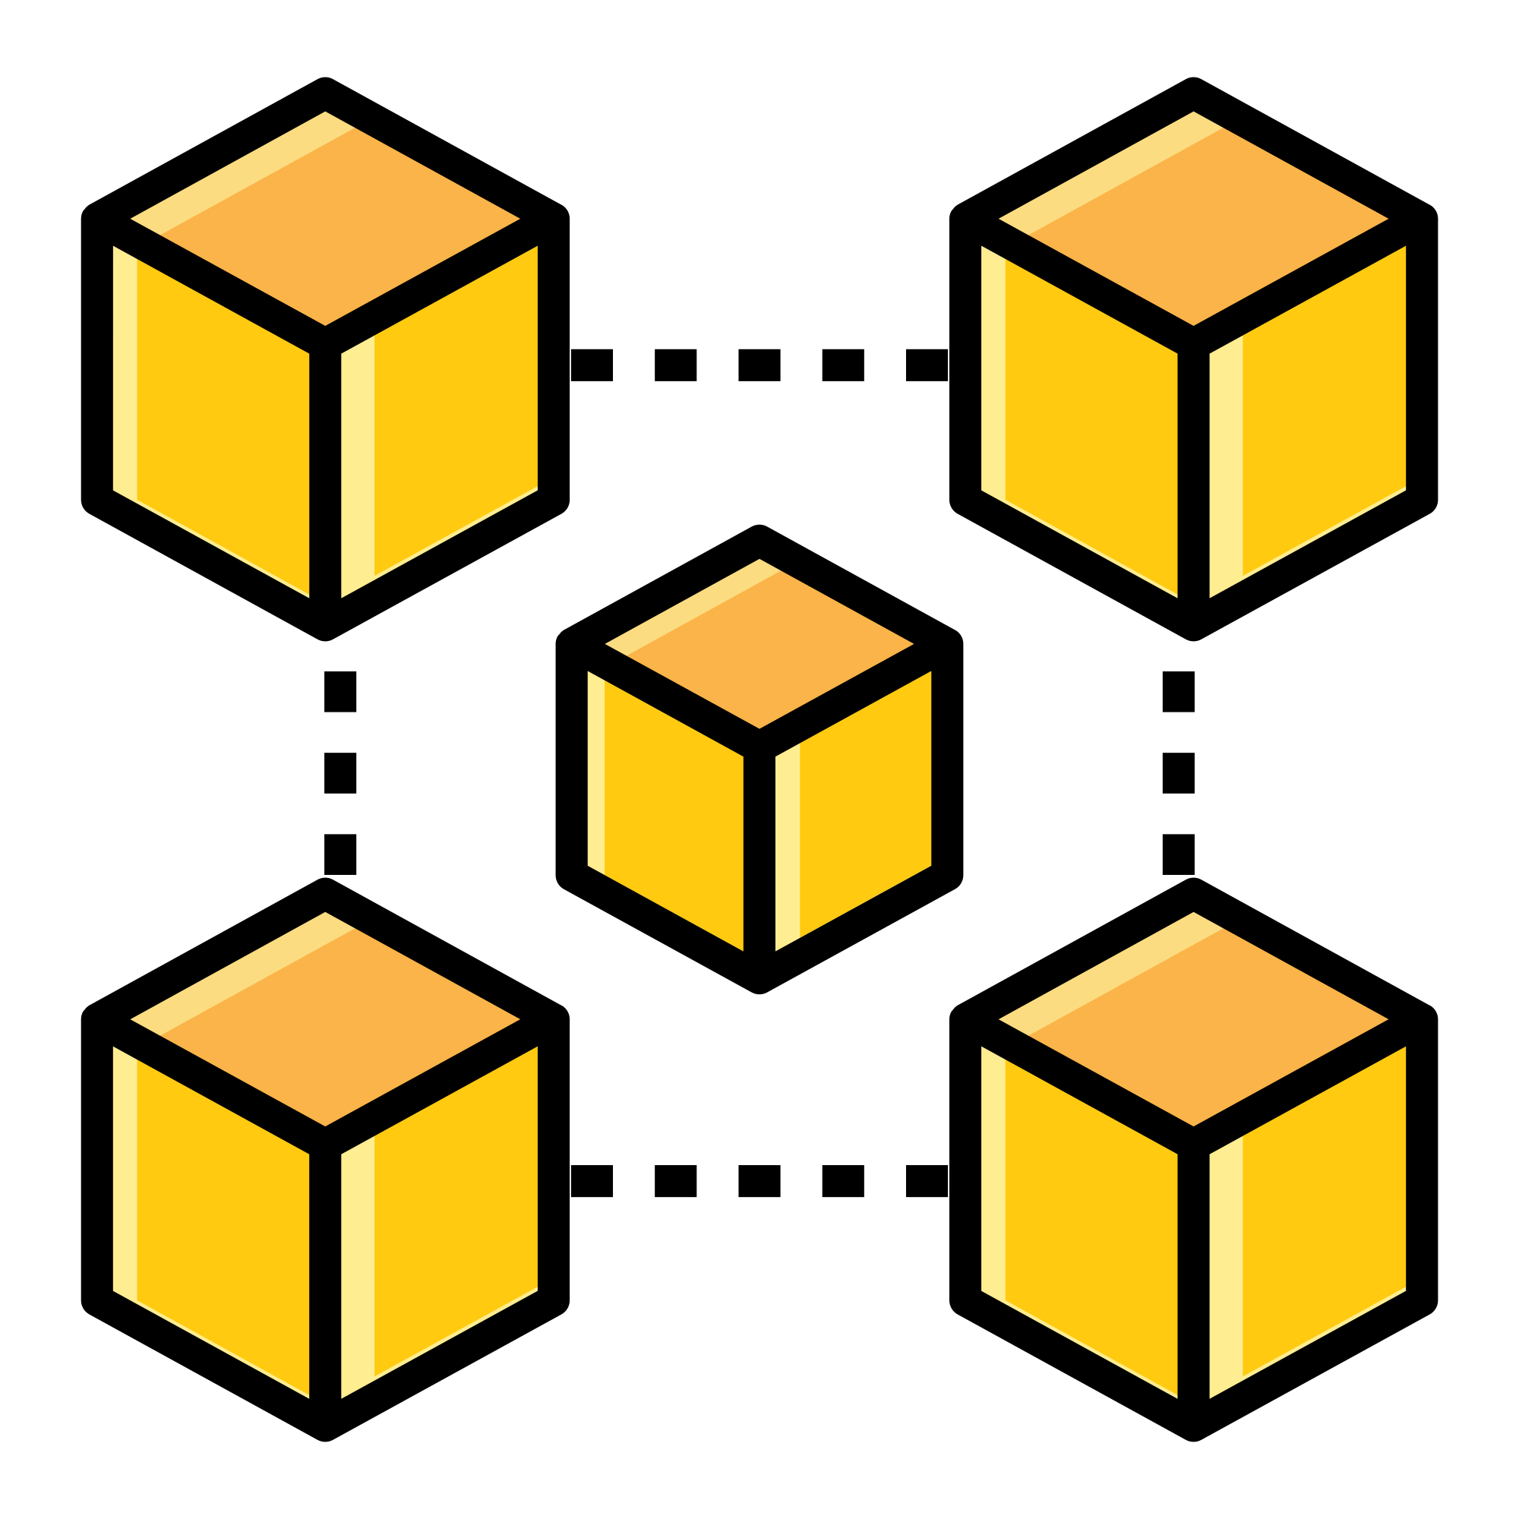
Extended Monitoring
Storage
Service
Crowdsourcing
monitoring
Transmission
Network Layer
Monitoring
Indicators
Report
Broadcast
Weather
Fire
Noise pollution
Geological
Hazards
Air quality
Video Surveillance
Redundant block
Data block
Transition Block
Control block
Control block
Initial block
Data block
UAV
RS
physical sensors
Data block
Data block
Redundant block
Redundant block
Data block
Data block
Multiple monitoring scenarios
Sensing Layer
Consensus Layer
体现出：（1）新增节点（2）三级节点（3）可信和恶意节点（4）分布式（5）侧链节点

Slide 7
传感数据区块
A子链区块
过渡区块
B子链区块
C子链区块
控制数据区块
叔区块哈希索引
父区块哈希索引
blockheader
blockheader
blockheader
blockheader
blockheader
blockheader
blockheader
list of sensing data
previous hash
previous hash
previous hash
previous hash
previous hash
previous hash
list of sensing data
list of sensing data
list of sensing data
list of sensing data
subchain audit info
subchain audit info
initial blcok
subchain audit info
subchain audit info
blockheader
blockheader
blockheader
blockheader
blockheader
previous hash
previous hash
previous hash
previous hash
previous hash
list of sensing data
list of sensing data
list of sensing data
list of sensing data
list of sensing data

Slide 9
传感数据区块
A子链区块
传感数据和控制数据区块
B子链区块
C子链区块
控制数据区块
叔区块哈希索引
父区块哈希索引
blockheader
blockheader
blockheader
blockheader
blockheader
blockheader
blockheader
list of sensing data
previous hash
previous hash
previous hash
previous hash
previous hash
previous hash
list of sensing data
list of sensing data
list of sensing data
list of sensing data
subchain audit info
subchain audit info
initial blcok
subchain audit info
subchain audit info
blockheader
blockheader
blockheader
blockheader
blockheader
previous hash
previous hash
previous hash
previous hash
previous hash
list of sensing data
list of sensing data
list of sensing data
list of sensing data
list of sensing data

Slide 10
传感数据区块
A子链区块
传感数据和控制数据区块
B子链区块
C子链区块
控制数据区块
叔区块哈希索引
父区块哈希索引

Slide 11
Virtuous
Miner
Miner
Sensor
Broadcaster
New
Malicious
Sensor
Broadcaster

Slide 12
3.科研经历
基于区块链的可信传感网构建方法
传感数据区块
A子链区块
传感数据和控制数据区块
Virtuous
Miner
Miner
B子链区块
C子链区块
New
Sensor
Broadcaster
控制数据区块
Malicious
Sensor
Broadcaster
叔区块哈希索引
父区块哈希索引

Slide 13
Network Performance
Node Indicators
Throughput
Data Valid
Convergence node
Average Delay
Work Efficiency
Sensor node
Stability
Computational power
Central node
Online duration
Report data
Blocklist
Connectivity
Forward data
Allowlist
Processing Delay

Slide 14
Node Indicators
Data Valid
Work Efficiency
Computational power
Online duration
Network Performance
Connectivity
Throughput
Processing Delay
Average Delay
Stability
Convergence node
Sensor node
Blocklist
Central node
Allowlist
Report data
Forward data

Slide 15
传感数据区块
A子链区块
传感数据和控制数据区块
B子链区块
C子链区块
控制数据区块
叔区块哈希索引
父区块哈希索引

Slide 16
blockheader
blockheader
blockheader
blockheader
blockheader
blockheader
blockheader
list of sensing data
previous hash
previous hash
previous hash
previous hash
previous hash
previous hash
list of sensing data
list of sensing data
list of sensing data
list of sensing data
subchain audit info
subchain audit info
initial blcok
subchain audit info
subchain audit info
blockheader
blockheader
blockheader
blockheader
blockheader
previous hash
previous hash
previous hash
previous hash
previous hash
list of sensing data
list of sensing data
list of sensing data
list of sensing data
list of sensing data

Slide 17
传感数据区块
A子链区块
传感数据和控制数据区块
B子链区块
C子链区块
控制数据区块
叔区块哈希索引
父区块哈希索引

Slide 20
传感数据区块
A子链区块
传感数据和控制数据区块
B子链区块
C子链区块
控制数据区块
叔区块哈希索引
父区块哈希索引
blockheader
blockheader
blockheader
blockheader
blockheader
blockheader
blockheader
list of sensing data
previous hash
previous hash
previous hash
previous hash
previous hash
previous hash
list of sensing data
list of sensing data
list of sensing data
list of sensing data
subchain audit info
subchain audit info
initial blcok
subchain audit info
subchain audit info
blockheader
blockheader
blockheader
blockheader
blockheader
previous hash
previous hash
previous hash
previous hash
previous hash
list of sensing data
list of sensing data
list of sensing data
list of sensing data
list of sensing data

Slide 22





Slide 23
Convergence node
Sensor node
Central node
Report data
Forward data

Slide 24
blockheader
blockheader
blockheader
blockheader
blockheader
blockheader
blockheader
list of sensing data
previous hash
previous hash
previous hash
previous hash
previous hash
previous hash
list of sensing data
list of sensing data
list of sensing data
list of sensing data
subchain audit info
subchain audit info
initial blcok
subchain audit info
subchain audit info
blockheader
blockheader
blockheader
blockheader
previous hash
previous hash
previous hash
previous hash
list of sensing data
list of sensing data
list of sensing data
list of sensing data

