Slide 1
Computer Architecture: Principles & Tradeoffs
(A serious course in fundamental concepts for understanding computer architecture)
Yale Patt
The University of Texas at Austin
EE460N/EE382N.1
August, 2014

Slide 2
Introduction, Focus, Overview

Slide 3
Outline
A science of tradeoffs
The transformation hierarchy
The algorithm, the compiler, the microarchitecture
The microarchitecture view
The physical view
Speculation
Intro to Nonsense: Is hardware parallel or sequential
Design points
Design Principles
Role of the Architect
Numbers
Thinking outside the box

Slide 4
Trade-offs, the overriding consideration:
What is the cost?
What is the benefit?
Global view
  Global vs. Local transformations
Microarchitecture view
  The three ingredients to performance
Physical view
  Wire delay (recently relevant) – Why? (frequency)
  Bandwidth (recently relevant) – Why? (multiple cores)
  Power, energy (recently relevant) – Why? (cores, freq)
  Soft errors (recently relevant) – Why? (freq)
  Partitioning (since the beginning of time)

Slide 5
Trade-offs, the overriding consideration:
What is the cost?
What is the benefit?
Global view
  Global vs. Local transformations
Microarchitecture view
  The three ingredients to performance
Physical view
  Wire delay (recently relevant) – Why? (frequency)
  Bandwidth (recently relevant) – Why? (multiple cores)
  Power, energy (recently relevant) – Why? (cores, freq)
  Soft errors (recently relevant) – Why? (freq)
  Partitioning (since the beginning of time)

Slide 6
Problem
Algorithm
Program
ISA (Instruction Set Arch)
Microarchitecture
Circuits
Electrons

Slide 7
The Triangle
(originally from George Michael)
Only the programmer knows the ALGORITHM
  Pragmas
  Pointer chasing
  Partition code, data
Only the COMPILER knows the future (sort of ??)
  Predication
  Prefetch/Poststore
  Block-structured ISA
Only the HARDWARE knows the past
  Branch directions
  Cache misses
  Functional unit latency

Slide 8
Trade-offs, the overriding consideration:
What is the cost?
What is the benefit?
Global view
  Global vs. Local transformations
Microarchitecture view
  The three ingredients to performance
Physical view
  Wire delay (recently relevant) – Why? (frequency)
  Bandwidth (recently relevant) – Why? (multiple cores)
  Power, energy (recently relevant) – Why? (cores, freq)
  Soft errors (recently relevant) – Why? (freq)
  Partitioning (since the beginning of time)

Slide 9
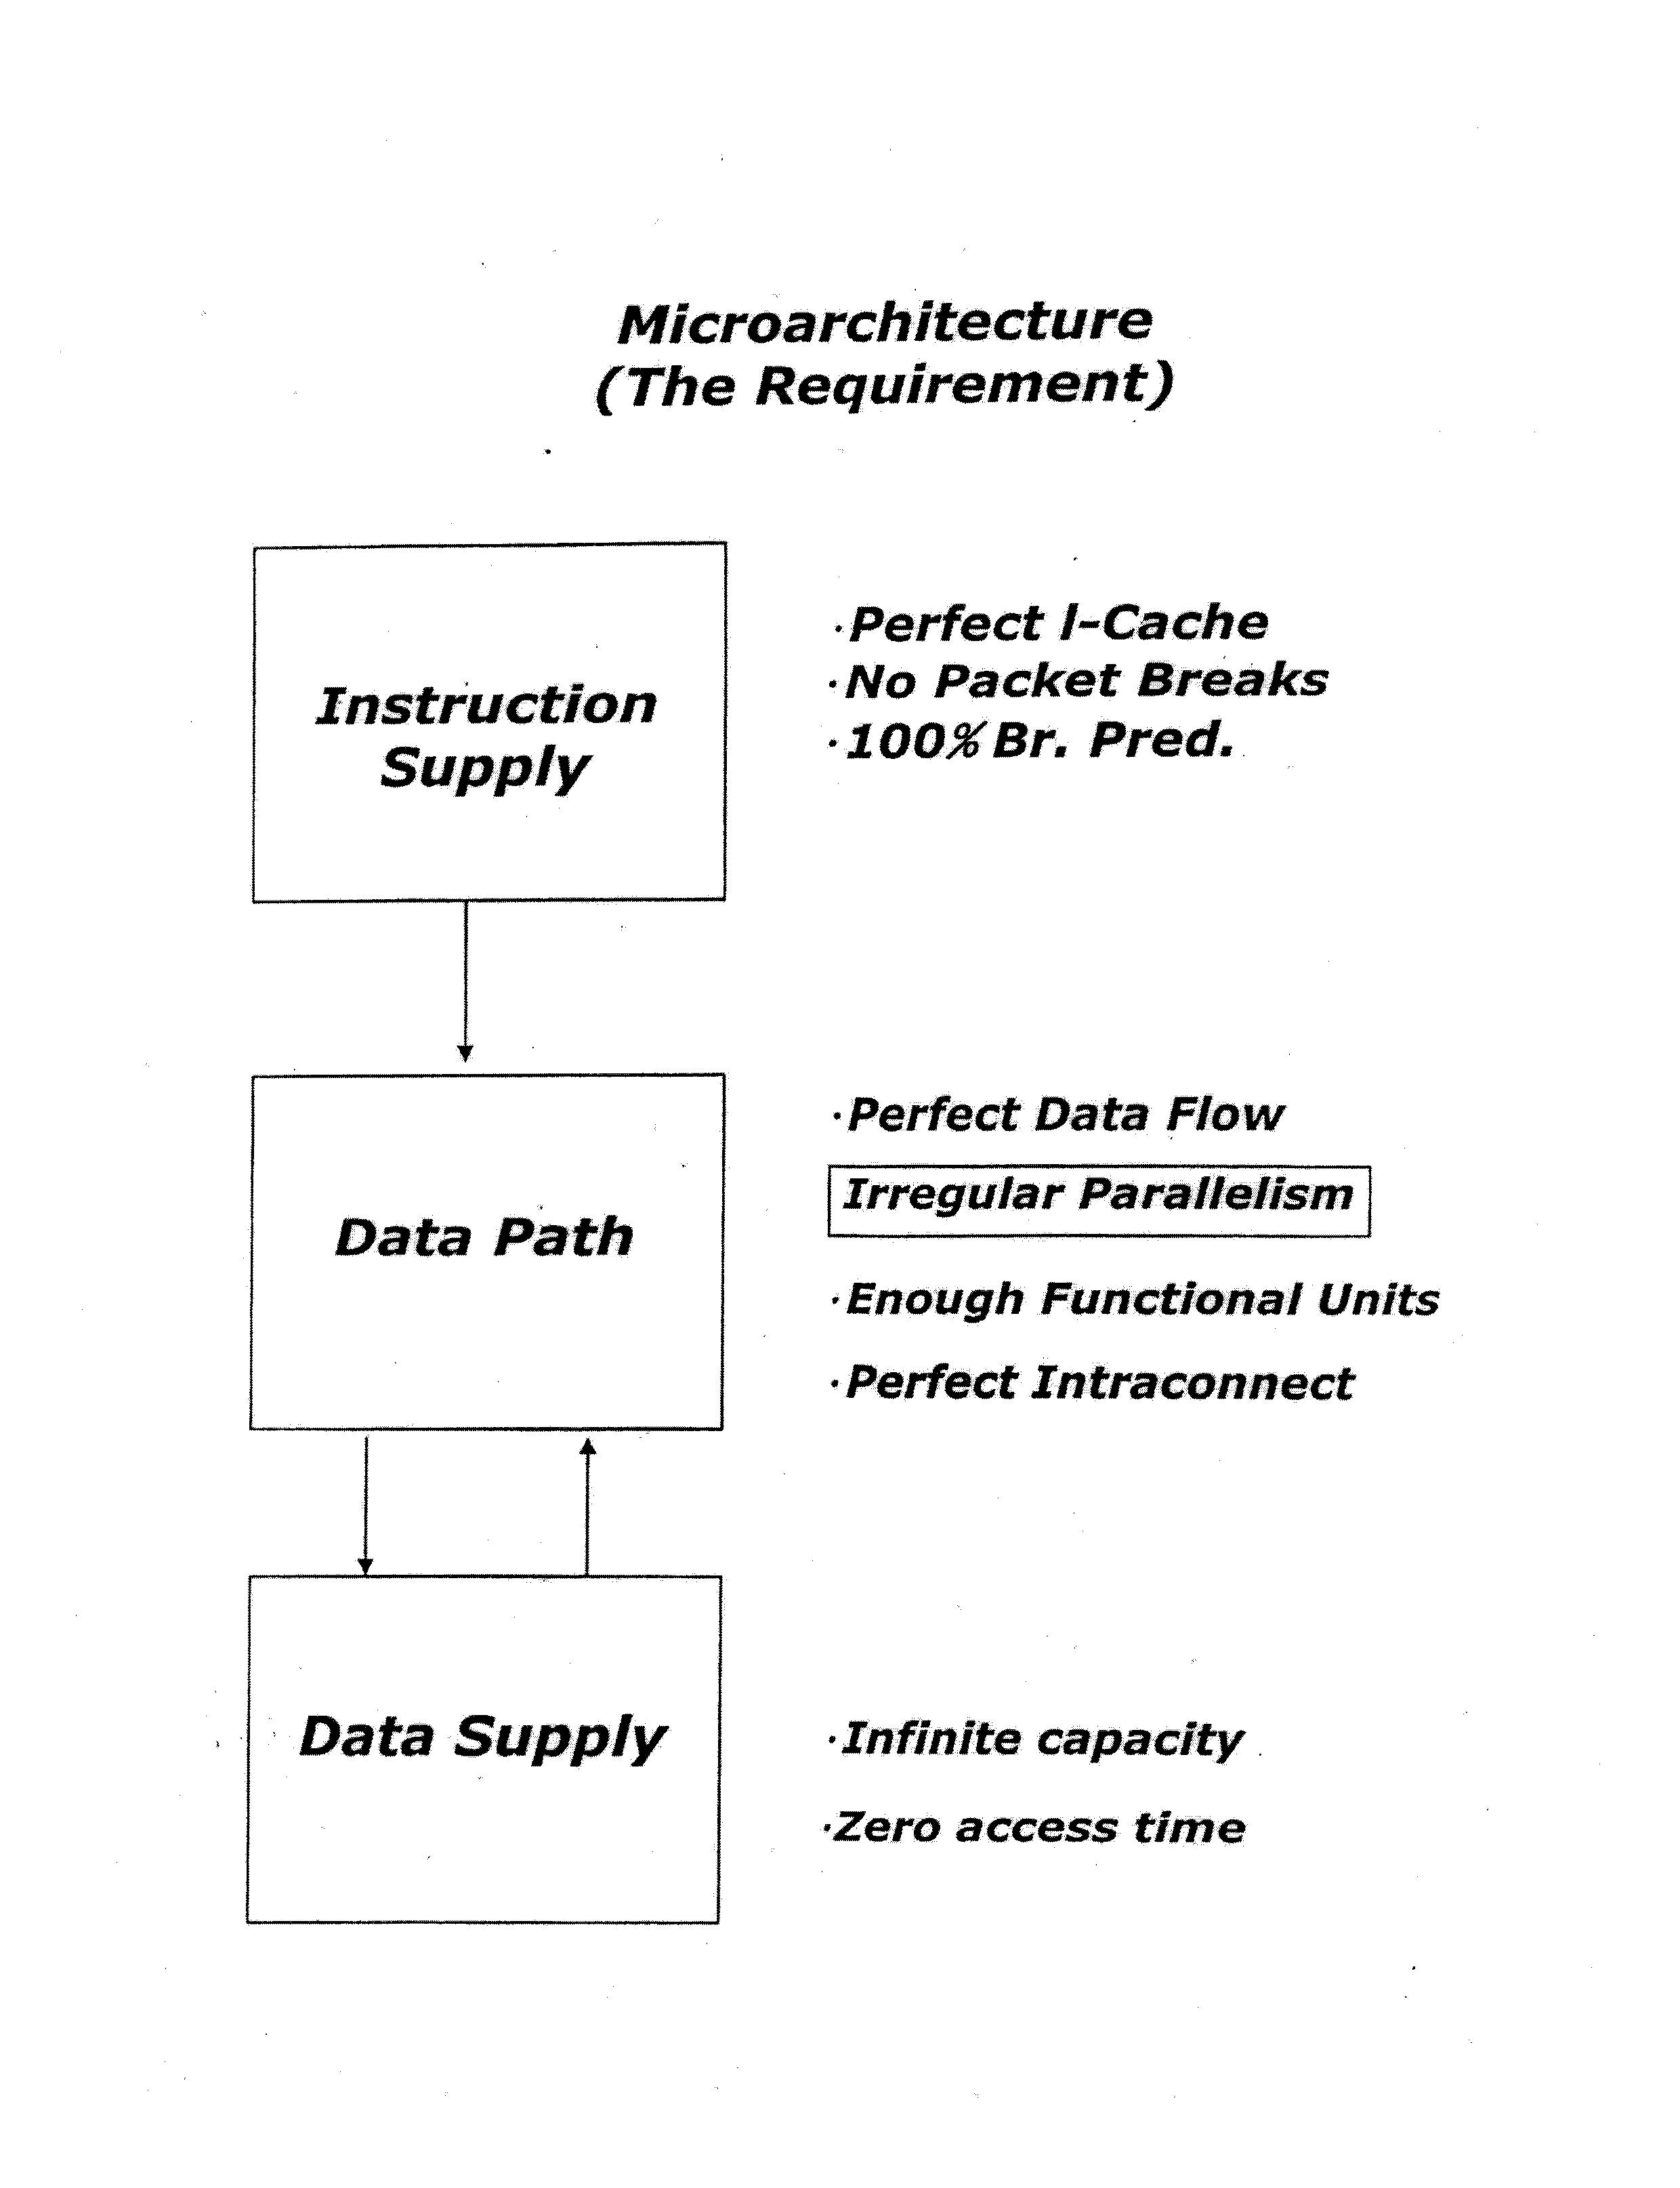

Slide 10
A few more words on Data Supply
Memory is particularly troubling
  Off-chip latency (hundreds of cycles, and getting worse)
  What can we do about it?
    Larger caches
    Better replacement policies
Is MLP (Memory level parallelism) the answer
  Wait for two accesses at the same time
  Do parallel useful work while waiting (Runahead)

Slide 11
Trade-offs, the overriding consideration:
What is the cost?
What is the benefit?
Global view
  Global vs. Local transformations
Microarchitecture view
  The three ingredients to performance
Physical view (more important in the multicore era)
  Wire delay (recently relevant) – Why? (frequency)
  Bandwidth (recently relevant) – Why? (multiple cores)
  Power, energy (recently relevant) – Why? (cores, freq)
  Soft errors (recently relevant) – Why? (freq)
  Partitioning (since the beginning of time)

Slide 12
Speculation
Why good? – improves performance
How? – we guess
  Starting with the design of ALUs, many years ago!
  Branch prediction – enables parallelism
  Way prediction
  Data prefetching – enables parallelism
  Value prediction – enables parallelism
  Address prediction – enables parallelism
  Memory disambiguation – enables parallelism
Why bad? – consumes energyl

Slide 13
Hardware – Sequential or Parallel?
Hardware is inherently parallel
  It has been since time began
  Then why the sudden interest
Useful if we pay attention to it (e.g., factorial)
The key idea is Synchronization
  It can be explicit
  It can be implicit
Pipelining
  Parallelism at its most basic level
  Everyone in the world understands that (e.g., factories)
Speculation
Single thread vs. multiple threads
Single core vs. multiple cores

Slide 14
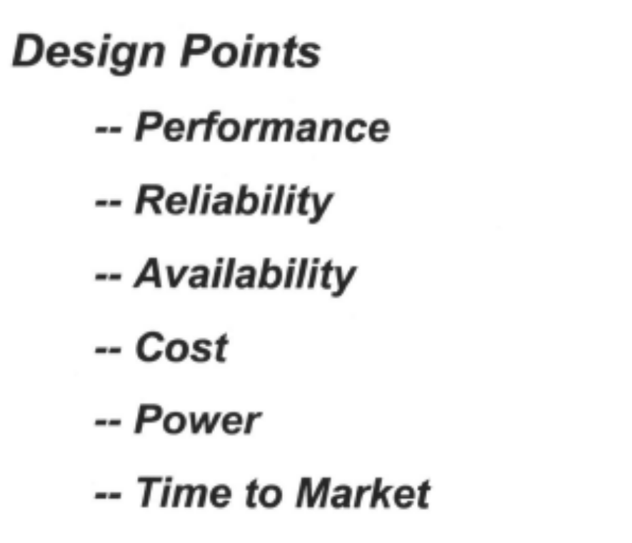

Slide 15
Design Principles
Critical path design
Bread and Butter design
Balanced design

Slide 16
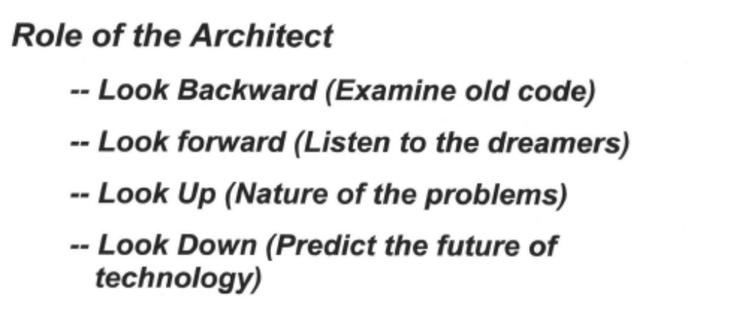

Slide 17
Numbers
(because comparch is obsessed with numbers)
The Baseline – Make sure it is the best
  Superlinear speedup
  Recent example, one core vs. 4 cores with ability to fork
The Simulator you use – Is it bug-free?
Understanding vs “See, it works!”
  16/64
You get to choose your experiments
  SMT, throughput: run the idle process
  Combining cores: what should each core look like
You get to choose the data you report
  Wrong path detection: WHEN was the wrong path detected
Never gloss over anomalous data

Slide 18
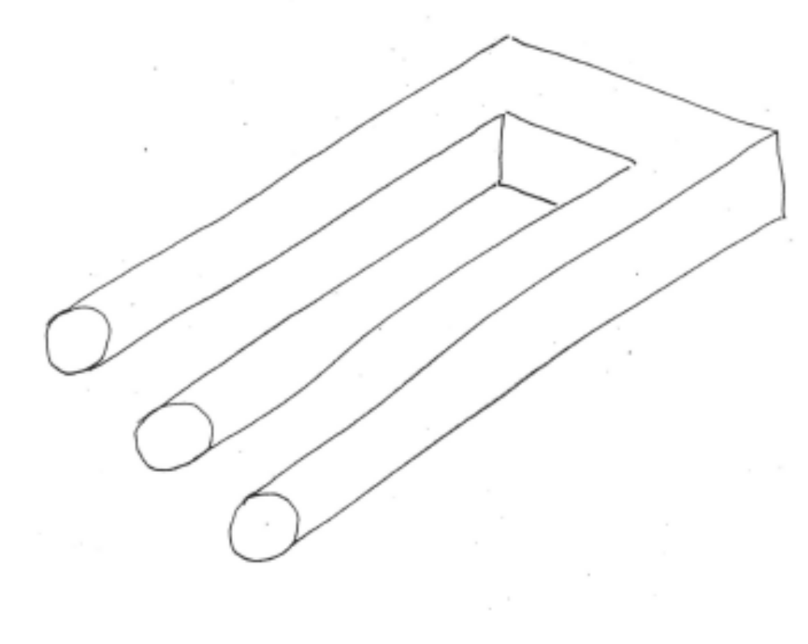
Finally, people are always telling you:
Think outside the box

Slide 19
I prefer: Expand the box

Slide 20
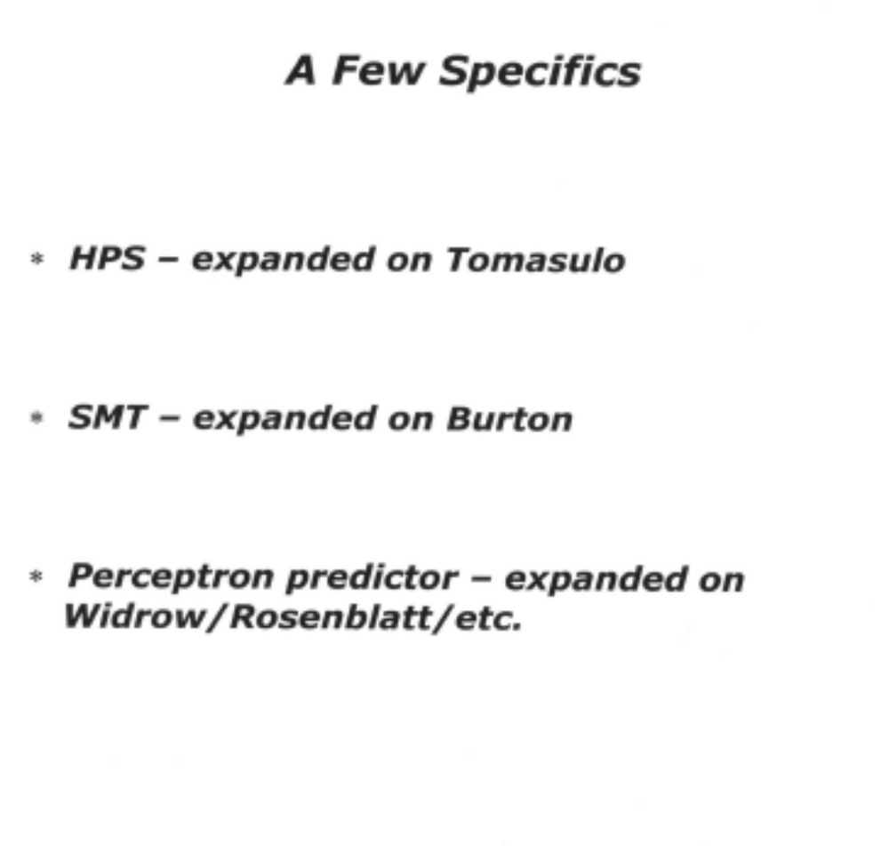

Slide 21
Something you are all familiar with:
Look-ahead Carry Generators
They speed up ADDITION
But why do they work?

Slide 22
Addition
12
9
21
182378
645259
827637

