Slide 1
Single Thread Parallelism

Slide 2
Outline
Pipelining
SIMD (both vector and array processing)
VLIW
DAE
HPS
Data Flow

Slide 3
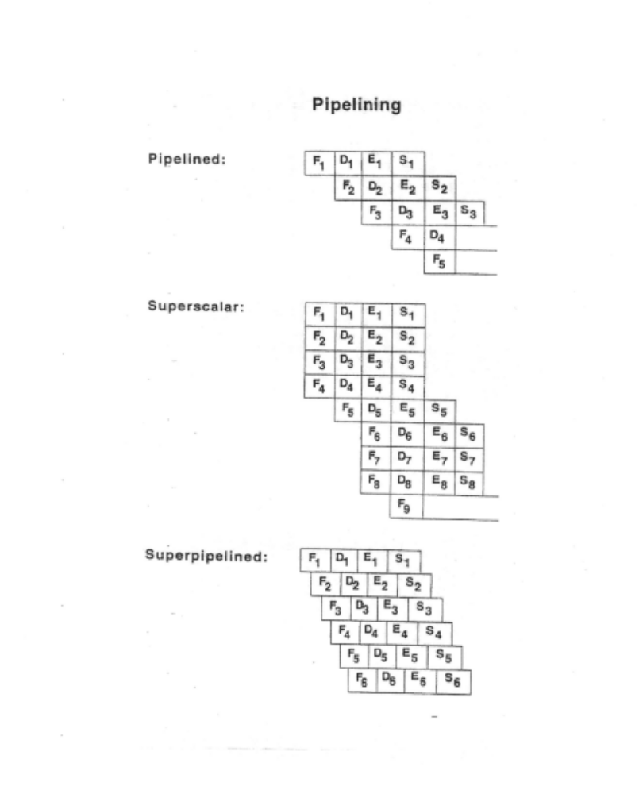

Slide 4
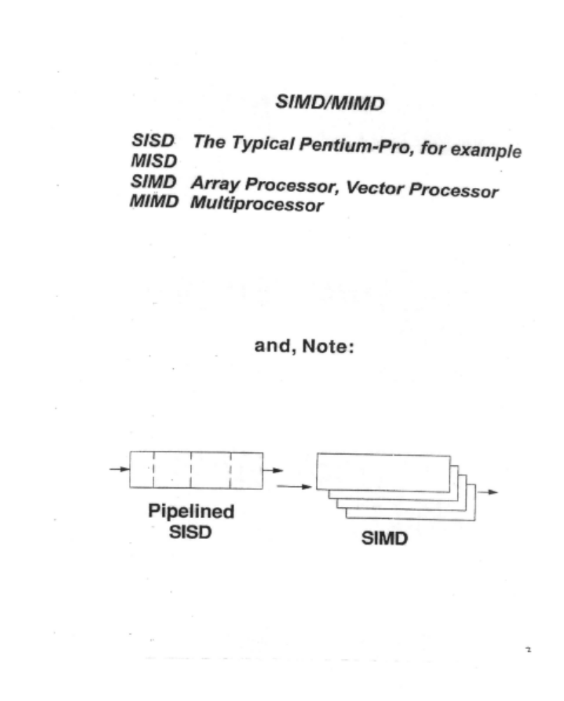

Slide 5
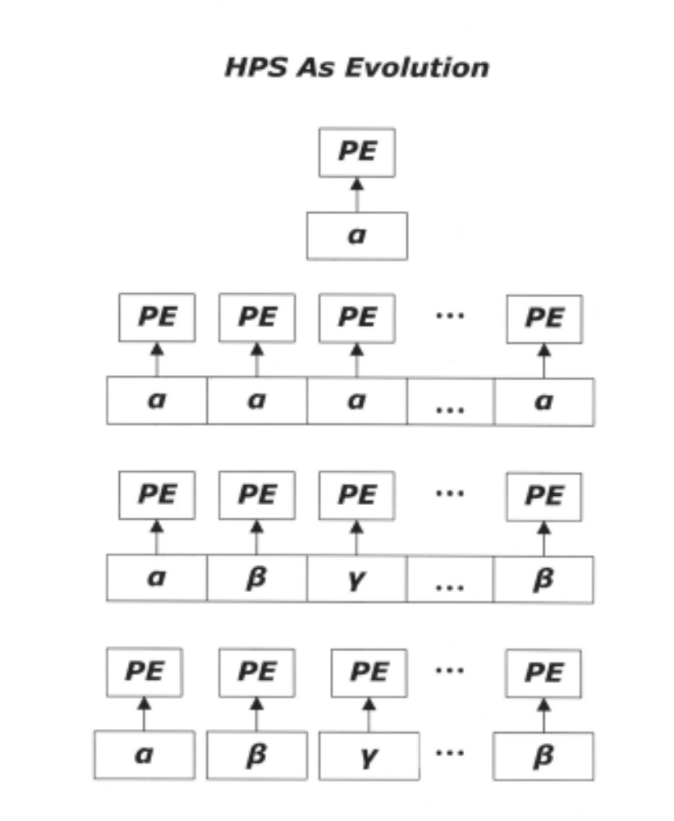

Slide 6
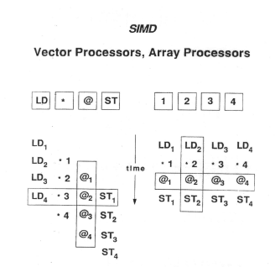

Slide 7
An example: Vector processing
The scalar code:
for i=1,50
A(i) = (B(i)+C(i))/2;
The vector code:
lvs 1
lvl 50
vld V0,B
vld V1,C
vadd V2,V0,V1
vshf V3,V2,1
vst V3,A

Slide 8
Vector processing example (continued)
Scalar code (loads take 11 clock cycles):
Vector code (no vector chaining):
Vector code (with chaining):
Vector code (with 2 load, 1 store port to memory):

Slide 9
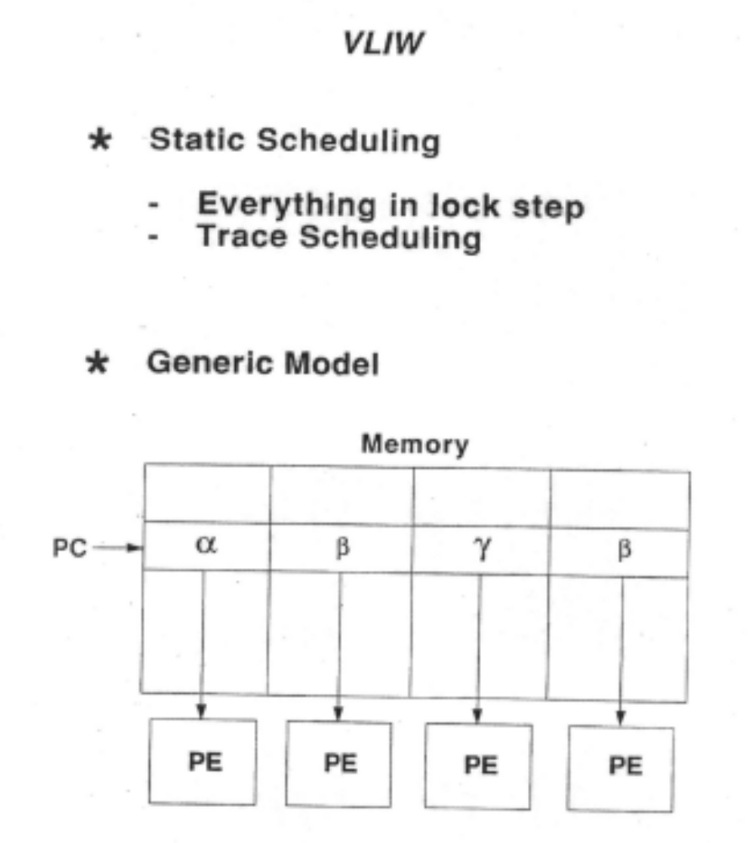

Slide 10
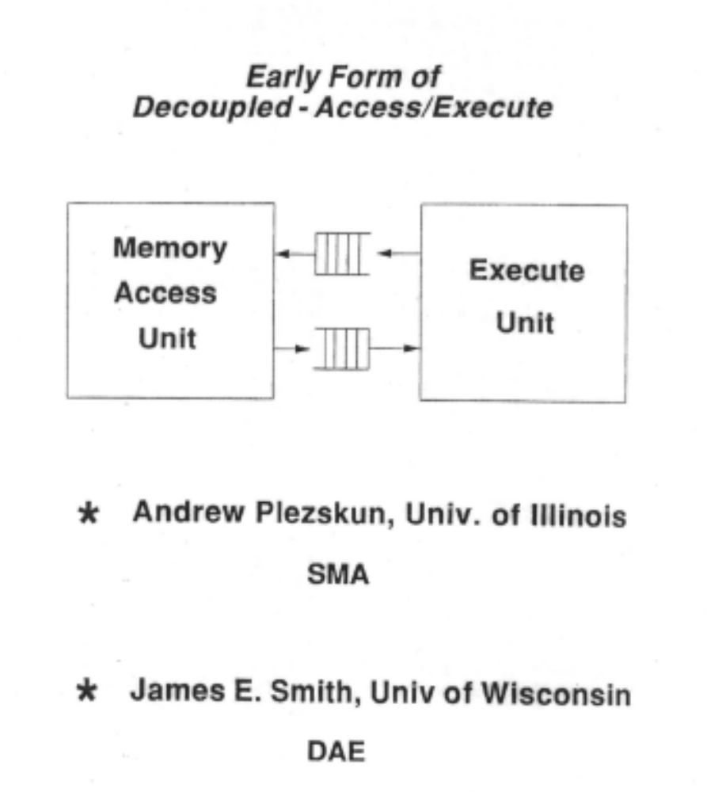

Slide 11
The HPS Paradigm
Incorporated the following:
  Aggressive branch prediction
  Speculative execution
  Wide issue
  Out-of-order execution
  In-order retirement
First published in Micro-18 (1985)
  Patt, Hwu, Shebanow: Introduction to HPS
  Patt, Melvin, Hwu, Shebanow: Critical issues

Slide 12
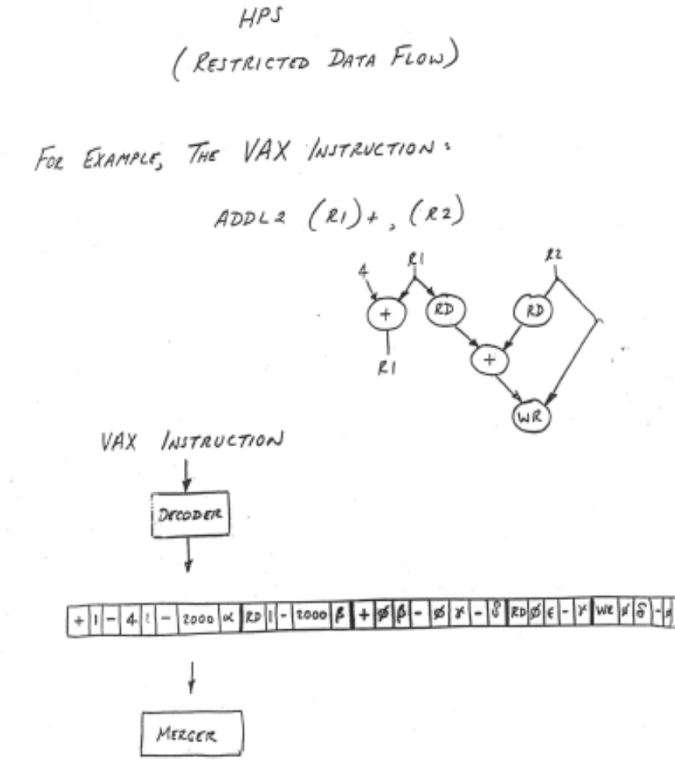

Slide 13
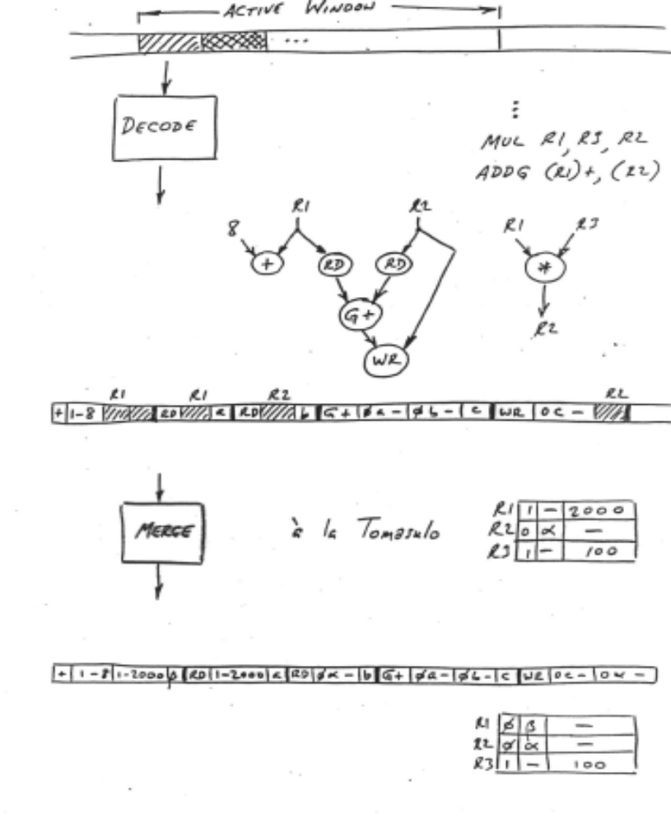

Slide 14
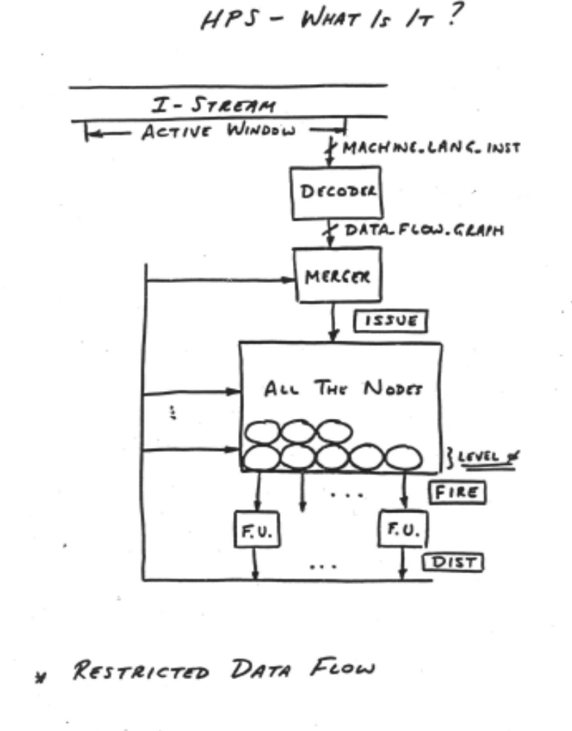

Slide 15
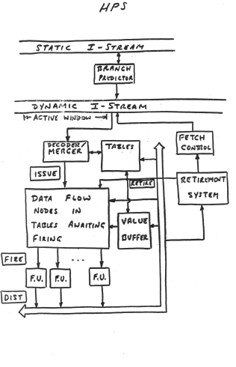

Slide 16
Data Flow
Data Driven execution of inst-level Graphical code
  Nodes are operators
  Arcs are I/O
Only REAL dependencies constrain processing
  Anti-dependencies don’t (write-after-read)
  Output dependencies don’t (write-after-write)
  NO sequential I-stream (No program counter)
Operations execute ASYNCHRONOUSLY
Instructions do not reference memory
  (at least memory as we understand it)
Execution is triggered by presence of data

Slide 17
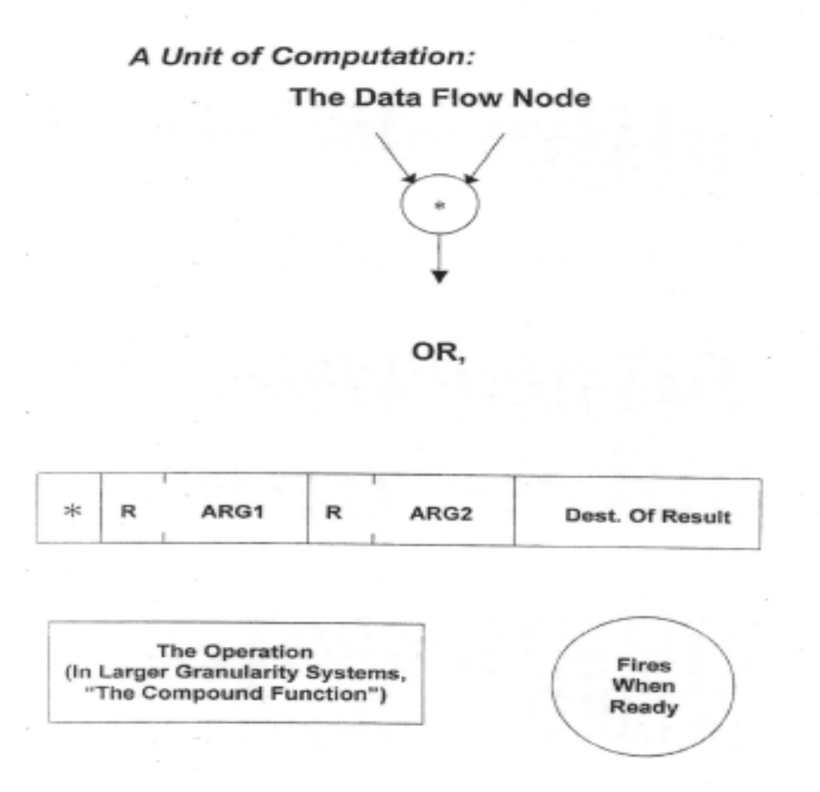

Slide 18
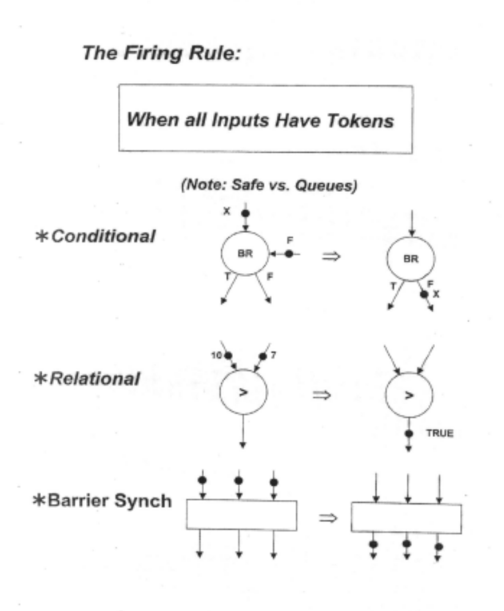

Slide 19
