Slide 1

MapReduce vs Apache Spark
CS5229 – Big Data Analytics Technologies
Name: Chinthalanka Wijesinghe
Index No: 239375E

Slide 2

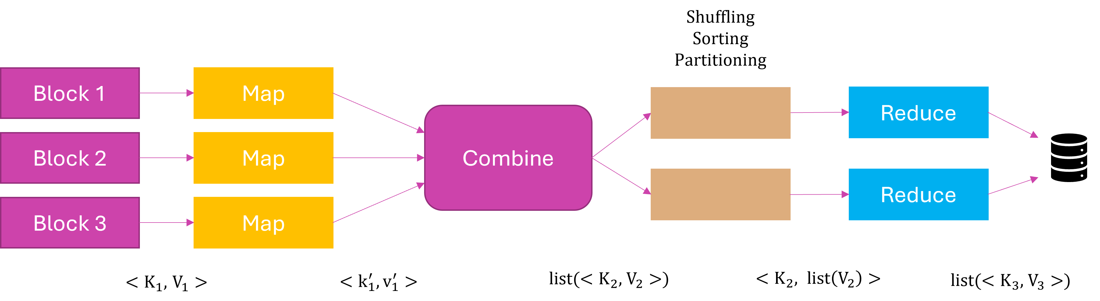
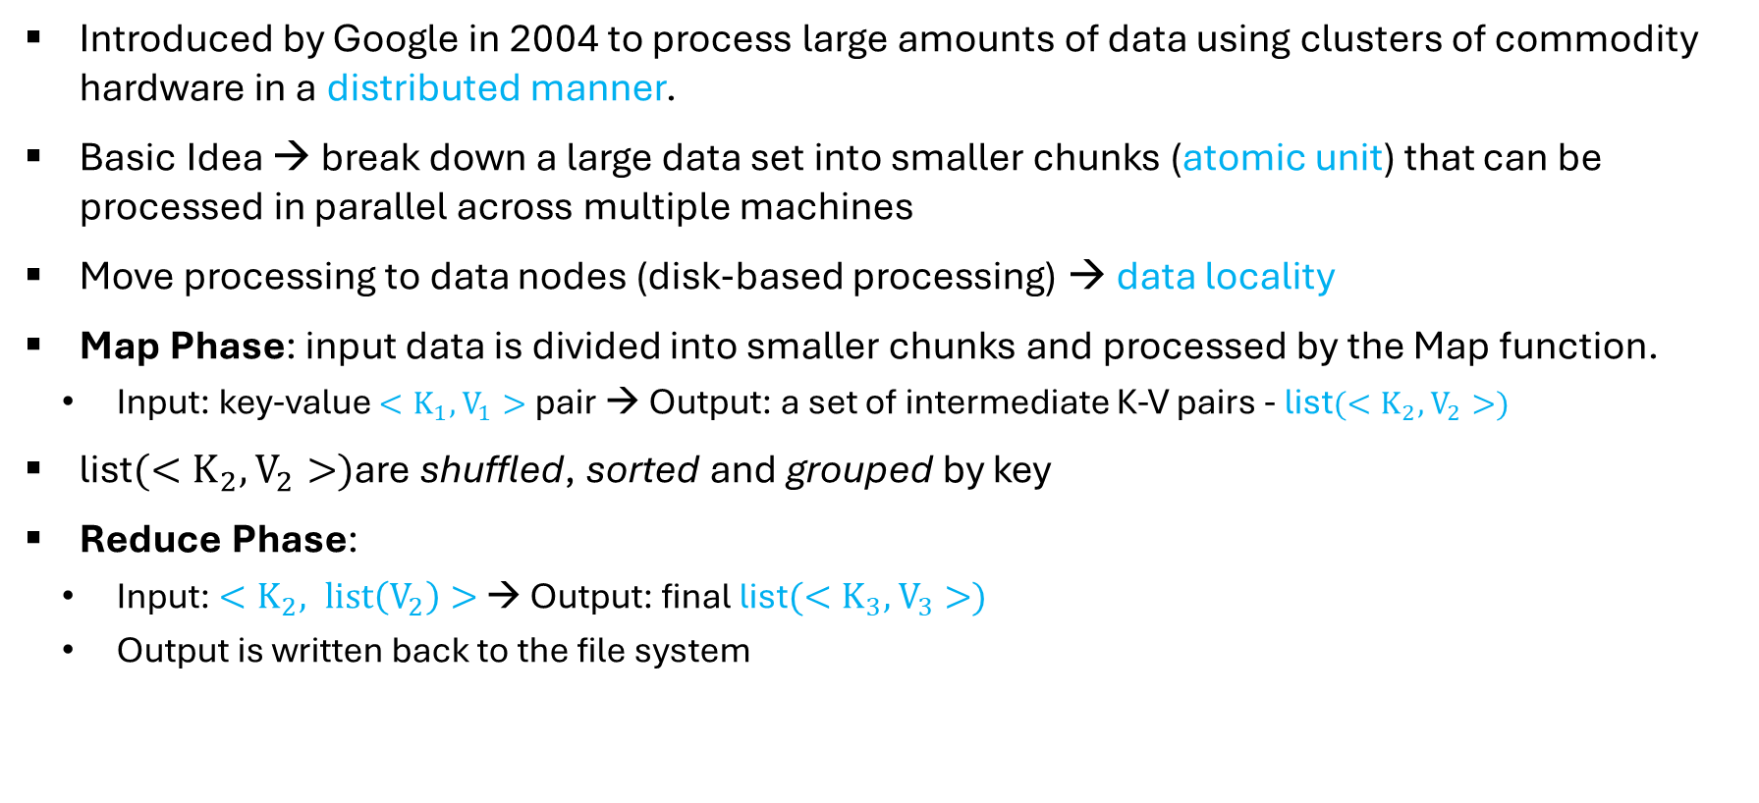
Introduction to MapReduce
Introduced by Google in 2004 to process large amounts of data using clusters of commodity hardware in a distributed manner.
Basic Idea → break down a large data set into smaller chunks (atomic unit) that can be processed in parallel across multiple machines
Move processing to data nodes (disk-based processing) → data locality
Map Phase: input data is divided into smaller chunks and processed by the Map function.
Input: key-value $<K_{1},$ $V_{1}>$ pair → Output: a set of intermediate K-V pairs - list$({<K}_{2},$ $V_{2}>)$
list$(<K_{2},$ $V_{2}>)$are shuffled, sorted and grouped by key
Reduce Phase:
Input: ${<K}_{2}, list\left(V_{2}\right)>$ → Output: final list$({<K}_{3},$ $V_{3}>)$
Output is written back to the file system
Notes:
Data Locality – since moving data to a central node for processing is costly

Slide 3






Introduction to MapReduce (Cont.)
Shuffling
Sorting
Partitioning
Block 1
Map
Reduce
Combine
Block 2
Map
Reduce
Block 3
Map
$<K_{1},$ $V_{1}>$
$<k_{1}^{′},v_{1}^{′}>$
list$({<K}_{2},$ $V_{2}>)$
${<K}_{2}, list\left(V_{2}\right)>$
list$({<K}_{3},$ $V_{3}>)$

Slide 4

Introduction to Apache Spark
Open-source distributed computing system that is designed to process large amount of data in fast and efficient manner – developed by Apache Software Foundation
Witten in Scala programming language
Supports multiple languages: Java, Scala, Python and R
Flexible APIs allow developers to write applications in a variety of languages
Provides a set of libraries for processing data: Spark SQL, Spark Streaming, MLlib and GraphX
Provides advanced analytics: interactive SQL queries, stream processing, machine learning, graph algorithms
Main feature: in-memory data processing → increases processing speed of the application
100X faster than MapReduce
Not necessarily dependent on Hadoop → has its own cluster management computation
Run on various platforms: Hadoop, Kubernetes and Apache Mesos
Notes:
Uses Hadoop only for storage purpose

Slide 5


Demo
S3
EMR
Analyze the Airline Delay dataset using MapReduce and Spark
Year wise carrier delay from 2003-2010
Year wise NAS delay from 2003-2010
Year wise Weather delay from 2003-2010
Year wise late aircraft delay from 2003-2010
Year wise security delay from 2003-2010
Prerequisites
Create an AWS S3 bucket - airline-delay-analysis
Create a folder named “code” in the bucket and upload the SQL scripts and the pyspark script
Create a folder named “input” in the bucket and upload the Airline Delay dataset
Create an AWS EMR cluster with Hive and Spark applications - chinthalanka-cluster-1

Slide 6
Demo (Cont.)
S3
EMR
MapReduce
SSH to the primary node and sync the codes in S3 to the node
Run the DDL query to create an external table
Run the Hive queries and record the execution time
Apache Spark
SSH to the primary node and sync the codes in S3 to the node
Run spark-submit command to run the PySpark script
Record the execution time
aws s3 sync s3://airline-delay-analysis/code/ ./code/ --exclude 'folder’
hive -f <file_name>
aws s3 sync s3://airline-delay-analysis/code/ ./code/ --exclude 'folder’
spark-submit --master yarn --deploy-mode client --driver-memory 8G --executor-memory 4G --num-executors 4 ~/code/airline_delay_analysis.py <sql_script> iterative --num_iter 5

Slide 7
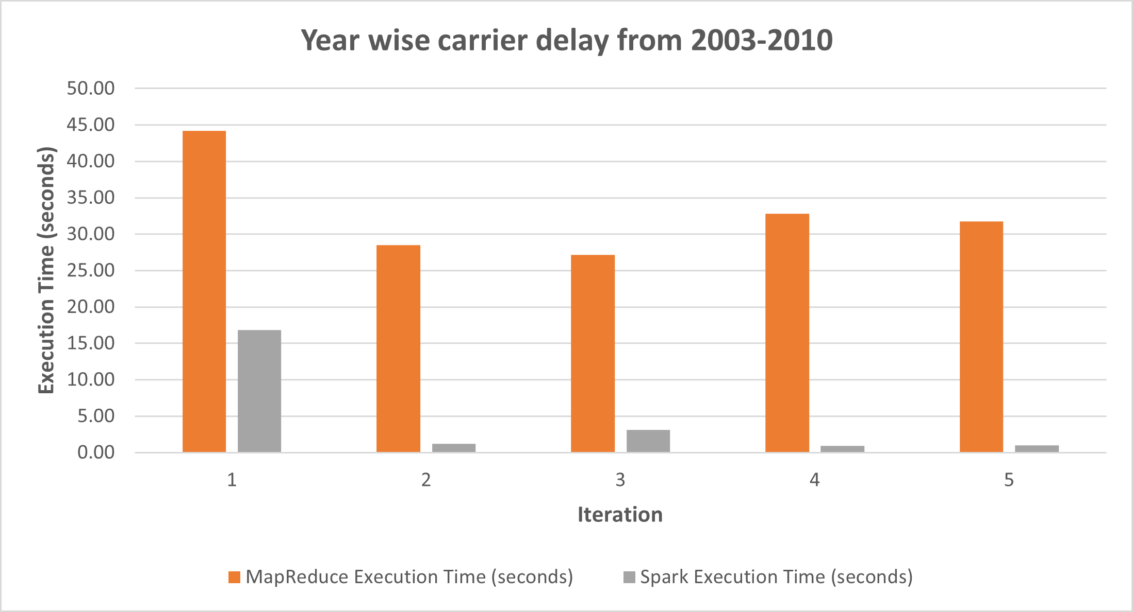
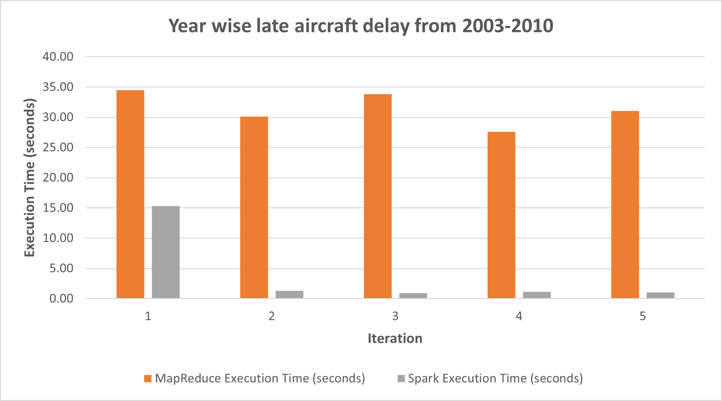
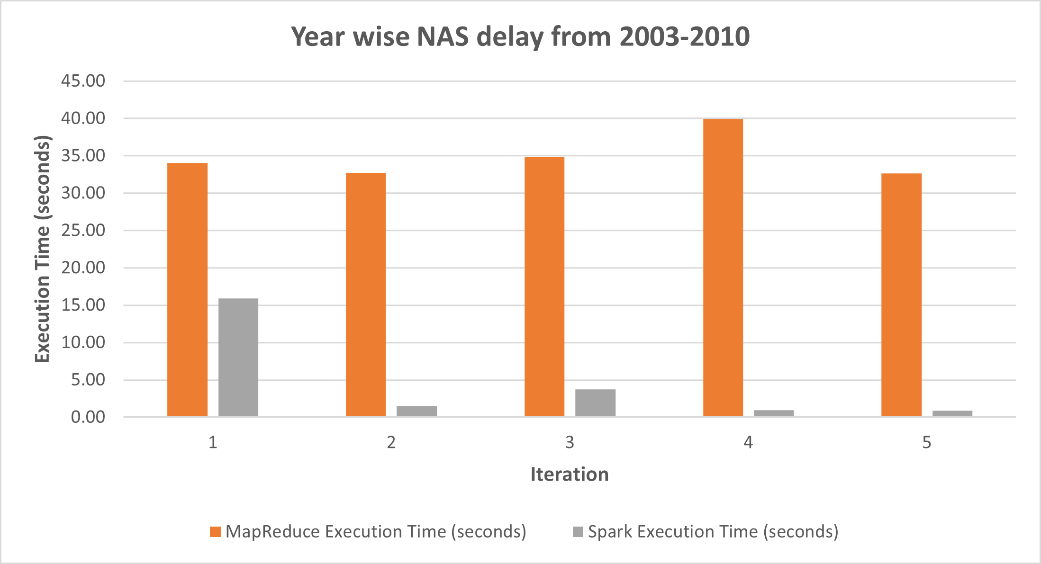
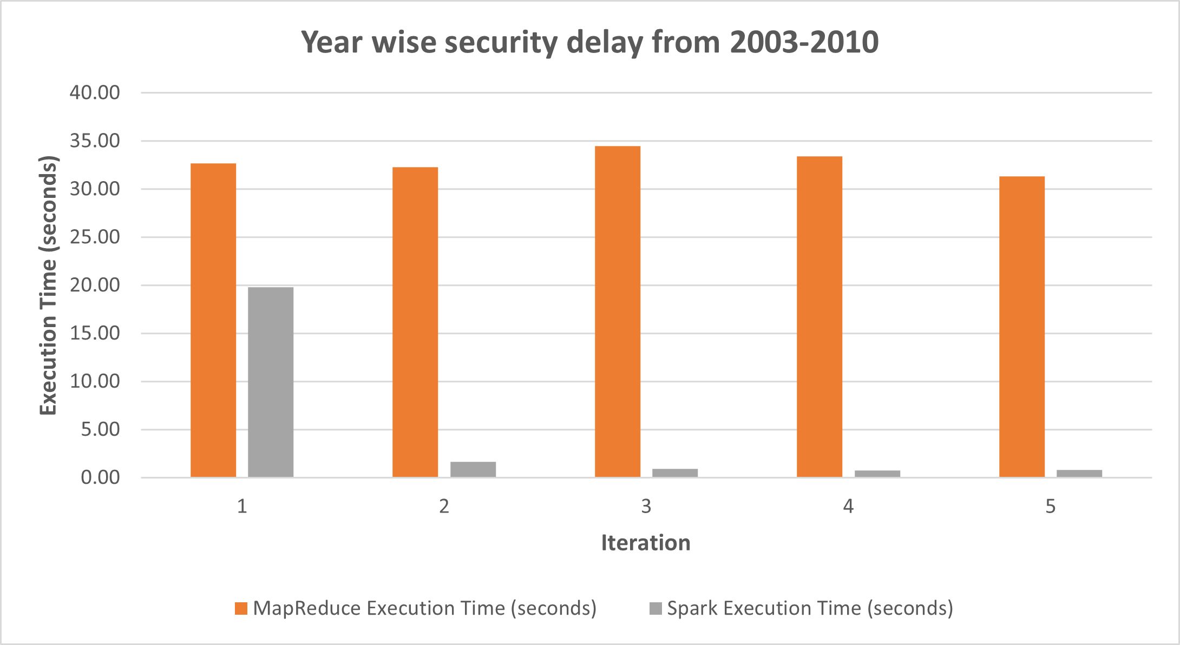
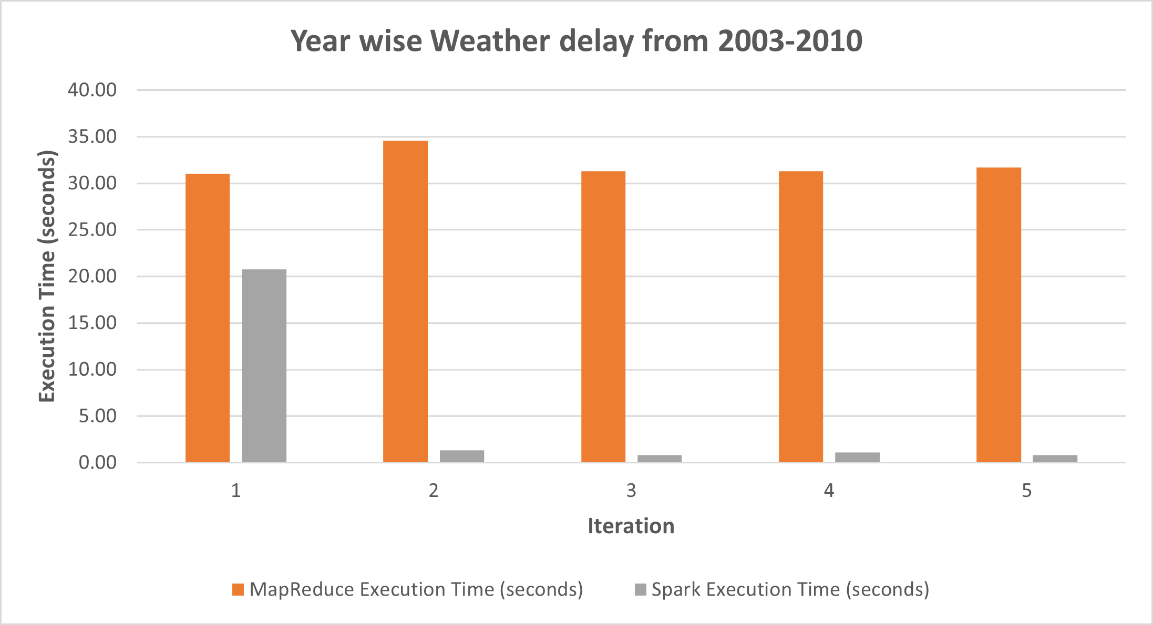
Results – Query Execution Time for 5 Iterations

Slide 8
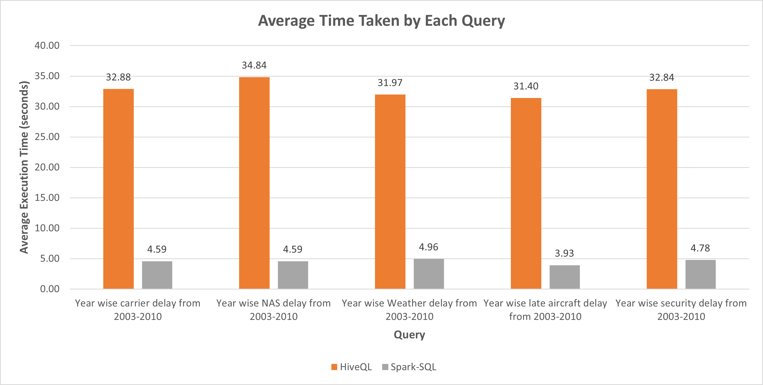
Results – Average Time Taken by Each Query

Slide 9
MapReduce vs Apache Spark
 | MapReduce | Apache Spark
Ease of use | Requires the developer to write code to explicitly manage the parallel processing of data and handle errors Need to write low-level code to process the data Makes programming process tedious and error prone | More user-friendly Supports multiple languages Includes a variety of high-level libraries for data processing Easy to perform complex data processing tasks without having to write low-level code
Fast processing | Faster than a traditional system Reliance on disk-based processing slows down the processing speed | Perform in-memory data processing 100x faster in-memory and 10x faster on disk than Hadoop Uses DAG engine for efficient job execution
vs
Notes:
Spark uses a DAG (Directed Acyclic Graph) engine for efficient job execution, which allows it to optimize the processing of multiple stages of computation and perform more efficient task scheduling.

Slide 10
Conclusion
Hive queries take longer time to execute due to disk-based processing
Spark SQL queries take less time to execute compared to Hive queries due to in-memory data processing and optimized query execution engine
After the data is loaded to the memory in the first iteration, it takes only around 1s to run the queries in subsequent iteration
Performance of the Spark job can be optimized by adjusting the parameters such as --driver-memory, --executor-memory and --num-executors
Hive command-line interface (CLI) can be used to write and run queries, which may be easier for some scenarios
Writing low-level code in MapReduce makes it more complex to use
Spark is more user friendly as it supports multiple languages and includes variety of data processing libraries

Slide 11
Thank You!

