Slide 1
Electronic Product And Pricing Analysis
Submitted By – Raveena Chiluka

Slide 2
Introduction
Aim
To Transform and Analyze the Electronic product and pricing Data set converting into a practical implementable data model using the appropriate technologies.
Steps:
DATA Modeling
DATA Loading
DATA Analysis
Technologies Used:
ETL Tool- Talend
Apache Hive
Data bricks

Slide 3
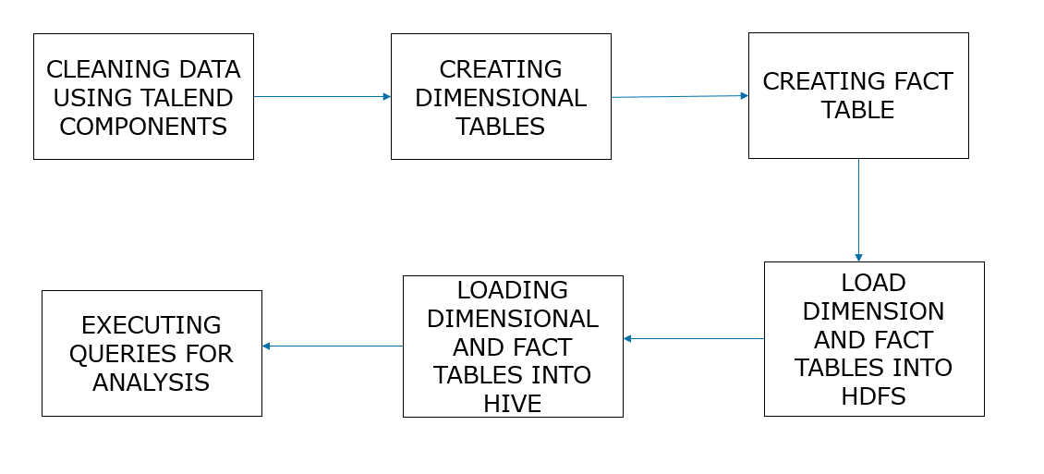
Analysis process

Slide 4
About the Data Set
This data set consists of different products which are sold by different product merchants.
It also consists of information about product prices, product availability, product condition, shipping, date added and updated.
There are about 7300 records in this dataset.

Slide 5
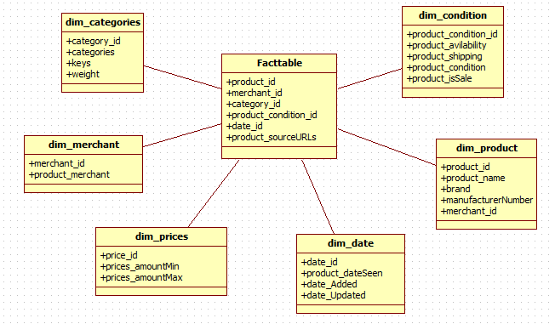
Data model

Slide 6
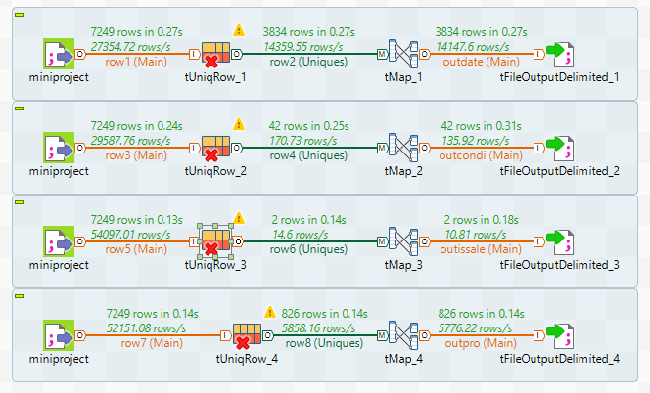
Dimension Tables in Talend

Slide 7
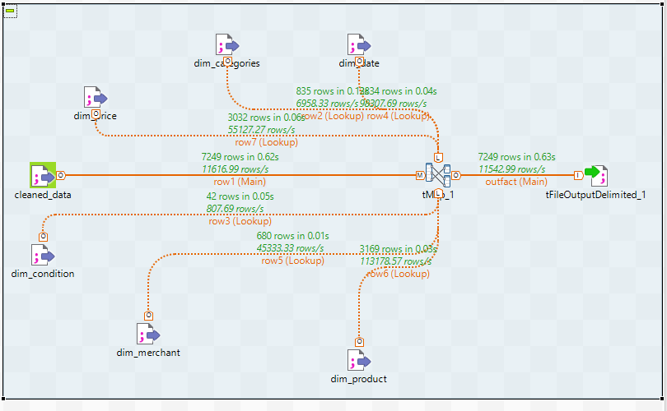
Creating fact table in Talend

Slide 8
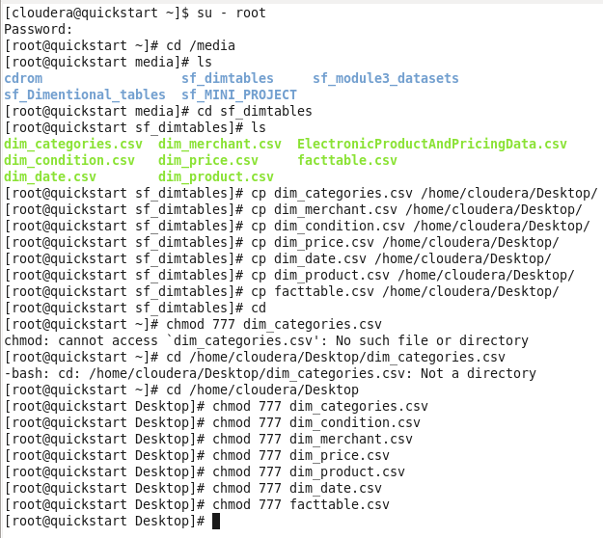
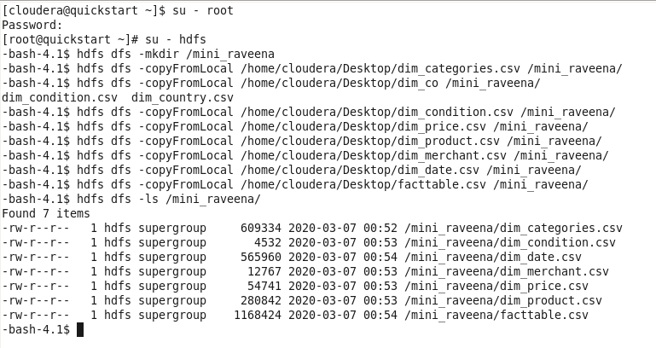
Data loading to hdfs

Slide 9
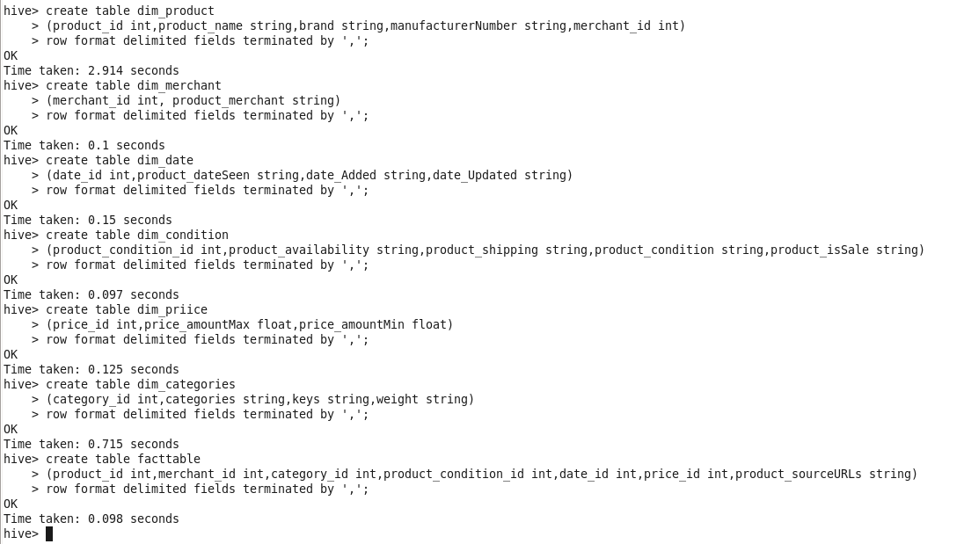
Creating Tables In Hive

Slide 10
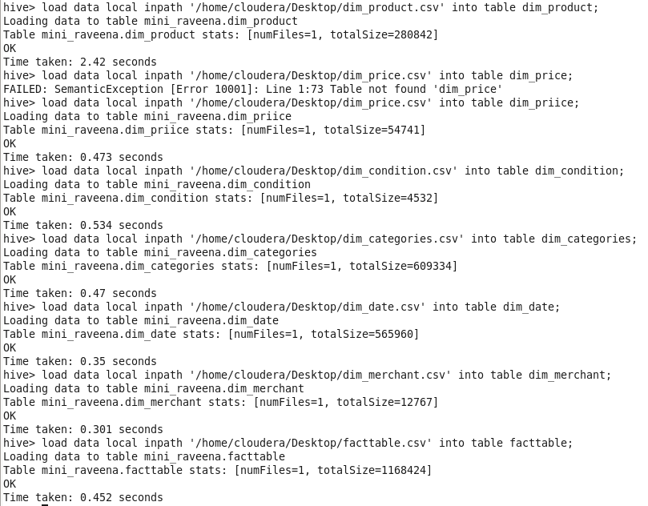
Loading data to hive tables

Slide 11
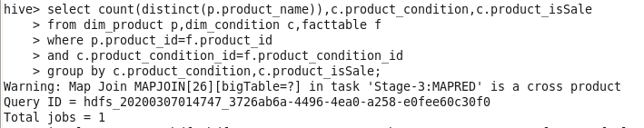
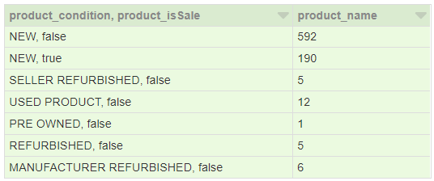
Scenario 1
To find number of products based on the its availability and its condition in the market.
Query
Output

Slide 12
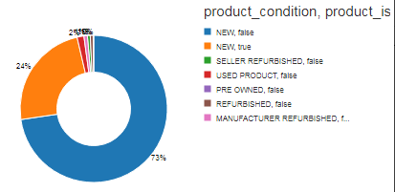
Analysis

Slide 13
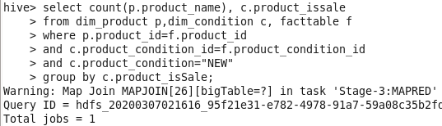

Scenario 2
To find the number of products which are new and whether they are available or not.
Query
Output

Slide 14
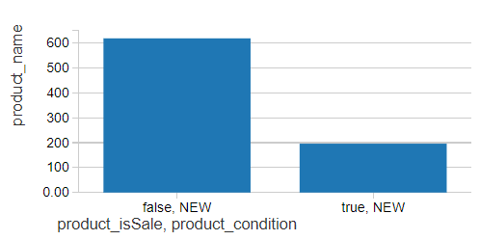
Analysis

Slide 15
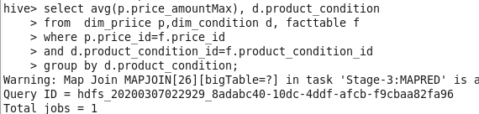
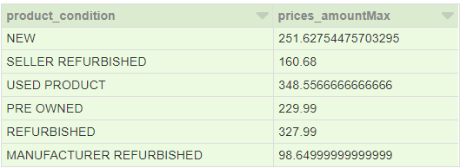

Scenario 3
To find the average price products based on their condition.
Query

Slide 16
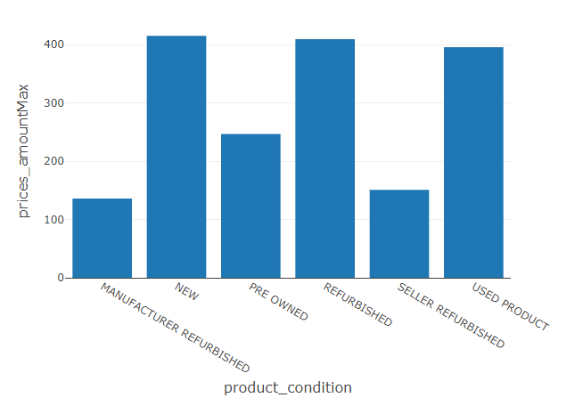
Analysis
To find the average price products based on their condition.

Slide 17
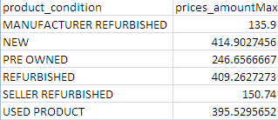
select avg(p.prices_amountmax), d.product_condition
from dim_prices p,dim_product d, facttable f
where p.price_id=f.price_id
and d.product_id=f.product_id
group by d.product_condition;

Slide 18
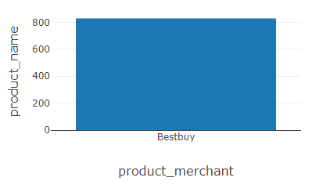
Query 4
to find the number of products sold by particular merchant lets say “bestbuy”

Slide 19
select count(distinct(p.product_id)) from
dim_product p,dim_merchant m
where p.merchant_id=m.merchant_id
and m.product_merchant=“bestbuy”;

Slide 20
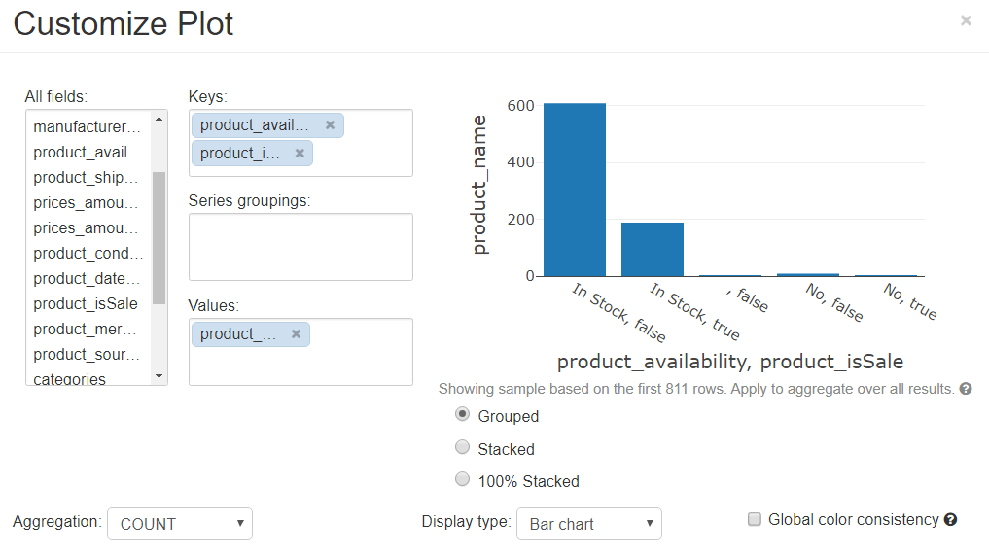

Slide 21
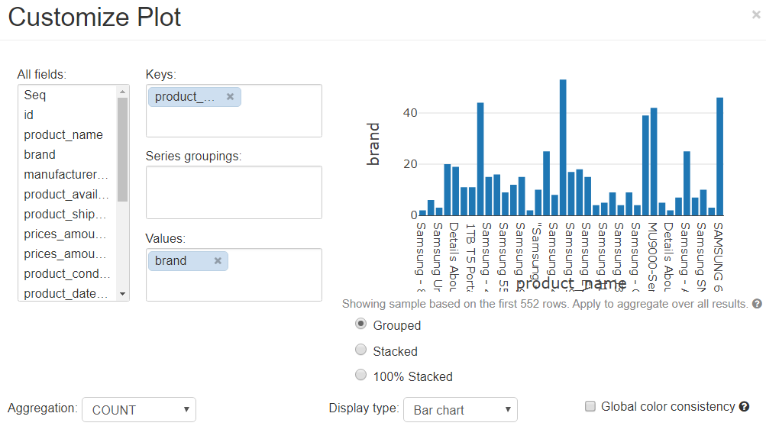

Slide 22
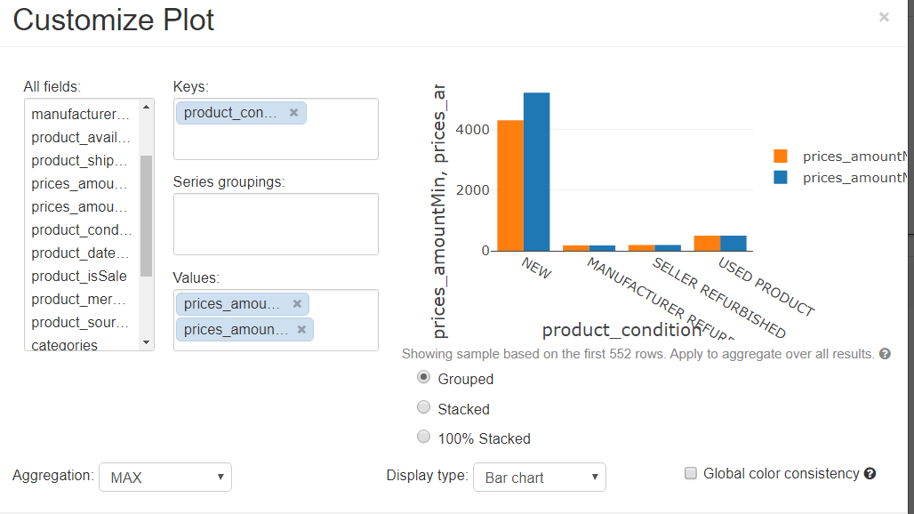

Slide 23
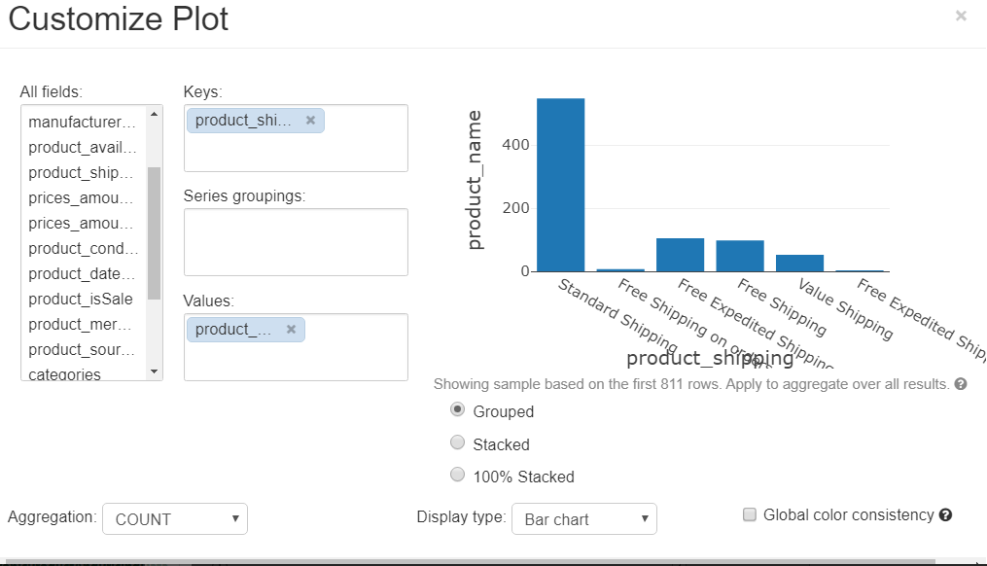

Slide 24


