Slide 1
Electronic Product And Pricing Analysis
Submitted By – Raveena Chiluka

Slide 2
Introduction
Aim
To Transform and Analyze the Electronic product and pricing Data set converting into a practical implementable data model using the appropriate technologies.
Steps:
DATA Modeling
DATA Loading
DATA Analysis
Technologies Used:
ETL Tool- Talend
Apache Hive

Slide 3
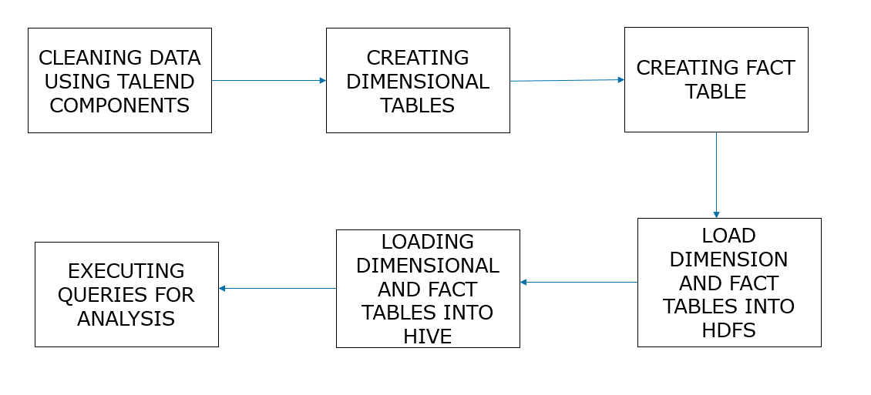
Analysis process

Slide 4
About the Data Set
This data set consists of different products which are sold by different product merchants.
It also consists of information about product prices, product availability, product condition, shipping, date added and updated.
There are about 7300 records in this dataset.

Slide 5
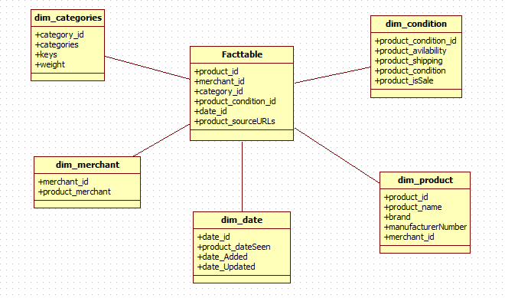
Data model

Slide 6
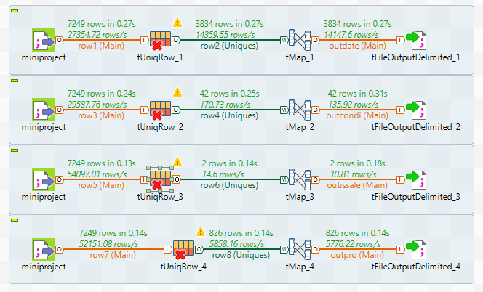
Dimension tables In talend

Slide 7
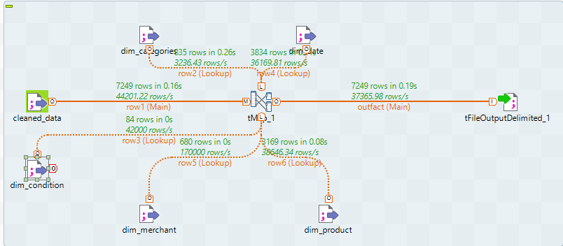
Creating fact table in talend

Slide 8
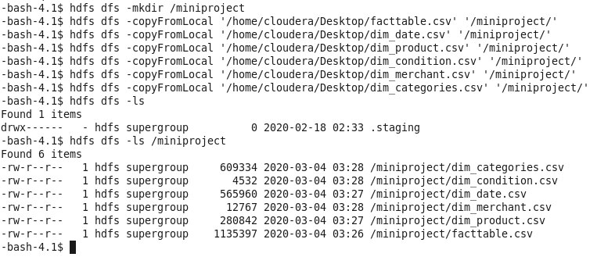
Data loading to hdfs

Slide 9
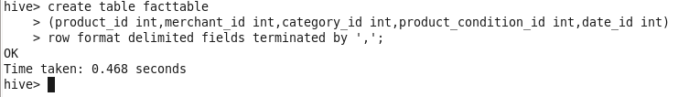
Creating Tables In Hive

Slide 10
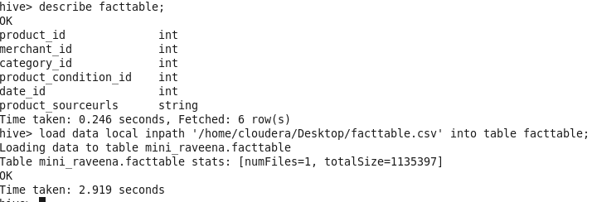
Loading data to hive

Slide 11
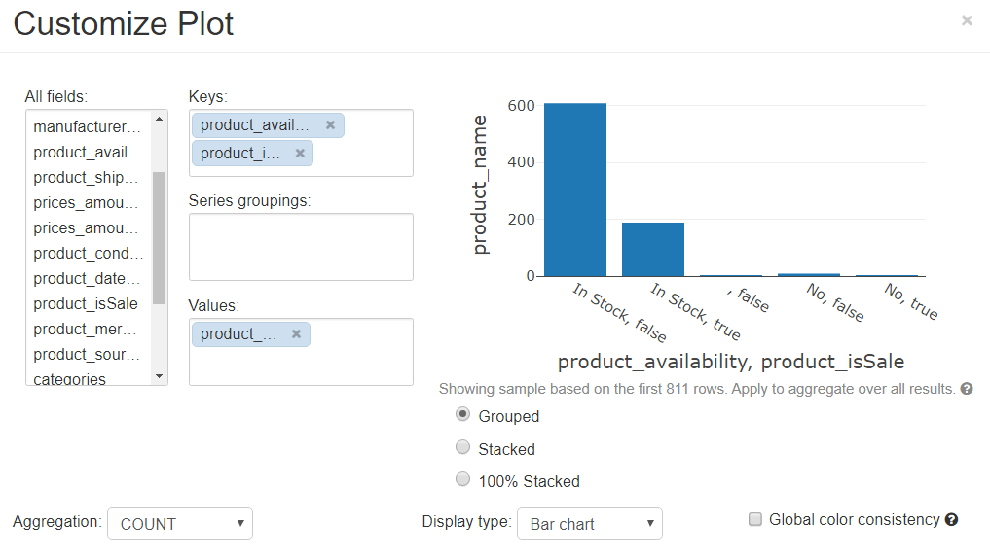

Slide 12
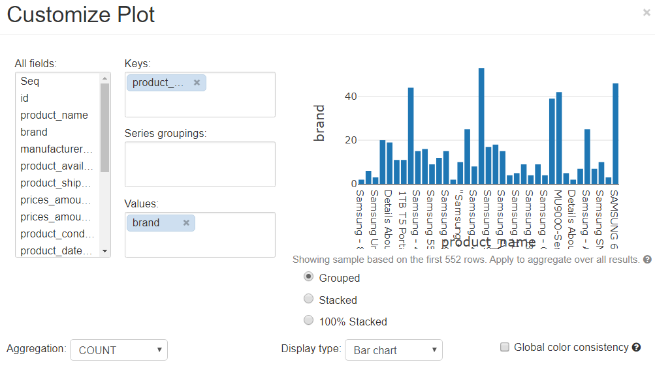

Slide 13
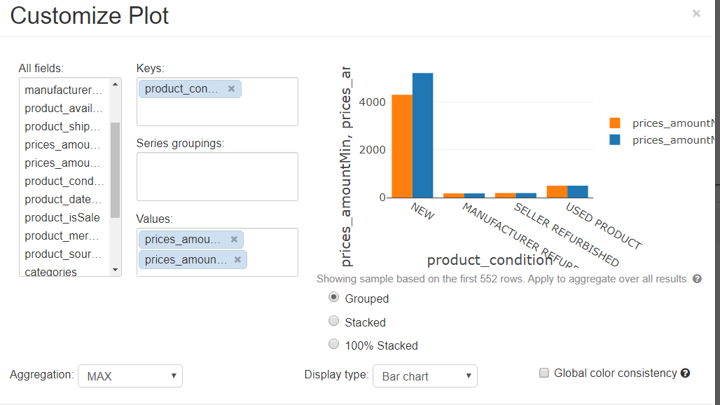

Slide 14
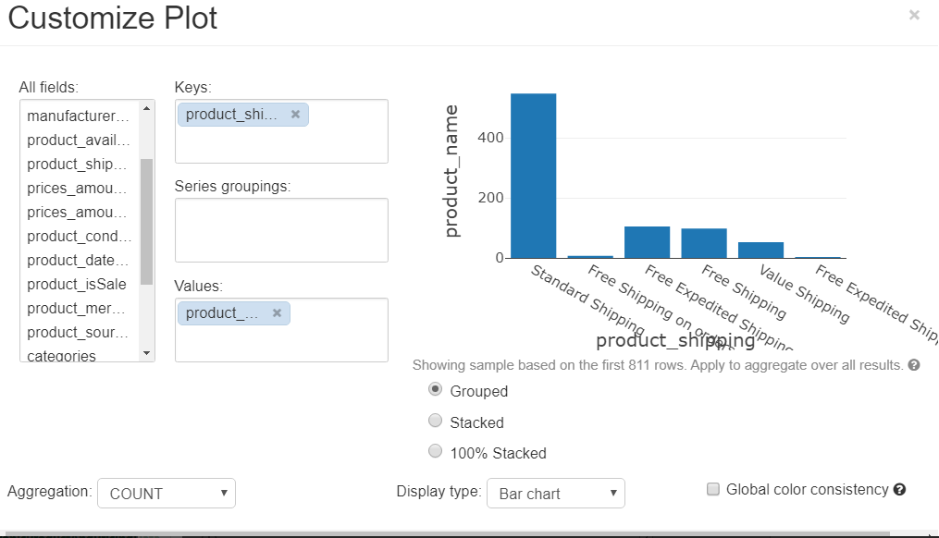

Slide 15


