Slide 1

CRIME ANALYSIS IN INDIA
Submitted By:
V.Swathi
G.Bindu Madhavi
K.Shivani
K.Srinidhi
Ch.Raveena

Slide 2
Topics covered
Introduction
Need to analyze the data
About the dataset
Workflow
Data Model
Data Cleansing
Creating dimension and fact tables
Loading data into HDFS
Creating and loading data into the Hive tables
Queries and graphs

Slide 3
Introduction
Crime is a problem around the world and represents a significant negative externality to the quality of life in a society.
With rapid urbanization and development of big cities and towns, the graph of crimes is also on the increase.
This phenomenal rise in offenses and crime in cities is a matter of great concern and alarm to all of us.

Slide 4
Need to analyze the dataset
Crime analysis plays a major role in devising solutions to crime problems, and formulating crime prevention strategies.
Our system can predict regions which have high probability for crime occurrence and can visualize crime prone areas.
Using the concept of data mining we can extract previously unknown, useful information from an unstructured data.

Slide 5
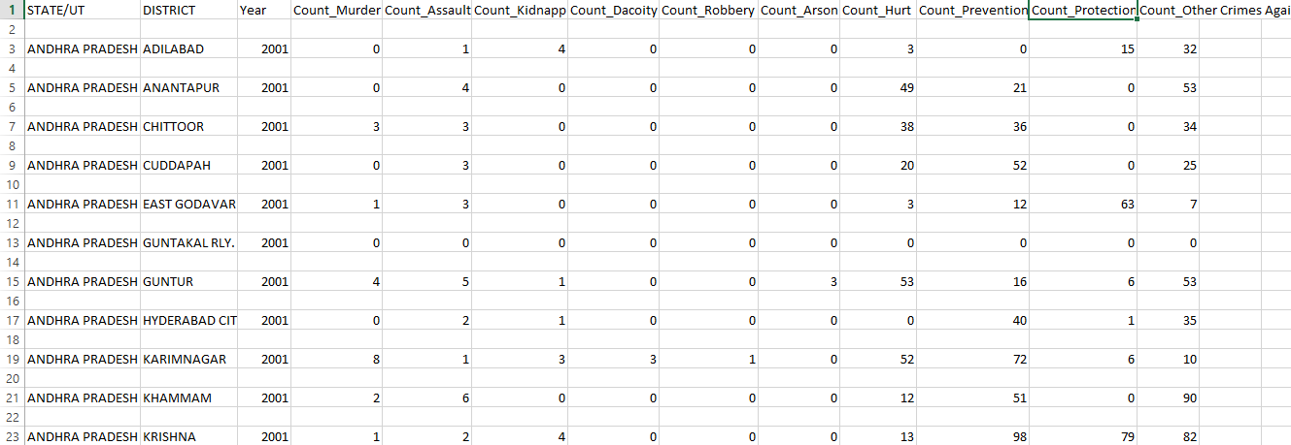
About the dataset
The Dataset contains record of crimes that had occurred in different states of India from 2001-2013.
Different types of crimes were given to understand the issue more carefully and deeply.
Total number of rows : 19683
Total number of columns: 13

Slide 6
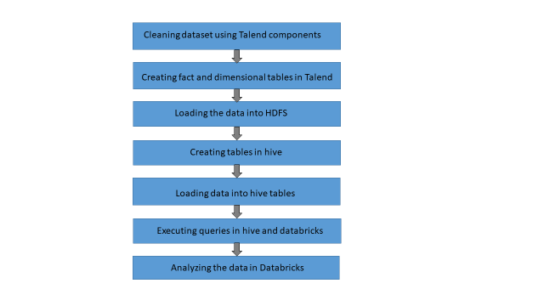
Work Flow

Slide 7
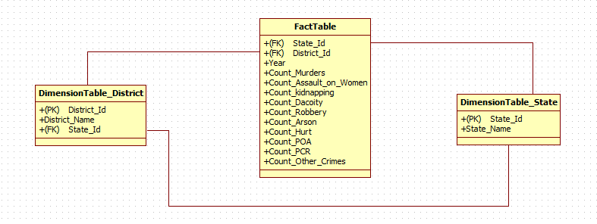
Data Model

Slide 8
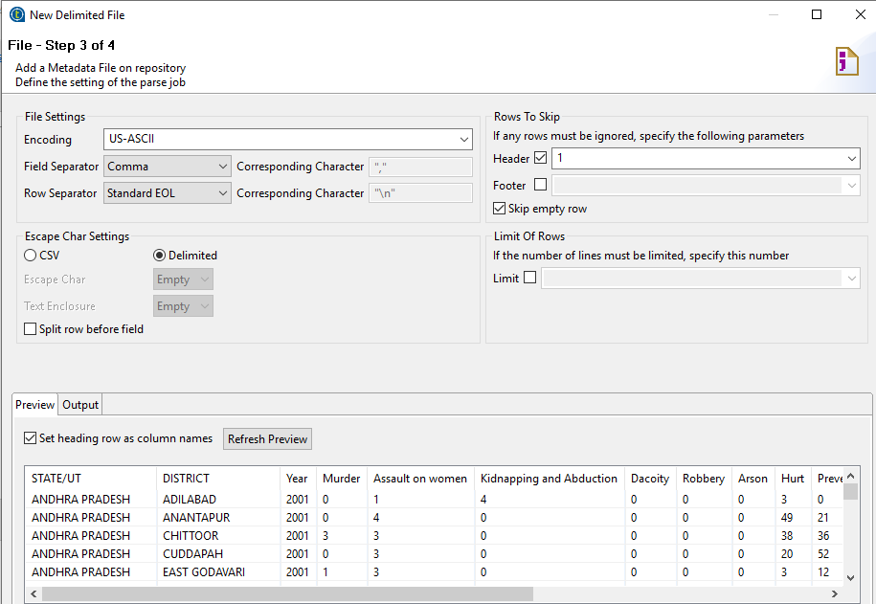
Data Cleansing

Slide 9

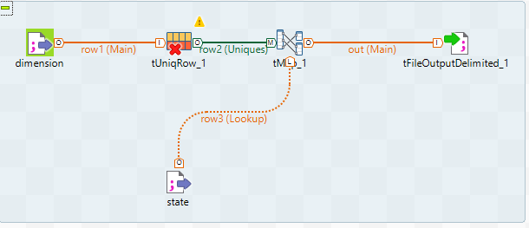
Creating dimension tables

Slide 10
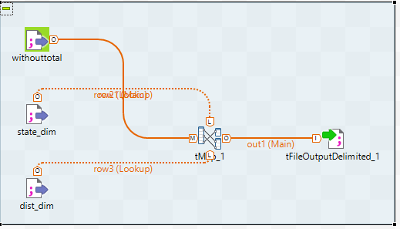
Creating fact table

Slide 11

Loading the data into HDFS

Slide 12
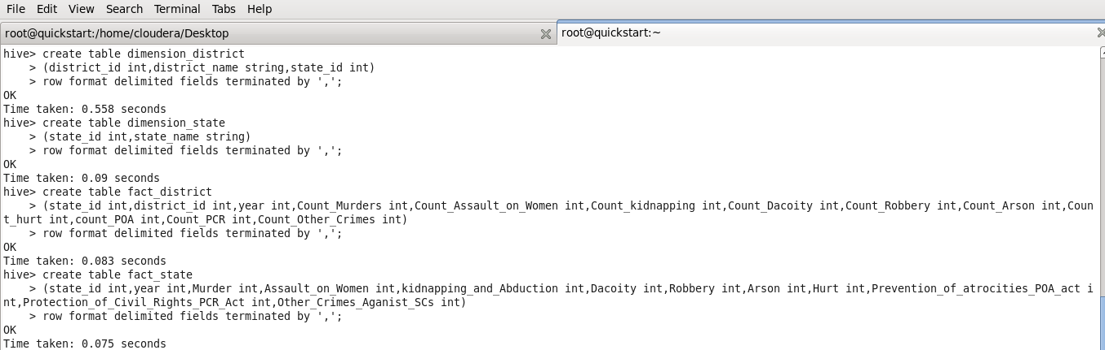
Creating tables in hive

Slide 13
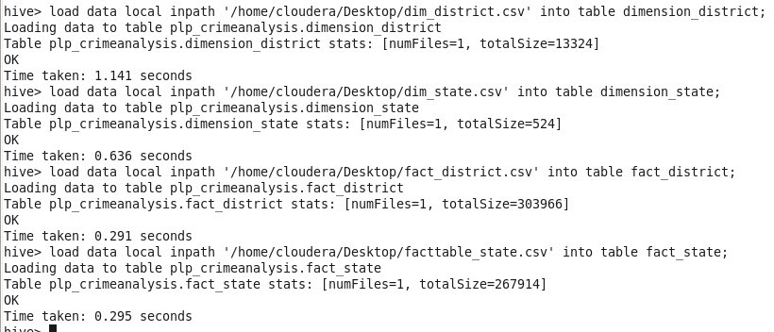
Loading the data into Hive tables

Slide 14
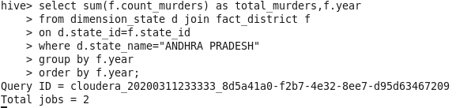
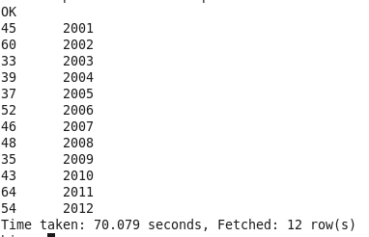
Scenario 1:Counting the Number of murders Year-wise in Andhra Pradesh

Slide 15
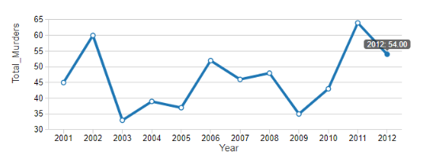
Graphical Representation

Slide 16
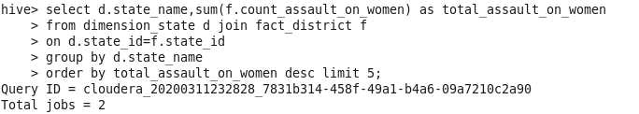
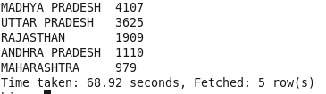
Scenario 2:Top 5 states where Assault on women has occurred.

Slide 17
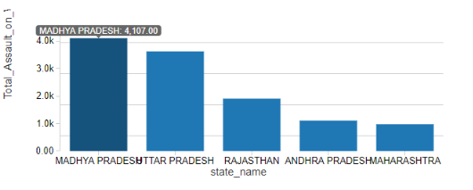
Graphical Representation

Slide 18
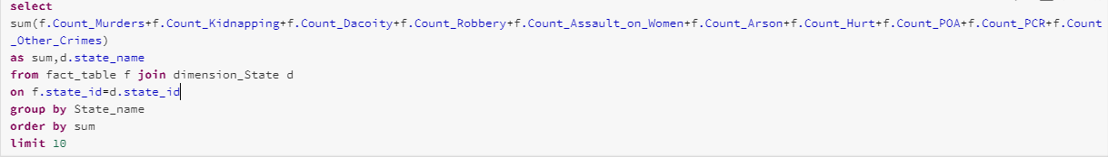
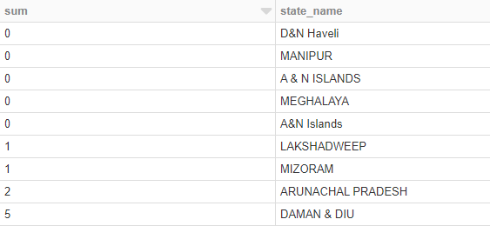
Scenario 3:Most Safest State with respect to Crime all over the Country

Slide 19
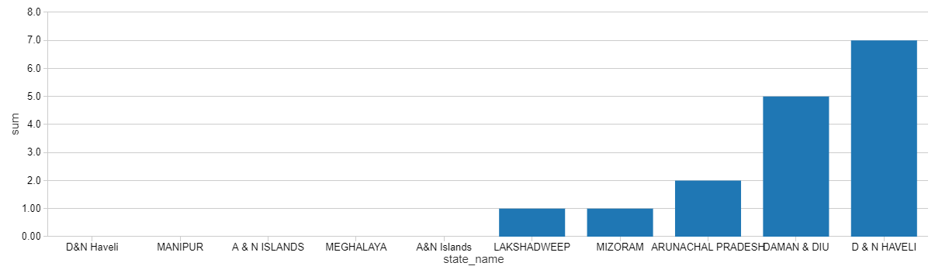
Graphical Representation

Slide 20
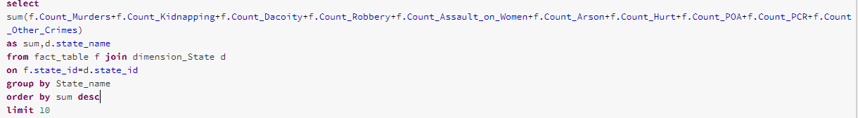
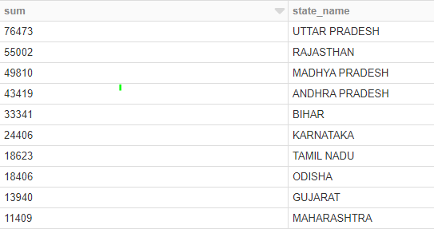
Scenario 4:Most UnSafest State with respect to Crime all over the Country

Slide 21
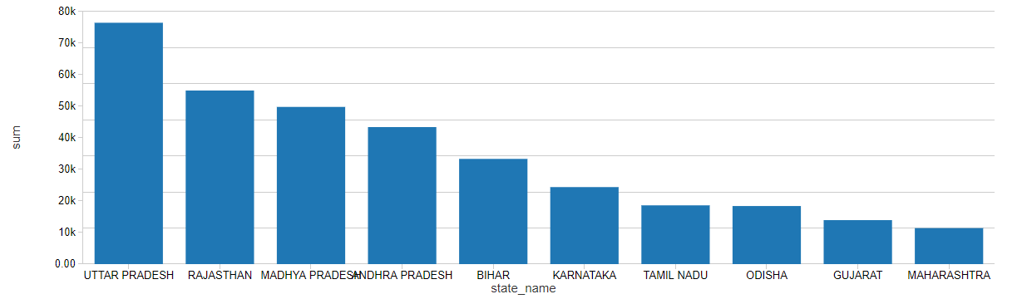
Graphical Representation

Slide 22
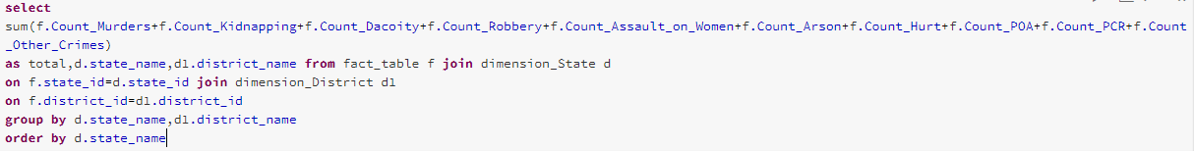

Scenario 5:Most UnSafest District in each State

Slide 23
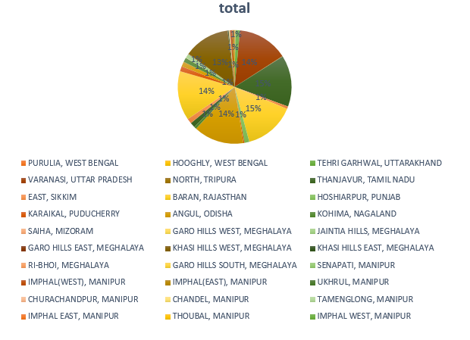
Graphical Representation

Slide 24

Scenario 6:Most Safest District in each State

Slide 25
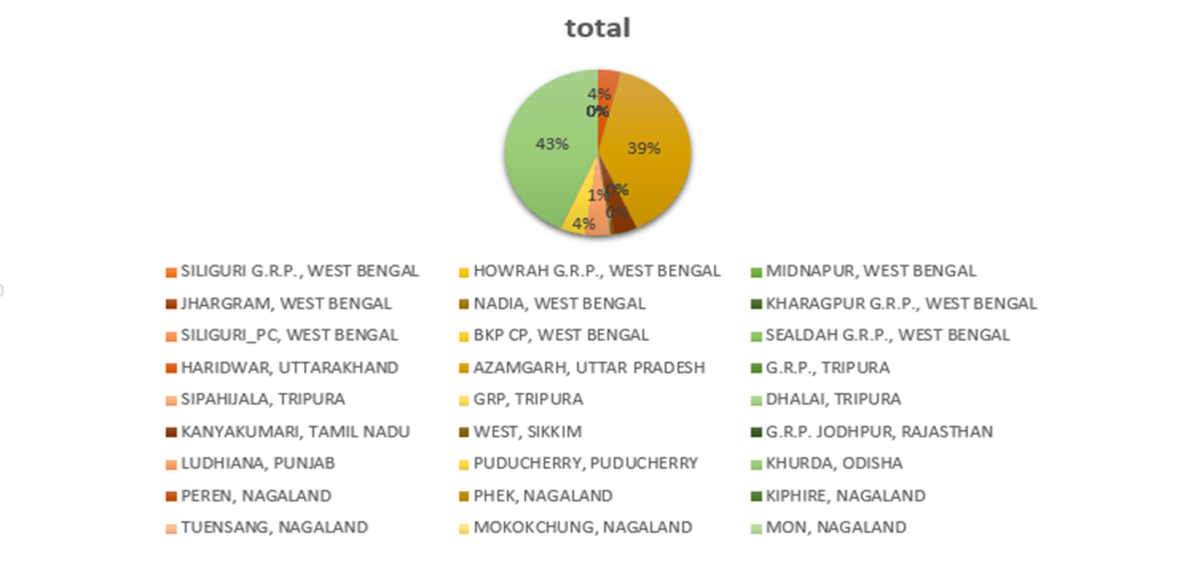
Graphical Representation

Slide 26
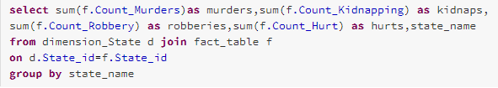
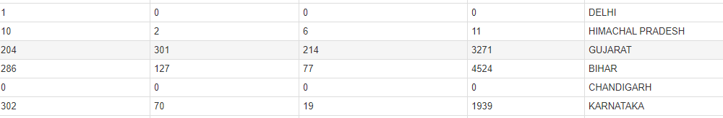
Scenario 7:Most Occurred Crime for particular State

Slide 27
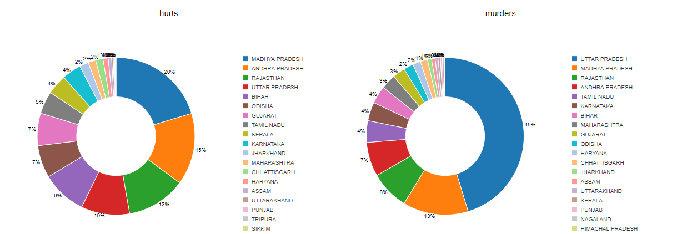
Graphical Representation

Slide 28
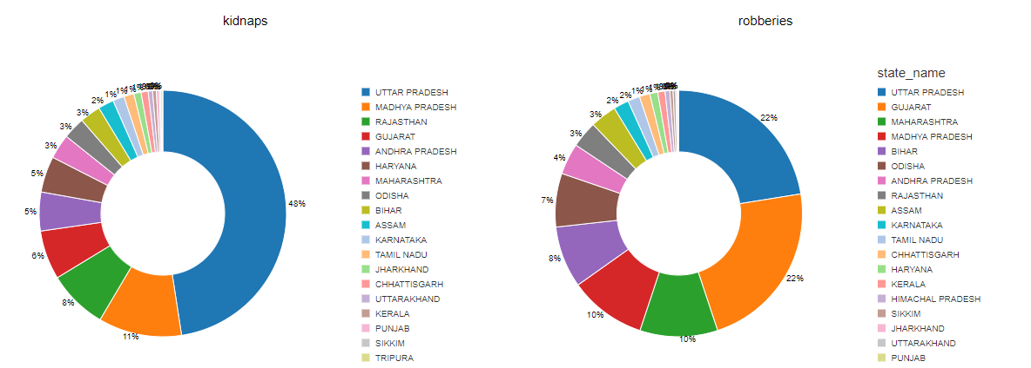
Graphical Representation

Slide 29
Conclusion
Crime analysis is gradually making its way up the ladder as a very effective method of crime prevention, reduction and apprehension.
After analyzing the dataset we can estimate the maximum and minimum number of crimes in each state and district through which we can take safety measures to reduce the crime rate.

Slide 30


