Slide 1

Vel Tech Rangarajan Dr. Sagunthala R&D Institute of Science and Technology
School of Computing
Department of Computer Science and Engineering
10211CS224 / FULL STACK APPLICATION DEVELOPMENT (JAVA)
END SEMESTER PROJECT REVIEW
Date: 06-05-2026
NEXORA: A SMART EVENT MANAGEMENT SYSTEM FOR COLLEGES
SDG: SDG 4 – Quality Education
Presented By:
CH.VENNELA REDDY– VTU25619-Reg.No.23UECS0956
Courses Handling Faculty:
Dr.S.Hemamalini,M.E,Ph.D.

Slide 2
INTRODUCTION
1
The Event Management System is a web-based application designed to automate and manage event-related activities.
It allows students to browse events, register, make payments, and download certificates easily.
Administrators can create and manage events, view registered students, and track attendance.
The system follows a three-tier architecture consisting of frontend, backend, and database layers.
The frontend is developed using React JS, HTML, and CSS to provide an interactive user interface.
The backend is built using PHP (XAMPP server) and uses MySQL to store user, event, and attendance data.
It integrates third-party tools such as SendGrid (for email), FPDF (for PDF generation), and cURL, ensuring automation and efficiency.
2
3
4
5
6
7
8
9

Slide 3
PROBLEM STATEMENT
1
In many institutions, event management and certificate distribution are often handled manually or through partially automated systems, which leads to inefficiencies and delays. The process of verifying attendance and generating certificates is time-consuming and prone to errors, making it difficult for students to receive their certificates on time. Administrators also face challenges in managing registrations, tracking attendance, and issuing certificates efficiently. Due to the lack of a centralized and automated system, overall performance and accuracy are affected. Therefore, there is a need for a fast, reliable, and fully automated solution that can streamline event management and enable quick certificate generation and delivery, ensuring improved efficiency and user experience.
2
3
4
5
6
7
8
9

Slide 4
OBJECTIVE(S)
1
To develop an automated system for managing events, including registration, attendance tracking, and administration
To enable fast and accurate certificate generation and delivery to participants..
To improve efficiency and reduce manual effort by integrating all event-related processes into a centralized platform.
2
3
4
5
6
7
8
9

Slide 5
PROPOSED SYSTEM
The system follows a three-tier architecture: frontend, backend, and database.
The frontend is built using React JS, HTML, and CSS for user interaction and interface.
The backend is developed using PHP on the XAMPP server to handle business logic.
The backend manages authentication, event registration, attendance, and certificate generation.
The MySQL database stores user details, event data, and attendance records.
The system uses SendGrid for sending emails and FPDF for generating certificates.
cURL is used for communication with external APIs.
This architecture ensures fast processing, automation, and efficient certificate delivery.
1
2
3
4
5
6
7
8
9

Slide 6
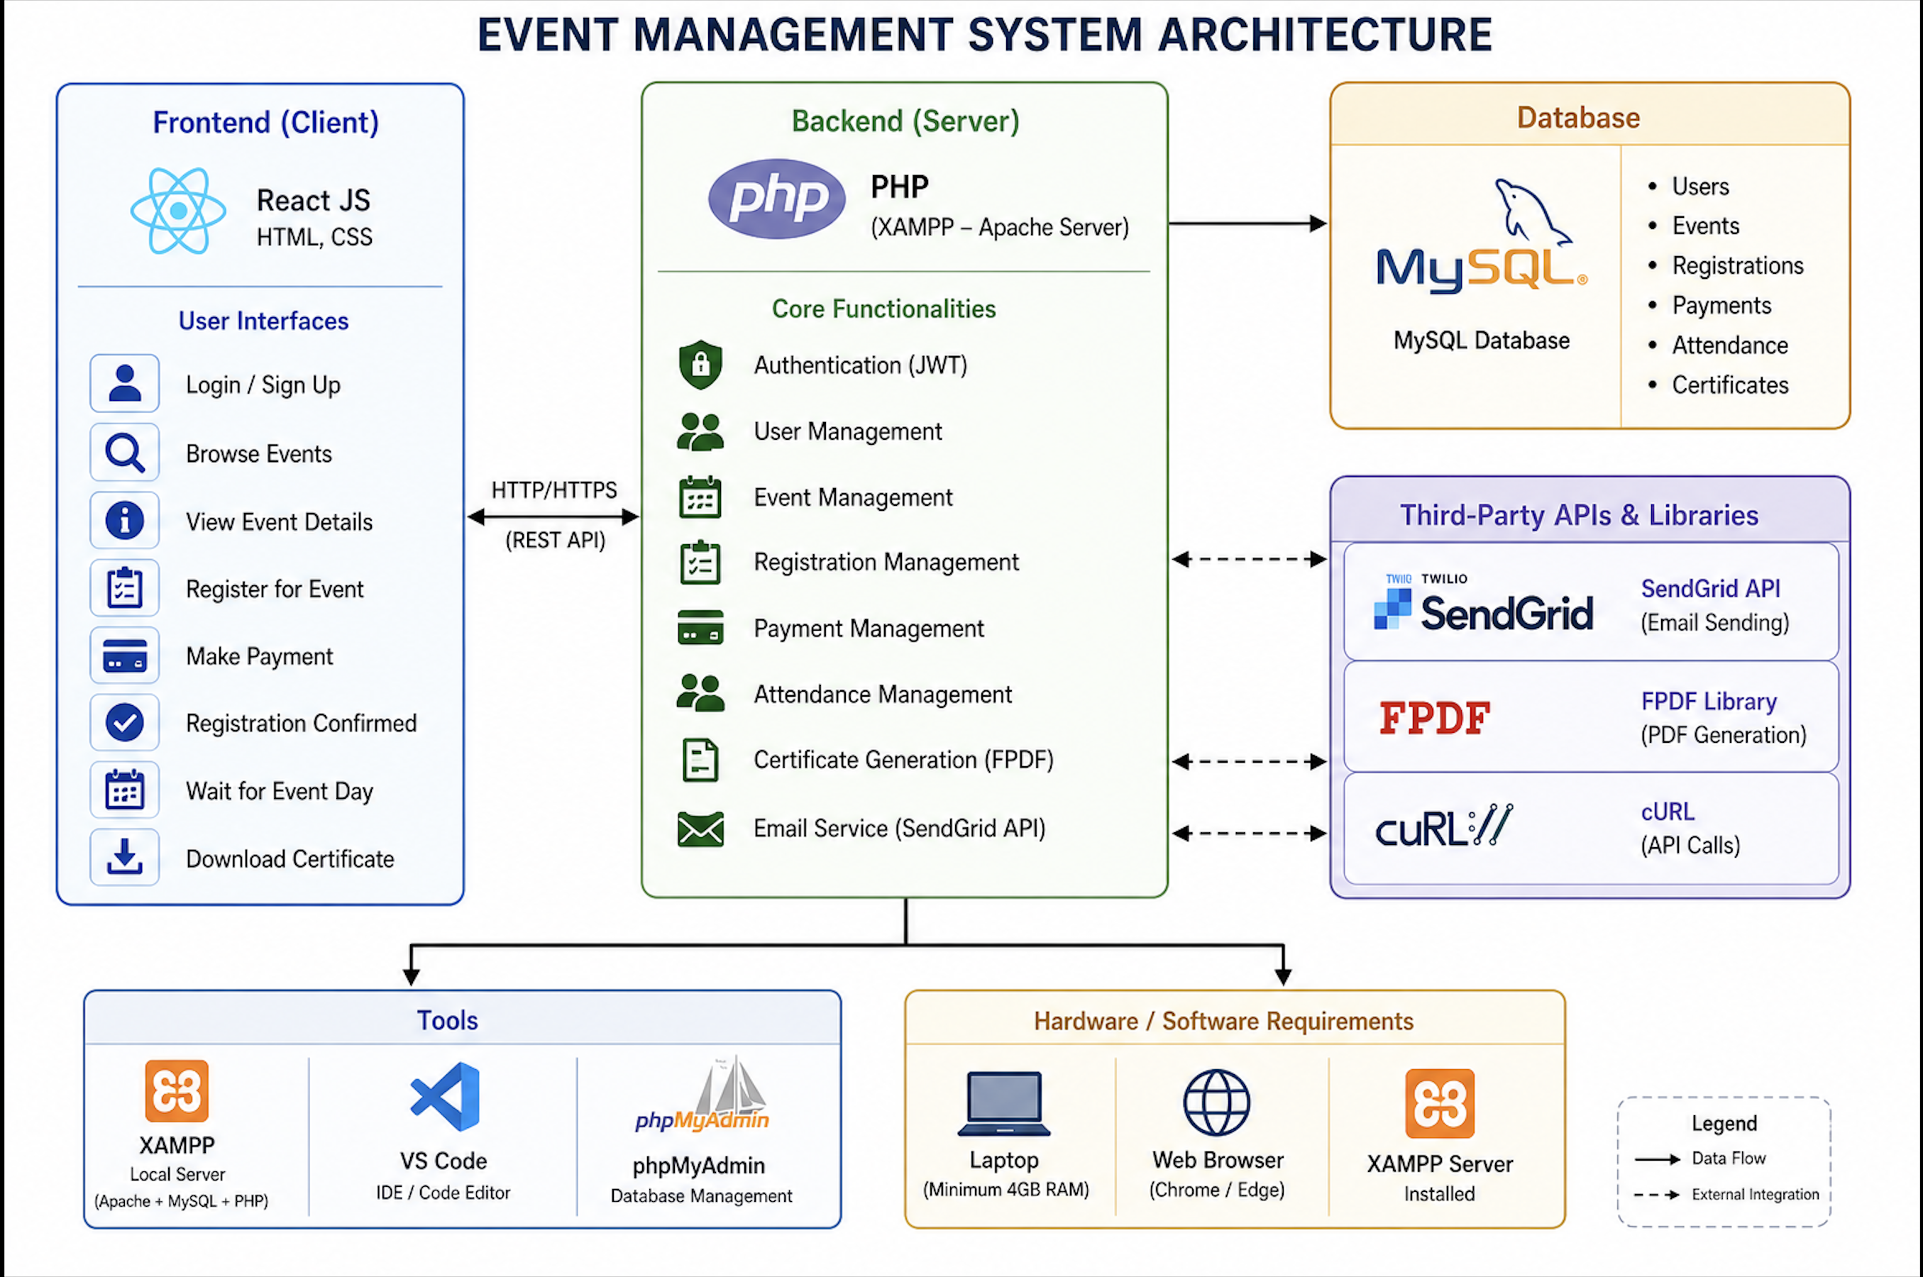
PROPOSED SYSTEM ARCHITECTURE
1
2
3
4
5
6
7
8
9

Slide 7
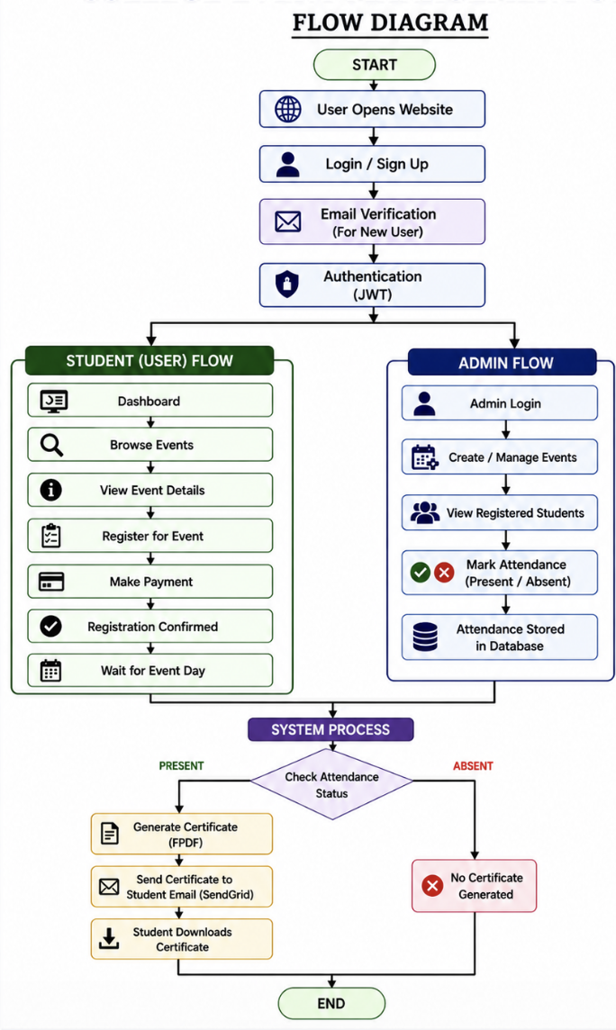
WORKFLOW
1
2
3
4
5
6
7
8
9

Slide 8
TECHNOLOGIES USED
Frontend: React JS, HTML, CSS
Backend: PHP
Database: MySQL
Third-Party API:SendGrid API,FPDF,cURL
Tools: XAMPP, VS Code, phpMyAdmin
Hardware/Software Requirements: A laptop with minimum 4GB RAM, web browser (Chrome/Edge), XAMPP server installed
1
2
3
4
5
6
7
8
9

Slide 9
MODULE DESCRIPTION
Module 1: Authentication & Access Control Module
This module handles user authentication, secure login, and access control to ensure only authorized users can access the system.
User Registration: Users (students, organizers, admins) can register with validated data. Passwords are securely stored using hashing (bcrypt).
User Login: Credentials are verified with proper error handling for invalid attempts.
JWT Authentication: A secure token is generated after login to manage user sessions.
Session Management: Stateless session using JWT; token is verified for each request.
Role-Based Access:
Students → Register for events
Organizers → Manage events
Admin → Full access
Security Features: Token expiry, logout, and data protection using encryption.
1
2
3
4
5
6
7
8
9

Slide 10
Module 2: Event Management & Registration Module
This module manages event creation, updates, and student participation.
Event Creation & Update: Organizers/admins can add or modify event details.
Event Deletion: Remove cancelled or unnecessary events.
Event Viewing: Students can browse and view event details.
Event Registration: Students can register and receive confirmation.
Categorization: Events are grouped (technical, cultural, etc.) for easy access.
Participant Management: Organizers can view registered users.
Notifications: Users receive updates about events.
Data Storage: All data is stored efficiently in the database.
Module 3: Attendance & Certification Module
This module manages attendance and certificate generation.
Attendance is marked by organizers (manual/digital).
Verified participants receive certificates automatically.
Certificates are generated in PDF format using FPDF.
Certificates are sent via email notifications (SendGrid).

Slide 11
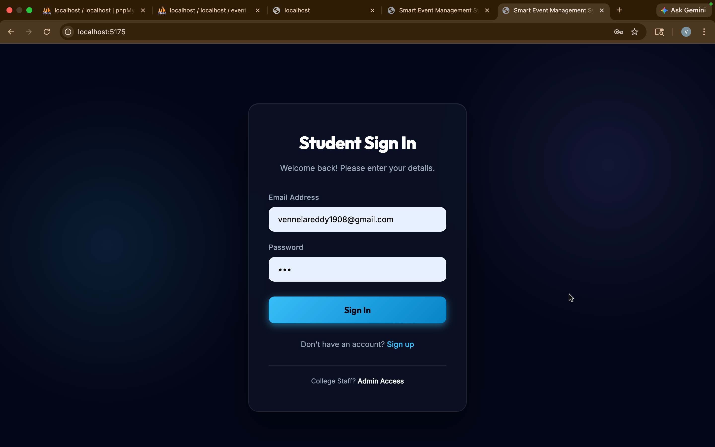
IMPLEMENTATION SCREENSHOTS
1
2
3
4
5
6
7
8
9
Student Login Page
The figure Shows the login page of the Nexora system, where users enter their credentials to securely access the platform.

Slide 12
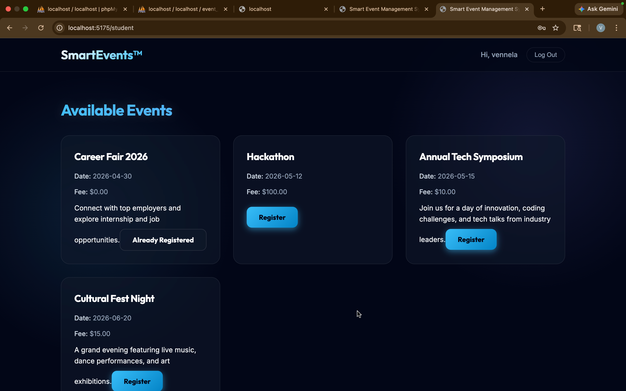
IMPLEMENTATION SCREENSHOTS
1
2
3
4
5
6
7
8(A)
9
Home Page
The figure Shows the student dashboard of the Nexora system,where users can view available events, register for them, and track their participation details.

Slide 13
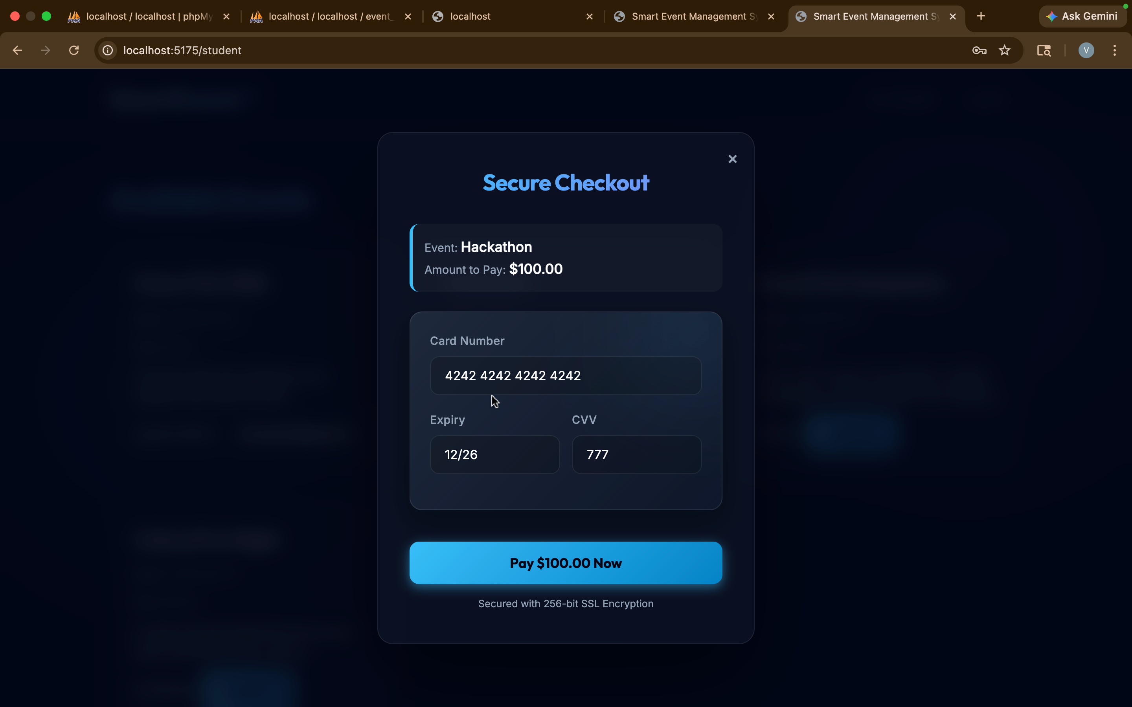
IMPLEMENTATION SCREENSHOTS
1
2
3
4
5
6
7
8(B)
9
Payment Gateway
Registered students can proceed with the Proceed

Slide 14
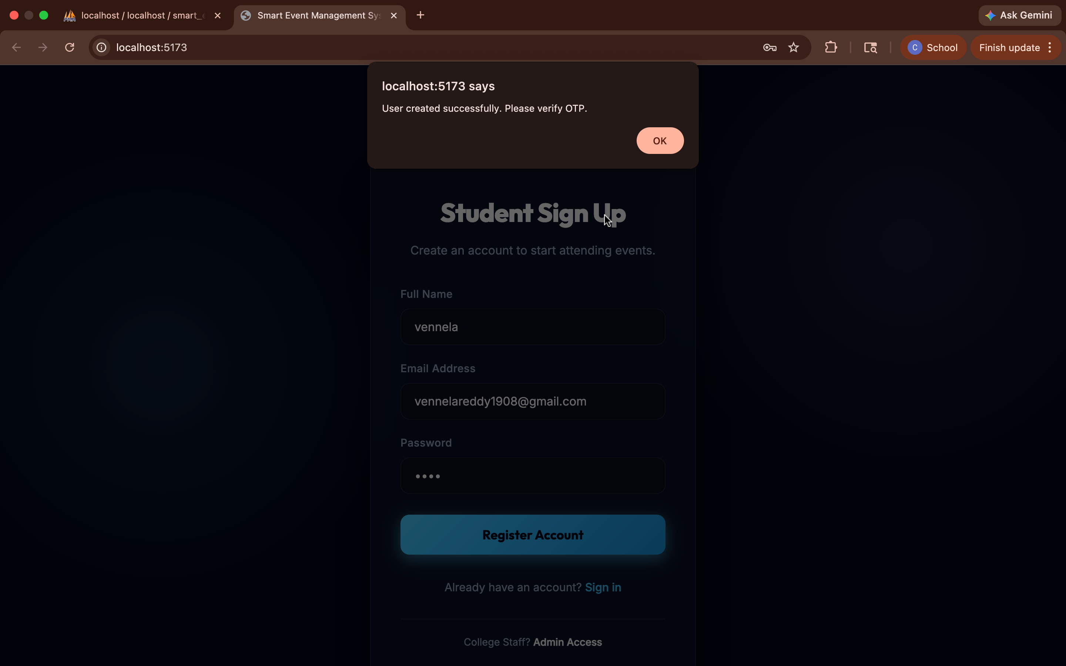
IMPLEMENTATION SCREENSHOTS
Module 1: Authentication & Access Control Module
1
2
3
4
5
6
7
8(C)
9
Student Signup Page with OTP Alert
User Registration Interface with OTP Verification Alert

Slide 15
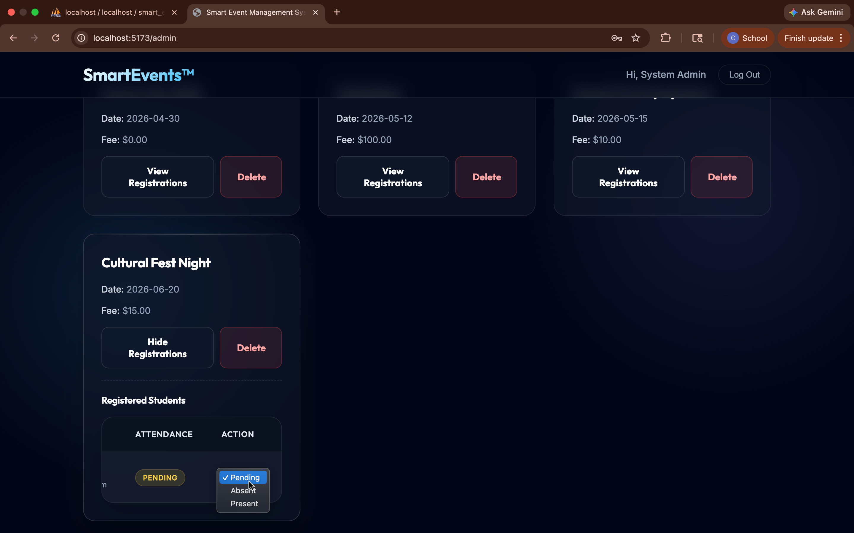
IMPLEMENTATION SCREENSHOTS
Module 2: Event Management & Registration Module
1
2
3
4
5
6
7
8(C)
9
Admin Dashboard with Events & Attendance
Admin Dashboard for Event Management and Attendance Tracking

Slide 16

Module 3: Attendance & Certification Module
Generated Certificate
Automatically Generated Certificate of Attendance (PDF Output)

Slide 17
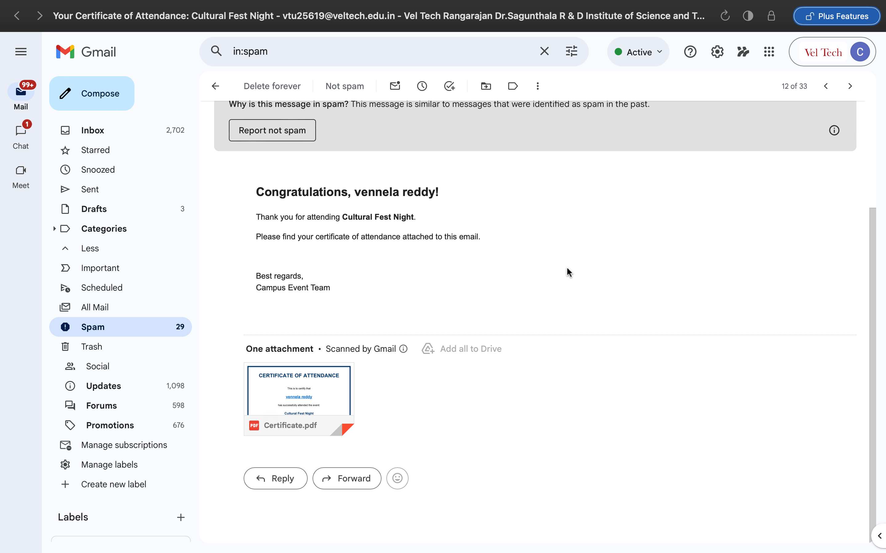
IMPLEMENTATION SCREENSHOTS
1
2
3
4
5
6
7
8(C)
9
Certificate Email in Gmail
Email Notification with Attached Certificate Sent to User

Slide 18
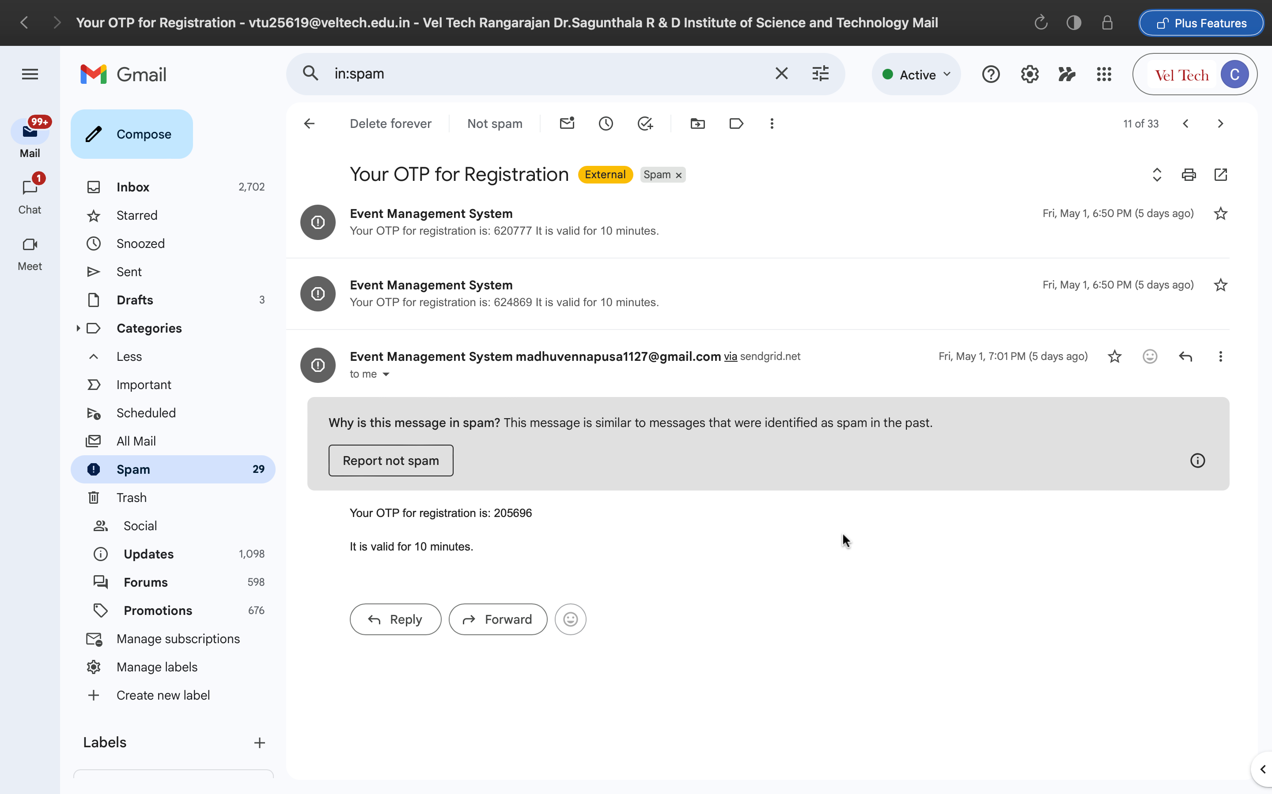
OTP Email
OTP Verification Email for Secure User Registration

Slide 19
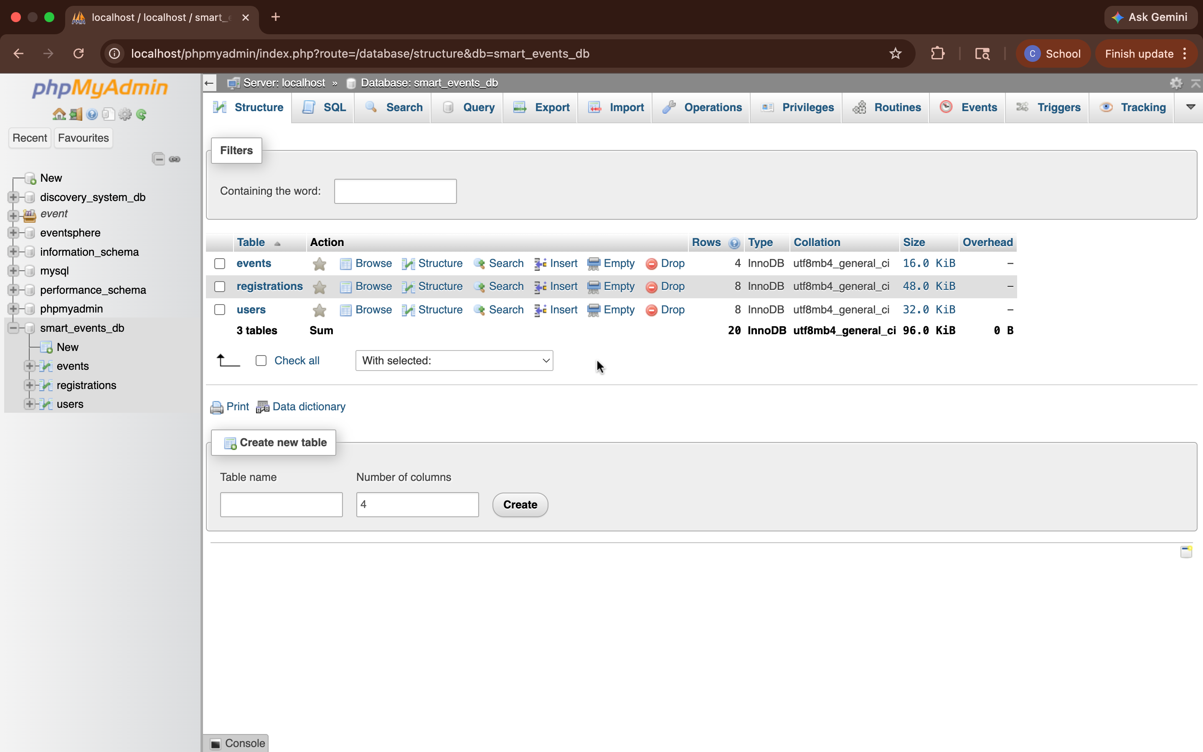
IMPLEMENTATION SCREENSHOTS
1
2
3
4
5
6
7
8(C)
9
phpMyAdmin Database Tables
Database Structure in MySQL (Users, Events, Registrations Tables)

Slide 20
ADVANTAGES & LIMITATIONS
1
Advantages
Time Saving: Automates registration, attendance, and certificate generation.
Easy to Use: Simple interface for students and administrators.
Reduced Manual Work: Minimizes paperwork and human effort.
Fast Certificate Generation: Certificates are generated and sent instantly.
Accurate Data Management: Reduces errors in attendance and records.
Centralized System: All event-related data is managed in one platform.
Disadvantages
Internet Dependency: Requires stable internet connection.
Initial Setup Required: Needs proper installation and configuration (XAMPP, database).
Maintenance Needed: Regular updates required for security and performance.
Technical Knowledge: Some users may need guidance initially.
Server Dependency: System may stop working if the server fails.
2
3
4
5
6
7
8
9

Slide 21
Thank you

